Slide 1
STUDENTS CREDENTIALS SHARING BASED ON DECENTRALIZED APPLICATION
Guided By : Mr. Rahul Gopal
Assistant Professor Dept. of CSE
Presented By :
Group IV
ADITYA R NAIR - STC20CS006
ANN MARIA SUNNY - STC20CS018
NADAR NAWAS - STC20CS040
STEEVE BINU BABY - STC20CS055
S7 B.Tech. Project Progress First Review
28 November 2023

Slide 2
OUTLINE
Abstract
Introduction
Requirements
Implementation
Literature Review
Existing System
Proposed System
Conclusion
References

Slide 3
ABSTRACT
In the era of digital transformation, traditional methods of verifying and sharing academic credentials face numerous challenges, including fraud, inefficiency, and a lack of transparency.
This abstract outlines the development of a decentralized application (DApp) utilizing blockchain technology to securely manage and share student credentials .
This introduces a novel approach to credential sharing by leveraging the power of blockchain, specifically Ethereum, to create a tamper-proof, transparent, and user-centric system.
In this decentralized ecosystem, students are given ownership of their academic records, ensuring privacy and control over their data .

Slide 4
INTRODUCTION
Most digital credential sharing schemes adopt centralized storage and management of credentials and associated keys, which could lead to a single point of failure and high security risks.
If data sharing is unavoidable, one approach to strengthen privacy is to minimize the data being disclosed.
Our design is flexible in that the user has full control of the credentials .
To increase the scalability, the proposed system uses a secure off-chain storage mechanism(IPFS) .
The performance and viability of the proposed architecture is analyzed by using an Ethereum based prototypical implementation .

Slide 5
REQUIREMENTS
Languages used
Web3js
Solidity
React
Node.js
Front End (Web DApp)
React
Back End
Node.JS
Web3.JS
Hosting Services
Metamask

Slide 6
IMPLEMENTATION
For the first-level implementation, three different types of stakeholders are considered:
School
Student
Company
School dashboard has two options:
(i) to add students to the list of enrolled students
(ii) to upload credentials for already enrolled students. When a credential is uploaded on IPFS, a hash value is returned. This hash value along with the metadata of the credential is pushed to the Ethereum such that only intended student can view it.

Slide 7
IMPLEMENTATION
Student dashboard offers three options:
(i) to view the uploaded credentials
(ii) to view the access requests sent by the companies
(iii) to grant access after viewing those access requests.
Company dashboard has three options:
(i) to view the list of schools and the students enrolled under a selected school
(ii) to send an access request
(iii) to view the credentials once the students grants access.

Slide 8
LITERATURE REVIEW
SL. No | Name | Dataset | Algorithm | Result
1 | Blockchain based Verifiable Credential Sharing with Selective Disclosure | Credential Data | Verifiable Blockchain | Improved Selective Disclosure and Privacy Protection (97%)
2 | Implementation and Analysis of Blockchain-Based DApp for Secure Sharing of Students’ Credentials | Student Academic Records Dataset | Blockchain Technology | Enhanced Security and Decentralized Sharing (95%)

Slide 9
LITERATURE REVIEW
3 | Privacy Protected Blockchain Based Architecture and Implementation for Sharing of Students’ Credentials | Students Credentials Data | Privacy Preaserving Blockchain | Enhanced Privacy And Secure Sharing (96%)
4 | A Blockchain-based framework for secure Educational Credentials | Educational Credential Data | Blockchain Technology | Improved Security and Credential Verification (95%)
5 | A Secure and Privacy Preserving Student Credential Verification System Using Blockchain Technology | Student Credential Data | Privacy Preserving Blockchain Algorithm | Enhanced Security and Privacy In Credential Verification (96%)

Slide 10
LITERATURE REVIEW
6 | Blockchain for Credibility in Educational Development | Educational Data | Blockchain Technology | Enhanced Credibility in Educational Records and Performance Evaluation (95%)
7 | A Blockchain Based Verification System for Academic Certificates | Academic Certificate Data | Blockchain Verification Algorithm | Enhanced Certificate Verification and Authenticity (96%)
8 | Smart Education Based on Blockchain Technology | Educational Data | Smart Blockchain Algorithm | Enhanced Efficiency and Security in Smart Education (94%)

Slide 11
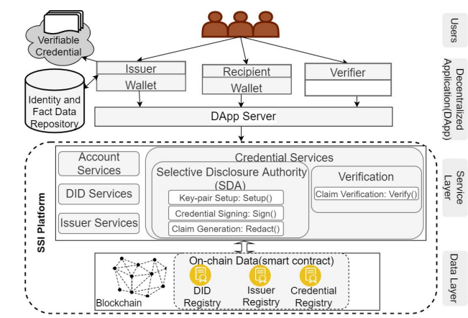
EXISTING SYSTEM
Figure: CredChain Architecture

Slide 12
EXISTING SYSTEM
The architecture is comprised of two parts: the SSI platform and a decentralized application layer which provides the means for users to interact with the blockchain network using a client wallet application.
Registered issuer hosts Identity and Fact Data Repository to store recipient’s identity data and facts and a cloud storage called Verifiable Credential to store and share generated credentials.
The service layer includes Account Services (for blockchain account management), DID Services (for managing DIDs), Issuer Services (for managing issuer eligibility to sign credential) and Credential Services (for managing credentials).

Slide 13
EXISTING SYSTEM
Creating an account in the SSI platform generates a blockchain account, key pair, and registers a new DID for the user. The key pair is used primarily for signing the credentials.
Upon successful registration, the DID Registry smart contract is initiated to store the DID and associated DDO.
If issuers are already registered in the system and their information is stored on another smart contract Issuer Registry after getting approval from the platform owner.
The process begins by a recipient sending an access request to the DApp server along with his DID, and information relevant for the issuer.

Slide 14
EXISTING SYSTEM
The DApp server collects the issuer identification details and forwards the access request to that issuer.
The issuer verifies recipient’s information against the course enrollment data from Identity and Fact Data Repository and obtains the recipient’s service endpoint from provided DID, then sends an acceptance notification to the recipient via the DApp server.
After identities have been established , the recipient sends a request for a credential to the DApp server.
The server verifies the identity against the DID Registry and forwards the request to the issuer along with the recipient’s DID.

Slide 15
EXISTING SYSTEM
Upon receiving the credential request, the issuer fetches relevant data from its Identity and Fact Data Repository and create a credential .
The issuer then calls the function Sign() from SDA to sign the generated credential.
Next, the issuer creates a blockchain transaction to store the hash of signed credential in the Credential Registry as a record of the issuance.
The issuer uploads the credential to their private cloud storage Verifiable Credential and generates a shareable link, then sends it to the recipient via the DApp server which then notifies the recipient.
The recipient in turn may view the credential and downloads it to their device.

Slide 16
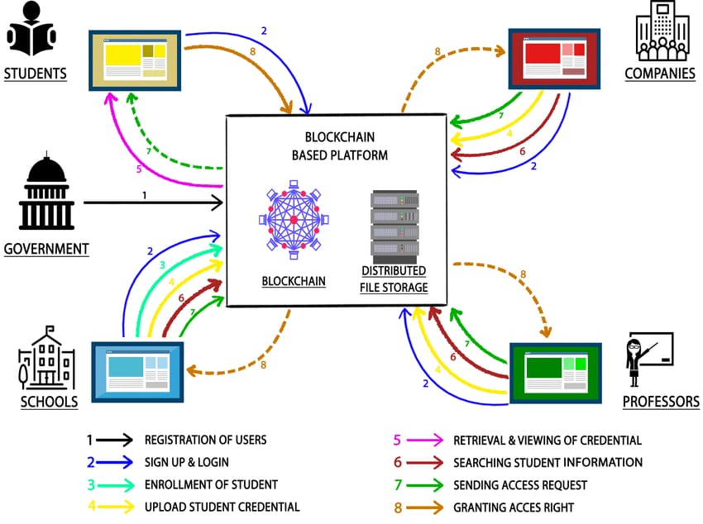
PROPOSED SYSTEM

Slide 17
PROPOSED SYSTEM
(i) Registration of User: assigns a unique ID to every user. The way to create unique IDs is discretion of the government body.
(ii) Sign-up and Login of User: allows users to undergo one-time sign-up process which would ease future logins.
(iii) Enrollment of Student: happens at the time of admission.
(iv) Uploading of Credential: by school or company or professor.
(v) Retrieval and Viewing of Credential: enables students to retrieve their credentials.
(vi) Searching Student Information: facilitates stakeholders to search student’s information.

Slide 18
PROPOSED SYSTEM
(vii) Sending Access Request: allows schools, professors and companies to send access request to students to view their credentials.
(viii) Granting Access Right: empowers students to approve the received access requests.

Slide 19
CONCLUSION
This project presents a simple blockchain based architecture for secure sharing student’s credentials.
Sharing the students’ credentials is the major problem for the organizations to issue to the students.
A decentralized application (DApp) will be built using Blockchain technology which provides the security and decentralization features.
The security and authenticity are being ensured by the smart contracts in the block chain. In the study, a block chain-based architecture for the safe transfer of student IDs will be presented.

Slide 20
REFERENCES
Anjali Singh, SPS Chauhan, Amit Kumar Goel, "Blockchain Based Verification of Educational and Professional Certificates", 2023 2nd International Conference on Computational Systems and Communication (ICCSC), pp.1-7, 2023.
Shubham Dubey, Aditya Kumar Tiwary, "Smart Education based on Blockchain Technology", 2023 International Conference on Sustainable Computing and Smart Systems (ICSCSS), pp.1485-1490, 2023.
Aamna Tariq, Hina Binte Haq, Syed Taha Ali, "Cerberus: A Blockchain-Based Accreditation and Degree Verification System", IEEE Transactions on Computational Social Systems, vol.10, no.4, pp.1503-1514, 2023.

Slide 21
REFERENCES
Swatesh Kumar Ambast, T A Sumesh, "A Blockchain Based Credential Verification System using IPFS", 2022 IEEE 19th India Council International Conference (INDICON), pp.1-5, 2022.
Mercy Effiong, Alex Norta, Chibuzor Udokwu, Marie Hattingh, "Adoption of Blockchain Technology in Academic Certificate-Verification Systems", 2022 IEEE 1st Global Emerging Technology Blockchain Forum: Blockchain & Beyond (iGETblockchain), pp.1-6, 2022.
Raihan Sulaiman, Andry Alamsyah, Puspita Wulansari, "Reshaping the Future of Recruitment through Talent Reputation and Verifiable Credentials using Blockchain Technology", 2022 10th International Conference on Information and Communication Technology (ICoICT), pp.316-321, 2022.

Slide 22
REFERENCES
R. A. Mishra, A. Kalla, N. A. Singh and M. Liyanage, "Implementation and Analysis of Blockchain Based DApp for Secure Sharing of Students' Credentials," 2020 IEEE 17th Annual Consumer Communications & Networking Conference (CCNC), Las Vegas, NV, USA, 2020, pp. 1-2, doi: 10.1109/CCNC46108.2020.9045196.
Archana Bathula, Suneet kr. Gupta, Suresh Merugu, Sanagala S. Skandha, "Academic Projects on Certification Management Using Blockchain- A Review", 2022 International Conference on Recent Trends in Microelectronics, Automation, Computing and Communications Systems (ICMACC), pp.1-6, 2022.22222222.

Slide 23
THANK YOU

