Slide 1
Coma
Meet your new favorite contact management app.

Slide 2
BRAAAWNSS
Stephen Blanco
Anthony Espinosa
Jonathan Wyatt Feck
Nyasha Frank
Steeve Joseph
Affner Lefevre
Rolando Murillo
Abraham Sanchez
Brian Wittel

Slide 3
What’s Coma?
Contact Management solution.
Allows you to access your contacts from any device with internet.

Slide 4
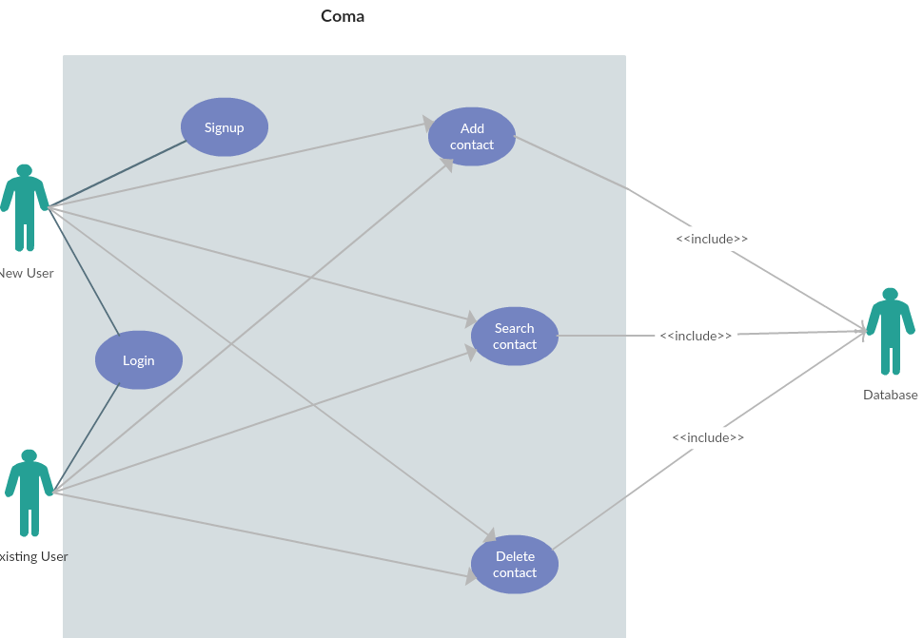
Use Case Diagram

Slide 5
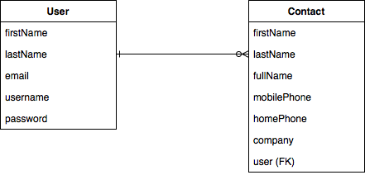
ER Diagram

Slide 6

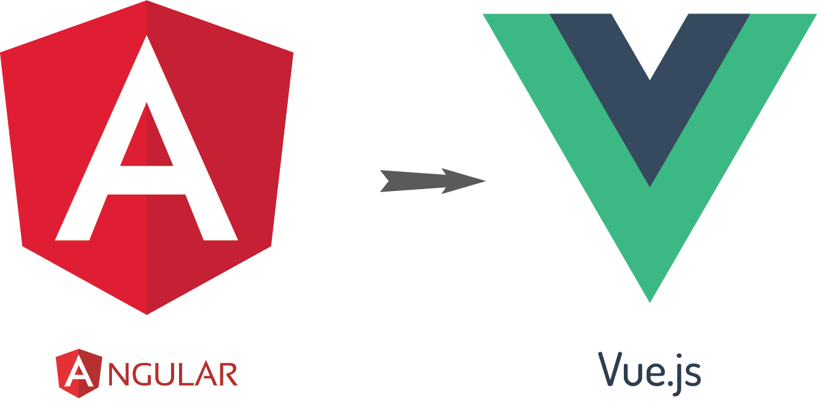
What’s Coma / how it was developed
ME∀N STACK

Slide 7
GITHUB/HEROKU/MLAB
Cloud9 IDE
Hosted on Heroku, MongoDB instance hosted on Mlab.
Disabled pushing to master branch on Github, review required for merging Pull Requests.
On every merge to master, Coma is automatically built and deployed to Heroku.
Easy to collaborate with shared/mirrored workspaces.
Consistent development environment between teammates.
Development environment same as production environment.

Slide 8
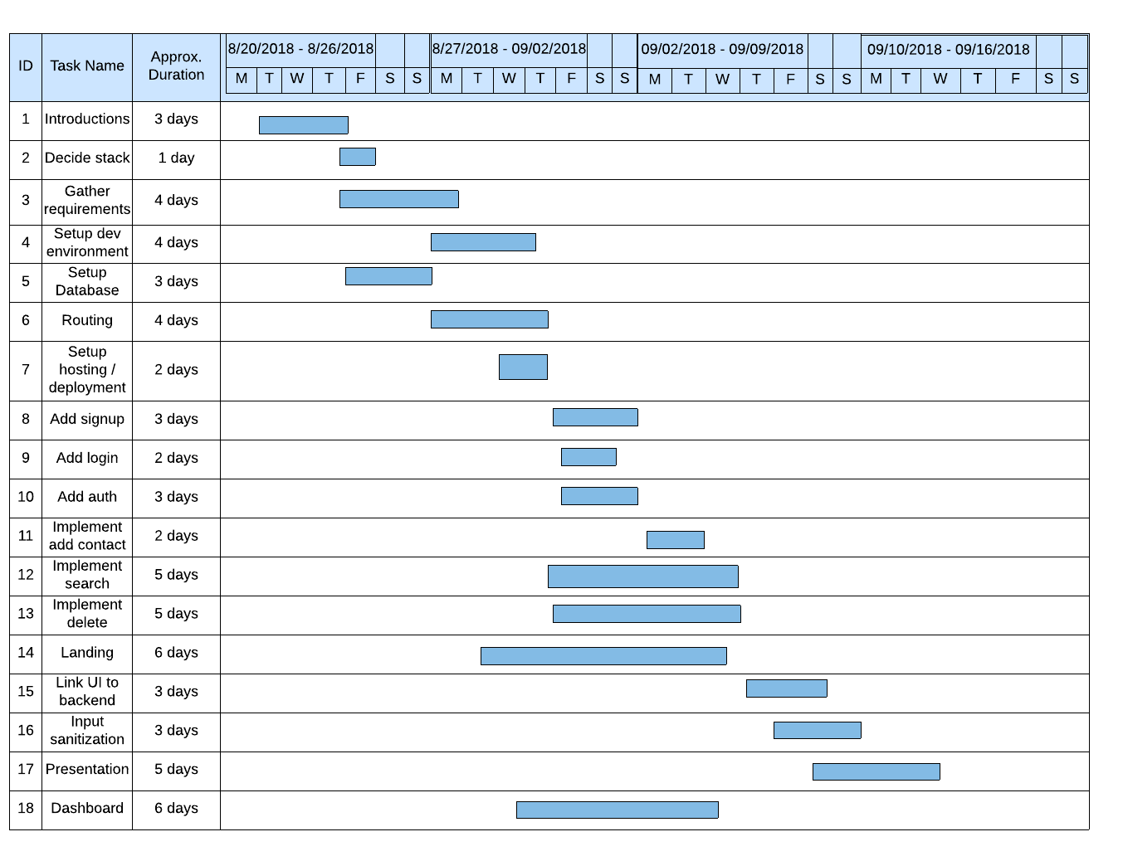
Agile
Daily (Tuesday/Thursday) standups.
Pair programming through Cloud9 IDE.
Front end developers coordinating with backend counterparts.
Easy to pivot to changing requirements or tasking.

Slide 9
PROS/CONS
What went well:
Personalities worked well together
Common willingness among members.
Quick pickup of tech skills.
What could be improved:
Not overwriting others’ work.
Scheduling conflicts with groupmates.

Slide 10

Get Excited for the Demo!

Slide 11
Questions?

