Slide 1
Coma
Meet your new favorite contact management app

Slide 2
BRAAAWNSS
Stephen Blanco
Anthony Espinosa
Wyatt Feck
Nyasha Frank
Steeve Joseph
Affner Lefevre
Rolando Murillo
Abraham Sanchez
Brian Wittel

Slide 3
What’s Coma / how it was developed

Slide 4
Anything that we feel is important

Slide 5
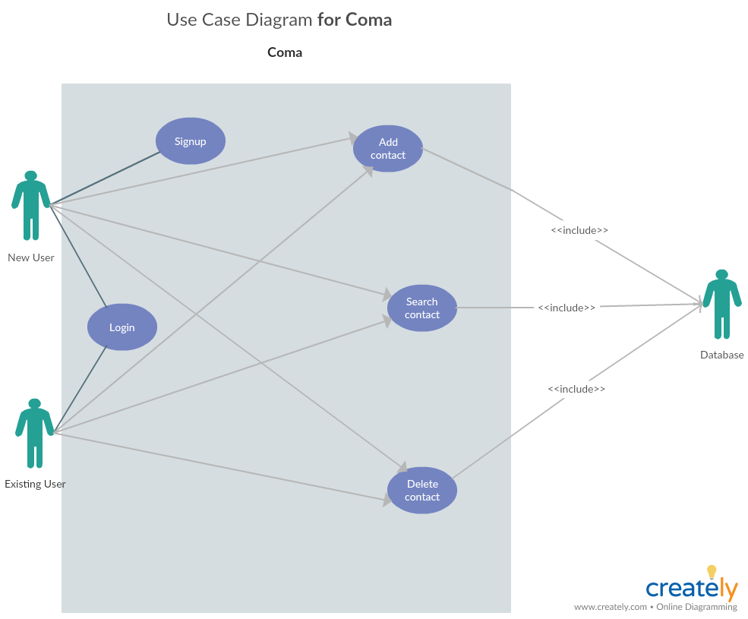
UML or ERD Diagrams

Slide 6
