Slide 1
DIPLOMA THESIS
A Study of the USB Power Delivery Protocol
using the STM32 Microcontroller
Fotopoulos Stefanos · Student ID: 4829
September 2024
Supervising Professor: Efthymiou Aristeidis

Slide 2
INTRODUCTION
What is USB Power Delivery?
USB Power Delivery (USB-PD) extends the power capabilities of the USB 2.0 and 3.1 standards, enabling smart, flexible power delivery over a single cable.
Type-C™ connector
Broad compatibility
Automatic negotiation
Bidirectional communication
Delivers up to 100W of power through one single, reversible connector.
Powers laptops, monitors and fast-charging devices alike.
Optimal voltage and current are determined dynamically between devices.
USB-PD communication takes place between two connected devices.
USB Power Delivery · STM32
1

Slide 3
USB-PD PROTOCOL
Power Data Objects (PDO)
PDOs are USB-PD data structures that define the power capabilities of a source device, ensuring safe power delivery between connected Type-C devices.
Fixed Supply PDO
APDO (Adjustable PDO)
Defines fixed voltage levels offered by the source device.
Typical voltages on our microcontroller: 5V, 9V, 12V.
Current range is set by the manufacturer, close to 3A.
Allows dynamic adjustment of output voltage and current.
Voltage range: 3.3V to 11V.
Adjustable current: from 0A to 3A.
USB Power Delivery · STM32
2

Slide 4
USB-PD PROTOCOL
Request Data Objects (RDO)
RDOs specify the power parameters requested by a sink device from a source device, and are essential to negotiating the power contract.
1
2
3
4
PDO selection
RDO fields
Source evaluation
Safety default
Once a suitable SRC PDO is chosen, the SNK device builds the corresponding RDO.
Index of the selected SRC PDO, operating current and maximum operating current.
The source device evaluates whether it can meet the request and adjusts accordingly.
If no matching PDO is found, the default 5V PDO is automatically selected.
USB Power Delivery · STM32
3

Slide 5
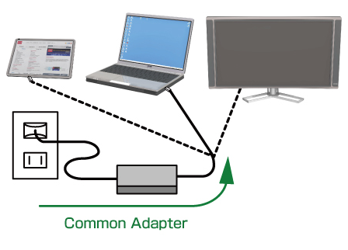
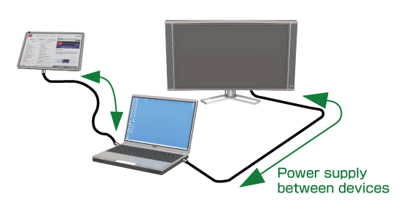
FUNCTIONALITY
Advantages of Dual Role Technology
Dual Role technology allows both power and data to be transmitted bidirectionally. The power role (sink ↔ source) and the data role (device ↔ host) can switch depending on the use case, under control of the USB-PD protocol.
Same cable, bidirectional power supply between devices.
Sink ↔ Source
Data ↔ Host
The role is fully controlled by the USB-PD protocol.
A single common adapter can power multiple devices.
USB Power Delivery · STM32
4

Slide 6
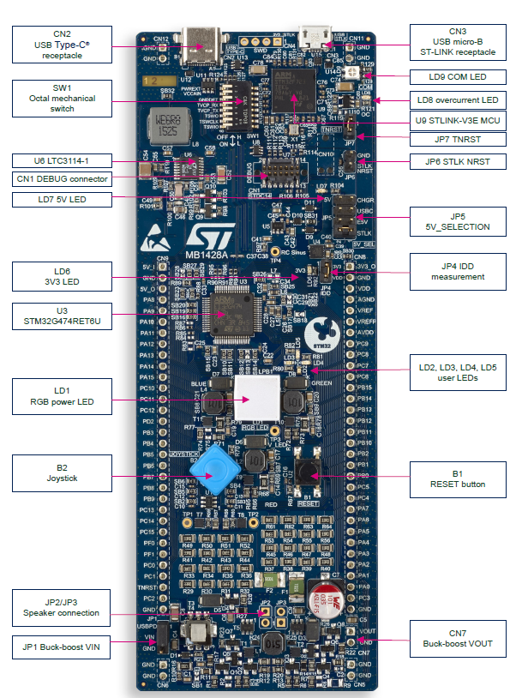
HARDWARE
STM32G474RE Microcontroller Architecture
The JP1 connector on the buck-boost converter board selects the VIN voltage source.
1
Default setting
JP1 selects power from the USBPD_VBUS charger (default 5V) via Type-C.
2
Alternative source
For an external supply, connect it to JP1's VIN/GND pins and remove the jumper.
USB Power Delivery · STM32
5

Slide 7
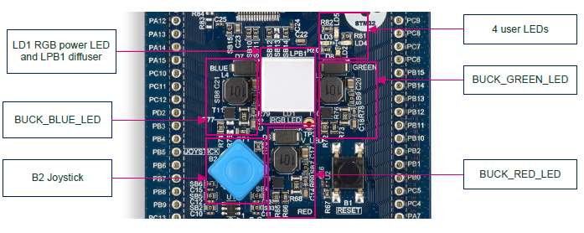
HARDWARE
STM32G474RE Microcontroller Architecture
The key user-interaction components on the B-G474E-DPOW1 Discovery kit board.
B2 Joystick
A four-direction joystick with a select button, used for voltage selection.
4 User LEDs
Status indicator LEDs, programmable according to the application's needs.
USB Power Delivery · STM32
6

Slide 8
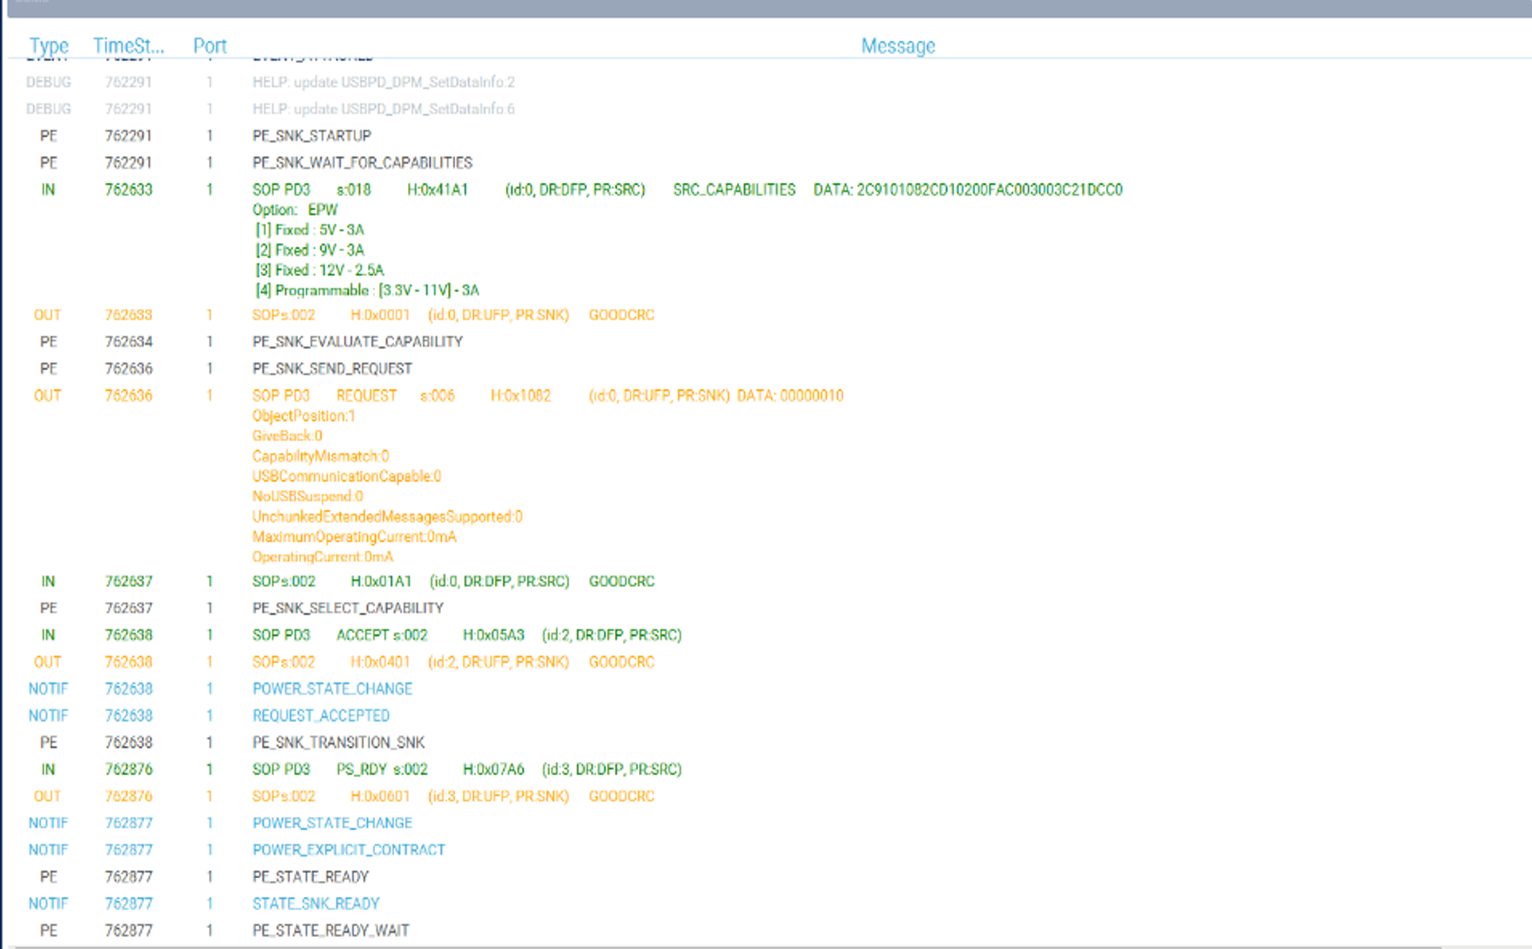
TOOLS
Understanding STM32CubeMonitor
In microcontrollers, traces refer to the logs of signals or events monitored during system operation.
They help with analysis and fault/bug detection.
They provide insight into the sequence of commands and communication between peripherals.
The image shows a sequence of traces with messages from a USB Power Delivery system.
USB Power Delivery · STM32
7

Slide 9
SOFTWARE
Main Function Flow Diagram
The main() function in main.c contains the initialization calls for all of the microcontroller's peripherals, before entering an infinite control loop.
1
2
3
4
Initialization
for() loop
Check Buttons()
1ms delay
HAL, peripherals and the system clock.
Entry into an infinite loop where the core functions run.
Checks which button was pressed; calls the matching voltage/LED function.
A short delay is introduced before the next check iteration.
loop back
USB Power Delivery · STM32
8

Slide 10
CODE ANALYSIS
Programming Analysis
MX_GPIO_Init()
Semaphore Creation
Initializes the GPIO pins for the joystick buttons and LEDs, with the help of STM32CubeIDE, which maps each pin to the correct component on the microcontroller.
A semaphore is used for each button so the critical action sequence runs exactly once per press, preventing concurrent execution and race conditions.
USB Power Delivery · STM32
9

Slide 11
CODE ANALYSIS
Programming Analysis
USBPD_DPM_SNK_EvaluateCapabilitiesPDO
USBPD_PE_Send_Request
Analyzes the USB-PD sink's capabilities by examining the source's data, and prepares the RDO with the sink's power requirements.
Sends the prepared RDO to the source, communicating the desired power change.
Together, these two functions enable safe and effective management of power transfer between source and sink.
USB Power Delivery · STM32
10

Slide 12
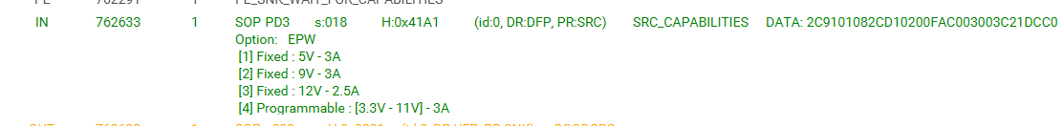
EXPERIMENTAL PROCESS
Diploma Thesis Procedure
0
Step 0 — Connection & Check via Monitor
After connecting to the charger and the computer, the port is selected ("Select Tracer Port", COM3). Disconnecting/reconnecting the USB-C cable and the "Detach" trace confirm the correct port.
1
Step 1 — Recording Power Capabilities
The system operates as a "sink", drawing power from a common phone charger. The PDOs in STM32CubeMonitor show the available voltages/currents; this thesis focuses on fixed values.
SRC_CAPABILITIES excerpt from the Monitor
USB Power Delivery · STM32
11

Slide 13
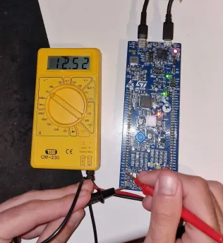
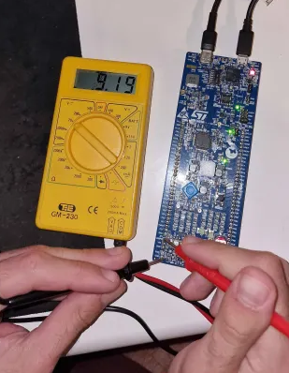
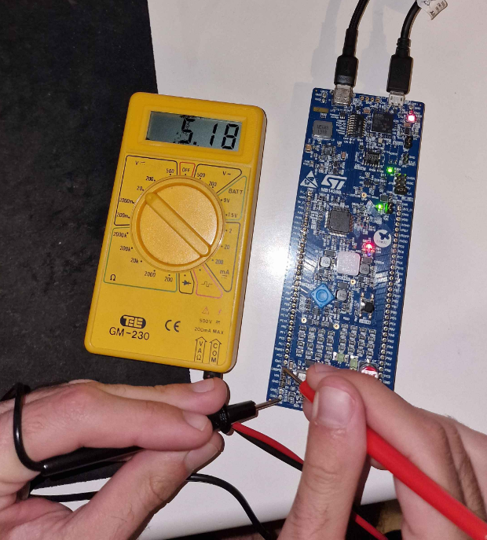
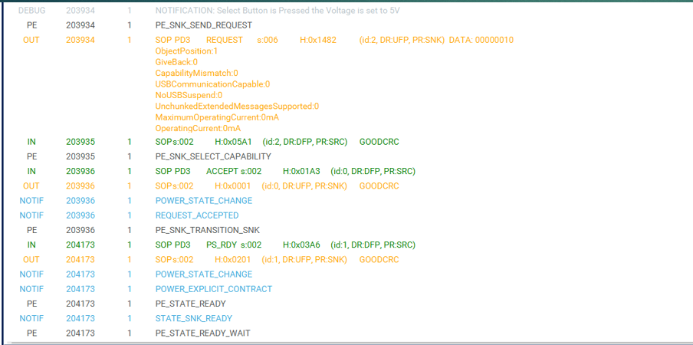
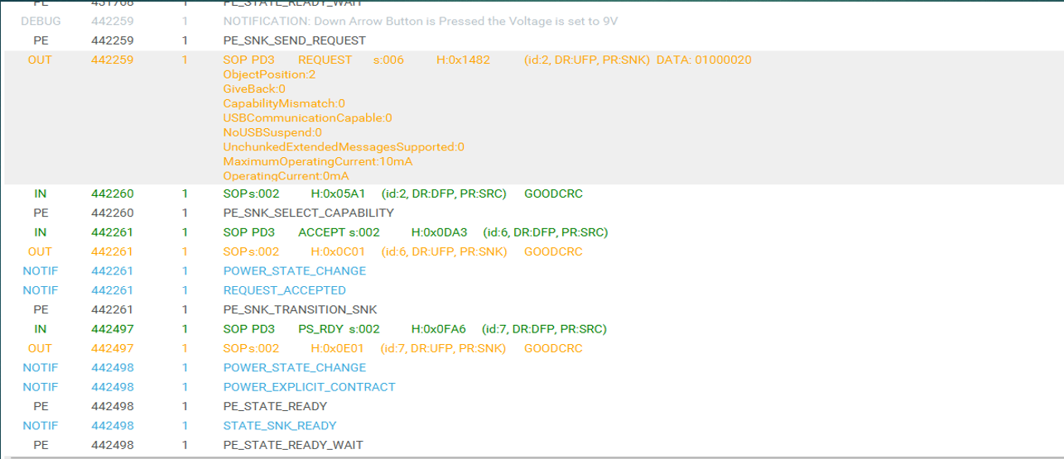
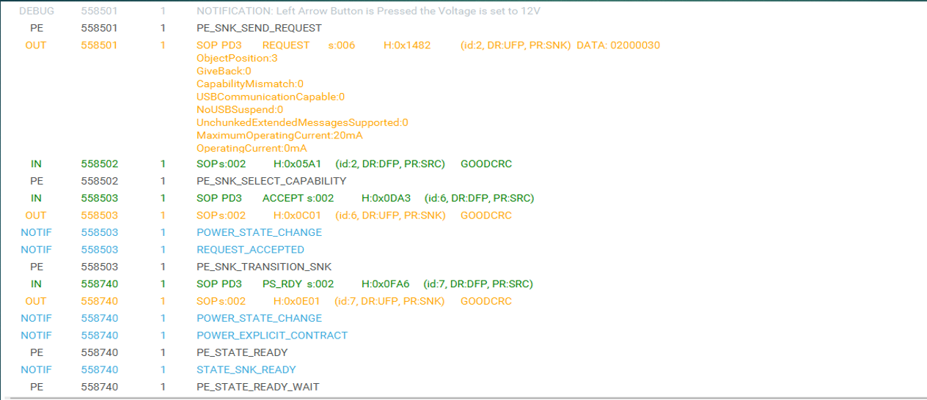
EXPERIMENTAL PROCESS
Step 2 — Voltage Selection via Joystick
Three joystick buttons are each mapped to one of the four user LEDs, allowing the user to select the desired voltage.
Select
Down Arrow
Left Arrow
5V
9V
12V
Red LED
Green LED
Orange LED
USB Power Delivery · STM32
12

Slide 14
EXPERIMENTAL PROCESS
Diploma Thesis Procedure
Step 3 — Confirming the Voltage Selection
Step 4 — User-Driven Voltage Change
The selection is confirmed by monitoring traces in STM32CubeMonitor in real time, and by measuring the voltage at the USBPD point (JP1) with a multimeter.
The user can continuously change the selected voltage via the joystick without affecting functionality; each new choice is re-verified.
USB Power Delivery · STM32
13

Slide 15
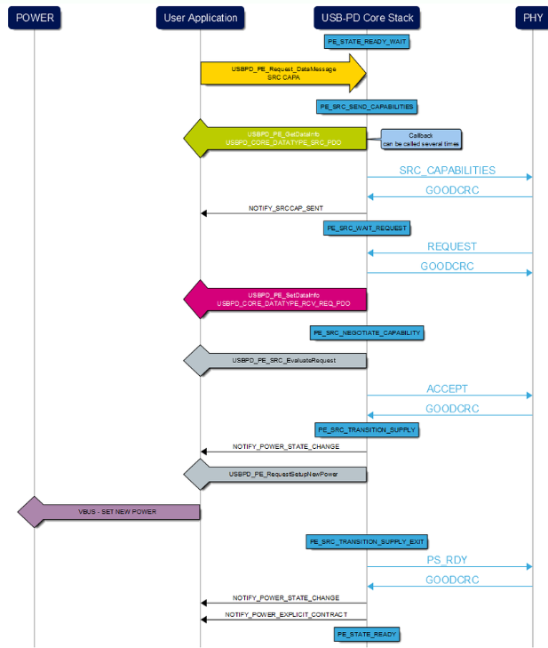
RESULTS ANALYSIS
Analysis & Explanation of USB-PD Traces
The trace sequence shows the Sink device requesting a voltage change from the Source device. The request is accepted and the voltage is set to the desired value, through accept, acknowledge and state-change messages.
USB Power Delivery · STM32
14

Slide 16
IMPLEMENTATION
Implementation and Functionality Verification
The process involved developing and progressively modifying a demo program in C, using Visual Studio Code and PlatformIO, with trace monitoring via STM32CubeMonitor.
1
2
3
LED control via buttons
Source capability recognition
Desired voltage selection
Semaphores are used to avoid interaction issues and synchronization problems.
Implemented a function to read the charger's capabilities.
Implemented the ability to select a voltage through a request.
USB Power Delivery · STM32
15

Slide 17
FUTURE EXTENSIONS
Additional Features
Programmable APDO
More Precise Measurement
Extending the current settings to support APDO parameters.
Setting voltage/current values allowed by the charger/source.
Using an oscilloscope to monitor voltage changes with high precision in real time.
Ensuring operation stays within safe limits, avoiding overload/overvoltage.
USB Power Delivery · STM32
16

Slide 18
CONCLUSIONS
What I Learned from this Thesis
I gained a deep understanding of the USB Power Delivery protocol and its role in system power management, and learned to use tools such as STM32CubeMonitor to monitor and verify power parameters.
Developing in C with Platform.io gave me hands-on experience with microcontroller programming. This thesis was an excellent introduction to embedded systems, hardware/software integration and problem-solving techniques.
USB Power Delivery · STM32
17

Slide 19
Thank you very much
for your time and attention!
USB Power Delivery · STM32G474RE

