Slide 1
Task 1 - Perturbation Workflow
Objective: Build reproducible in-silico knock-up/knock-down pipeline on the 112k-cell ALS AnnData matrix.
Workflow: Gene validation, copy-on-write edits, cell-type targeting, QC plots plus metrics, and perturbation logs.
Scalability: Handles bulk and targeted perturbations; demo applies 5 genes (MT-CO2, DPP10, NRXN3, LSAMP, NRXN1).
Results: Knock-downs reach 0.1x expression; knock-ups reach about 5x; total count shift only 1.8 percent, confirming localized edits.
Notes:
Validated knock-up/down helpers; example knock-down of MT-CO2 from 36.39 to 3.64, knock-up LSAMP 39.68 to 198.46.

Slide 2
Task 2 - ALS Gene Perturbations
Objective: Apply workflow to 10 ALS genes (SOD1, C9orf72, TARDBP, FUS, OPTN, VCP, UBQLN2, SQSTM1, TBK1, NEK1).
Scenarios: (1) Disease rescue - knock-down pathogenic genes in ALS neurons; (2) Disease model - knock-up in controls; (3) Baseline control.
Execution: 112k cells filtered to targeted subsets; each scenario subsampled to 5k cells for GeneFormer V2 (512-dim embeddings).
Outputs: Saved perturbed AnnData, embeddings (ALS_embeddings.npy), metadata, and scenario logs for downstream analysis.
Notes:
All target genes detected in dataset; embedding jobs completed with GeneFormer gf-12L-95M-i4096.

Slide 3
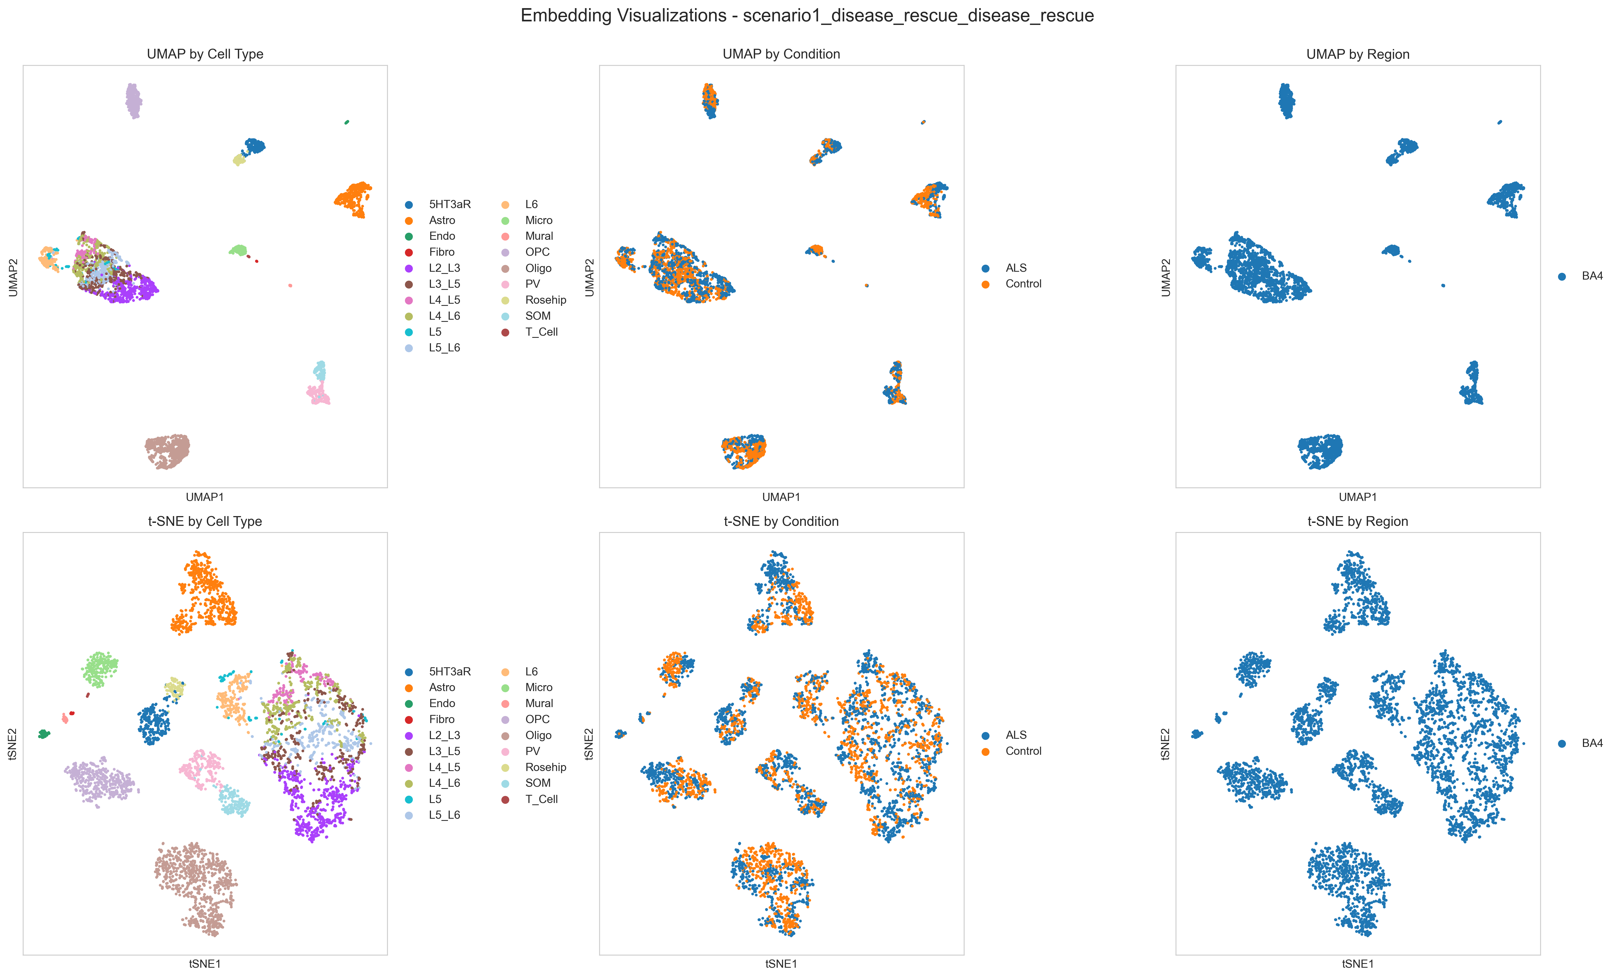
Task 3 - Embedding Interpretation
Objective: Compare perturbation scenarios in latent space and quantify ALS versus control separation.
Best scenario: Control to rescue perturbation (scenario 3) with Leiden k=6 (silhouette = 0.363).
Findings: Fibro cells show largest ALS-control shift; 3,880 significant DEGs (2,983 up, 897 down).
Deliverables: UMAP and t-SNE, clustering dashboards, ALS-control distance maps, volcano plus heatmap, DEG tables.
Notes:
Embeddings summarised in task3_summary.txt; scenario3_disease_rescue best aligns perturbed controls with ALS baseline.

