Slide 1
Building streaming APIs with gRPC
Stefan Georgiev
CONFIDENTIAL | © 2020 EPAM Systems, Inc.

Slide 2

Stefan Georgiev
Lead Software Engineer
Software engineer since 2012
Java-based data processing and messaging
Financial services
Natural Language Processing

Slide 3
Agenda
1
HTTP/2
2
Protocol Buffers
3
gRPC
4
Q&A

Slide 4
HTTP/2

Slide 5
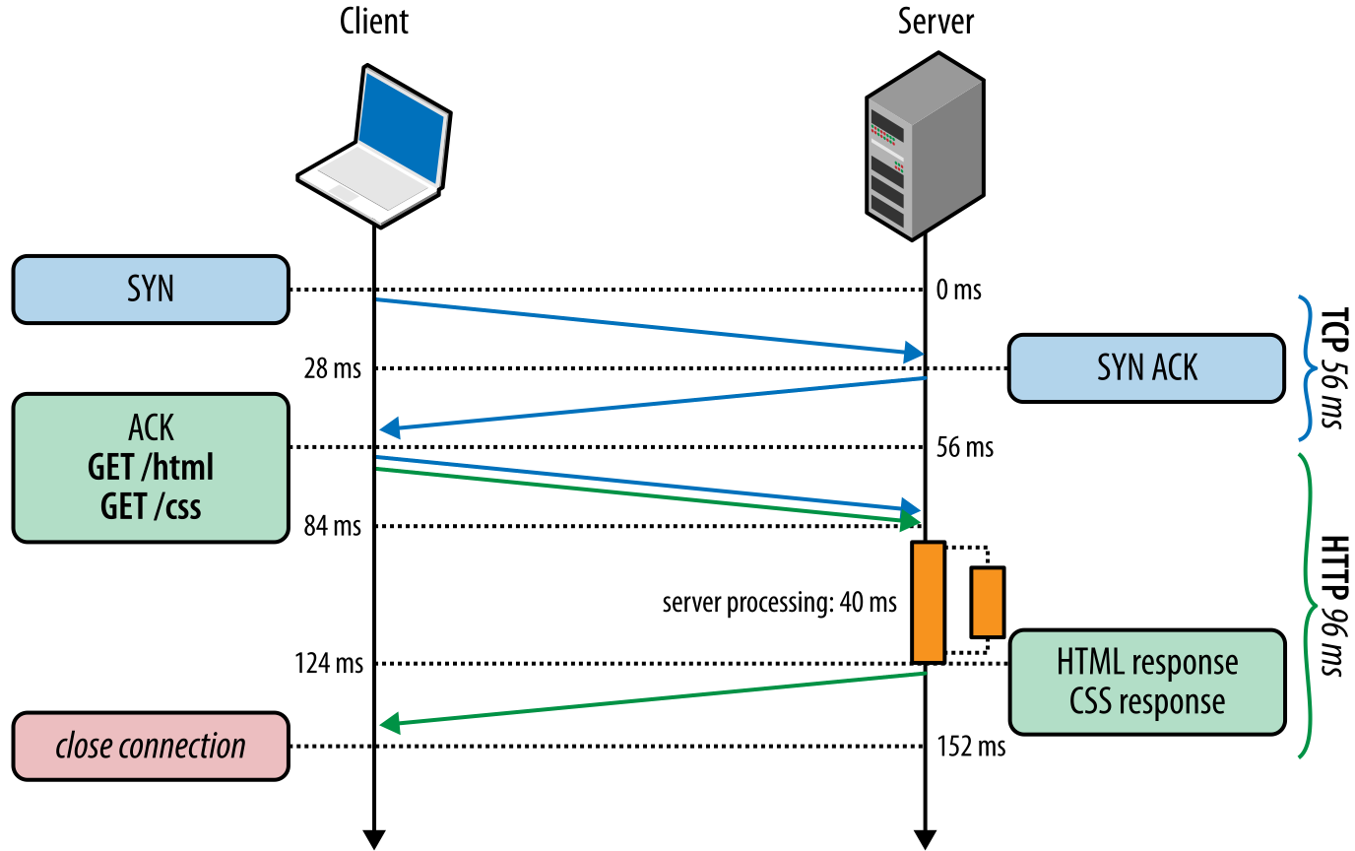
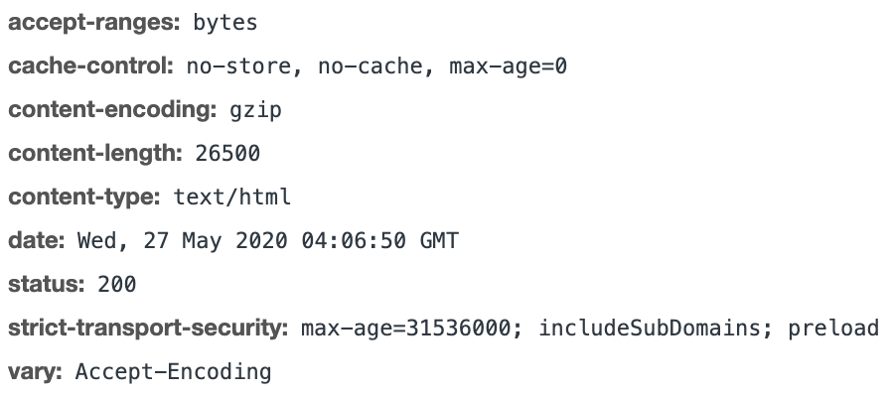
HTTP/1.1
Request/Response
Only one response can be delivered at a time, head-of-line blocking
Multiple parallel requests → multiple TCP connections
Plain text, headers are not compressed
https://hpbn.co/http1x/#http-pipelining

Slide 6
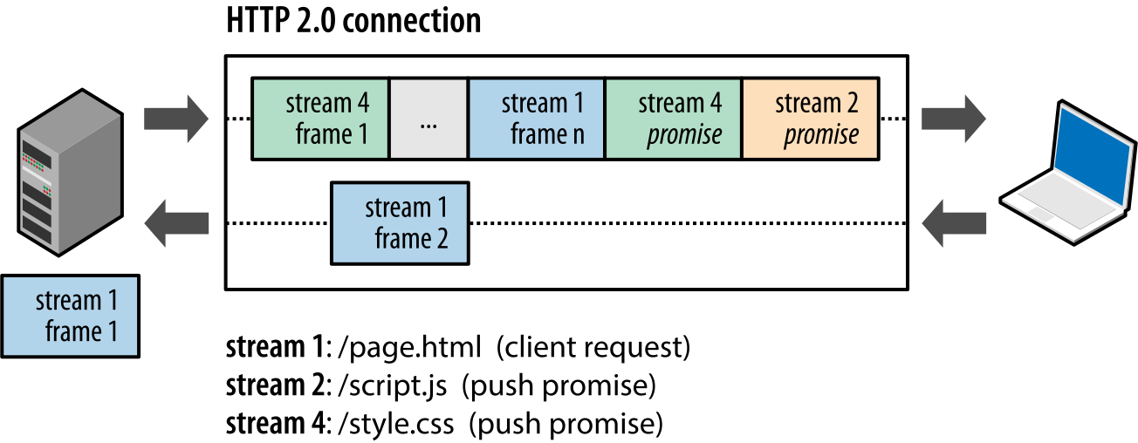
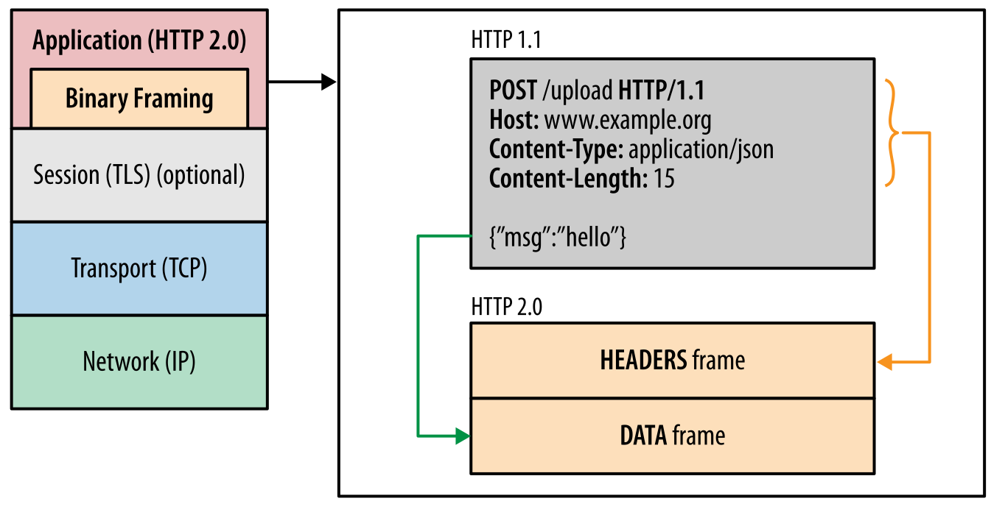
HTTP/2
Same high-level protocol semantics (HTTP methods, status codes, URIs, header fields)
Target a 50% reduction in page load time
Single TCP connection → less competition with other connections → better utilization of network capacity
Request and response multiplexing
Binary framing layer, compression of HTTP header fields
Server push, multiple responses for a single client request
https://hpbn.co/http2/#server-push
https://hpbn.co/http2/#binary-framing-layer

Slide 7
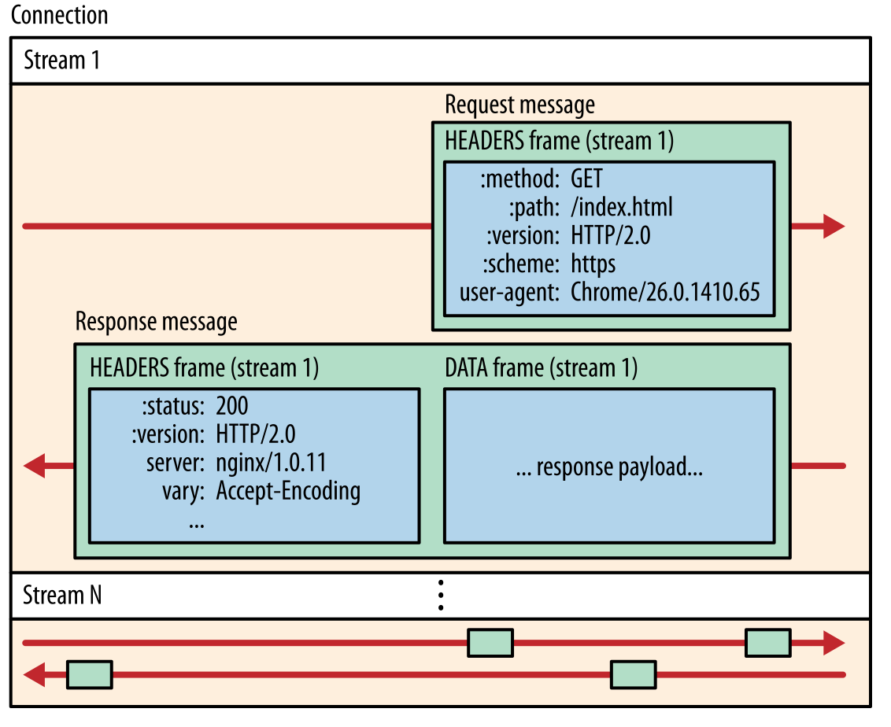
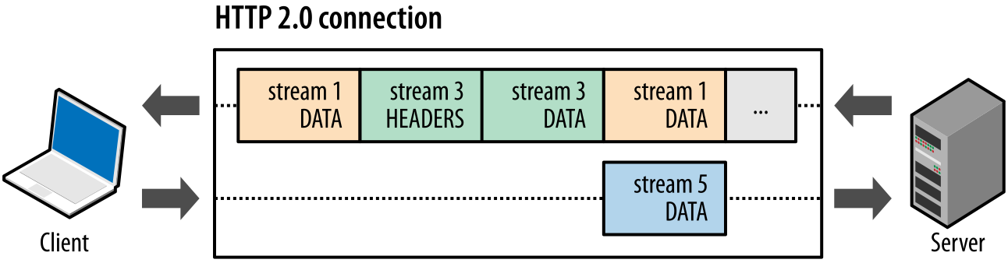
HTTP/2 terminology
Stream
A bidirectional flow of data within a connection, which may carry messages
Message
A complete sequence of frames
Frame
The smallest binary-encoded, multiplexed unit of communication
https://hpbn.co/http2/#request-and-response-multiplexing
https://hpbn.co/http2/#streams-messages-and-frames

Slide 8
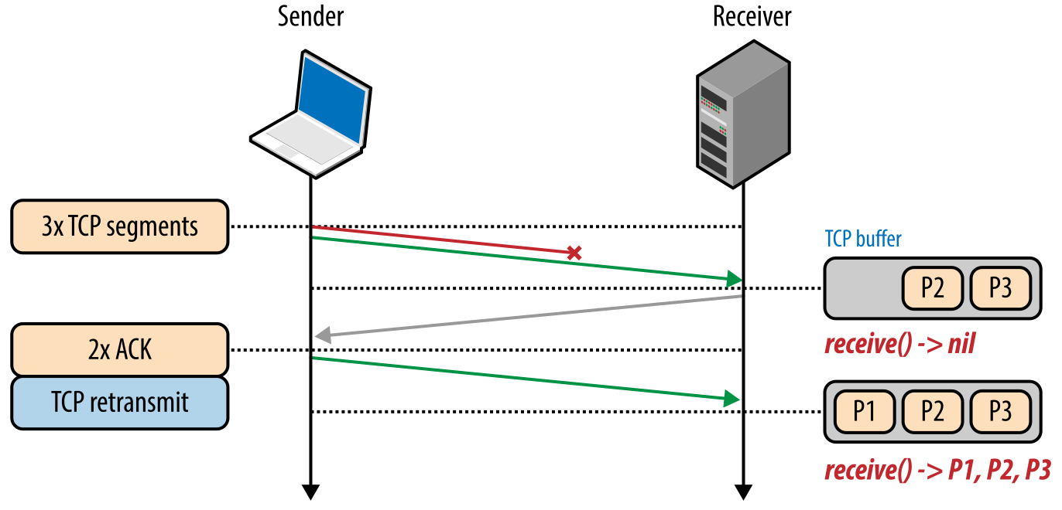
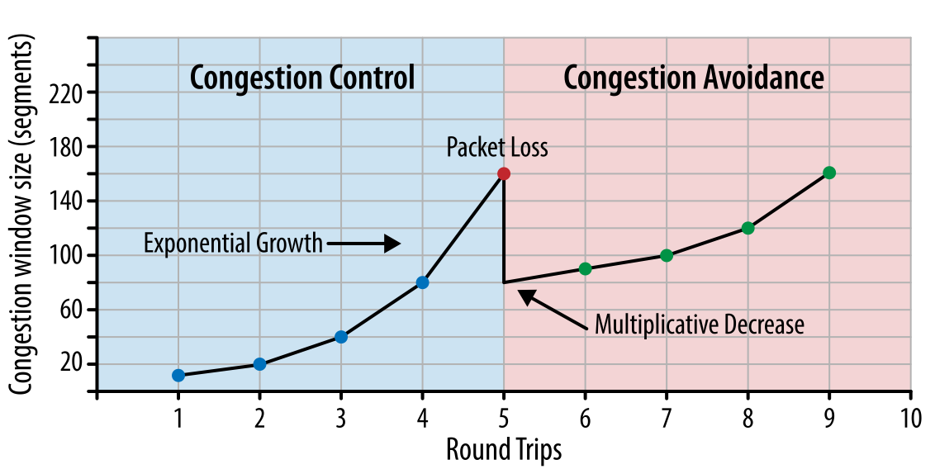
HTTP/3
HTTP/2 has no head-of-line blocking, but there is still TCP head-of-line blocking (in-order, reliable packet delivery)
Packet loss → reduced TCP congestion window size → reduced maximum throughput of the connection
HTTP/3 → HTTP over QUIC (over UDP), work in progress
https://hpbn.co/building-blocks-of-tcp/#head-of-line-blocking
https://hpbn.co/building-blocks-of-tcp/#congestion-avoidance-and-control

Slide 9
High Performance Browser Networking (https://hpbn.co/)
Ilya Grigorik

Slide 10
Protocol Buffers

Slide 11
Protobuf
Serialization of structured data, binary format
Communication and storage
Language and platform neutral
Message definition → Protobuf compiler → Generated serialization and deserialization source code
Hierarchical data structures
Compatibility between different definition versions
message PriceOverride { string product = 1; double price = 2; } message PriceOverrideSummary { int64 timestamp = 1; repeated PriceOverride priceOverrides = 2; }
PriceOverride banica = PriceOverride.newBuilder()
.setProduct("Banica")
.setPrice(2)
.build();
PriceOverrideSummary summary = PriceOverrideSummary.newBuilder()
.setTimestamp(System.currentTimeMillis())
.addPriceOverrides(banica)
.build();

Slide 12
Protobuf vs XML
3 to 10 times smaller
20 to 100 times faster to parse
Binary format is not human-readable and self-describing (message definition is required)
Definition:
message PriceOverride { string product = 1; double price = 2; }
Data:
product = Banica
price = 2
Approximate data serialization (field number, field type, field value):
1 2 Banica 2 1 2 3 0 14
Type | Meaning | Used For
0 | Varint | int32, int64, uint32, uint64, sint32, sint64, bool, enum
1 | 64-bit | fixed64, sfixed64, double
2 | Length-delimited | string, bytes, embedded messages, packed repeated fields
3 | Start group | groups (deprecated)
4 | End group | groups (deprecated)
5 | 32-bit | fixed32, sfixed32, float
https://developers.google.com/protocol-buffers/docs/encoding#structure

Slide 13
Proto3 example
syntax = "proto3";
package com.epam.grpc.intro.messages;
option java_package = "com.epam.grpc.intro.messages.proto";
option java_multiple_files = true;
option optimize_for = CODE_SIZE;
message PriceResponse {
reserved 4, 5;
string product = 1;
double price = 2;
PriceType price_type = 3;
}
enum PriceType {
SOURCE = 0;
OVERRIDE = 1;
}

Slide 14
GRPC

Slide 15
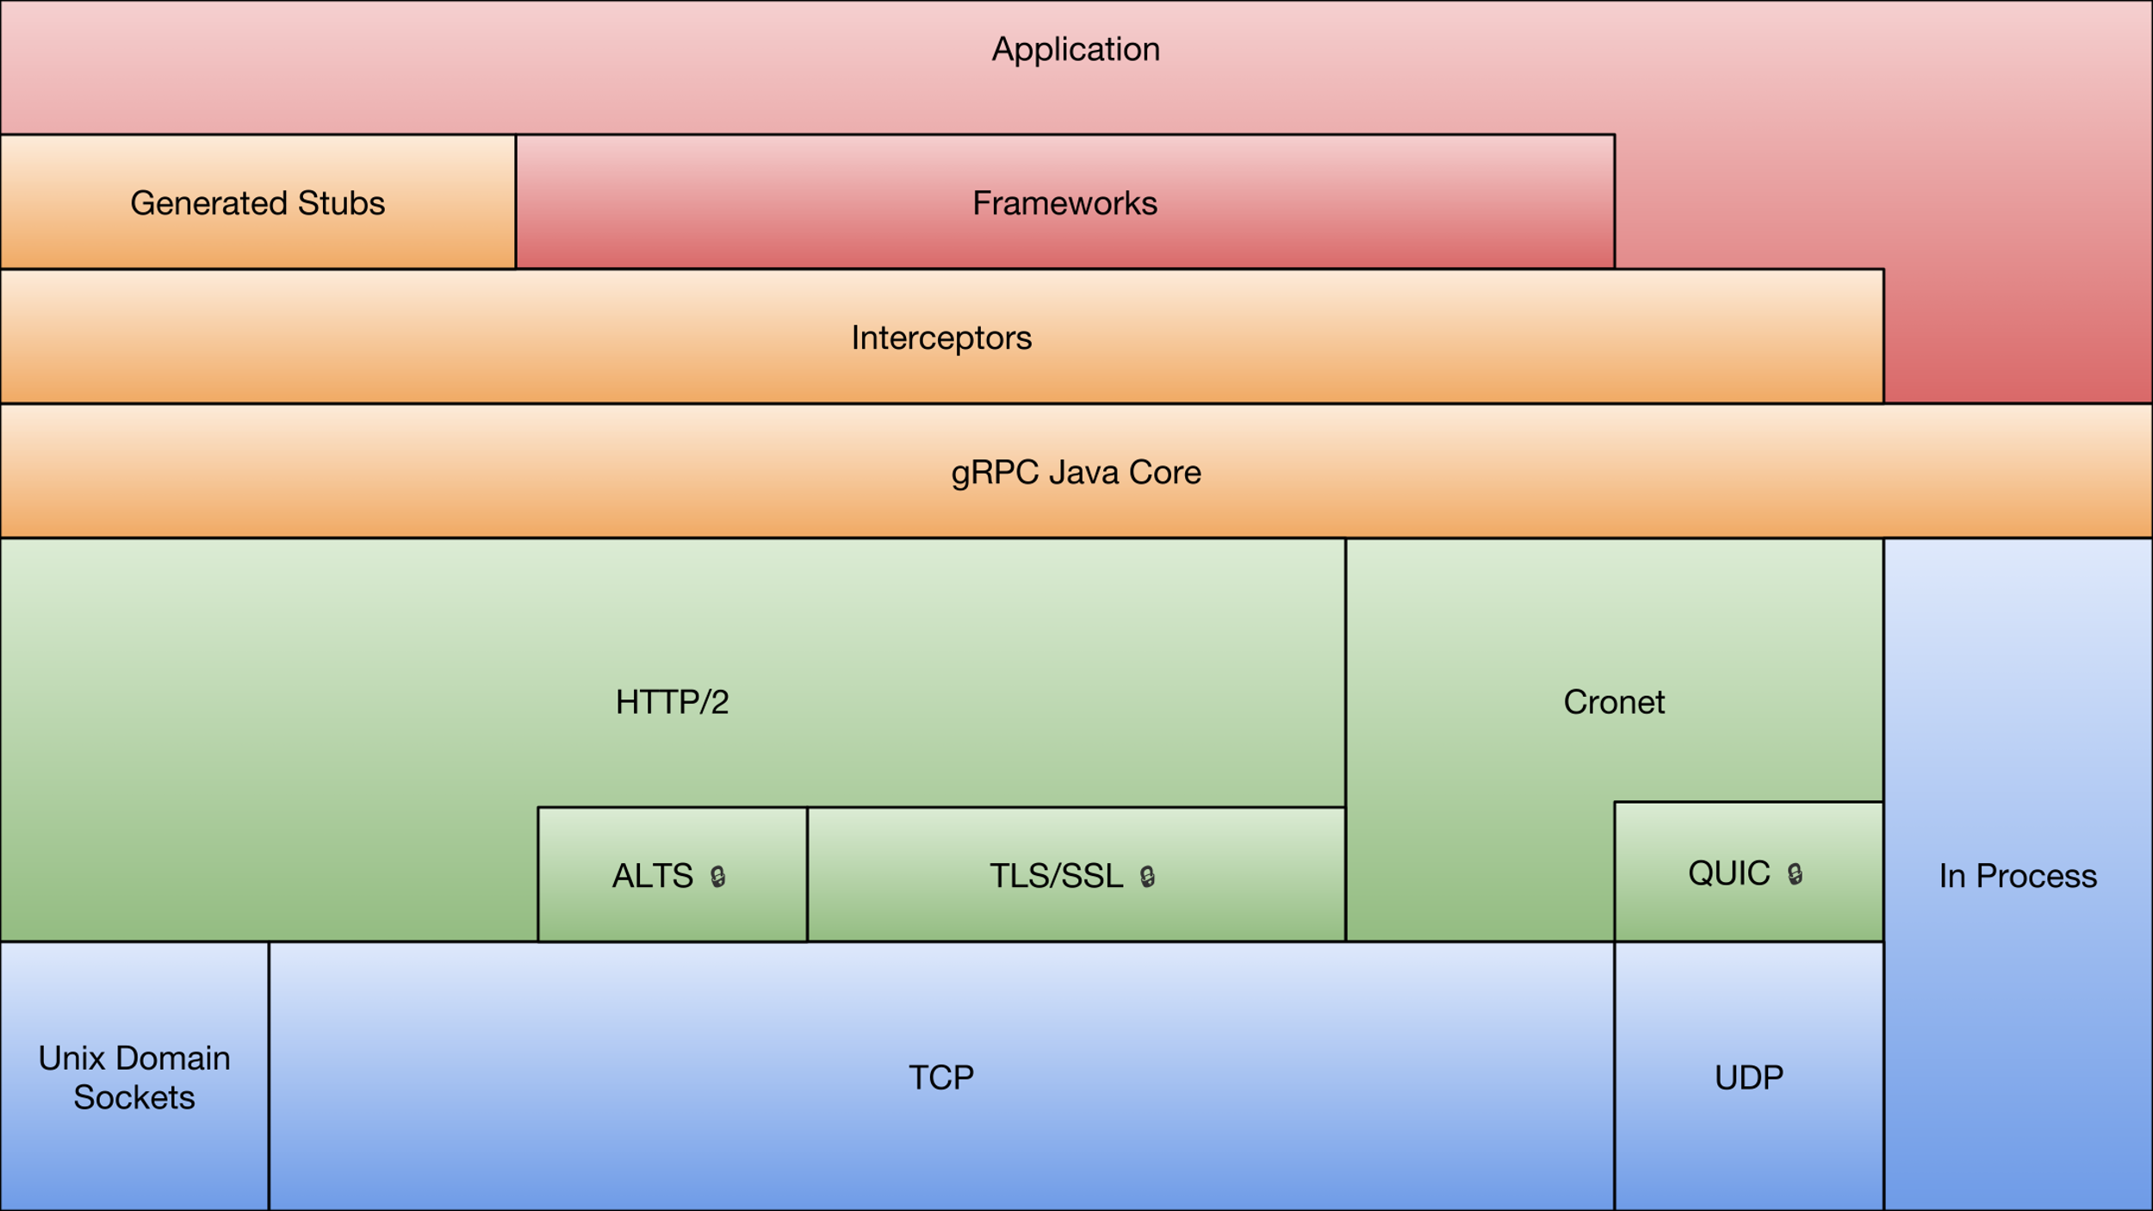
gRPC
Remote procedure call framework
HTTP/2 + Protobuf (support for other content types e.g. JSON)
Bi-directional streaming
Language independent APIs
Support for load balancing, tracing, health checking and authentication
Server, mobile and web applications
https://grpc.io/blog/grpc-stacks

Slide 16
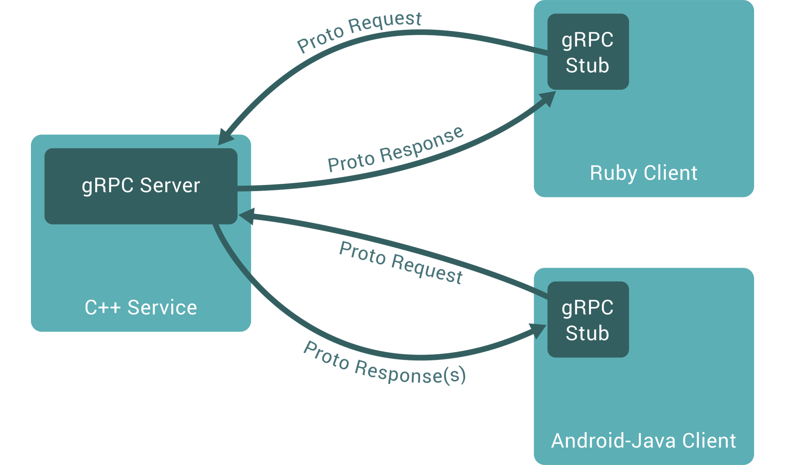
Service definition
message Request { ... } message Response { ... } service DemoService { rpc sendRequest(Request) returns (Response);
rpc streamResponses(Request) returns (stream Response);
rpc streamRequests(stream Request) returns (Response);
rpc streamRequestsAndResponses(stream Request) returns (stream Response);
}
Unary call
Server streaming
Client streaming
Bidirectional streaming
1
2
3
4
https://grpc.io/docs/guides

Slide 17
Maven
Dependencies
grpc-netty-shaded
grpc-protobuf
grpc-stub
annotations-api
Plugin
protobuf-maven-plugin
OR
Command line
protoc --plugin=protoc-gen-grpc-java --grpc-java_out="$OUTPUT_FILE" --proto_path="$DIR_OF_PROTO_FILE" "$PROTO_FILE"

Slide 18
StreamObserver interface
Client stub/service implementation sends/receives messages
Outgoing messages - gRPC provides StreamObserver to application
Incoming messages - application provides StreamObserver to gRPC
Thread-compatible
onCompleted() or onError(Throwable) - last method call
public interface StreamObserver<V> { void onNext(V value); void onError(Throwable t); void onCompleted(); }

Slide 19
Server: Unary call
service DemoService { rpc sendRequest(Request) returns (Response); }
public class DemoService extends DemoServiceGrpc.DemoServiceImplBase { @Override public void sendRequest(Request request, StreamObserver<Response> responseObserver) { Response response = ...; // Calculate response responseObserver.onNext(response); responseObserver.onCompleted(); } }

Slide 20
Server: Server streaming
service DemoService { rpc streamResponses(Request) returns (stream Response); }
public class DemoService extends DemoServiceGrpc.DemoServiceImplBase { @Override public void streamResponses(Request request, StreamObserver<Response> responseObserver) { // Calculate responses Response response1 = ...; Response response2 = ...; ... responseObserver.onNext(response1); responseObserver.onNext(response2); ... responseObserver.onCompleted(); } }

Slide 21
Server: Client streaming
public class DemoService extends DemoServiceGrpc.DemoServiceImplBase { @Override public StreamObserver<Request> streamRequests(StreamObserver<Response> responseObserver) { return new StreamObserver<>() { @Override public void onNext(Request request) { ...; // Handle requests } @Override public void onError(Throwable throwable) { ...; // Handle error } @Override public void onCompleted() { Response response = ...; // Calculate response responseObserver.onNext(response); responseObserver.onCompleted(); } }; } }
service DemoService { rpc streamRequests(stream Request) returns (Response); }

Slide 22
Server: Bidirectional streaming
public class DemoService extends DemoServiceGrpc.DemoServiceImplBase { @Override public StreamObserver<Request> streamRequestsAndResponses(StreamObserver<Response> responseObserver) { return new StreamObserver<>() { @Override public void onNext(Request request) { Response response = ...; // Calculate response/s responseObserver.onNext(response); } @Override public void onError(Throwable throwable) { ...; // Handle error } @Override public void onCompleted() { responseObserver.onCompleted(); } }; } }
service DemoService { rpc streamRequestsAndResponses(stream Request) returns (stream Response); }

Slide 23
Server
Server server = NettyServerBuilder.forPort(8080) .addService(new DemoService()) .build(); server.start(); ... server.shutdownNow();

Slide 24
Client managed channel and stubs
ManagedChannel managedChannel = ManagedChannelBuilder.forAddress("localhost", 8080) .usePlaintext() .build(); DemoServiceGrpc.DemoServiceBlockingStub blockingStub = DemoServiceGrpc.newBlockingStub(managedChannel); DemoServiceGrpc.DemoServiceFutureStub futureStub = DemoServiceGrpc.newFutureStub(managedChannel); DemoServiceGrpc.DemoServiceStub asynchronousStub = DemoServiceGrpc.newStub(managedChannel); ... managedChannel.shutdownNow();

Slide 25
Blocking stub
service DemoService { rpc sendRequest(Request) returns (Response); rpc streamResponses(Request) returns (stream Response); } try { Response response = blockingStub.sendRequest(request); } catch (StatusRuntimeException exception) { ...; // Handle error } try { Iterator<Response> responses = blockingStub.streamResponses(request); } catch (StatusRuntimeException exception) { ...; // Handle error }

Slide 26
Future stub
service DemoService { rpc sendRequest(Request) returns (Response); } ListenableFuture<Response> responseFuture = futureStub.sendRequest(request); ...; // Do some work while waiting try { Response response = responseFuture.get(); } catch (ExecutionException | InterruptedException exception) { ...; // Handle error }

Slide 27
Asynchronous stub unary call
asynchronousStub.sendRequest(request, new StreamObserver<>() { @Override public void onNext(Response response) { ...; // Handle response } @Override public void onError(Throwable throwable) { ...; // Handle error } @Override public void onCompleted() { ...; // Handle completion } });
service DemoService { rpc sendRequest(Request) returns (Response); }

Slide 28
Asynchronous stub server streaming
asynchronousStub.streamResponses(request, new StreamObserver<>() { @Override public void onNext(Response response) { ...; // Handle responses } @Override public void onError(Throwable throwable) { ...; // Handle error } @Override public void onCompleted() { ...; // Handle completion } });
service DemoService { rpc streamResponses(Request) returns (stream Response); }

Slide 29
Asynchronous stub client streaming
StreamObserver<Request> requestObserver = asynchronousStub.streamRequests(new StreamObserver<>() { @Override public void onNext(Response response) { ...; // Handle response } @Override public void onError(Throwable throwable) { ...; // Handle error } @Override public void onCompleted() { ...; // Handle completion } }); requestObserver.onNext(request1); requestObserver.onNext(request2); ...; // Send all requests requestObserver.onCompleted();
service DemoService { rpc streamRequests(stream Request) returns (Response); }

Slide 30
Asynchronous stub bidirectional streaming
StreamObserver<Request> requestObserver = asynchronousStub.streamRequestsAndResponses(new StreamObserver<>() { @Override public void onNext(Response response) { ...; // Handle responses } @Override public void onError(Throwable throwable) { ...; // Handle error } @Override public void onCompleted() { ...; // Handle completion } }); requestObserver.onNext(request1); requestObserver.onNext(request2); ...; // Send all requests requestObserver.onCompleted();
service DemoService { rpc streamRequestsAndResponses(stream Request) returns (stream Response); }

Slide 31
https://github.com/stef2georg/grpc-intro

Slide 32
Protobuf descriptor and code generation
PriceOverride.getDescriptor() .getFields() .stream() .map(field -> field.getType() + " " + field.getName() + " " + field.getNumber()) .forEach(System.out::println); Output: STRING product 1 DOUBLE price 2
Java annotation processing → code generation
message PriceOverride { string product = 1; double price = 2; }
message PriceOverride { string product = 1; double price = 2;
bool product_required = 3;
bool price_required = 4; }

Slide 33
Q&A

Slide 34
Thank you!

