Slide 1
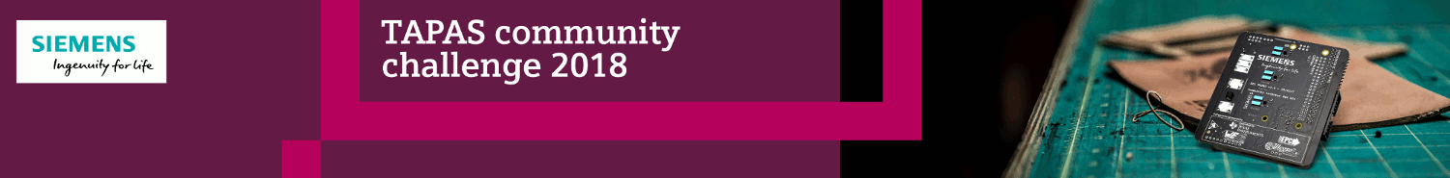
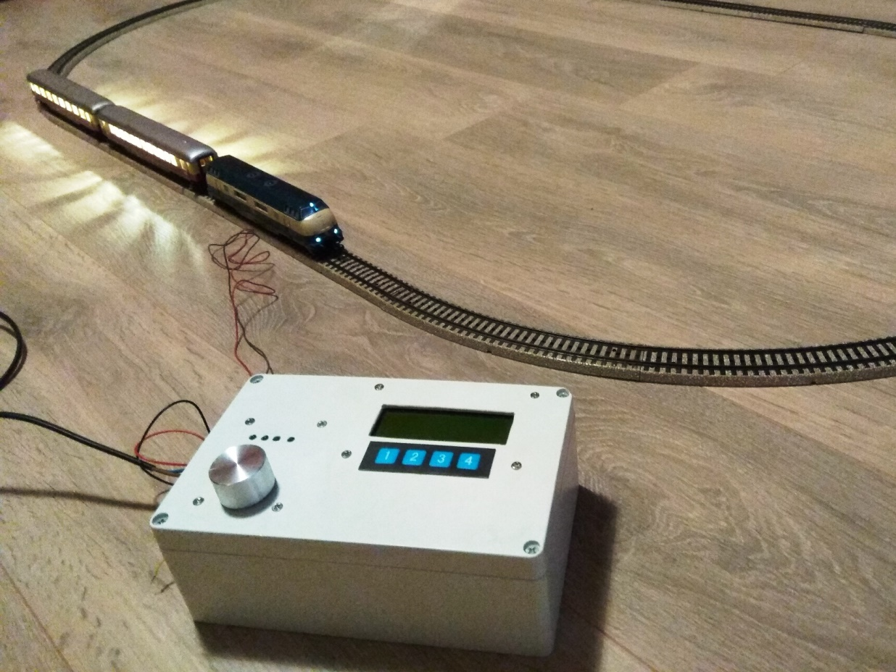
DCC Command Station using TAPAS
stefaandesmet2003@yahoo.co.uk

Slide 2
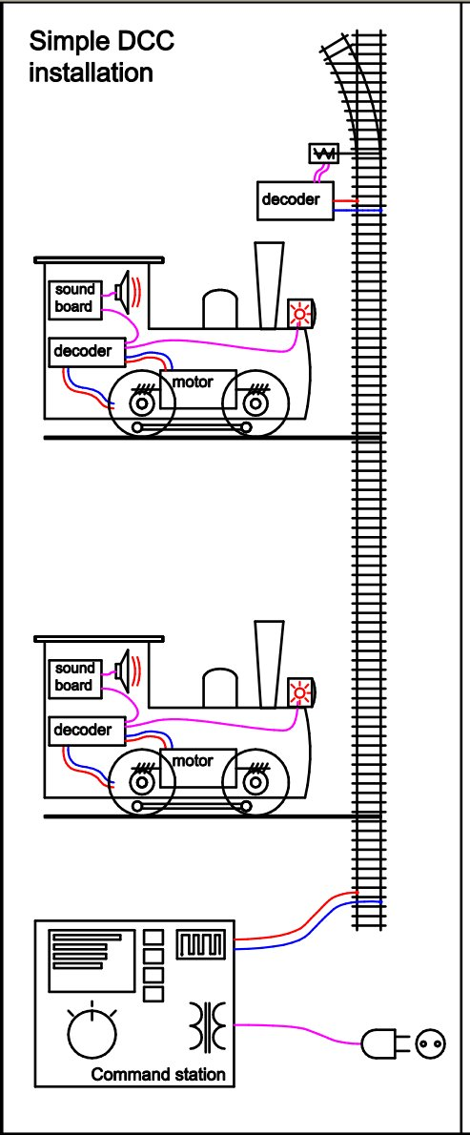
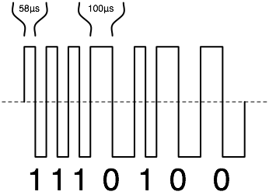

  DCC = Digital Command Control
DCC track signal format
Locomotives on the same track can be independently controlled
Loc decoders offer advanced features such as load-dependent acceleration, lighting, sound, etc.
Control of accessories (turnouts, signals, servos, …)
Computer-controlled model train layouts
Source : wikipedia

Slide 3
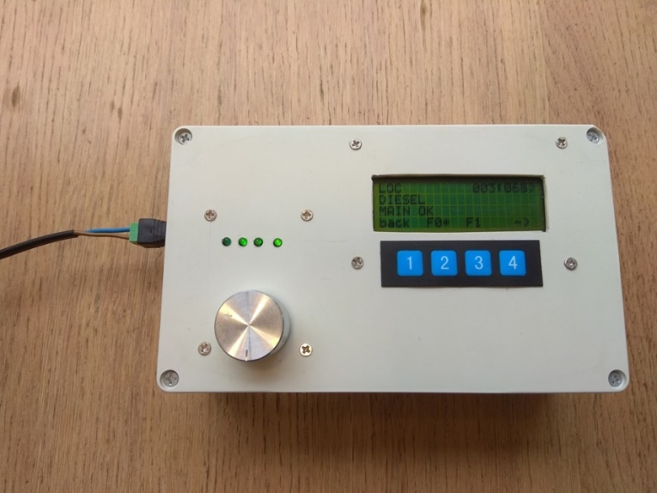
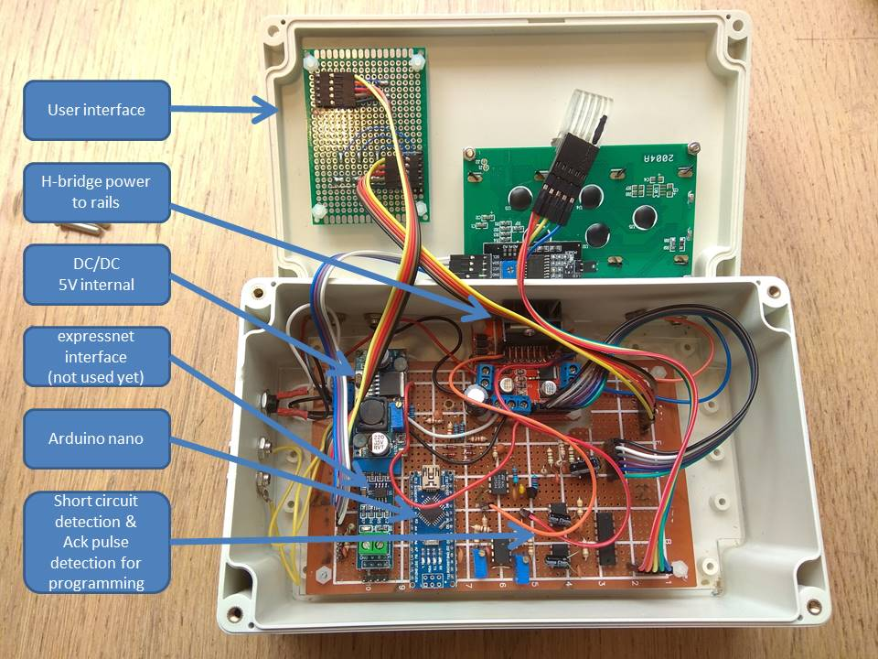
  DCC Command Station
Built in 2016 using arduino nano
Software from opendcc.org ported to arduino (atmel328p)

Slide 4
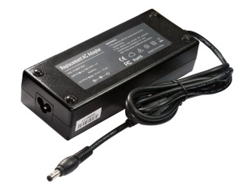
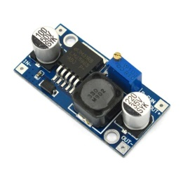
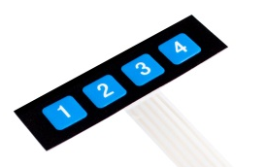
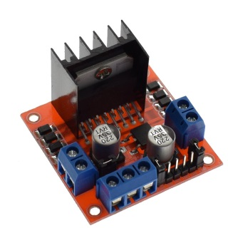

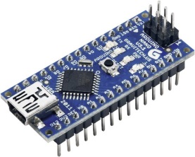
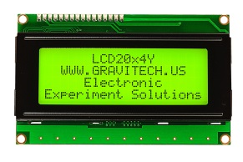



  Arduino DCC Command Station
  Hardware Concept
15V
DC/DC
5V
OUT1, OUT2 : main track
Dcc,
Enable Bridge
5V inputs from
membrane keypad &
rotary encoder
OUT3, OUT4 : programming track
i2c
Current sense A & B
Short Circuit Detected,
Acknowledge Pulse
Detected
glue
uart/USB

Slide 5
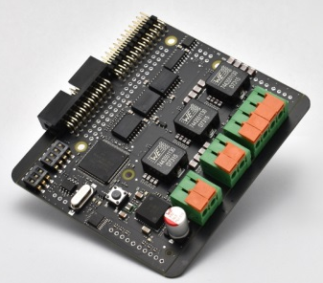
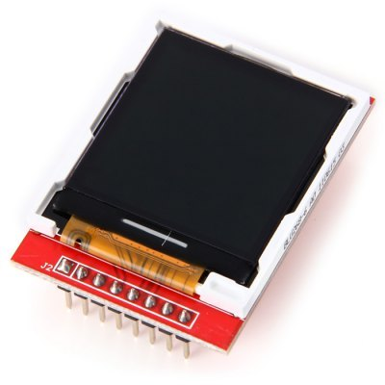
  Arduino → TAPAS
TAPAS advantages !
Much higher power output, for use on large layouts or size “1” gear
Glue replaced with code : short circuit & acknowledge pulse detection (programming track) can be implemented in software using on-board current sensors
More flash & more cycles -> SPI color LCD for user interface upgrade
glue

Slide 6
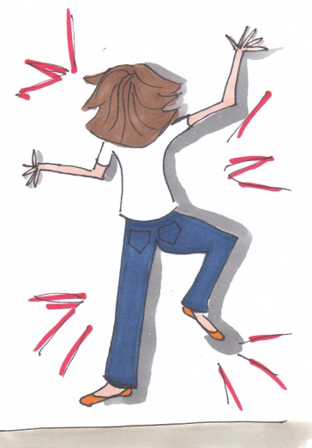
  TAPAS DCC Command Station
  Initial Concept
15V
epwm4/epwm5 : main track
Eqep2 : 3x 5V input
(3 keys)
epwm4/epwm6 : programming track
Eqep1 : rotary encoder
(dt, clk,sw)
i2c
SCI-B
uart/USB
RATIONALE
2 output phases needed for DCC signal with alternating polarity
JP12 digital inputs designed for 24V level -> use EQEP1&2 (5V)
I2C & SCI-A muxed on same pins, & io32/io33 not routed -> use SCI-B for uart
TAPAS OUTPUT FILTER ISSUE!
Filters 4kHz & 8kHz DCC base frequencies very effectively ☹
filter draws >2A with outputs disconnected -> unusable!
For reference : stereo audio amplifier use case would face a similar issue

Slide 7
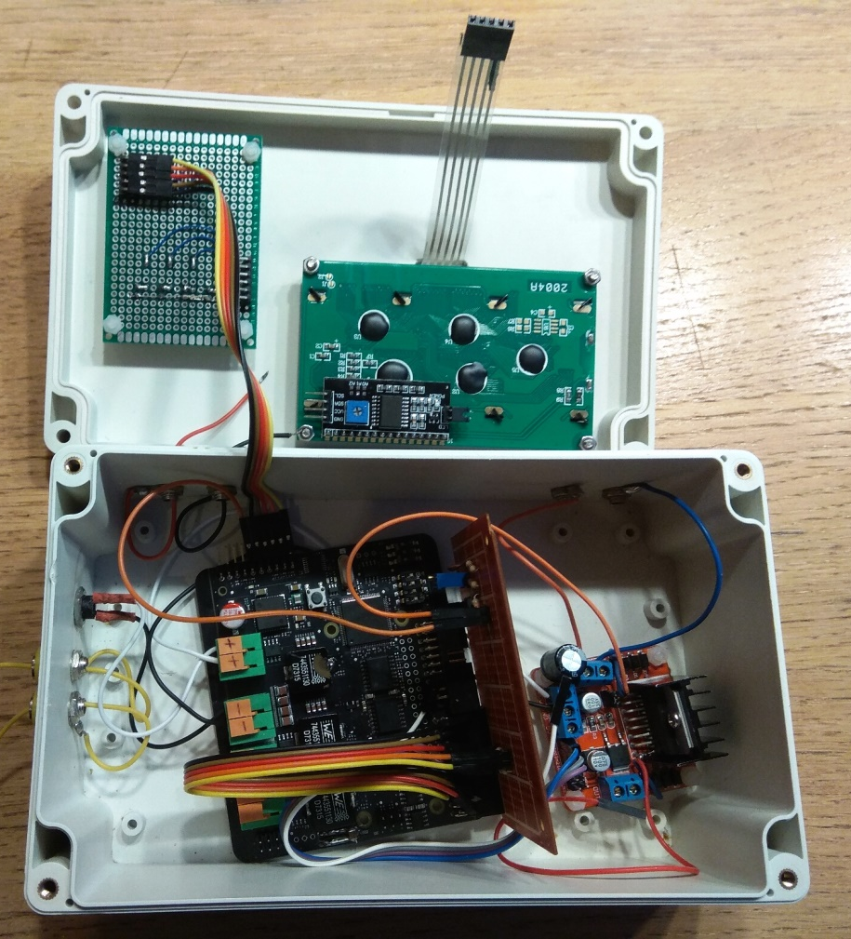
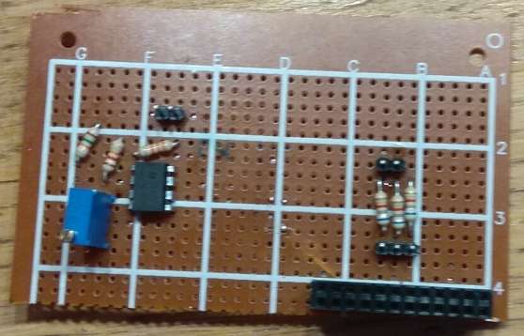
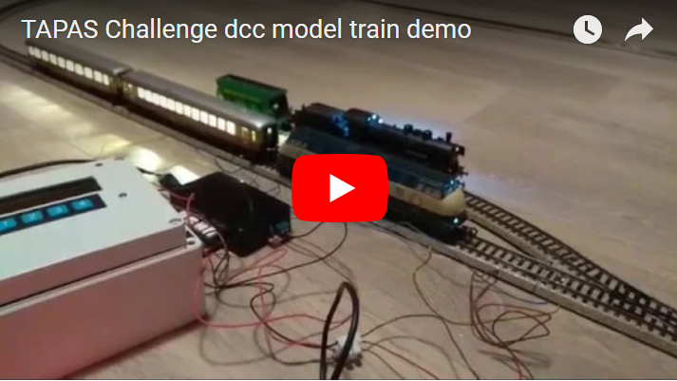

  TAPAS DCC Command Station
  Proof of Concept Implementation
DEMO!
https://www.youtube.com/watch?v=X4YlN5SQy1U
MOVING FORWARD
Remove output filter ?
Use L298N module ?

Slide 8
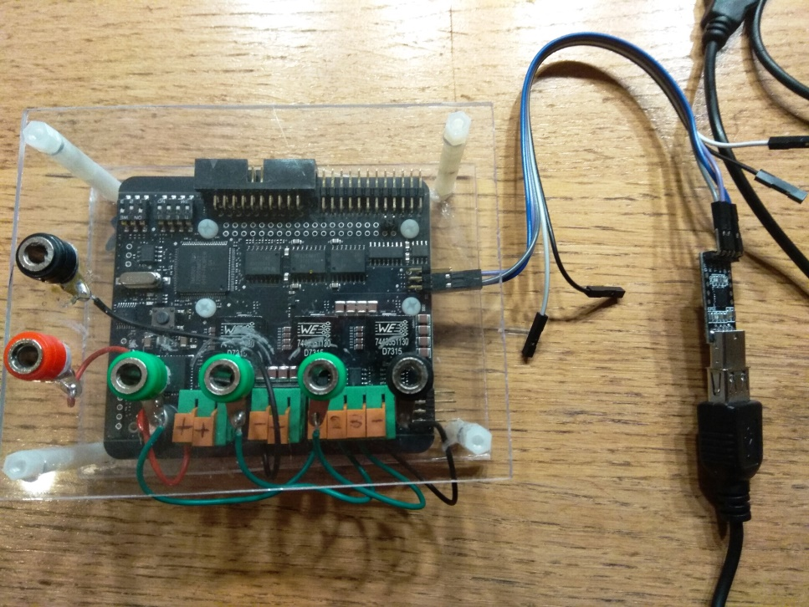

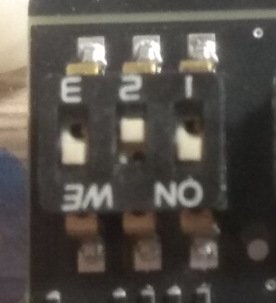
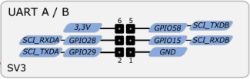
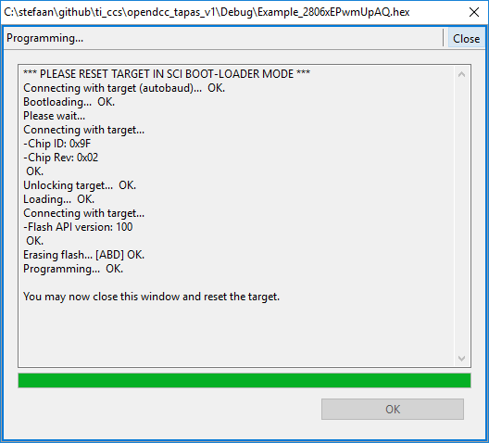
  A word on my development setup
SCI boot mode
DEVELOPMENT SETUP
Code Composer Studio
TAPAS board in SCI boot mode
CP2102 3V3 uart/usb adapter
serial_flash_programmer tool to load .hex in RAM (28069_RAM_lnk.cmd)
‘arduino-style’ debugging : serial prints & on-board leds (io34/io39)
Serial_flash_programmer or C2Prog for flashing code (F28069M.cmd)

Slide 9
  Lessons learnt
TAPAS H-bridges definitely need dead-band settings (L298N module does not)
→ thanks TAPAS team for sending a new board after I destroyed the power stage unintentionally!
Arduino style environment would be nice for makers using C2000. Energia does not yet officially support C2000 → will test later!
A TAPAS board variant without filter would be nice (or an easy(?) way to couple in/out the filter stage).
This board variant would also allow a stereo audio amplifier application for example
Wiring tms320 io32/33 to a connector (SV4?) would be nice; then i2c can be used together with sci-a & sci-b
Digital inputs at 5V level : for example adding solder bridges to short the 47K resistors (R68/70/72/74) would be nice.
My journey with TAPAS has only begun..

