Slide 1
CoMT
Conference Management Tool

Slide 2
Features

Slide 3
Quick access to all important data
View:
Events
Sessions
Papers
People

Slide 4
Easy scheduling
For the visitor:
Bookmark interesting events, add them to your personal schedule
For the organizer:
Auto-schedule events/sessions to accommodate visitor preferences

Slide 5
Better audience interaction
Speakers can
Get an idea of attendance in advance
Provide their presentation files
Get feedback via comments and votes

Slide 6
Technologies

Slide 7
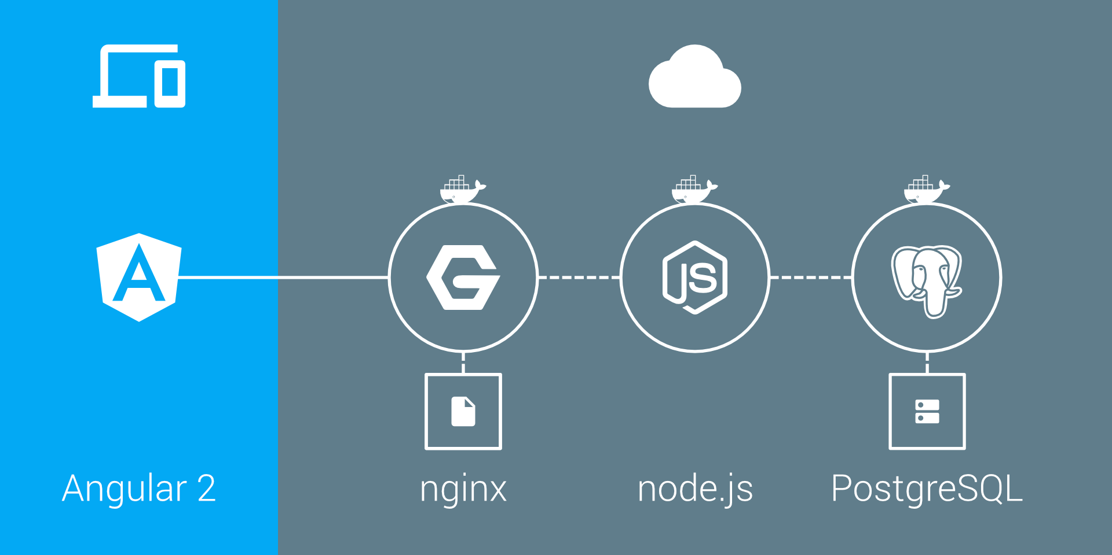

Slide 8
Demo

