Slide 1
Learning to Rank

Slide 2



Applications of Ranking
Web search engines:
Video service recommender systems:
Online shopping recommender systems:

Slide 3



Scoring model for ranking
Object = a pair of query and document
Scoring model:
Inference: for given query and collection of documents output a list of top-ranked documents w.r.t. their scores
Query/documents examples
Web search: query = search query + user/location, documents = web pages
Online shopping: query = current order + user/location, documents = goods
Video service: query = current/recent video history + user/location, documents = videos

Slide 4



Supervision in Ranking
1. Relevant/non-relevant objects (users click data):
2. Ranking for pairs of documents (users click data or given by assessors):
3. Graded relevance: 0(bad), 1(fair), 2(good), 3(excellent), 4(perfect) (given by assessors)
In real search engines usually a combination of different supervision is used with more weight for assessor’s data

Slide 5
Supervision in Ranking
Pointwise relevancy
y=1, if:
user clicks the link and stay on the site enough time
user clicks the link and doesn’t return to search results within the same session
y=0, if user skips this link and clicks some link below in search results
Users click data: easy to collect, large amount, but very noisy

Slide 6
Supervision in Ranking
Pairwise relevancy
Can be collected from user clicks. Advantage w.r.t. pointwise relevancy: remove positional bias (the user clicks the link just because it is on the first positions)
Can be collected from assessors (cheaper then collecting graded relevancy)
Graded relevancy
Expensive to collect, but has high quality

Slide 7



Ranking Evaluation Metrics
Pointwise relevance:
Let’s sort all objects w.r.t. their relevance scores and take top-K elements
Their corresponding relevancies:
This metric doesn’t consider the ordering, e.g. for [0,0,0,1,1] and [1,1,0,0,0] it has the same value

Slide 8
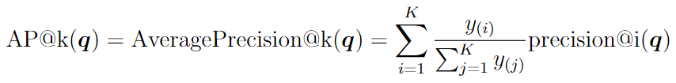



Ranking Evaluation Metrics
For the case y=[0, 0, 0, 1, 1]
For the case y=[1, 1, 0, 0, 0]

Slide 9
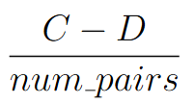
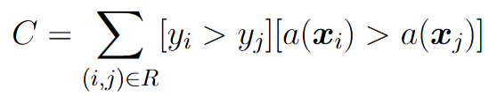
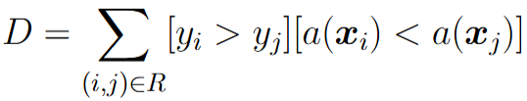

Ranking Evaluation Metrics
Pairwise relevancy
Rank correlation Kendall’s tau:
Concordant pairs:
Discordant pairs:
Concordance index (accuracy):

Slide 10
Ranking Evaluation Metrics
Pairwise relevancy
Rank correlation Kendall’s tau:
Main disadvantage: these metrics don’t account for positions of errors in ranking list (mixing up 1st and 2nd position costs the same as mixing 9th and 10th )
Practical usage: comparison of two ranking systems, assessors’ control

Slide 11



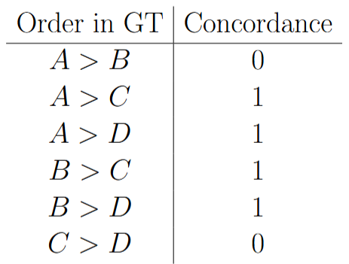
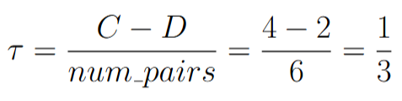
Ranking Evaluation Metrics
Kendall’s tau example
Ground truth order:
Prediction order:
Number of pairs:
Concordance table:
Rank correlation:

Slide 12

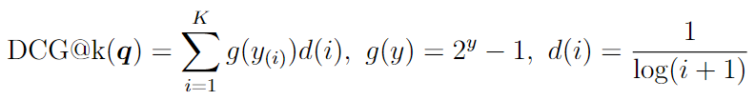


Ranking Evaluation Metrics
Graded relevance:
Discounted Cumulative Gain (g – gain, d – discount):
Normalized DCG:
Here maximum is attained for descending order of relevance y
Final metric:

Slide 13
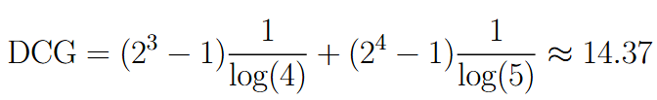


Ranking Evaluation Metrics
DCG and nDCG example
For the case y = [0, 0, 3, 4, 0]
maxDCG is DCG for sorted relevance y = [4, 3, 0, 0, 0]

Slide 14
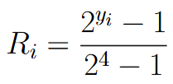
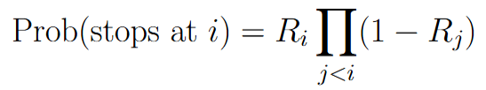
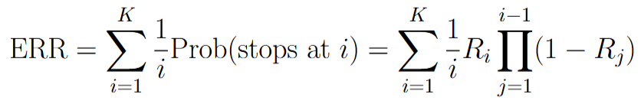
Ranking Evaluation Metrics
Graded relevance:
Alternative to nDCG: ERR (Expected Reciprocal Rank)
User inspects ranking sequentially from top to bottom:
- probability to click the current link

Slide 15
Ranking Evaluation Metrics
ERR: better for internet search results, where the first relevant answer is important
nDCG: better for online shopping search results, where assortment of goods is important

Slide 16
Features for ranking
Object = a pair of query and document
Features:
Query features
Document features
Joint query-document features

Slide 17
Features for ranking
Query features:
Query intent: navigational, informational, transactional, etc.
Query text: length, language, presence of Named Entities, etc.
Query statistics: popularity, freshness
Query location and time sensitivity
Query text embedding (computed by some neural network like BERT)
User profile: age, sex, preferred topics, etc.
User information: previous queries in session, device, location, time
User embedding

Slide 18
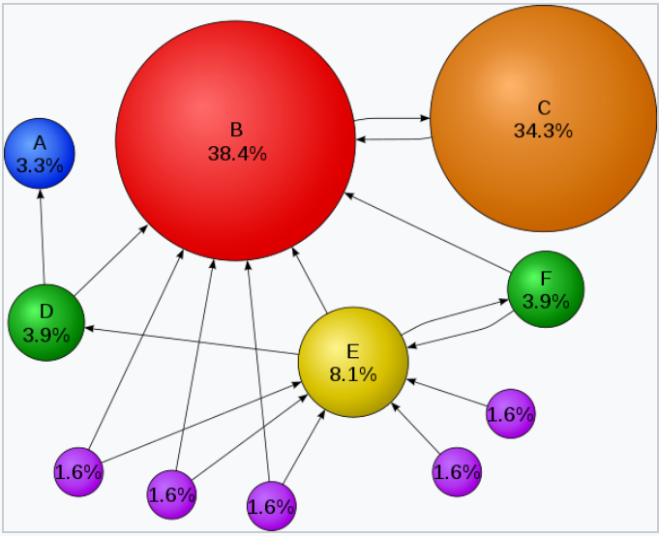



Features for ranking
Document features:
Document embedding
Document popularity
Document category
PageRank
- list of pages that link to p_i
- number of outbound links from p_j
PageRank can be manipulated

Slide 19
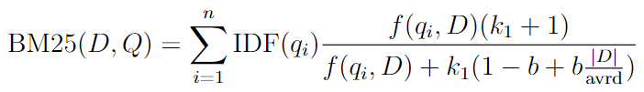



Features for ranking
Joint query-document features:
Scalar product of query and document embeddings
BM25 (“best-match 25”)
Query = collections of words/terms q_1, … q_n
- frequency of word/term q_i in the document D
- inverse document frequency
Avrd – average document length in collection

Slide 20
Ranking Methods
Pointwise methods: the loss is computed using individual objects (query-document pairs)
Pairwise methods: the loss is computed using pairs of objects
Listwise methods: the loss is computed for a list of objects

Slide 21

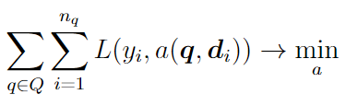
Pointwise method
Binary relevance:
Learn two-class classifier:
Usage: preliminary retrieval (find candidate list for further ranking with more precise pairwise/listwise ranking model), in loss combination with other models

Slide 22




RankNet (pairwise method)
Pairwise relevance:
or any other differentiable score function w.r.t. w
Training procedure using SGD and linear a(x):

Slide 23


Mismatch between ranking error rate and ranking metrics
In training we minimize loss function that corresponds to minimization of ranking error rate, but in practice we’re interested in high values of MAP, nDCG, etc.
Example: only one relevant document
Moving relevant document from 3-rd to 2-nd position: error rate changes by 1, AP increases by
Moving relevant document from 10-th to 9-th position: error rate changes by 1, AP increases by
Simple heuristic for RankNet: measure MAP/nDCG on validation set at the end of every epoch and output the solution with the highest value

Slide 24
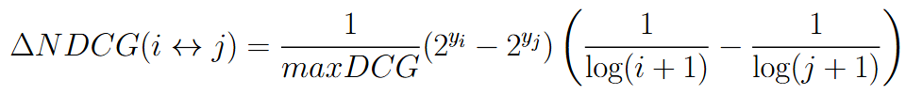
LambdaRank
It is hard to invent a smooth loss function that would approximate MAP, nDCG, ERR, etc.
Instead, we can modify gradients:
- change in NDCG value in case of swapping i-th and j-th documents in output and leave all the other documents unchanged
Similarly change in MAP/ERR value can be used

Slide 25
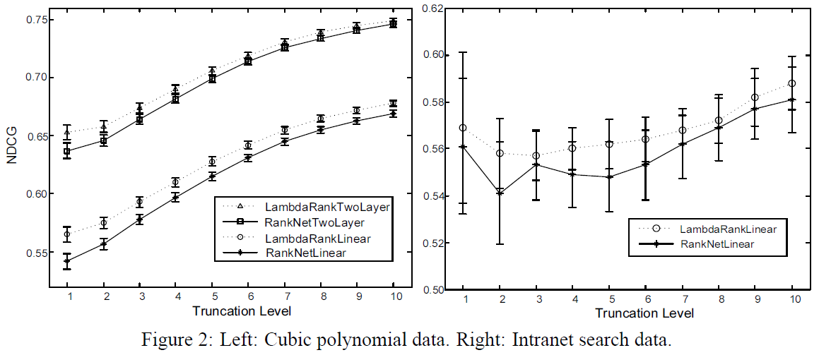
LambdaRank
LambdaRank usually better optimizes target ranking metrics compared to RankNet

Slide 26
LambdaRank
LambdaRank is a mixed pairwise/listwise method: for updates we need to sample only pair of documents, but need the value maxDCG from the full list
LambdaRank is used when scoring model is linear/neural network, if scoring model is boosting, then use LambdaMART

Slide 27
LambdaMART
MART (Multiple Additive Decision Tree) – a classic version of gradient boosting on top of decision trees. Boosting uses loss gradients as pseudo-targets for training next decision tree.
LambdaRank chooses gradients for training rank algorithm by adding nDCG/MAP absolute change
LambdaMART = MART, where pseudo-targets are computed using loss gradients + nDCG/MAP absolute change

Slide 28
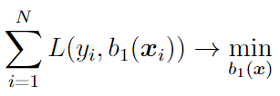



Recall on gradient boosting for two-class classification
Train first model:
Pseudo-residuals:
Train MSE decision tree regression model as next base model:

Slide 29

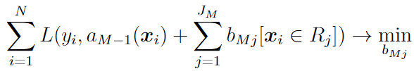

Recall on gradient boosting for two-class classification
Train DT on pseudo-residuals and fix found predicates
Fine-tune prediction in each region by solving 1d optimization problem using one-step Newton procedure:

Slide 30
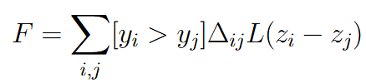


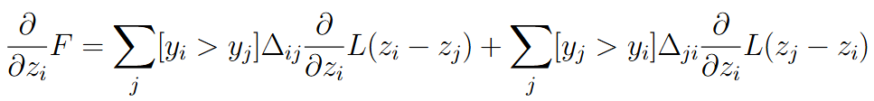

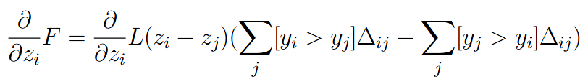
Pseudo-targets in LambdaMART
Weighted RankNet loss:

Slide 31
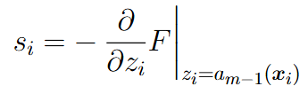
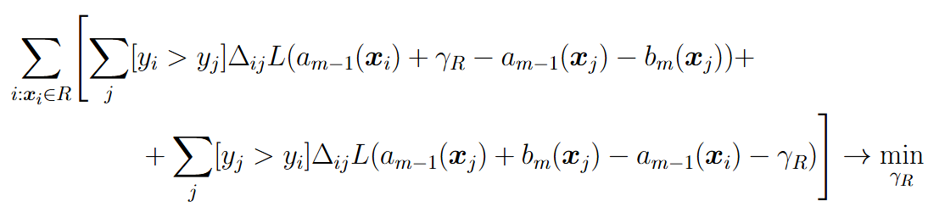
Pseudo-targets in LambdaMART
Pseudo-residuals:
Train next DT base model (find all regions):
Fine-tune prediction in each region by solving 1d optimization problem using one-step Newton procedure:

Slide 32
LambdaMART
All popular boosting libraries (xgboost, lightgbm, catboost) can optimize LambdaMART-like ranking criterions

Slide 33

Listwise Method
For given query and relevant documents let’s compute their scores
For optimization we need to define a differentiable loss function measuring the distance between graded ordering and given set of scores

Slide 34
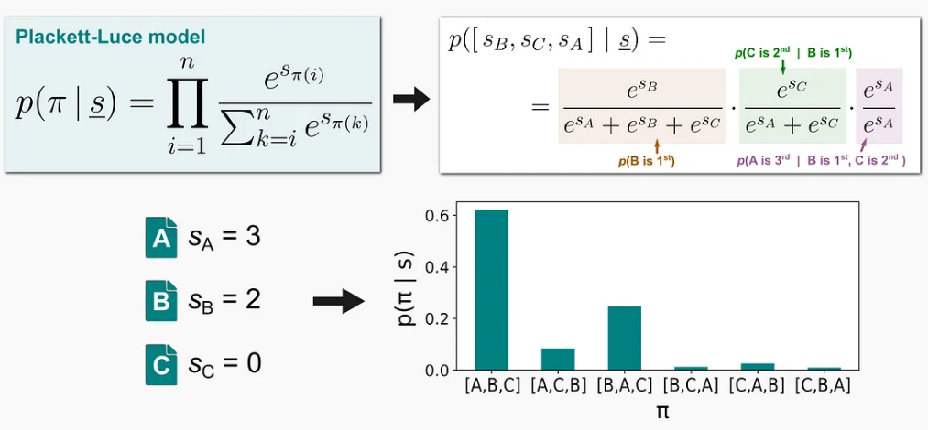

Listwise Method
Let’s introduce probability distribution on a set of permutations (Plackett-Luce probability model):
Loss function:
This loss is hard to deal with directly due to too many terms (= number of possible permutations)

Slide 35

ListNet
Probability that the given element is stated on the first position under Plackett-Luce probability model:
Loss function:
Usage: final ranking between top documents

