Slide 1
Wireless Security Protocols: A Hacker's Perspective
WiFi Hacking Tutorial
Understanding Protocols = Tactical Advantage
Presented by: stefan-hacks

Slide 2

whoami
$ echo “Hello World!” >> Hello.txt ; cat Hello.txt
#Former Olympic swimmer turned IT nerd | I read technical manuals of instruction in my spare time (in the terminal of #course). | Capture the Flag enthusiast | Family world-travel & digital-nomad | Rock/Reggae/Metal Lover.
Hello_World!

Slide 3
Why Understanding Protocols Matters
This Isn't Academic—It's Tactical
Each protocol = Different attack surface
Different vulnerability profiles
Different cracking methodologies
Attack strategy changes completely based on protocol
Knowledge Gap: Not knowing protocols = Wasting time on wrong attacks

Slide 4
The Evolution Timeline
1999 - WEP: Easily broken in minutes
2003 - WPA: Temporary fix, still vulnerable
2004 - WPA2: Current standard (90% of networks)
2018 - WPA3: New standard, limited adoption

Slide 5
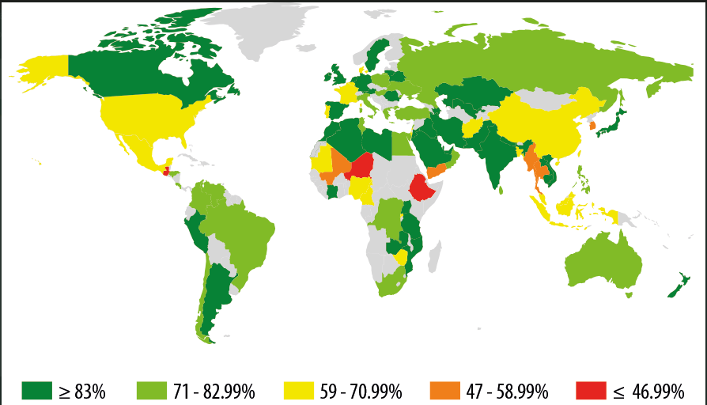
Share of Wi-Fi hotspots that use WPA/WPA2

Slide 6
WPA2 - Your Main Target - The Current Standard (2004-Present)
How it works:
CCMP encryption with AES (strong crypto)
4-way handshake for key establishment
PMK derived from password via PBKDF2
Critical Vulnerabilities:
KRACK Attack (Key Reinstallation Attack)
Handshake capture + dictionary attacks
WPS vulnerability (separate feature)
Why This Matters: 90% of networks = WPA2
Notes:
The WPA2 4-way handshake is a secure process where a device and an access point (AP) generate unique session keys, proving they know the Wi-Fi password (PMK) without ever sending it, using random numbers (nonces) and MAC addresses to create temporary Pairwise Transient Keys (PTK) for data encryption

Slide 7

TIME TO HACK
Hypervisor - Virtualbox
Kali VM
external wifi adapter - which supports monitor mode
test router - TP-Link

