Slide 1
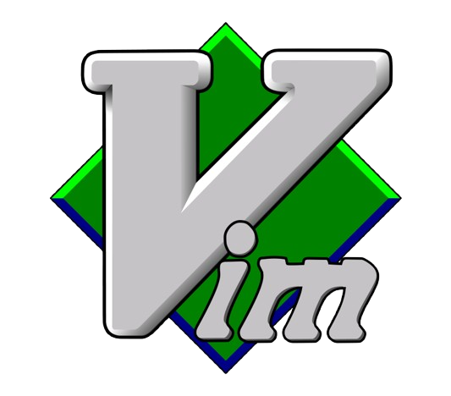
30 min VIM Workout - with stefan-hacks

Slide 2

$ whoami
stefan-hacks
$ echo “Hello World!” >> Hello.txt ; cat Hello.txt
#IT Trainer #Former Olympic swimmer turned IT nerd | I read technical manuals of instruction in my spare time (in the terminal of #course). | Capture the Flag enthusiast | Family world-travel & digital-nomad | Rock/Reggae/Metal Lover and guitarist.
Hello_World!

Slide 3
What & Why: History and Philosophy
vi vs. Vim: What's the difference?
Practice Time: Let's try it together.
Resources & Q&A
Notes:
"Here's our game plan for the next half hour. We'll start with a bit of history to understand why this editor is the way it is. We'll clarify the difference between vi and Vim, then jump into the single most important concept: modes. From there, it's all hands-on keyboard. We'll learn the essential commands, practice them live, and I'll point you to resources to continue your learning after this session."

Slide 4
1976: vi (Visual Editor) is created by Bill Joy for an early BSD Unix release.
The Predecessor: ed (line editor) -> ex (extended editor) -> vi (visual mode of ex).
The Constraint: Built for slow, low-bandwidth connections (300-baud modems!). Every keystroke mattered. Hence, no mouse, no menus.
1991: Vim (Vi IMproved) is created by Bram Moolenaar. It extends vi with:
Syntax highlighting
Better scripting support
Graphical versions (gVim)
Massive portability (Windows, Mac, Linux)
Philosophy: Modal Editing. Different modes for different tasks (insert text vs. manipulate text). This is the key to efficiency.
Notes:
"Vi was born out of necessity. In an era of slow terminals, you couldn't waste keystrokes or redraw entire graphical screens. The solution was a modal editor. You wouldn't drive a car in just one gear; you have park, reverse, neutral, and drive. Vi/Vim is the same—you change modes for the task at hand. This philosophy is what makes it so powerful and efficient once you learn it."

Slide 5
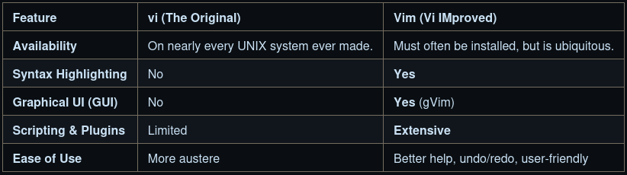
The Bottom Line:
vi is a standard. You can always expect it to be there. On modern systems, vi is often just a symlink (shortcut) to vim.
vim is what you should use. It's vi with superpowers and training wheels. For this session, we are learning Vim.
Notes:
"Think of vi as the classic, base model car. It gets you from A to B. Vim is the modern version of that car with power steering, air conditioning, and a GPS. Unless you're on a deeply embedded system, you should be using vim. The commands we will learn today work in both."

Slide 6

Notes:
Alright, everyone, your turn! Let's all do this together.

