Slide 1
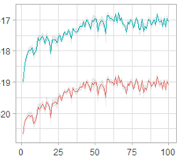

ds.monitored_fitdbm()
1
3
Researcher
Clinic
ds.dbm.samples()
2
4
5

