Slide 1
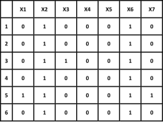
4
Clinic 1
3
1
2
1
3
Clinic 2
2

