Slide 1
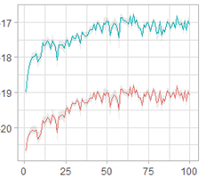



ds.monitored_fitdbm()
1
3
Clinic
Researcher
ds.dbm.samples()
2
4
5

