Slide 1
Intermediate Coding
FUNCTIONS & ARRAYS

Slide 2
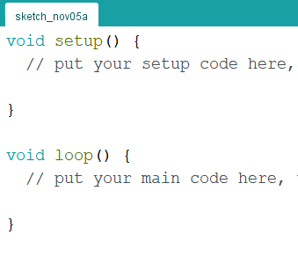
Functions so far
We’ve seen 2 functions so far:
  setup()
  loop()
These run automatically (once or repeating)
We can write our own functions. Why?
  Organize code
  Reusable code

Slide 3
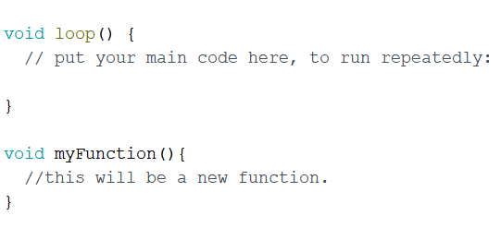
Writing a function
Functions can’t be inside of other functions.
  make sure it is outside of the script brackets for setup() and loop()
Let’s look more closely at the different parts.

Slide 4
For now, start with the keyword void.
This means the function doesn’t produce any output.
Give our function a descriptive name.
Must start with a letter, there are a few reserved words we can’t use.
Add two brackets () here. Inside of these we can add variables if this function will need input values.
If not, the brackets can be empty.
Add two brackets () here. Inside of these we can add variables if this function will need input values.
If not, the brackets can be empty.

Slide 5
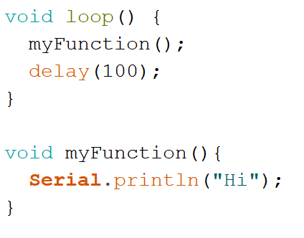
Calling a function
Functions we create won’t run on their own.
We need to invoke or call the function to run.
To do this, type functionName();
wherever you want the function to execute.
(including any inputs necessary inside the brackets)
Notes:
Try building some simple printing functions and run them first. That’s likely better than jumping into a complicated fading LED example…

Slide 6
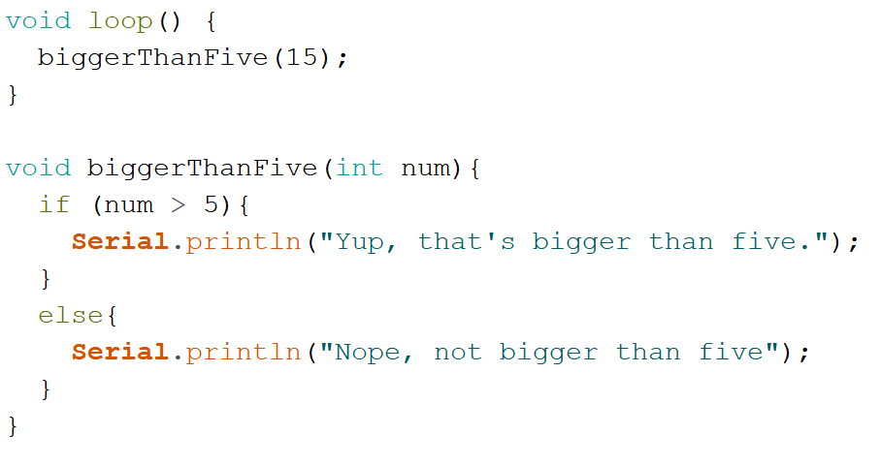
Functions with inputs
Multiple input values are separated by commas.
Each value is copied into the corresponding parameter before the function runs.
When calling the function, we must include as many values as inputs as the function has parameter variables.
If our function wants one or more inputs, create variables to store them inside the brackets.
These variables are local (and temporary) to the function, and are called parameters.

Slide 7
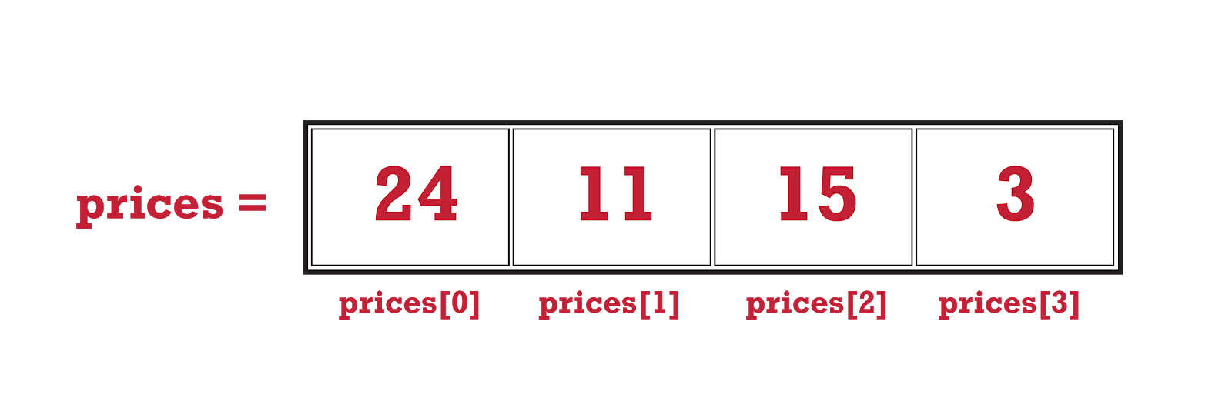
Arrays
We’ve used variables, which can hold one piece of information.
Arrays are like variables, but are containers that can hold multiple pieces of information.

Slide 8
The array has a single name, just like a variable does. But each array will have several spots, like cubbies in a shelf.
Each spot has an index or position number, starting at 0.
To access something from in an array:
nameOfArray [index]

Slide 9
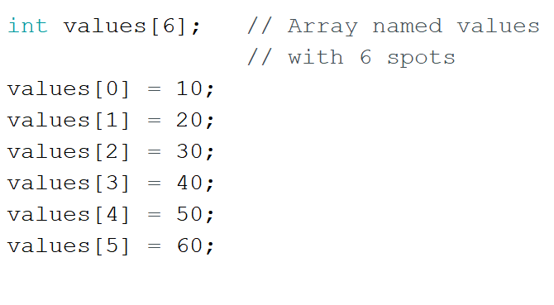
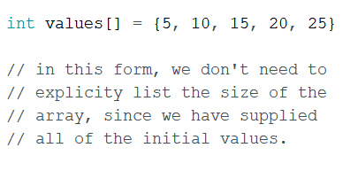
Arduino Arrays
Two ways to make an array in Arduino:

