Slide 1
Intermediate Coding
REPETITION & LOOPS

Slide 2
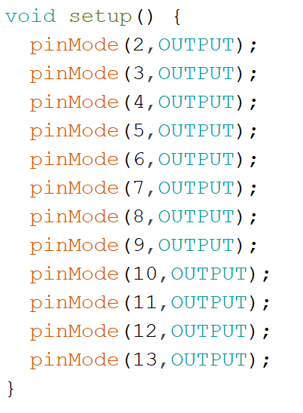
Looking for patterns
There will be times that we have an obvious pattern in our code
  Notice all the pinMode() functions are all identical, except that the pin number goes up by one each time.
Writing out line individually is a bit slow and takes up quite a bit of space.
  In programming, we can create loops, where some code is repeated several times (possibly with slight variations)

Slide 3
Two Types of Loops
For our Arduino Programs, there are two different types of loops:
FOR loops
WHILE loops
  Both allow us to repeat code, but each type of loop has advantages in certain contexts.

Slide 4
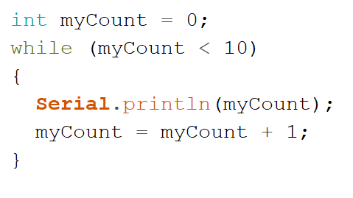
while keyword indicates that we are going to make a loop here.
In the brackets must be a Boolean Expression
( true / false question).
The Loop Body will run if this is true, and we ask the question each time the code returns to the top.
Code surrounded by script brackets is the Loop Body.
Each time the condition at the top is true, the loop body is run once.
Afterwards, check loop condition again
Script brackets { } surround the Loop Body.
Notes:
Following this slide, have students code and run this in tinkerCAD (using text coding).
- show how if this is in loop(), that it counts 0 to 9 indefinitely.
- modify so that this code is called from setup()
- could put into a function called whileLoopTest() to help better organize.
student challenge: change code to print out numbers from 10 to 1

Slide 5
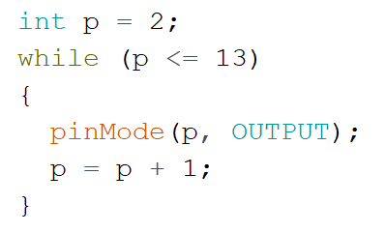
Using a while loop to improve our code:
Notes:
These two snippets are identical, but we can see that the while loop version is much more concise.
It could be easily expanded to set more pins to OUTPUT (if working with a microcontroller that had a larger number of IO pins)

Slide 6
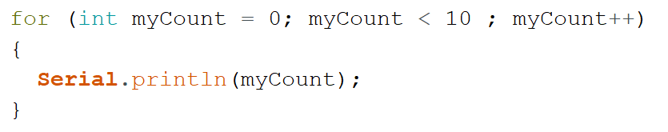
for keyword indicates that we are going to make a loop here.
Section Two – Loop Condition
A Boolean (true/false) expression. If this is true, run the Loop Body.
Section Three – Incrementation
A single-line statement that is run each time the loop body is complete.
Should modify the loop variable, and approach a state where the loop will end.
Section One – Variable Initialization
Create a Loop Variable and give it an initial value.
for loops have 3 sections inside the brackets ()
These sections are separated by semicolons ;
Code surrounded by script brackets is the Loop Body.
Each time the condition at the top is true, the loop body is run once.
Afterwards, check loop condition again
Script brackets { } surround the Loop Body.
Notes:
Following this slide, have students code and run this in tinkerCAD (using text coding).
have this code called from setup()
- could put into a function called forLoopTest() to help better organize.
student challenge: change code to print out numbers from 10 to 1

Slide 7
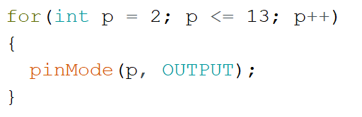
Using a for loop to improve our code:
Notes:
These two snippets are identical, but we can see that the for loop version is much more concise.
It could be easily expanded to set more pins to OUTPUT (if working with a microcontroller that had a larger number of IO pins)

Slide 8
while loop vs for loop
  When we want a loop that:
  Repeats a known number of times
  To keep track of a number that is increasing/decreasing
  A for loop is usually chosen as it is more concise.
Notes:
These two snippets are identical, but we can see that the while loop version is much more concise.
It could be easily expanded to set more pins to OUTPUT (if working with a microcontroller that had a larger number of IO pins)

Slide 9
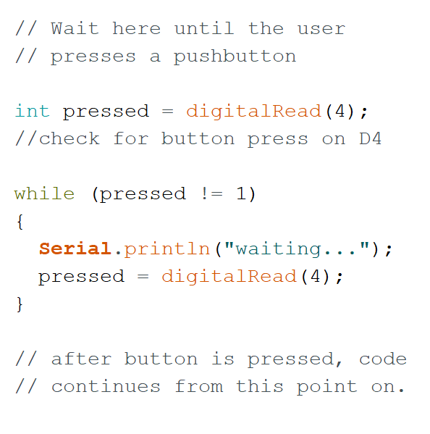
When are while loops better?
There are situations where we may want to repeat some code, but we don’t actually know how many times we’ll need to repeat!
Example: using a loop to wait for the user to press a button before carrying on with the rest of the program.
Since the amount of time this will take entirely depends on the user’s choice, it is impossible to predict ahead of time. In this case, a while loop works much better.

Slide 10
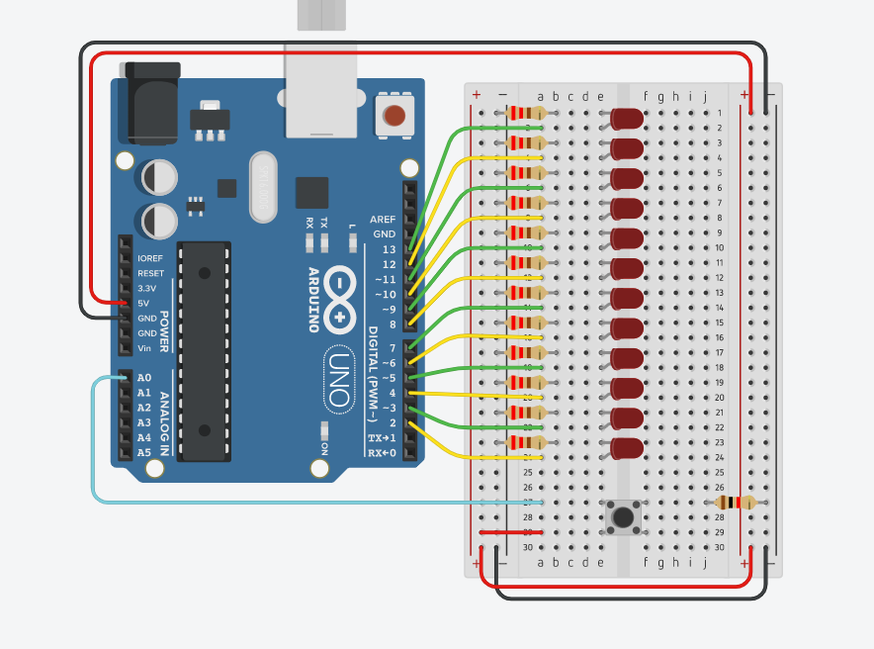
DEMO
evens|odds
Notes:
Even/Odd Demo .
Have either all even or odd LEDs on at once, button press to switch between.
Can use this as a chance to recap functions:
Create a few helper functions:
ledOn(pin) -> turn on led on this pin
ledOff(pin) -> turn off led on this pin
allOff() -> turn all leds off (pins 2-13 for this project) [loops]
evens() -> turn on all even pins [loops]
odds() -> turn on all odd pins [loops]
Test evens() and odds() individually. Test button press with Serial Monitor
Use while loop to create a loop that hangs until button is pressed. Once loop stops, switch to evens. Repeat with another blocking loop before switching to odds.

Slide 11
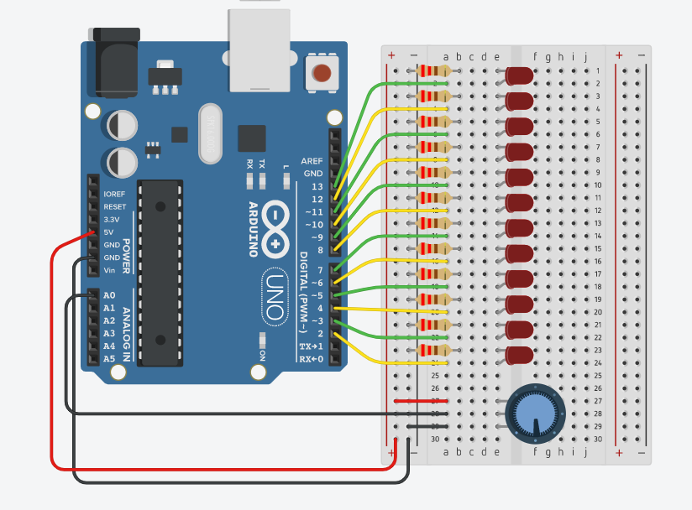
DEMO
LED chase
Notes:
LED Chase demo:
note: potentiometer instead of pushbutton
use same helper function: ledOn() ledOff()
start with delayTime variable set to constant amount (200 ms)
loop through each LED pin. For each:
turn it on
wait delayTime
turn it off
map delayTime to be analogRead into range 20-300ms
extension: change so that groups of 2 or 3 LEDs chase (instead of turning current LED off, turn position i-1 off (and account for special case of wrap-around)

