Slide 1
PWM
PULSE WIDTH MODULATION

Slide 2
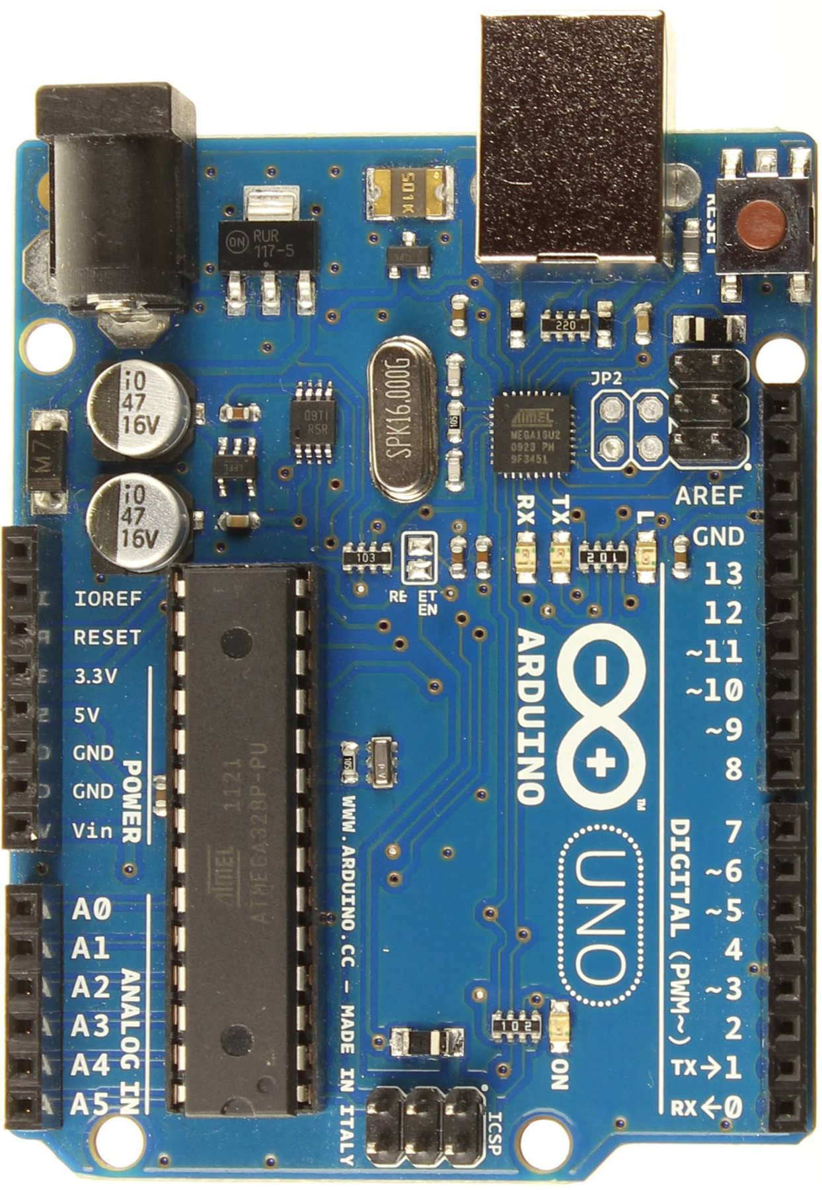
Doing more with digital pins
We’ve seen digital pins can only
read two values:
  1 – HIGH (5v)
  0 – LOW (0v)
However, if we look carefully at the pin labels, you should notice a special symbol (tilde) beside some of the numbers

Slide 3
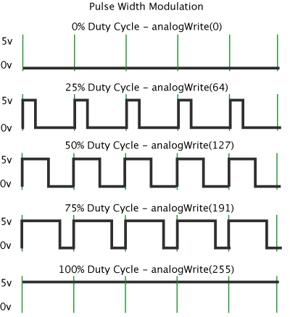
PWM
These pins (3, 5, 6, 9, 10, 11) are
pwm-enabled, meaning that we can use pulse width modulation with any wires connected to these pins.
Although digital pins can only be at a HIGH or LOW voltage state, it is possible to flip back and forth very quickly.
If we were to image a small amount of time (say 2 milliseconds), a duty cycle defines what percentage of that time the pin is at 5v.
This allows a component to behave as if it was receiving some voltage in between 0 – 5v.
Notes:
Last point: This allows a component to behave as if it was receiving some voltage in between 0 – 5v.
For Motors, this effectively is what is happening, as the motor windings have enough energy storage that the burst values are smoothed out to lesser or greater voltage depending on the duty cycle.
For LEDs, the light is flipped on/off faster than we can detect, but will be perceived as brighter or dimmer depending on the duty cycle

Slide 4
Arduino – use analogWrite()
Although its name implies it should be used for analog pins, this instruction can be used for PWM-enabled digital pins as well.
analogWrite( pin number, PWM amount )
pin number: digital pin number (must be PWM)
PWM amount: value between 0 - 255

