Slide 1
Robotics 30

Slide 2
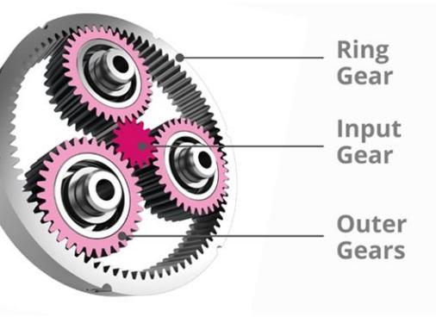
In this class, you’ll study:
Mechanisms
Design and Manufacturing
Circuits and Electronics
Coding and Logic
Projects

Slide 3


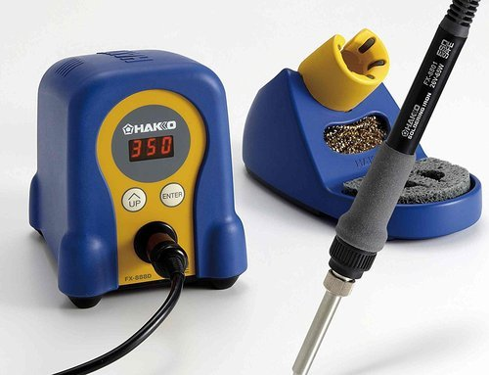


Safety

Slide 4
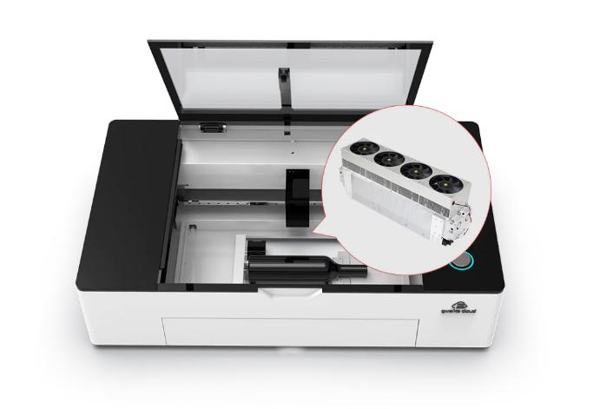
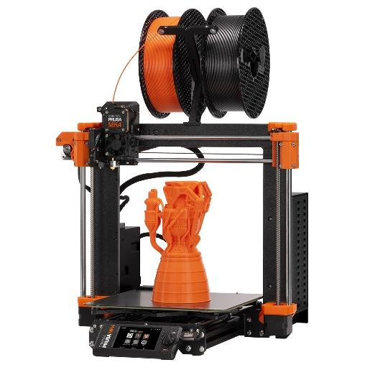
Equipment | Care and Responsibility
In this class, you’re trusted with thousands of dollars of equipment’s use
You are trusted to use this equipment in a manner that is safe for:
You
Your classmates
The Equipment
Please treat any borrowed school equipment with care so that others may use it after you!

Slide 5
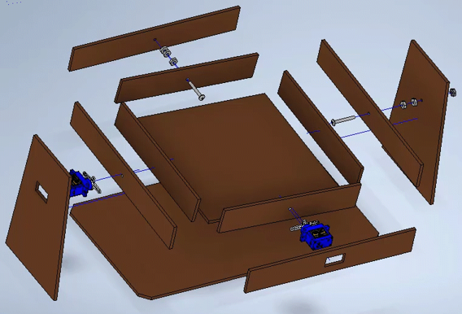
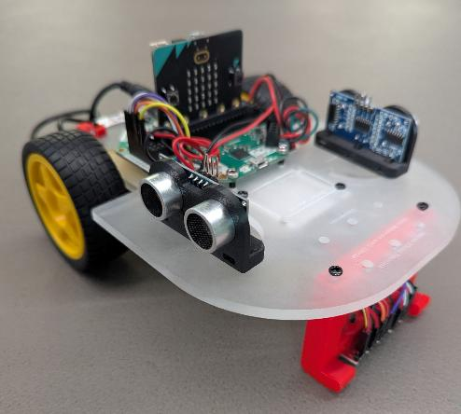

RBA20 Projects
Creative Circuit Project
Marble Maze
Micro:bit Sensor Car

Slide 6
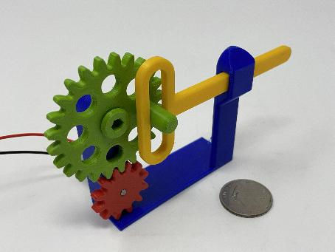
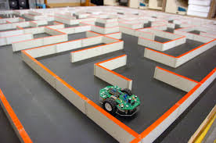
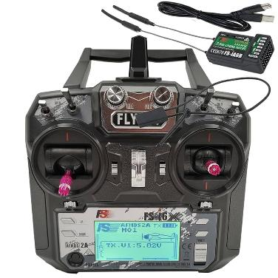
RBA30 Projects
Mechanisms Research
Autonomous Maze Solver
Teleoperated Robot
(Task Unknown…)
Student-directed individual/pair project (if time allows)

Slide 7

Here there be Dragons
As this is a pretty new course, this is in some ways uncharted territory.
I’ll be doing my best to make this an amazing class, but I’ll be relying on each of you as well!
Be present and on-time
Come with an open and interested mind
Have patience, be resilient
Be willing to help your peers

Slide 8
Grades...
This course is focused on skill development and design thinking.
I hope your motivation in the class has more to do with personal growth than the grade you get – but here is the breakdown:
RBA20
Assignments → 55% Major Projects (2-3) → 45%
RBA30
Assignments → 30% Major Projects (2-3) → 70%
- graded primarily by self-assessment

Slide 9
Lab / Workshop Rules
I don’t have many rules, but these are non-negotiable if you are to be in my class:
Computer Usage During Class time. No social media, games, sites unrelated to current class work.
No Food by Computers. Plan ahead or be patient. Bottled water only.
Don’t mess with the cords. Leave computer cables as they are. If there is an issue, call me over.
Keep your area clean(er). Please help me out by taking care of recycling and garbage in your area.
Equipment Organization. Please do your part to help keep all our equipment/components/tools organized.
If you take it out, please ensure you put it back!

Slide 10
Start.

