Slide 1
Review
TINKERCAD CORE CODING BLOCKS

Slide 2


pins as inputs
Uses I/O pin as a digital input.
Returns either:
  0 (LOW, 0v)
  1 (HIGH, 5v)
Uses I/O pin as an analog input.
Returns values in a range between:
  0 (LOW, 0v) – 1023 (HIGH, 5v)
Only pins A0-A6 can be used for analog reads

Slide 3
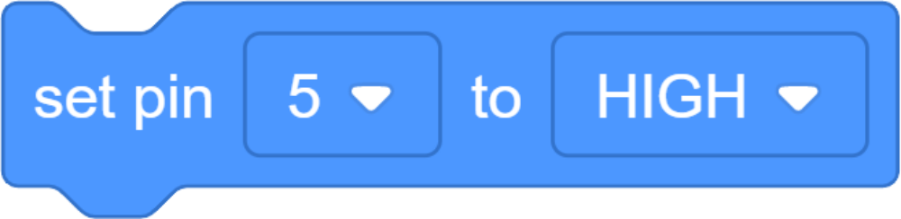

different outputs
Changes the voltage on a particular IO pin. (pin being used as an output)
Can be set to:
HIGH (5v)
LOW (0v)
Allows us to print a message to the Serial Monitor.
Essential for debugging
Can print words (strings) or numeric values

Slide 4
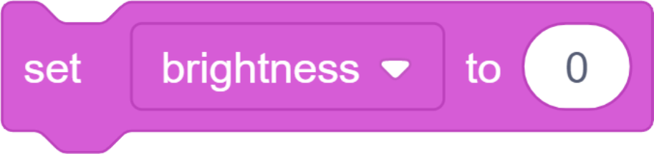


using variables
Puts a value into a variable
Also creates the variable if it hasn’t been used before
If it currently has a value, the old one is discarded to make room for the new one.
Increases the value of a variable by addition
Adds the number entered (argument) and the existing value together, and stores that new value in the variable.
Actual variable block.
Allows us to refence the value stored in the variable

