Slide 1
Comparison
TINKERCAD BLOCKS VS TEXT CODE

Slide 2
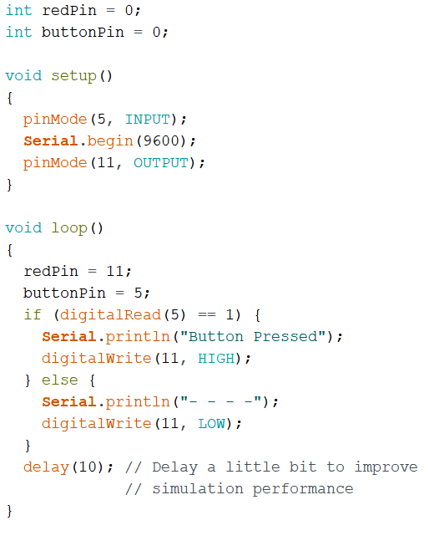
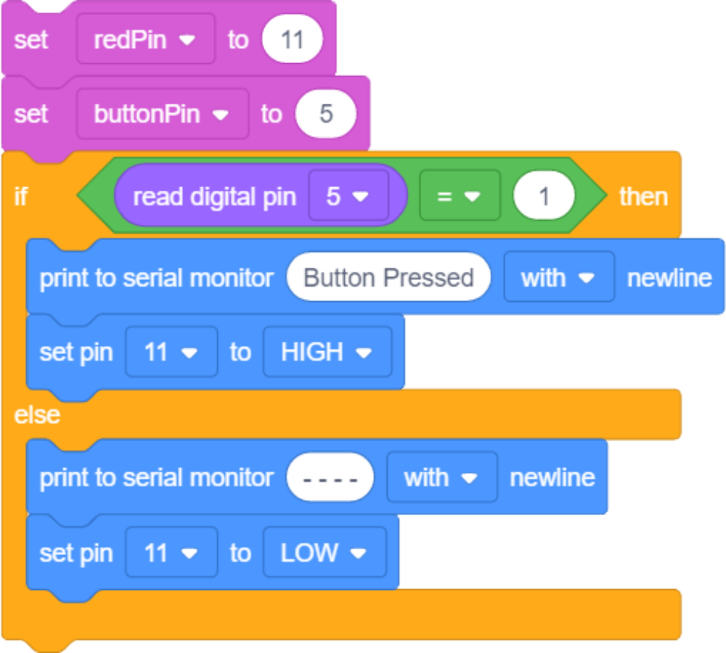
Global Variables
Setup runs once
Loop Repeats

Slide 3
Variables are often declared globally in the area above setup()
Here we are resetting the values once per loop (wasteful and unnecessary)

Slide 4
pinMode() must be set in setup() for each IO pin we will use. Either INPUT or OUTPUT
Syntax to digital read is basically the same as the block.

Slide 5
Comparisons must be inside brackets (). Equality operator is ==

Slide 6
Code to run if the condition is true is wrapped inside of script brackets.
Be very careful to make sure you match every opening bracket { with a closing one }

Slide 7
In order to activate the Serial Monitor, this line must be in setup().
9600 is a baud rate, which can be changed, but for our purposes this will be sufficient.
Serial.println() - with newline
Serial.print() – without newline

Slide 8
digitalWrite() command similar to block.
Notice inside the brackets:
(pin number, HIGH/LOW value)

