Slide 1
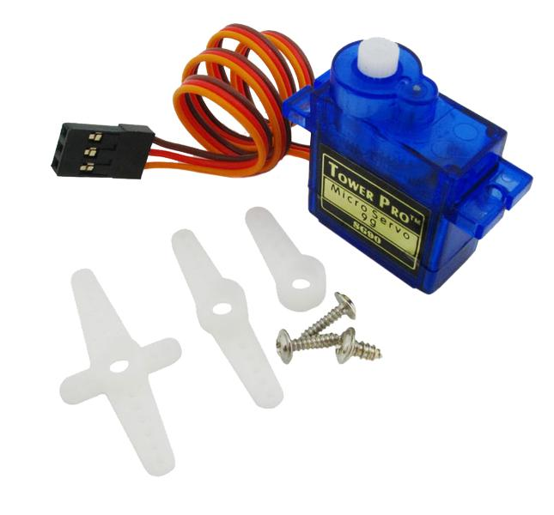
Servo Motors
QUICK INTRO

Slide 2
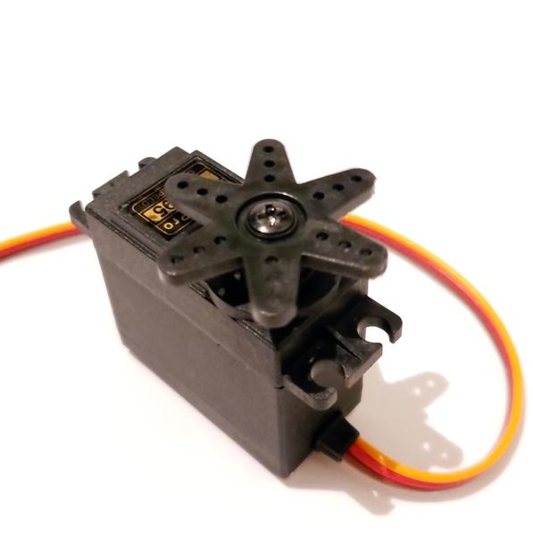
Servo Characteristics
Limited Rotational Motion
Can rotate to specific angle positions
Limited to angles 0 – 180 (typically)
  Not going to extremes helps prolong lifespan ( 10-170 )
  Servos are able to track their current position
Different styles of Servo Horn attach to the output shaft
  Allow Servo rotation to be connected to many things
If using more than 1 or 2, External Power needed.
  Servos draw a considerable amount of power.

Slide 3
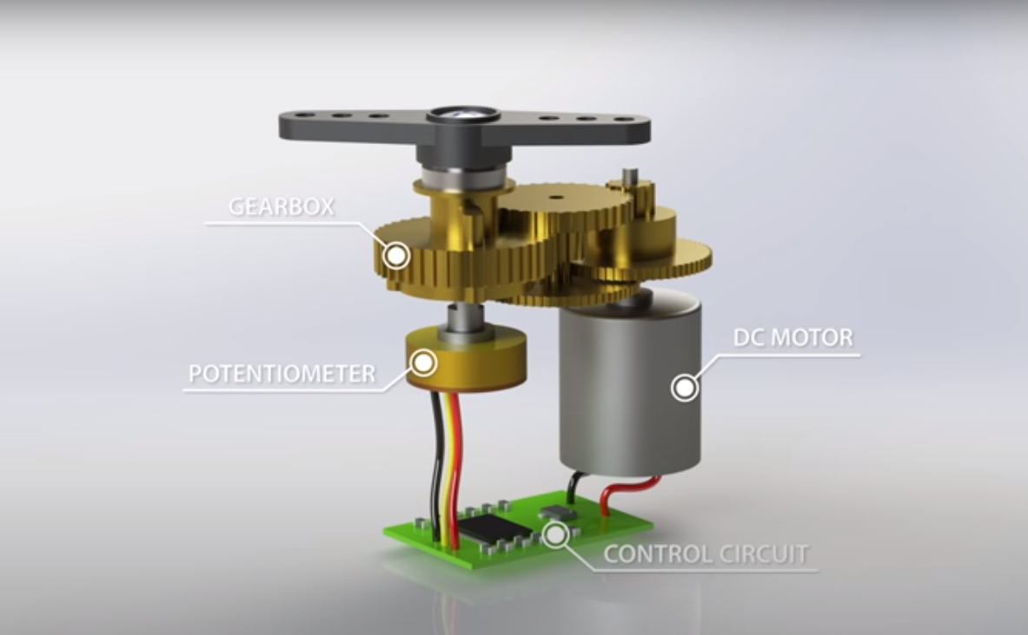
Notes:
This illustration and next are from the following How-to- Mechatronics video on Youtube.
Reference: https://www.youtube.com/watch?v=LXURLvga8bQ

Slide 4
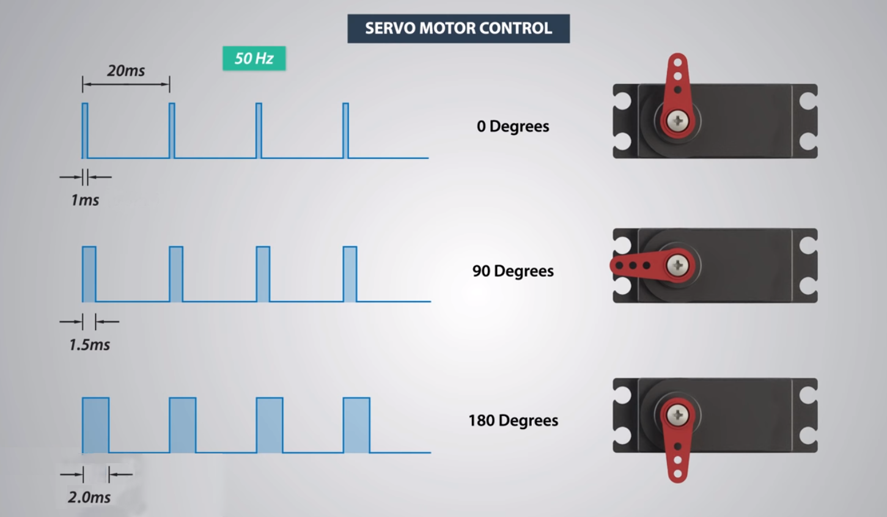
Notes:
Shows relationship between pulse timing and servo position

Slide 5
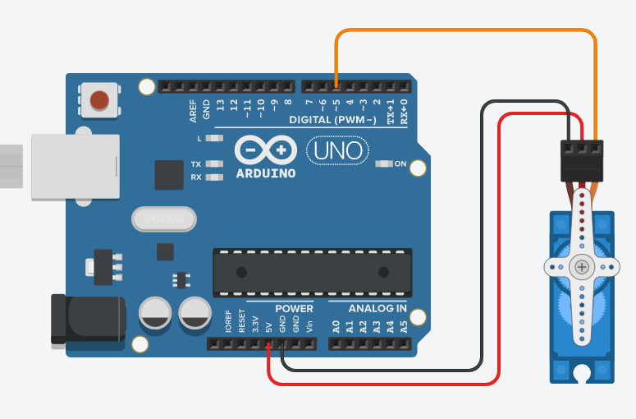
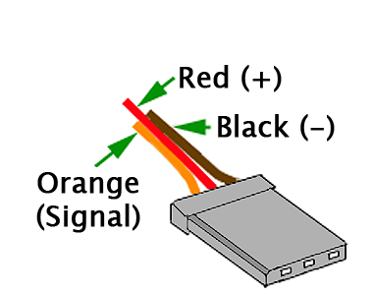
Wiring
Using Servos with the Arduino Uno has some side effects. It is not possible to analogWrite() to pins 9 or 10 when your program uses the Servo.h Library.

Slide 6
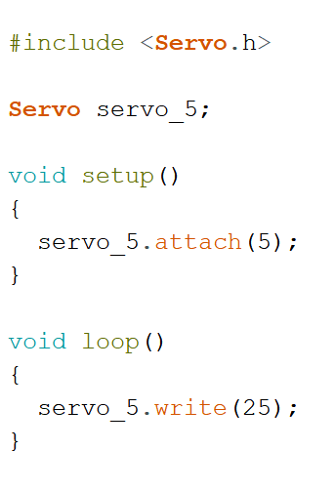
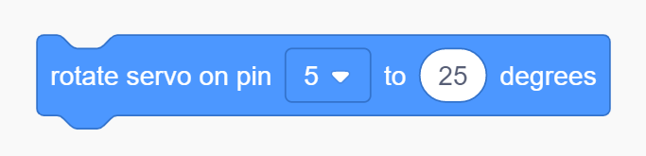
Code
Link to library file Servo.h to your code
SERVO CONTROL
create a Servo type variable. Will allow us to send instructions to Servo.
Call the .attach() function to enable a servo on a specific pin.
Any time the .write() function is called, the servo will start to move to the supplied angle position.

