Slide 1
Lezione 4 Introduction to FPGAs and Xilinx devices
Stefan Cristi Zugravel 20/01/2026

Slide 2
Early times of digital electronics

Slide 3
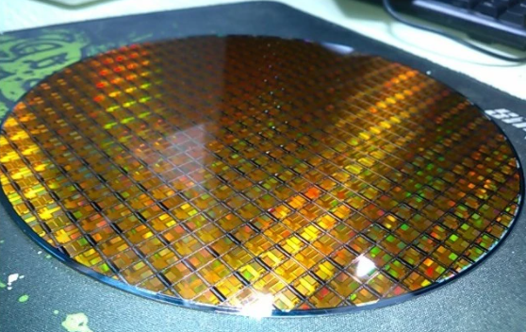
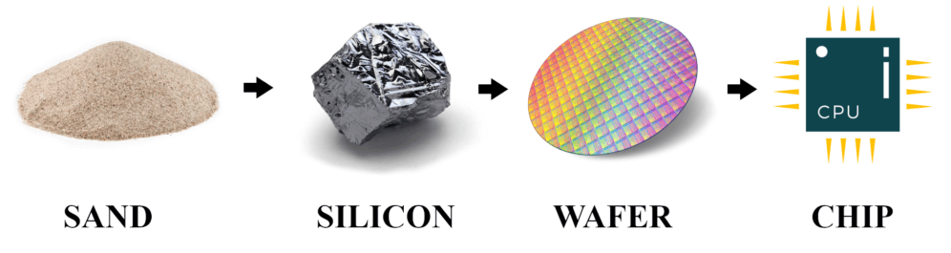
Why programmable ICs?
Producing a Chip costs much more than producing a PCB
Using one Chip on many PCBs increases Number of Chips and reduces Costs per Chip
If a Chip is programmable, it can be used on many PCBs in different situations
Producing one wafer costs ~ 10k€
Not included manpower to design wafer & packaging
Saving space on a PCB

Slide 4
What are FPGAs?
Field Programmable Gate Array
Simple:
Programmable Logic Devices
More detailed:
Programmable Logic Devices
With lot of additional function-block (e.g. RAM, DSP)
Flexible configuration
Can host microcontroller

Slide 5
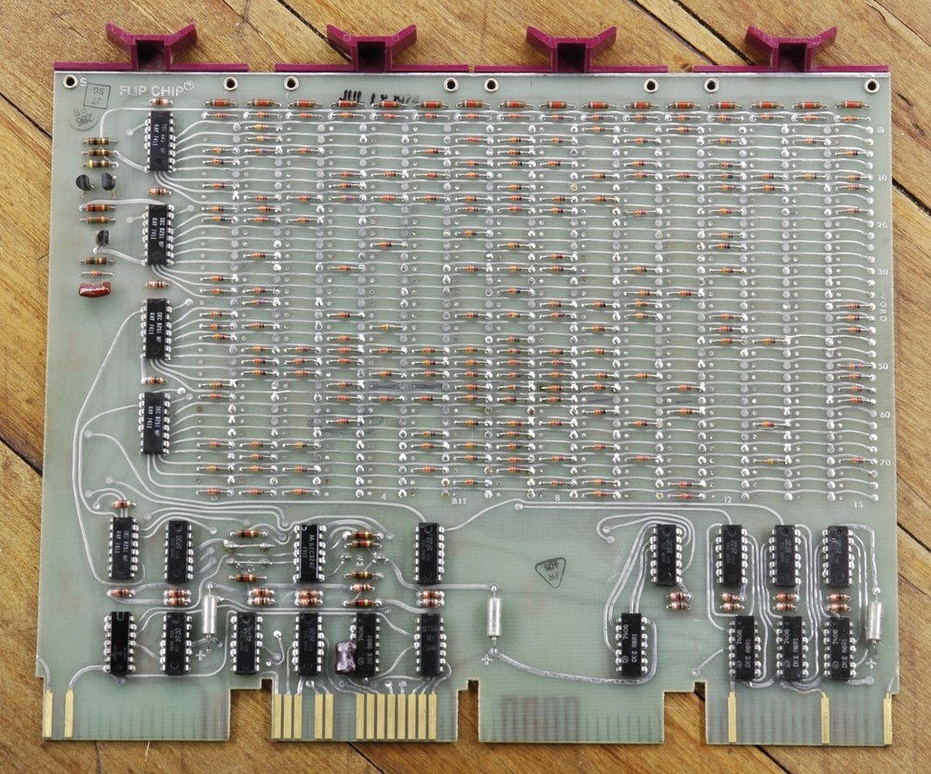
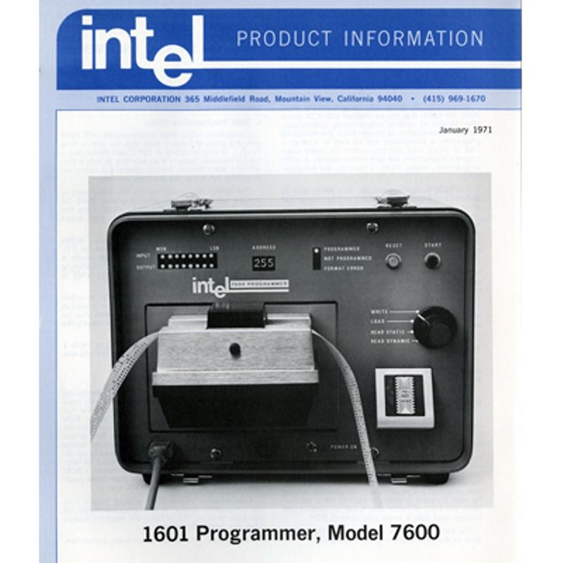
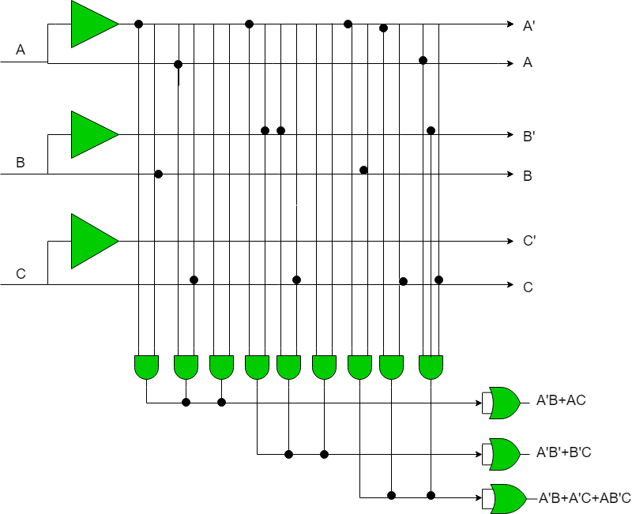
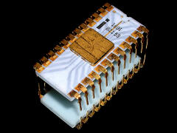
History of Programmable Logic Devices /1
1960s: Fuse Configurable Diode Matrix
First form of programmable logic
One-Time Programmable (OTP)
1971: Programmable ROM (PROM)
Logic functions stored as truth tables
Still limited flexibility and efficiency
PAL (Programmable Array Logic):
Fixed AND/OR logic structure
Programmable interconnections
OTP technology
256 x 8-bit Static/Dynamic PROM

Slide 6
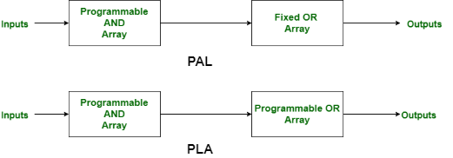
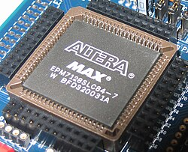
History of Programmable Logic Devices /2
1978: PLA (Programmable Logic Array)
Programmable AND plane and OR plane
CPLD (Complex Programmable Logic Device)
Multiple PAL-like blocks
In-system programmable
Configuration retained after power-off
The most noticeable difference between a large CPLD and a small FPGA is the presence of on-chip non-volatile memory in the CPLD, which allows CPLDs to be used for bootloader functions
Comparison with other Programmable Logic Devices
PLA has a programmable AND gate array and programmable OR gate array.
PAL has a programmable AND gate array but a fixed OR gate array.
ROM has a fixed AND gate array but programmable OR gate array.

Slide 7
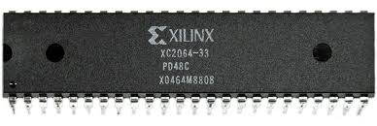
History of Programmable Logic Devices /3
1989: First Field Programmable Gate Array (FPGA)
Configurable Logic Blocks (CLBs)
Programmable routing fabric
Massive parallelism
Compared to CPLDs:
Much higher logic density
SRAM-based configuration (loaded at startup)
Ideal for complex systems

Slide 8
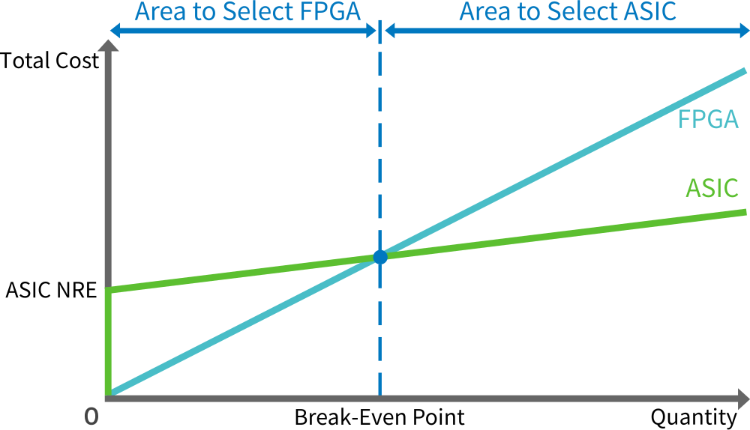
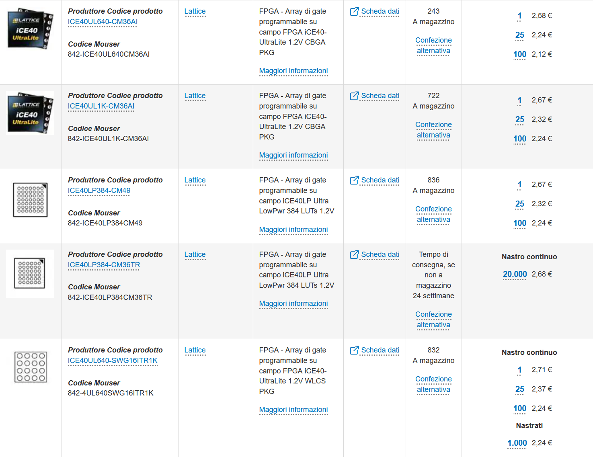
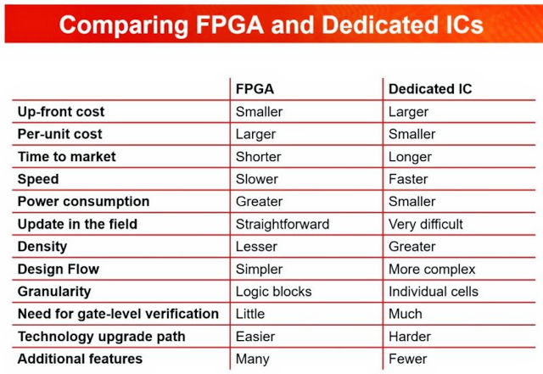
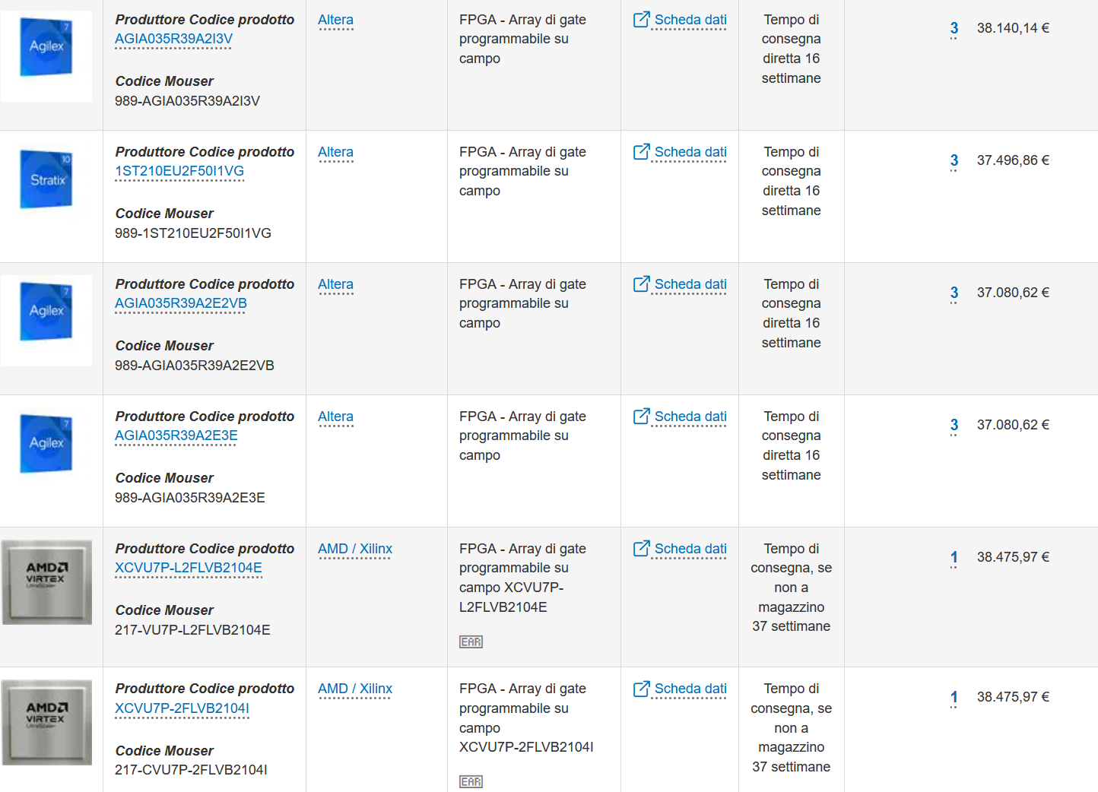
Price point

Slide 9
Fundamental FPGA components
PSM
IOB
CLB
In addition to:
PLL and clock management
Distributed memory
DSP blocks
Soft-cores (microblaze)
Hard-cores
Transceivers
Configuration logic

Slide 10
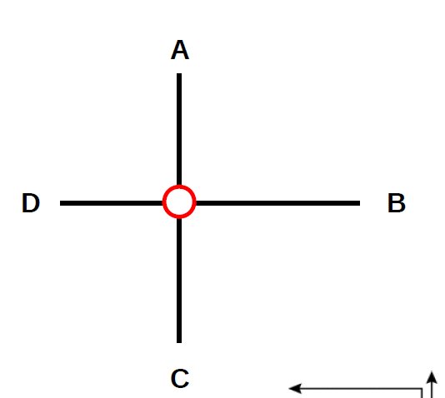
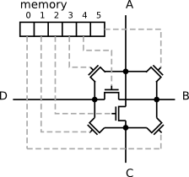
Programmable interconnections /1

Slide 11
Programmable interconnections /2
Programmable Switch Matrix

Slide 12
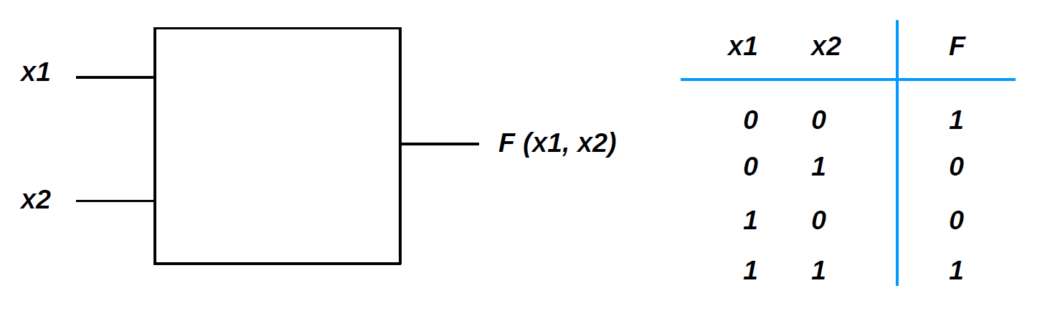
Look-up tables (LUT) /1
How to implement a 2-bit truth table (boolean logic) ?
XNOR

Slide 13
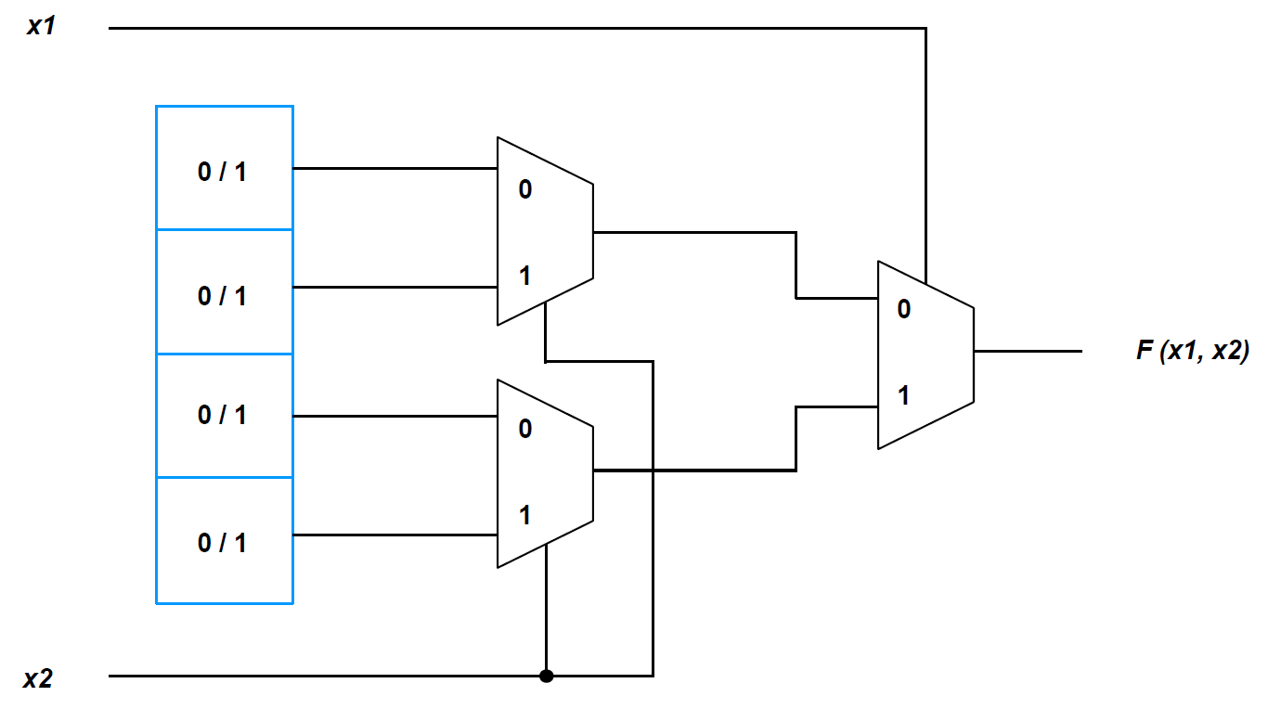
Look-up tables (LUT) /2
FPGA solution: write the truth table into a RAM !

Slide 14
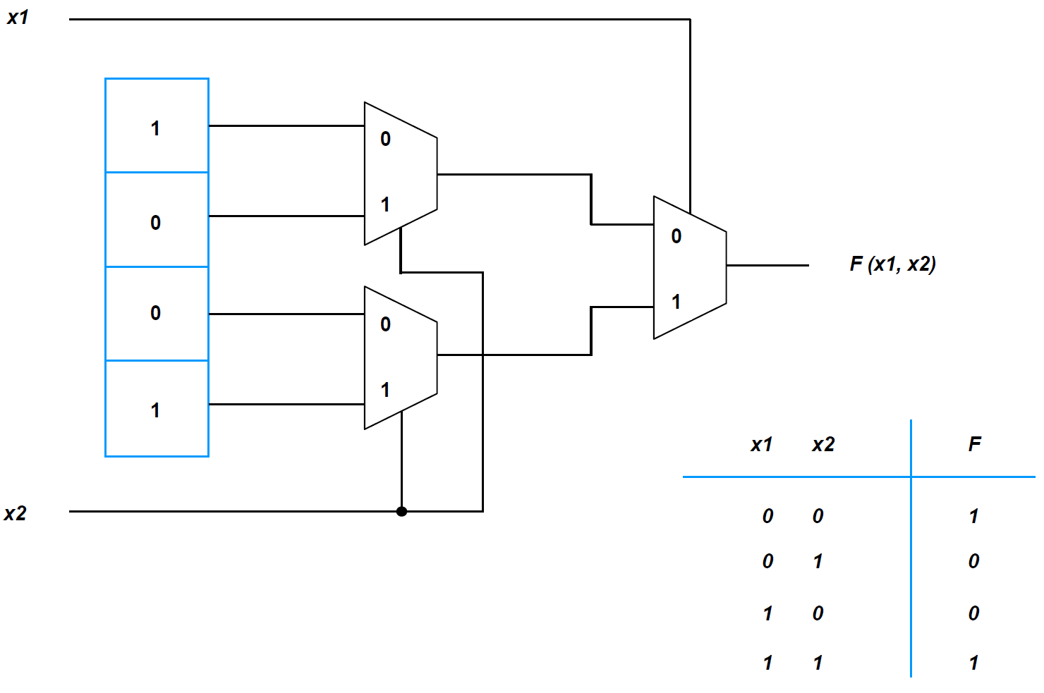
Look-up tables (LUT) /3

Slide 15
Logic Cell (LC)
Xilinx terminology :
Logic Cell (LC) = 1x LUT + 1 register (FF) + programmable MUX
LUT implemented as 6-inputs, 64-bit RAM
slice = 4x LUTs + 8 registers (FFs) + MUXs + fast-carry chain (CLA)
Congurable Logic Block (CLB) = 2x slices
Basic Element (BEL) = any device primitive
WHY?
carry-lookahead adder

Slide 16
Programmable I/O pads
I/O BLOCK
Programmable
pad

Slide 17
Xilinx FPGA line-up

Slide 18
Xilinx 7-series family comparison
Different size, number of programmable logic cells, I/O capabilities, performance and cost depending on the chosen device family :
Spartan 7 : lowest-cost, lowest-power, good I/O performance, lowest number of resources
Artix 7 : low-power, medium number of resources and I/O, good choice for DSP
Kintex 7 : best compromise between number of resources, I/O, speed, power and cost
Virtex 7 : highest system performance (resources, speed, I/O) but also largest power consumption and highest cost

Slide 19
FPGA advantages and disadvanges
Advantages
Disadvantages
Cheap
Do anything!
Super fast
Fiel programmable
Massively parallel
High I/O count
Expensive
High power
Volative / BOOT time
High pin count / BGA
Complicated
Many traps
Complex tools
Hard to chose / compare
HDL “not easy” / intuitive

Slide 20
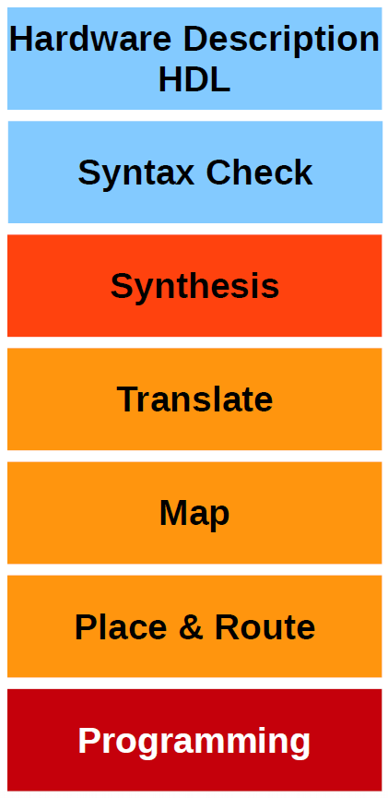
How “programming” a FPGA?
Describe what the hardware should do.
Check Syntax
“compiles” the design to transform HDL source into an architecture-specific design netlist. (connections)
Merges incoming netlists and constraints into a Xilinx design file
→ connections are merged with timing
Fits the design into the available resources
→ tell the FPGA which gate structures should be used
Places and routes the design to the timing constrains
→ decide, which gate is used for which function
Write configuration into the FPGA or configuration memory

Slide 21
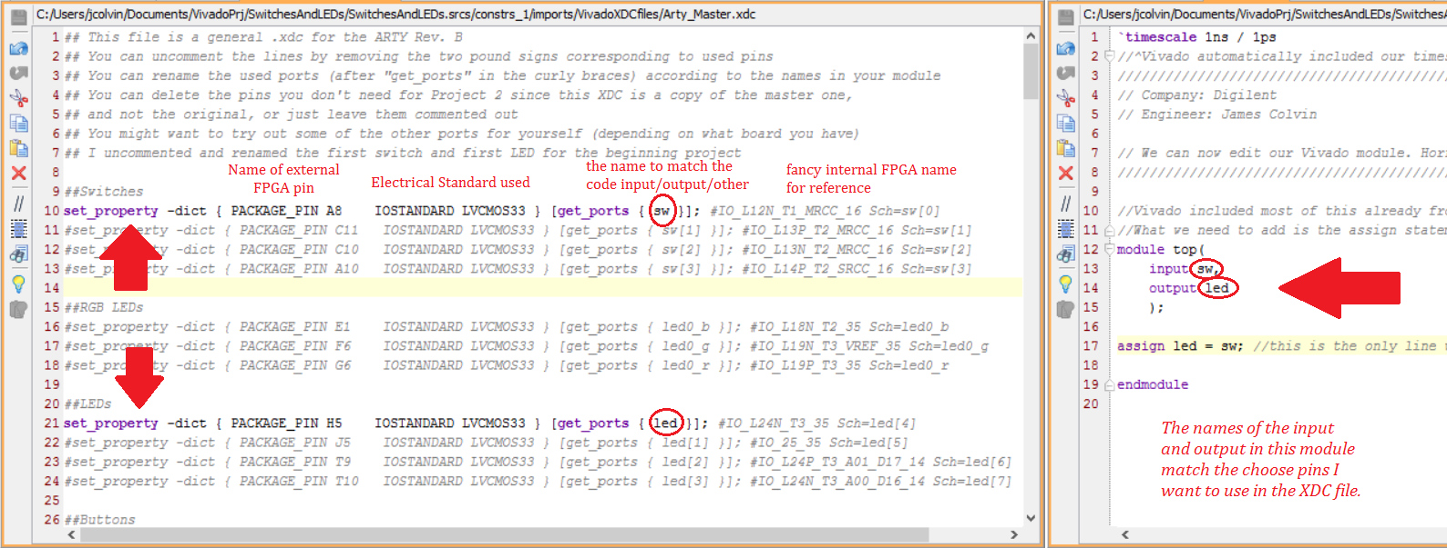
Xilinx XDC – Xilinx Design Constraints file
XDC constraints are based on the standard Synopsys Design Constraints (SDC) format. SDC has been in use and evolving for more than 20 years, making it the most popular and proven format for describing design constraints.

Slide 22
XDC key concepts
Create clock
Define clocks interactions
Set input an output pins (and delays)
Set timing exceptions
a timing constraints which is not required to be optimized for timing
The main difference between a multicycle path with many available cycles (large n) versus a false path is that the multicycle path will still be checked against setup and hold requirements and will still be included in the timing analysis.
Set False Path
Set Clock Groups
Set Multicycle Path
Set Max Skew/Set Max Delay -datapath_only

Slide 23
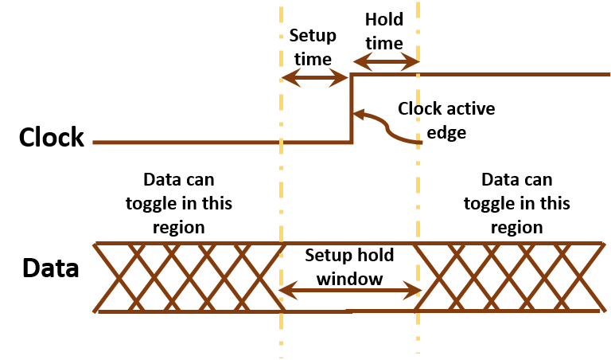
WNS TNS WHS THS
Worst Negative Slack
Total Negative Slack
Works Hold Slack
Total Hold Slack

Slide 24
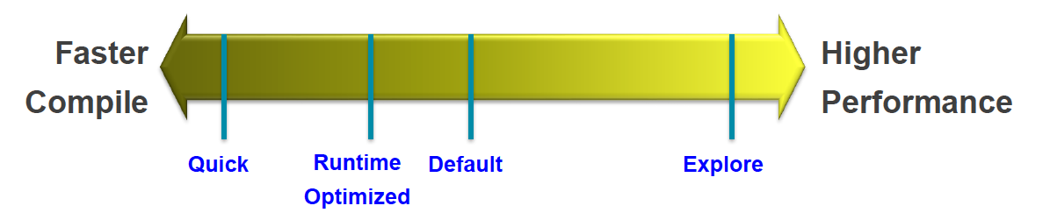
Vivado Implementation Strategies and Directives
Directive: “directs” command behavior to try alternative algorithms
Enables wider exploration of design solutions
Applies to opt_design, place_design, phys_opt_design, route_design
Strategy: combination of implementation commands with directives
Performance-centric: all commands use directives for higher performance
Congestion-centric: all commands use directives that reduce congestion
Flow-centric: modifies the implementation flow to add steps to Defaults
power_opt_design
post-route phys_opt_design

Slide 25
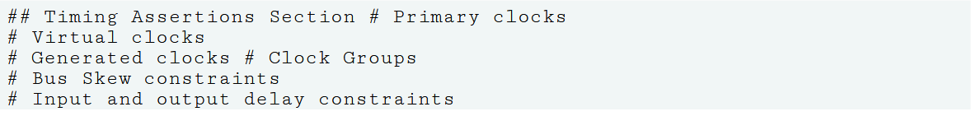
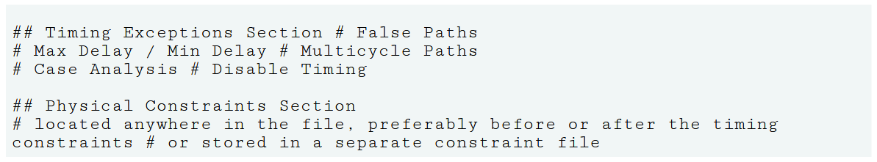
Recommended Constraints Sequence

Slide 26
Example: Digilent Arty-A7 evaluation board
Device: Xilinx Artix-7

