Slide 1
Lezione 2 Spice simulation
Stefan Cristi Zugravel 15/01/2026

Slide 2
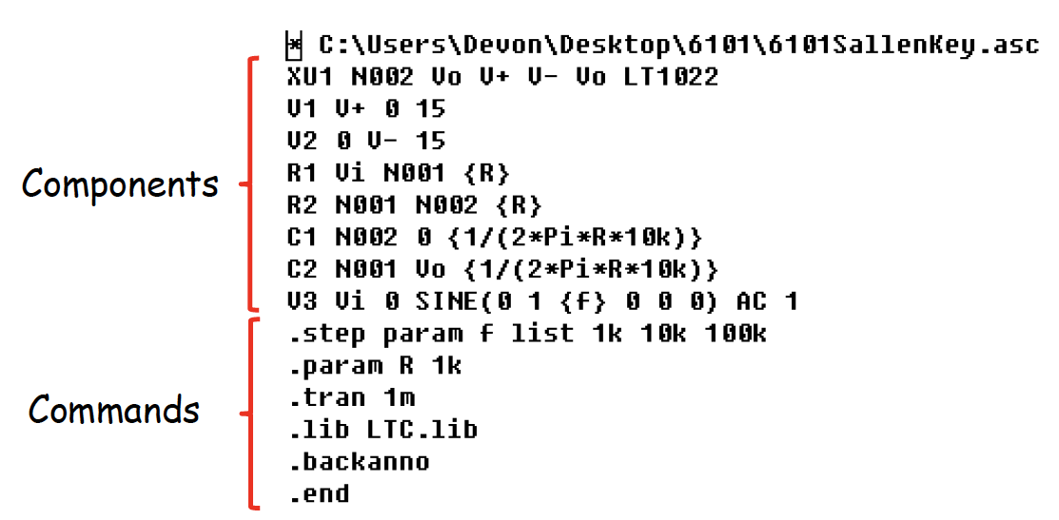
What is SPICE?
Simulation Program with Integrated Circuit Emphasis
Developed in 1973 by Laurence Nagel at UC Berkeley’s Electronics Research Laboratory
Dependent on user defined device models

Slide 3
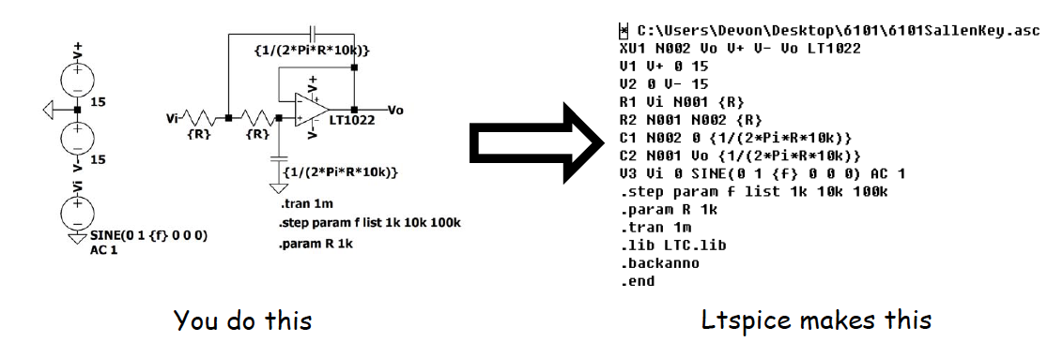
LTspice
Developed in 1998 at Linear Technology Corporation
GUI, simulator, and schematic -> netlist for SPICE
FREE and comes with tons of models
Linear Technology was acquired by Analog Devices in 2017

Slide 4
What Should My Circuit Do?
The very first step to any simulation is to know how your circuit should behave.
Simulation is a verification tool NOT A CIRCUIT SOLVER.
So how should this circuit behave?

Slide 5
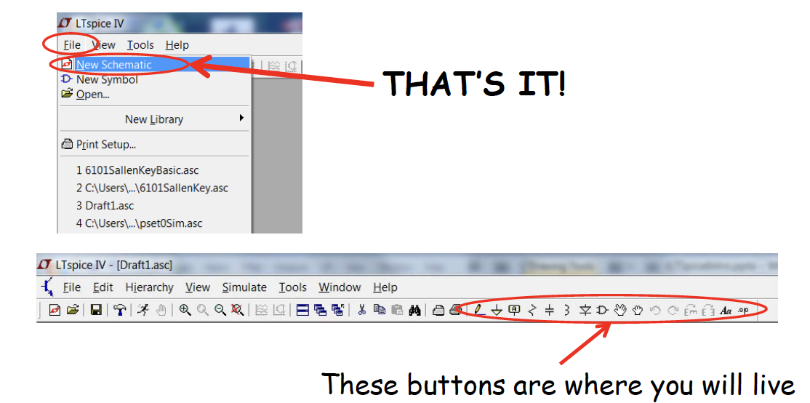
Getting Started

Slide 6
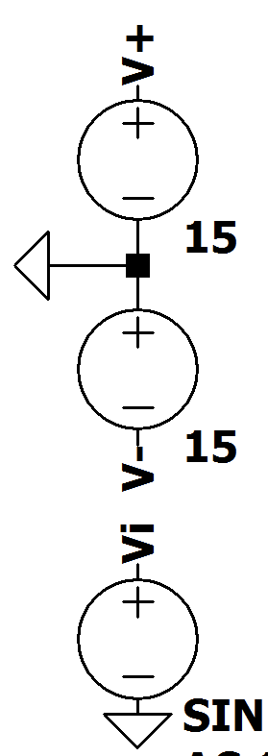
Net Labels
By labeling nets you can avoid a giant mess of wires.
Always use these for at least your power supplies.
When you start making large circuits, your power supplies will provide energy all over your schematic.

Slide 7
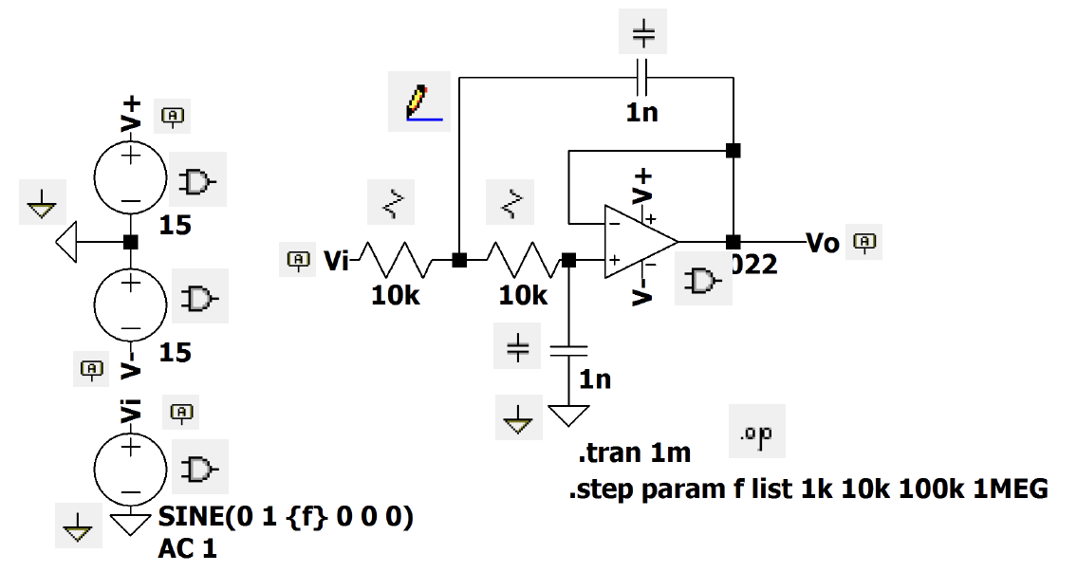
Component to Menu Item Matchup

Slide 8
Simulation: DC Operating Point Analysis (.op)
“The DC operating point analysis calculates the DC voltage and current of each node in the steady state of the electronic circuit.”

Slide 9
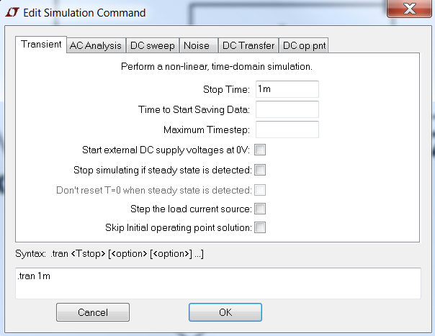
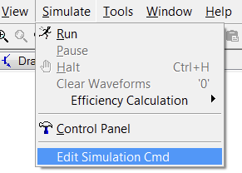
Simulation: Transient (.tran)
This is all you really need

Slide 10
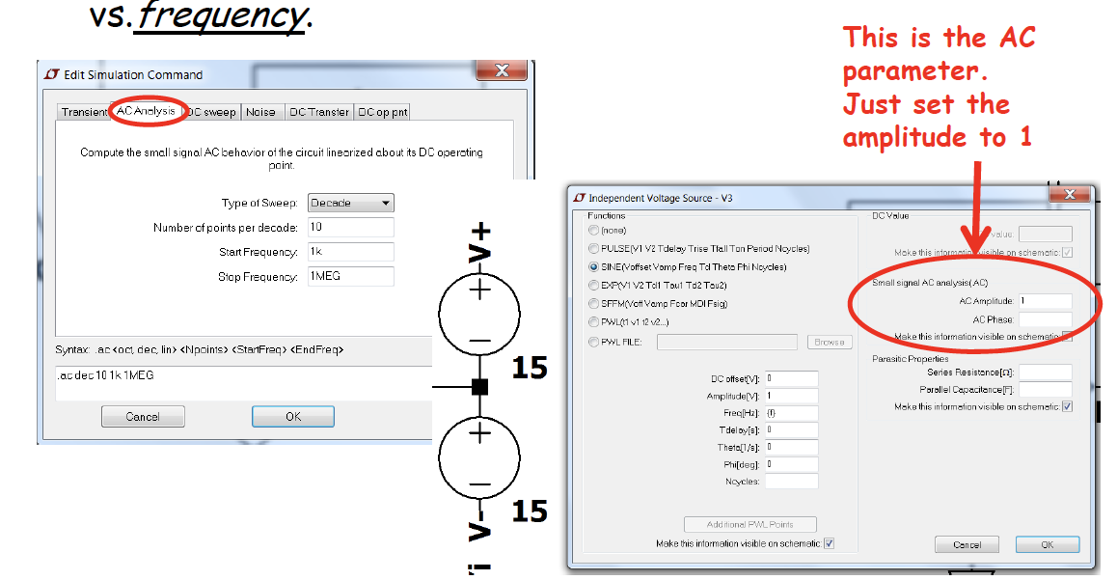
Simulation: AC (.ac) - 1
“The small signal analysis results are plotted in the waveform viewer as magnitude and phase over frequency.”
AC simulation gives Voltage and/or Current vs.frequency.

Slide 11
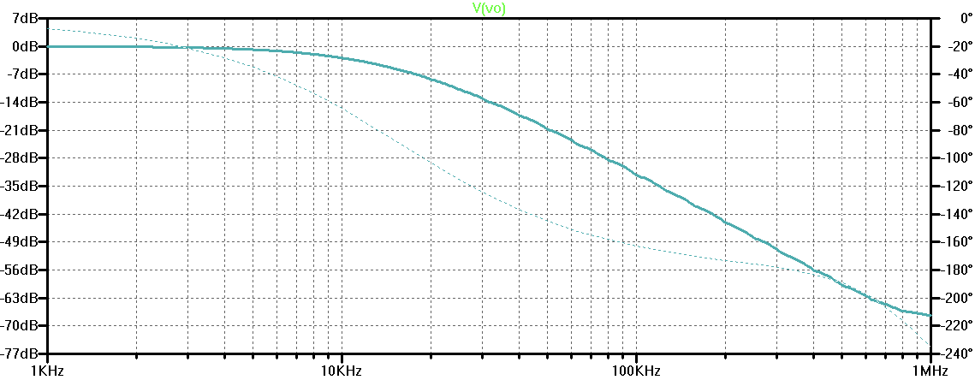
Simulation: AC (.ac) - 2

Slide 12
Simulation: AC (.ac) - 3
Small-signal AC analysis:
Does not simulate time-domain waveforms
Does not show distortion or clipping
Does not handle large input swings
Does not model switching behavior
When you set AC: 1 V it is not really 1 V, it is symbolic

Slide 13
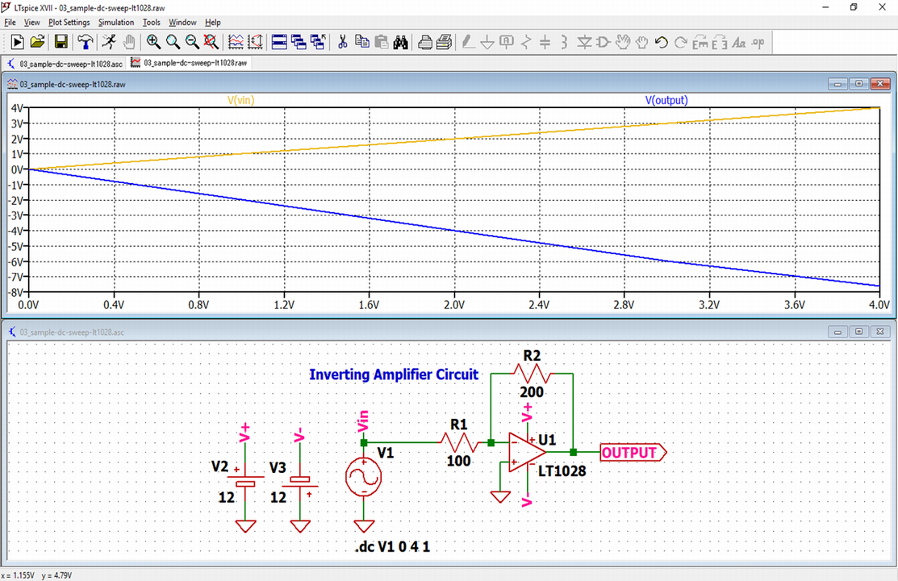
Simulation: DC Sweep (.dc)
DC sweep analysis sweeps the DC voltage of the input signal of the electronic circuit.
It is used to analyze DC characteristics of diodes, transistors, op amps and so on.

Slide 14
