Slide 1
Labs
Stefan Cristi Zugravel 22/01/2026

Slide 2
Lab 0 Keypad PCB with KiCAD

Slide 3
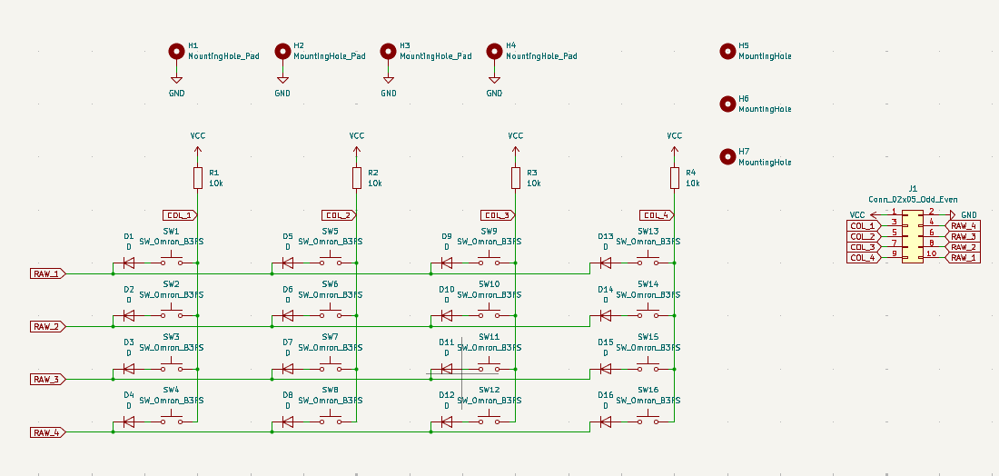
Schematic

Slide 4
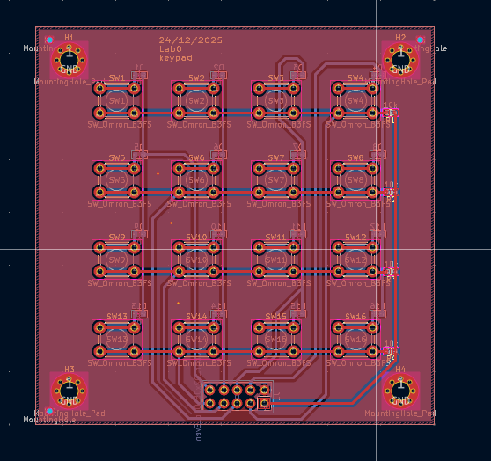
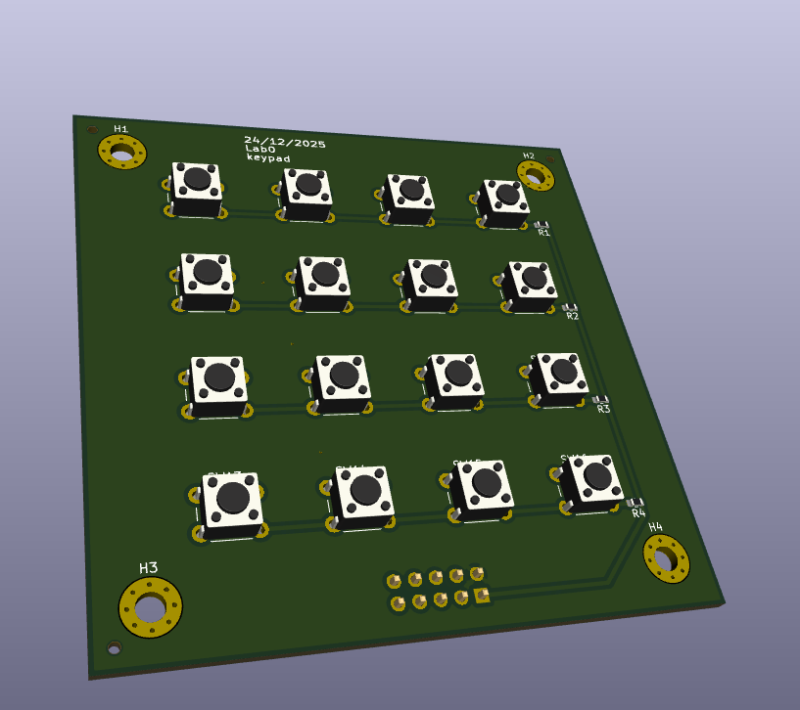
Layout

Slide 5
Lab 1 Current sensing PCB

Slide 6
Block Diagram

Slide 7
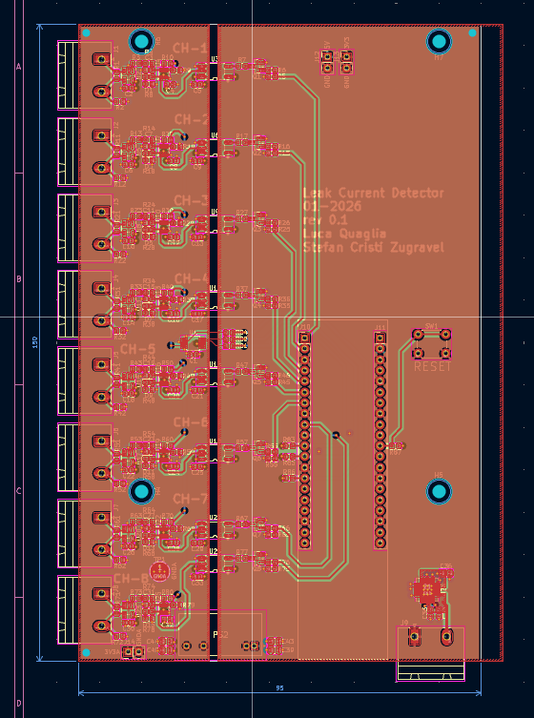
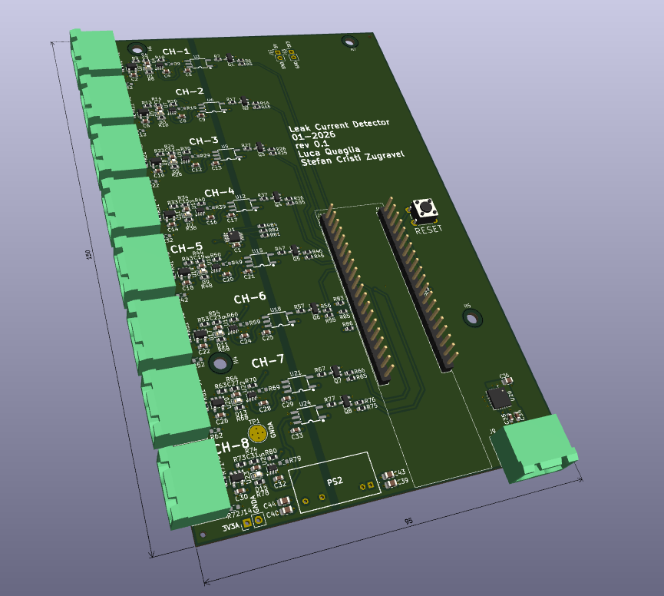
Layout and 3D model

Slide 8
Lab 2 Insert an FPGA in your PCB (quick preview)

Slide 9
Lab 3 Inverter, logic gates and mux in VHDL

Slide 10

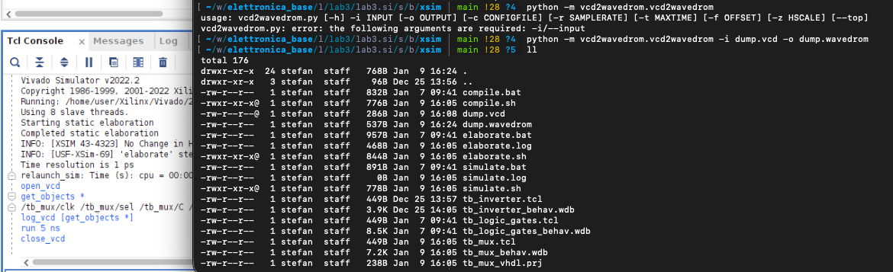

Slide 11
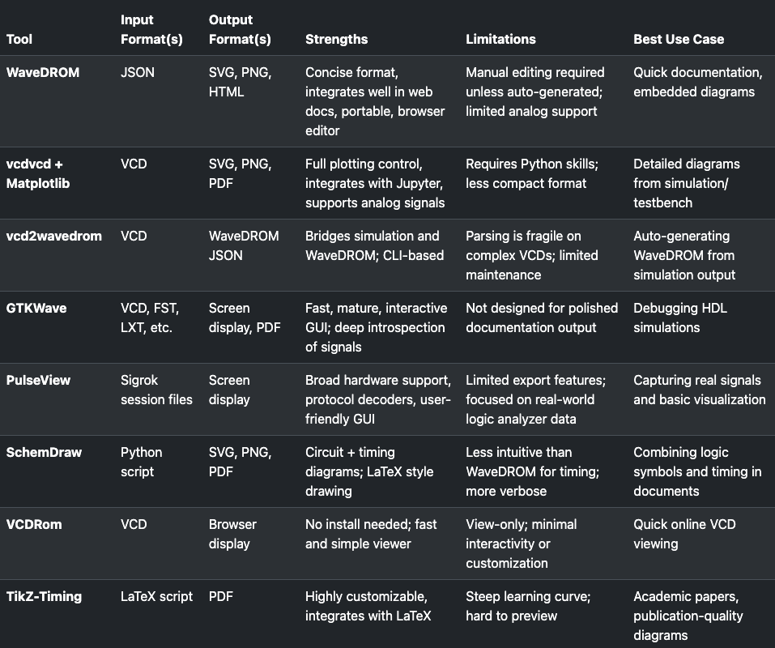

Slide 12
Lab 4 Length tuning and de-skewing in KiCAD

Slide 13
Lab 5 BCD counter in VHDL and differnt ways of dividing clock

Slide 14
Lab 6 LTspice labs

Slide 15
Lab 7 FIR filter and DDS compiler using FPGA

Slide 16
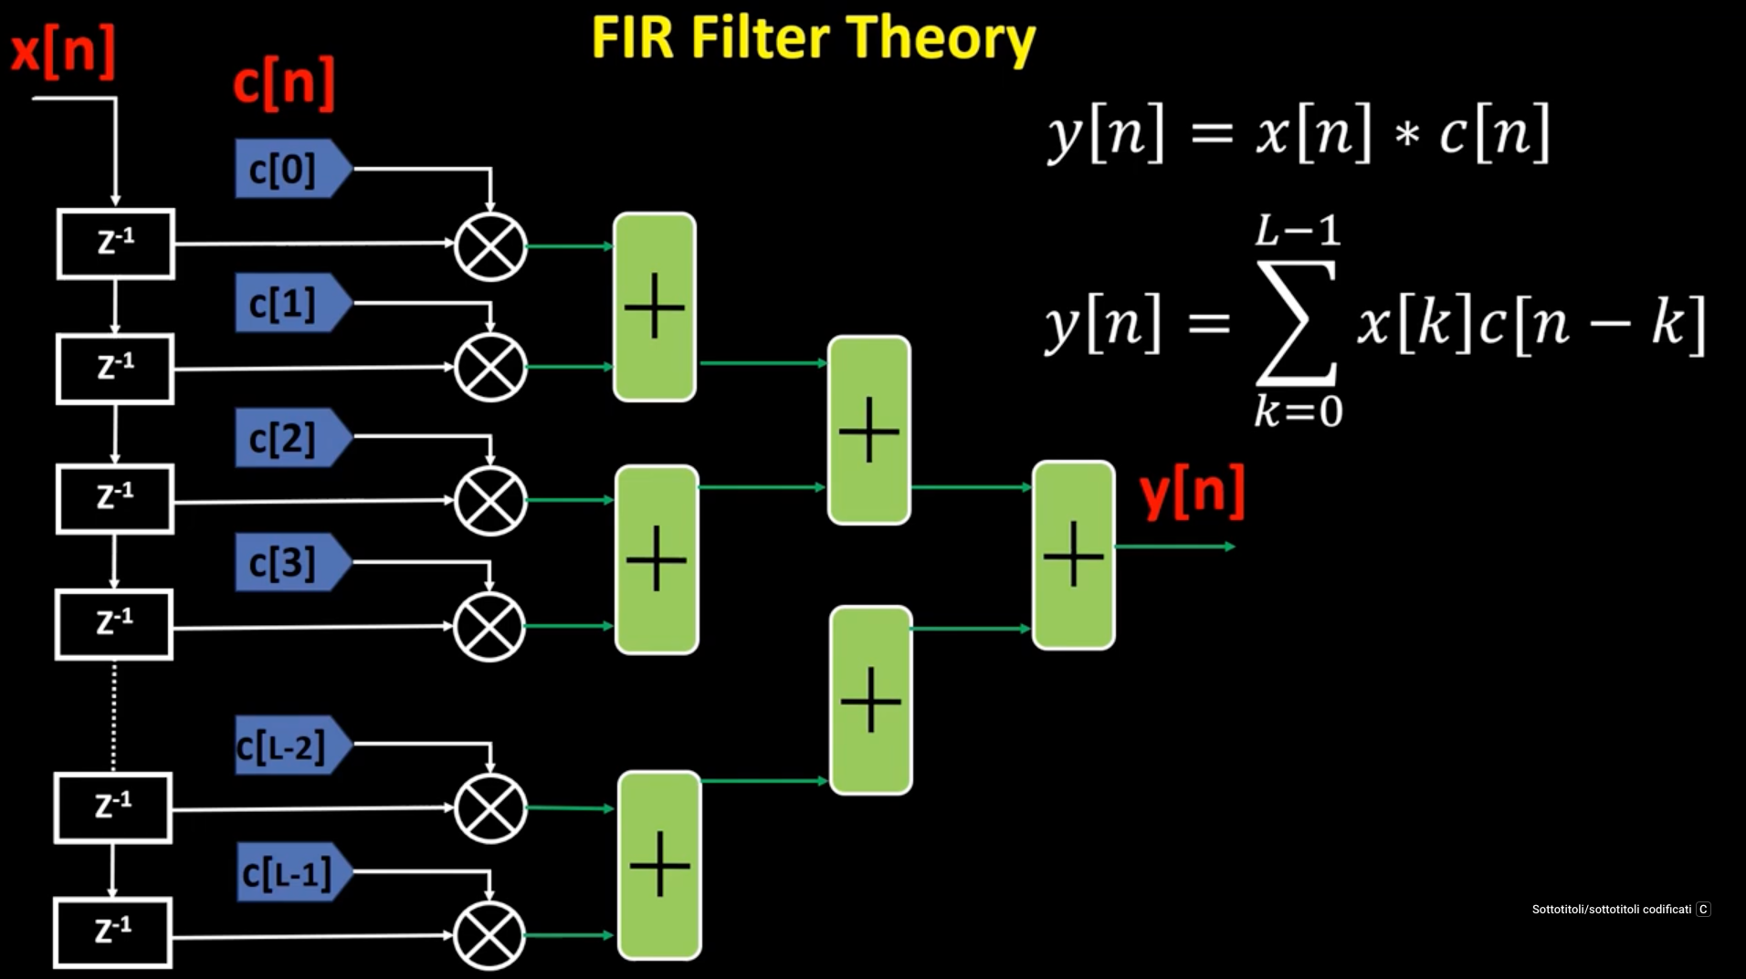
The filter architecture

Slide 17
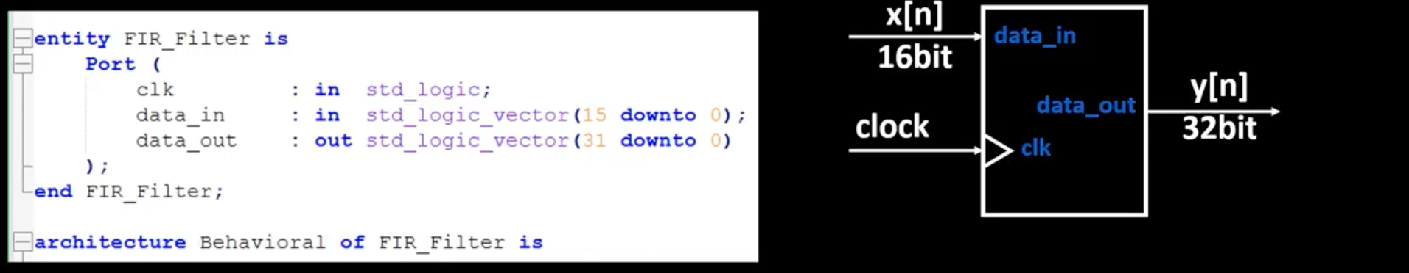
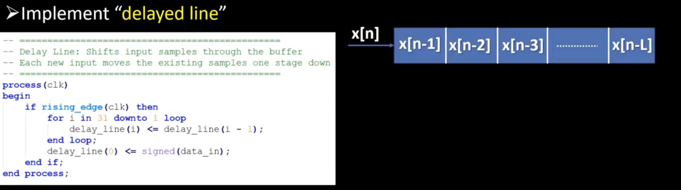

Slide 18
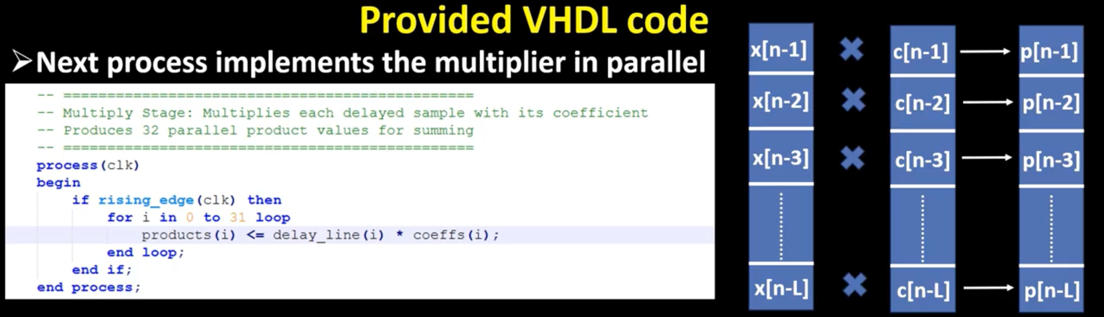

Slide 19
Lab 8 FPGA PWM controller used for LED breathing effect

Slide 20
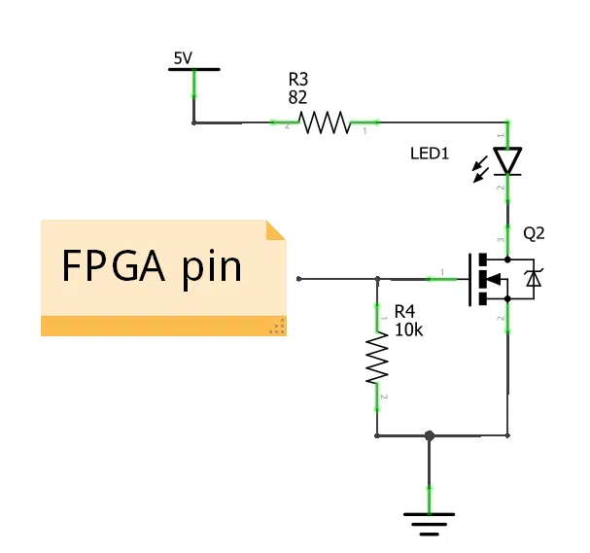
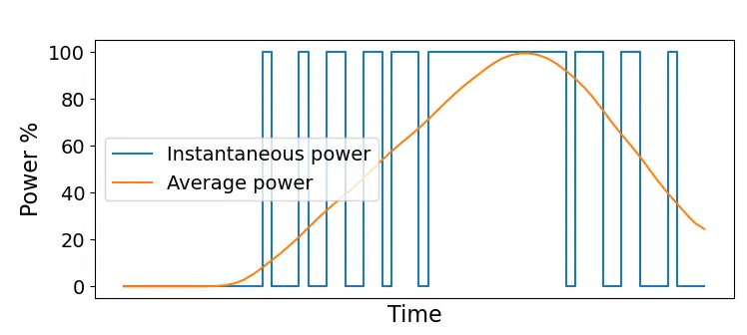

Slide 21
