Slide 1
Lezione 3 Digital systems & VHDL
Stefan Cristi Zugravel 19/01/2026

Slide 2
Digital systems
analog signals :
continuous in both time and amplitude
usually a voltage v(t) or a current i(t) as a function of time
reach of information (e.g. frequency spectrum, FFT)
digital signals :
usually continuous in time but discrete in amplitude
only two possible values e.g. high/low voltage levels, true/false, on/ff, closed/open etc.
less information, but more robust against noise
can be either asynchronous signals or synchronous signals

Slide 3
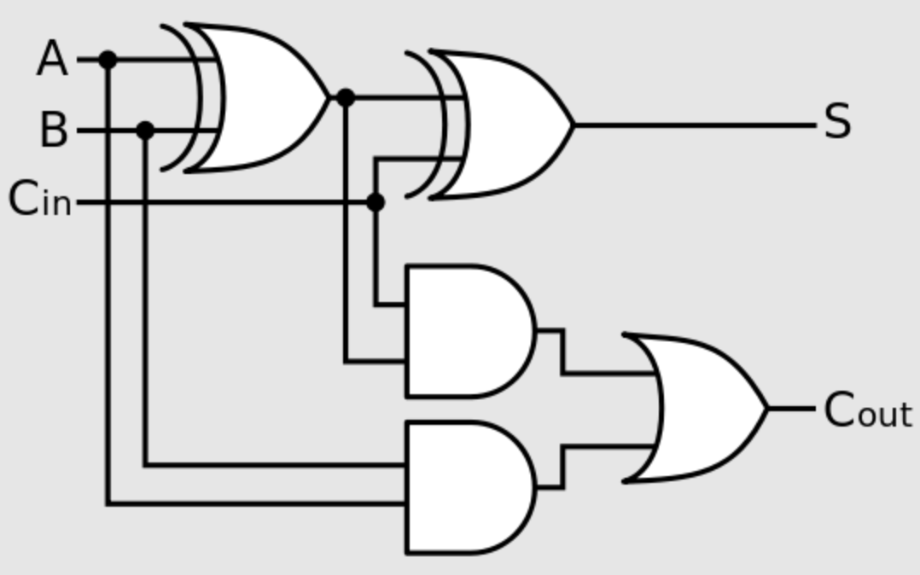
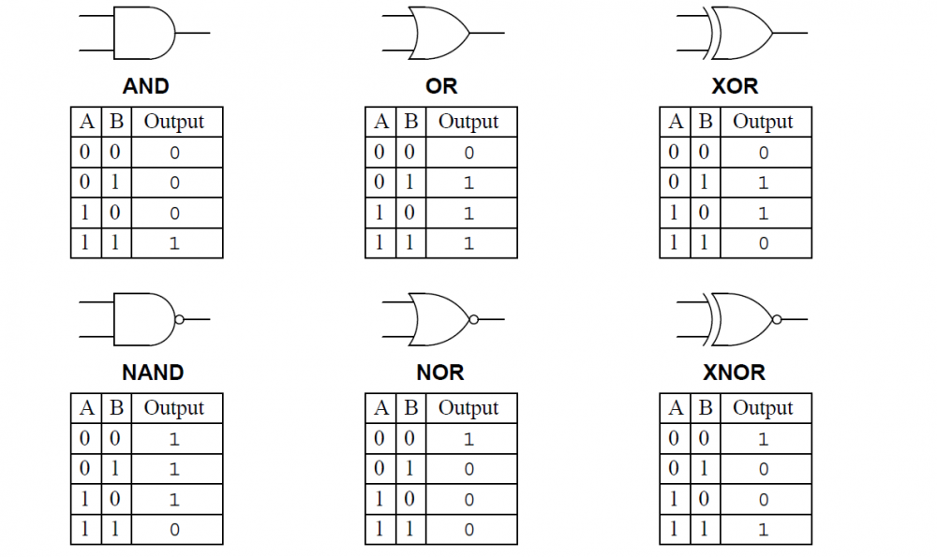
Classification of digital circuits
Digital circuits are classified as :
combinational circuits
sequential circuits
asynchronous
synchronous

Slide 4
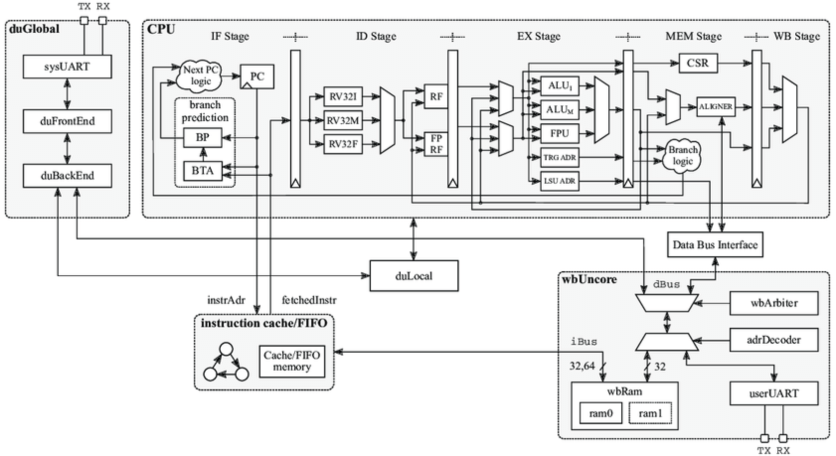
Hardware Description Languages (HDL)

Slide 5
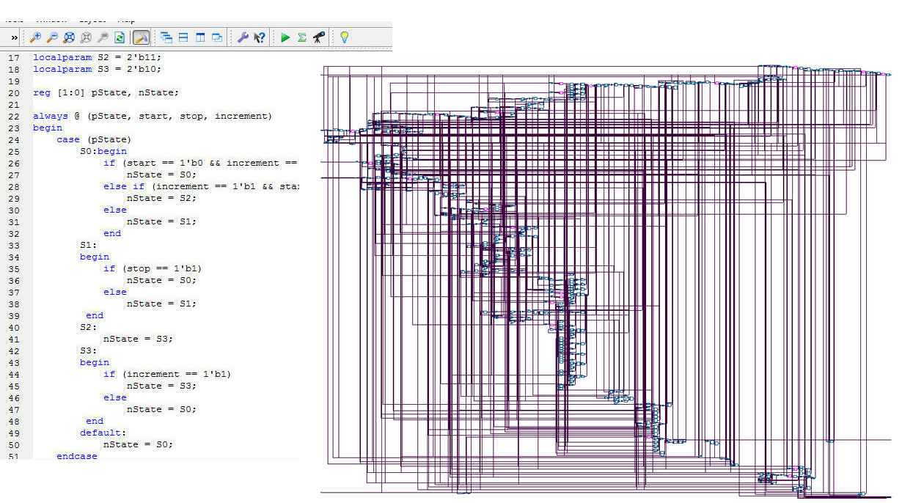
Hardware Description Languages (HDL)
COMPLEX digital system (e.g. micro-processor) are designed and simulated writing code!
a SYNTHESIS tool generates the real HARDWARE for you !

Slide 6
Hardware Description Languages (HDL)
Hardware Description Languages (HDLs) :
they are NOT "programming" languages !
provide constructs for both implementation (describe the functionality of digital circuits) and verification (simulations, assertions etc.)
synthesis ( first step of modern digital design
"synthesizable" constructs are only a minimal subset of the full language
Two main options on the market :
VHDL
Verilog
advanced options :
high-level synthesis (HLS) using C/SystemC
SystemVerilog
analog and mixed-signal simulations (Verilog-A, Verilog-AMS, VHDL-AMS)

Slide 7
VHDL
VHDL = VHSIC-HDL (Hardware Description Language)
VHSIC = Very High Speed Integrated Circuit
born in 1983 as a project from US Department of Defense (DoD)
syntax derived from the ADA programming language (similar to PASCAL) as requested by DoD
initially foreseen as a language used to describe and simulate digital integrated circuits
later used also for digital synthesis
1987: first standardization as IEEE Std. 1076-1987 (aka "VHDL 87")
1993: first major revision of the language as IEEE Std. 1076-1993 (aka "VHDL 93")
2008: second major revision of the language as IEEE Std. 1076-2008 (aka "VHDL 2008")
provides constructs for both physical implementation (synthesizable) and simulation
very reach syntax
extremely verbose and strongly typed !

Slide 8
Verilog
created by P. Goel, P. Moorby, C.L. Huang and D. Warmke between late 1983 and early 1984
syntax derived from the C programming language
introduced by Gateway Design Automation, later purchased by Cadence Design Systems in 1990
born as a verification language for logic designs, intended to describe and simulate digital integrated circuits similar to VHDL
initially a proprietary and closed language owned by Cadence
later released by Cadence as an open language in order to cope with the increasing popularity of VHDL (already standardized by IEEE in 1987)
1995: first standardization by IEEE as IEEE Std. 1364-1995 (aka "Verilog 95")
2001: first major revision of the language with extensions and new language features known as IEEE Std. 1364-2001 (aka "Verilog 2001")
2006: second major revision with minor changes as IEEE Std. 1364-2006 (aka "Verilog 2006")
finally merged as a sub-set of the SystemVerilog HDL as IEEE Std. 1800-2009

Slide 9
Verilog vs. VHDL
Verilog and VHDL are the two most widespread HDLs in the world :
approx. 50% market each one
Verilog more popular in US and Japan, VHDL in Europe
Verilog more used (and integrated with professional CAD tools) to design Application-Specific Integrated Circuits (ASICs)
traditionally VHDL more used for FPGA programming instead
both equally and well supported by Xilinx
exception: gate-level timing simulations only supports Verilog netlists
individual preference, usually mostly historical (that is, first language learned...)
Verilog is easier to learn (C-like syntax), but also potentially more error-prone due to its relaxed data typing
that is... you can make real disasters on silicon with Verilog, while using VHDL is pretty impossible
starting alone from scratch... learn VHDL first, then move to Verilog once really annoyed with VHDL "verbose" coding

Slide 10
Digital simulators
Many different digital simulators available on the market.
From the "big threes" :
QuestaSim (the professional version of ModelSim) by Mentor (now Siemens)
Xcelium (legacy Incisive) by Cadence
VCS by Synopsys
Integrated with FPGA programming suites :
XSim as part of the Vivado design suite by Xilinx
ISim as part of the legacy ISE design suite by Xilinx
ModelSim Altera as part of the Quartus design suite by Altera (now Intel)
Other solutions :
Aldec HDL by Aldec
open source simulators ( FreeHDL, Icarus, GHDL etc,)

Slide 11
VHDL fundamentals

Slide 12
Case sensitivity, statements, white spaces
VHDL is case insensitive (on the contrary, Verilog is case sensitive) :
every VHDL statement is terminated with a semicolon ;
VHDL is also not sensitive to blanks (white spaces) between statements and empty lines are ignored by the compiler

Slide 13

Comments
in VHDL comments starts with two dashes :
VHDL lacks the possibility to quickly comment large sections of code (on the contrary, Verilog provides C-style block-comments enclosed within /* and */)
always put a lot of appropriate comments to document your code !

Slide 14
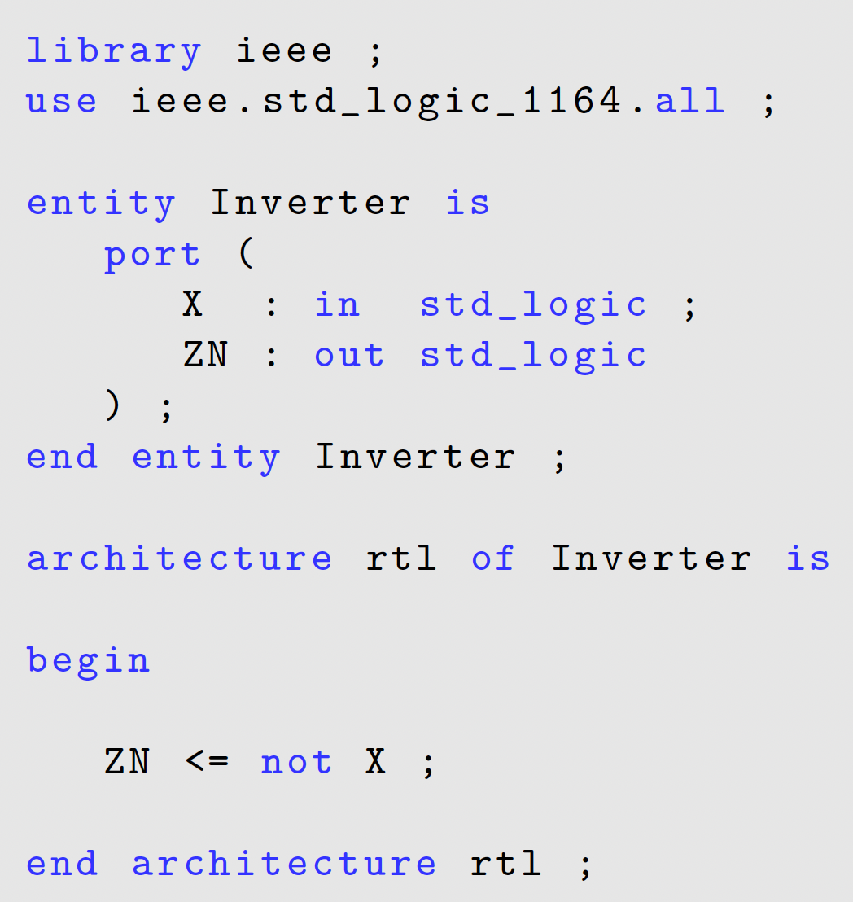
VHDL core elements
libraries and packages
import all useful data types and functions
ENTITY declaration
interface of the digital block
optional parameters
ARCHITECTURE declaration
actual implementation of the block

Slide 15
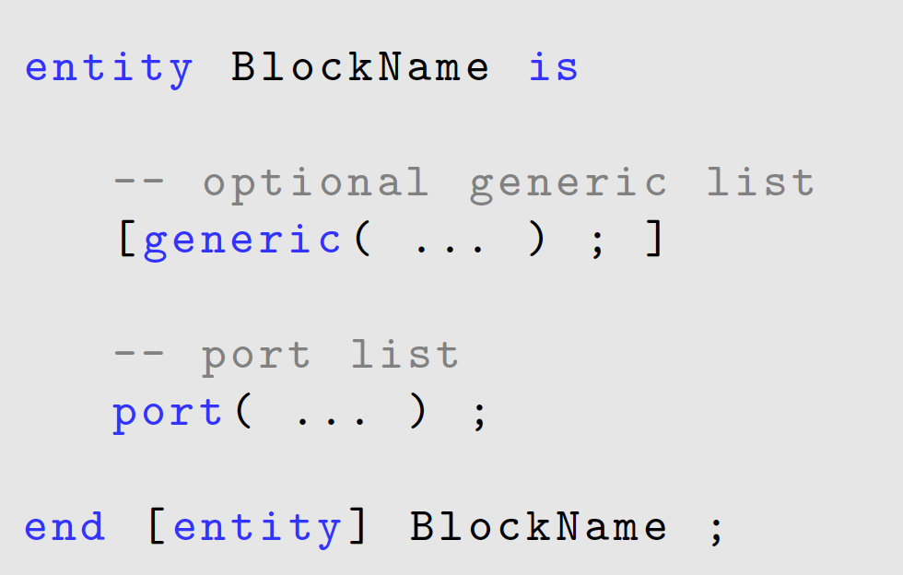
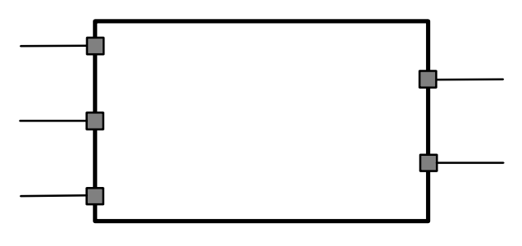
Entity declaration
Any digital block implementing some functionality in VHDL is called entity :
the VHDL entity has I/O ports that can be declared as :
in
out
inout
buffer
optionally, the block can also include parameters (generics)

Slide 16
Port list
Input ports :
Output ports :
Inout (bidirectional) ports :

Slide 17
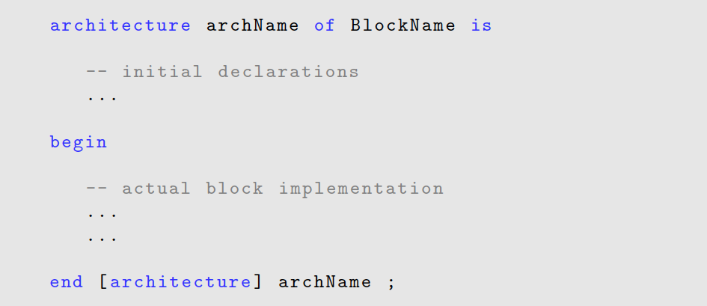
Architecture declaration
The actual block implementation is coded in the architecture instead :

Slide 18
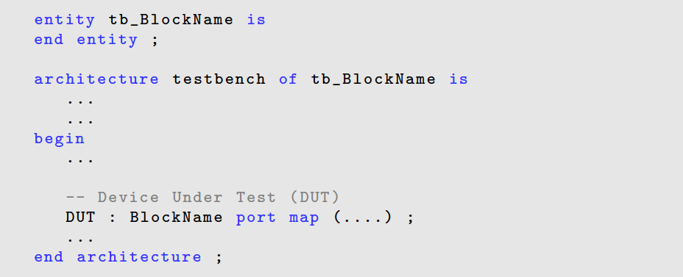
Testbench
In order to simulate the functionality of the digital block we also need a testbench that generates stimuli fed to input ports of our Device Under Test (DUT):
The module under test is always instantiated inside the testbench module, which contains non-synthesizable code.

Slide 19
VHDL data types

Slide 20
Logic constants
Fundamental logic constants in VHDL are ‘1’ and ‘0’ :
single quotes for 1-bit (scalar) logic constants
double quotes for multiple-bits (buses) logic values

Slide 21
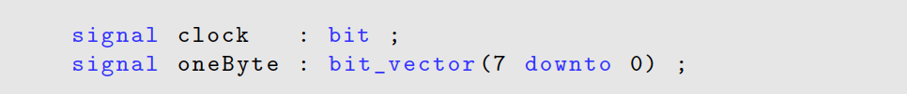
Built-in logic values
original VHDL-87 logic values :
bit for 1-bit (scalar) signals
bit_vector for multiple-bits (buses) signals
unresolved data types…..
not enough to describe actual digital circuits ! (e.g. high-impedance for 3-state buffers)

Slide 22
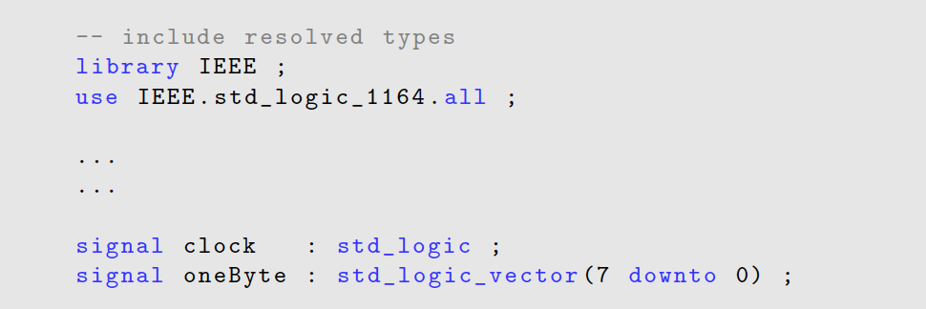
Extended logic values
1 logic one
0 logic zero
Z high-impedance
U uninitialized (sim. only)
X unknown (driven)
- don't care
H weak high
L weak low
W weak signal
extended VHDL logic values :
std_logic for single-bit signals
std_logic_vector for multiple-bits signals (buses, see later)
require external library as defined by IEEE Std. 1164

Slide 23
Buses and endianess
Most Significant Bit (MSB) vs. Least Significant Bit (LSB)
the ordering of bits within a multi-bit string is referred to as endianess
big endian :
little endian :

Slide 24

Sum between vectors (counting…)
In order to use the + operator between std_logic_vector you must use specific libraries:
IEEE.std_logic_unsigned
IEEE.numeric_std
IEEE.std_logic_unsigned is now DEPRECATED since:
despite the prefix IEEE they are NOT IEEE standard, but Synopsys proprietary !
since 1995, IEEE defines numeric types and arithmetic functions in the standard package numeric_std to outline a true standard approach for use arithmetic operator with synthesis tools

Slide 25
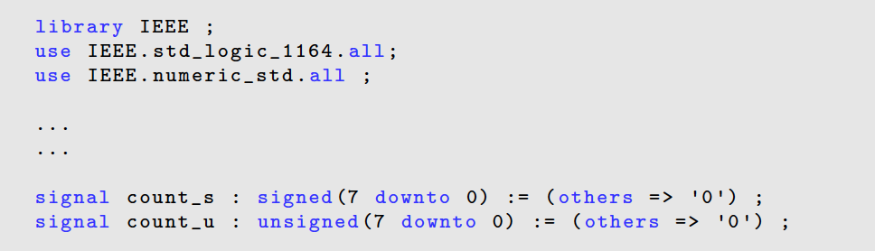
Signed/unsigned vectors
Extension of std_logic_vector :
signed
unsigned
The IEEE.numeric_std provides also provides functions to perform type-casting :
<= std_logic_vector( <unsigned signal> )
<= std_logic_vector( <signed signal> )

Slide 26
Binary codes
"straight" binary (the usual "power of 2")
Gray code
thermometer
one-hot / one-cold
Many many others : e.g. Hamming (for SEU protection)

Slide 27
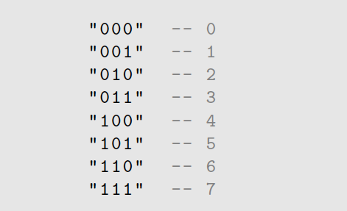
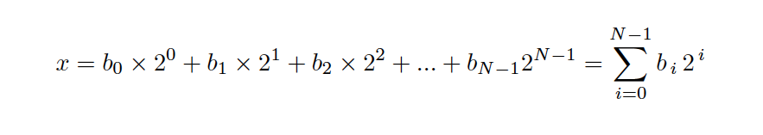
Straight binary code
Usual binary strings interpreted as usual as "power of 2" integer numbers :

Slide 28
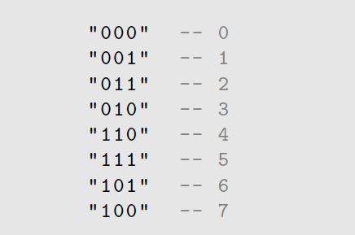
Gray code
Only one bit change from a code to the next one :

Slide 29
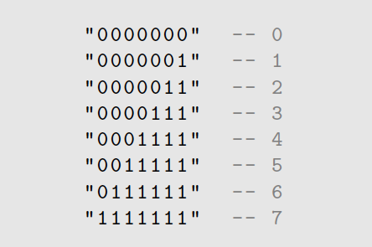
Thermometer code
Continue to "padd" the code with a 1 on the right :

Slide 30
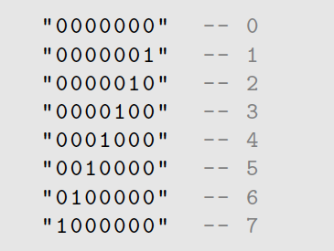
One-hot code
Only one bit set to one, then moving to the left :
The complementary is sometimes called "one cold"

Slide 31
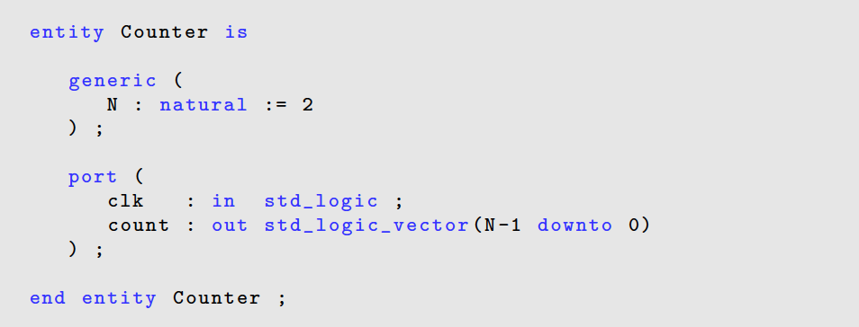
Integer numbers
VHDL provides 32-bit integer numbers, can be signed or unsigned :
integer
natural
positive

Slide 32
Real
real 64-bit double-precision real numbers :
Example :
Useful for Real-Number Modeling (RNM)

Slide 33
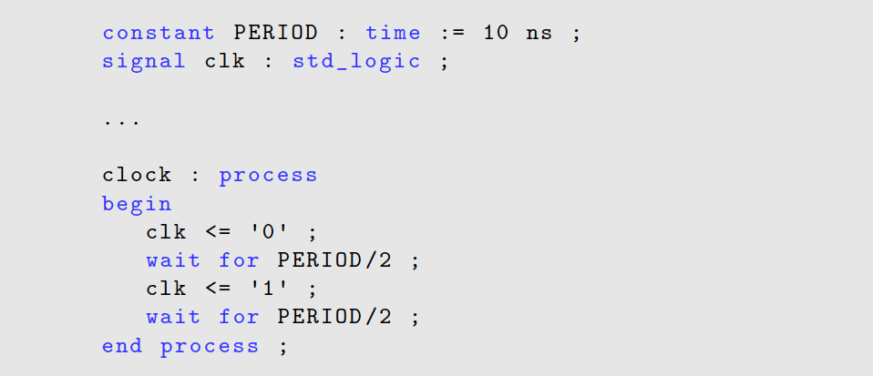
Physical data types

Slide 34
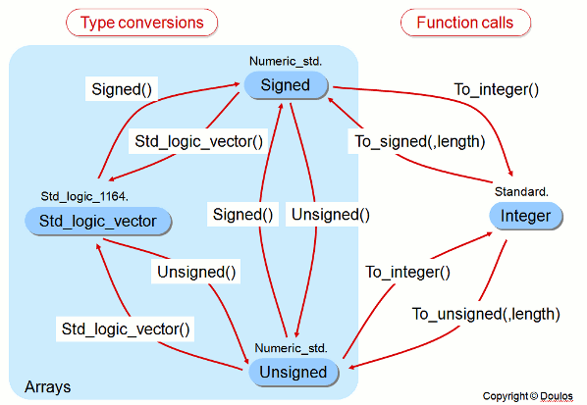
Numeric Std Conversions

Slide 35
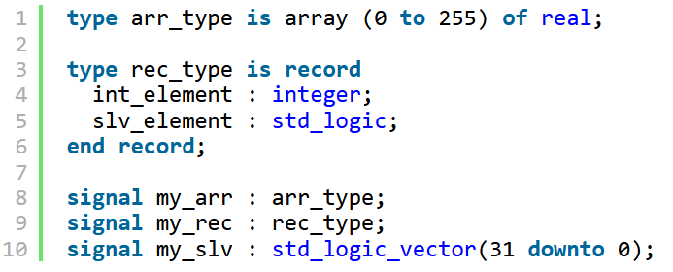
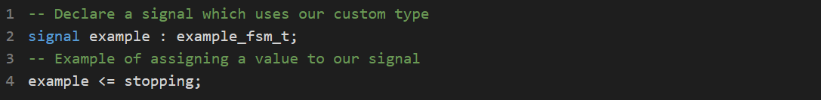
Composite type
A composite type is a datatype consisting of several subelements.

Slide 36
Boolean algebra

Slide 37
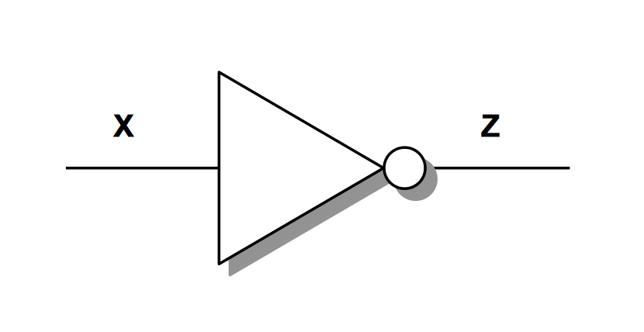

NOT gate
$$z=\overline{X}$$
VHDL syntax :

Slide 38
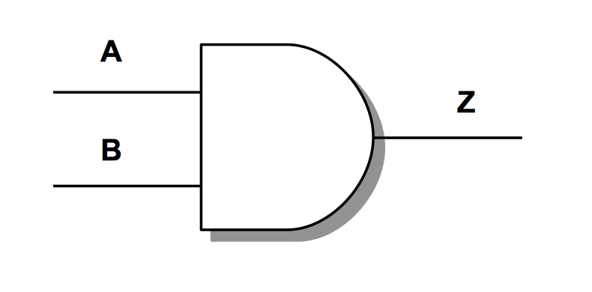

AND gate
$$Z=A∙B$$
VHDL syntax :

Slide 39
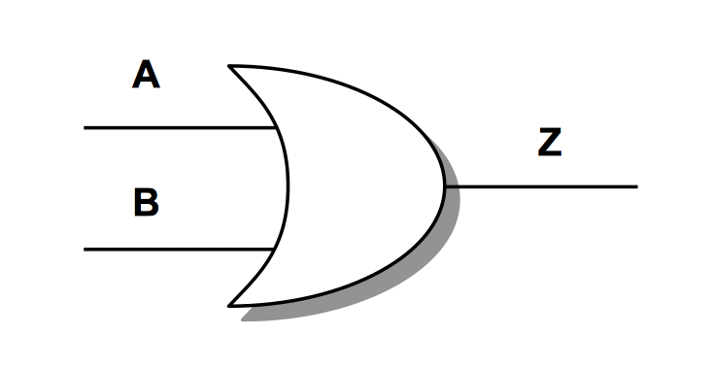

OR gate
$$Z=A+B$$
VHDL syntax :

Slide 40
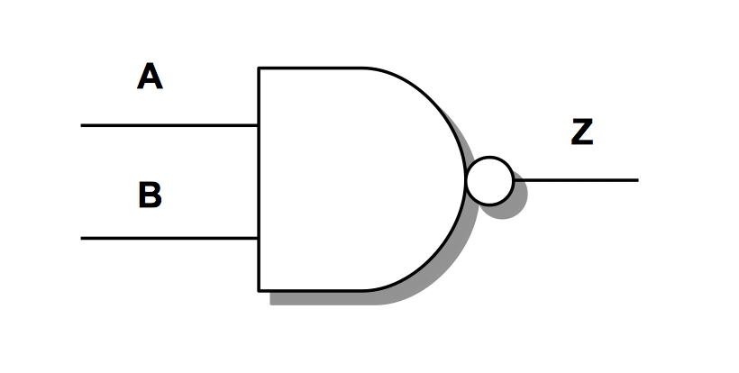

NAND gate
$$Z=\overline{A∙B}$$
VHDL syntax :

Slide 41
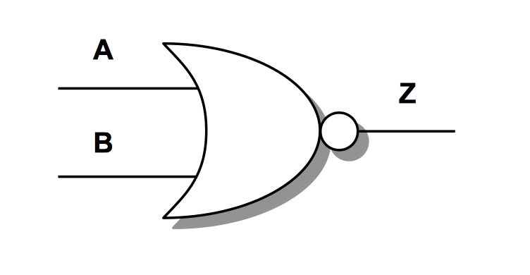

NOR gate
$$Z= \overline{A+B}$$
VHDL syntax :

Slide 42
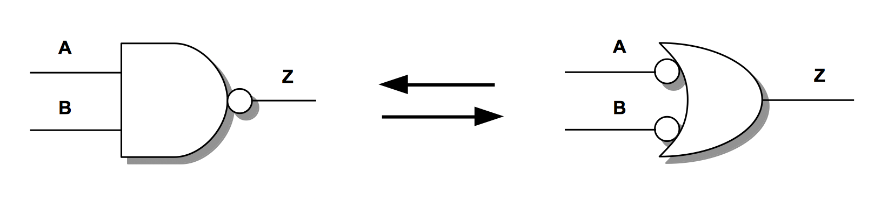

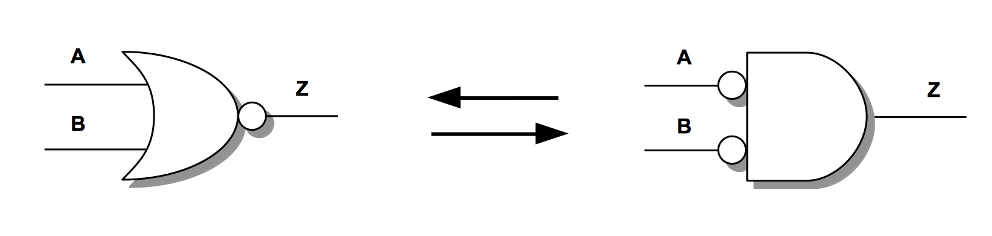

De Morgan's theorem

Slide 43
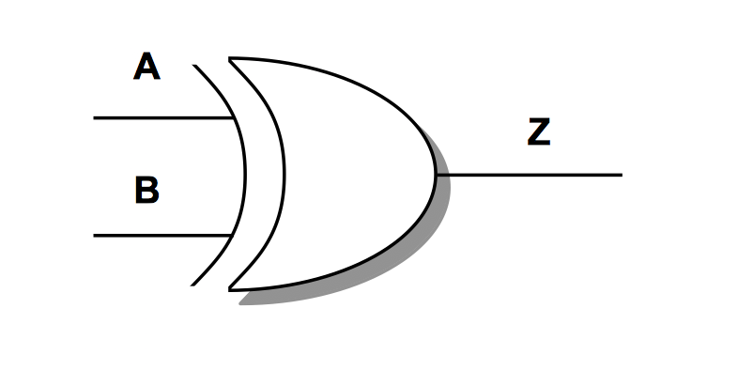

XOR gate
VHDL syntax :

Slide 44
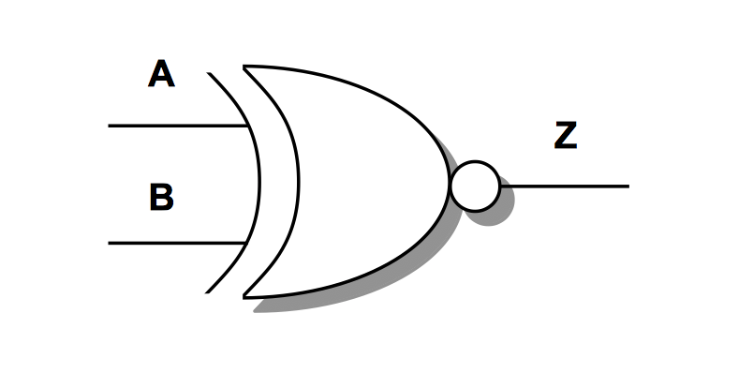

XNOR gate
VHDL syntax :
not implemented in the original VHDL-87
later added as part of VHDL-93 revision upon designers request
detects if two bits are identical
fundamental component for binary comparators

Slide 45

Propagation delays
VHDL syntax :
Only for simulation purposes !

Slide 46
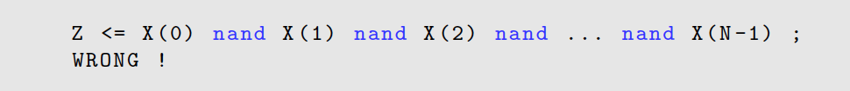
Multiple-inputs gates

Slide 47
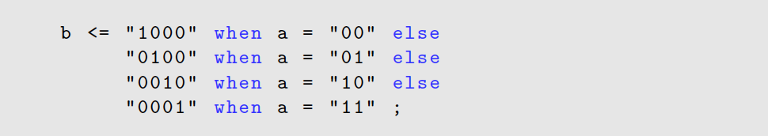
when/else conditional signal assignment
A concurrent conditional assignment used outside processes.
Evaluates conditions in order and assigns the first matching value.
Commonly used for simple combinational logic and multiplexers.

Slide 48
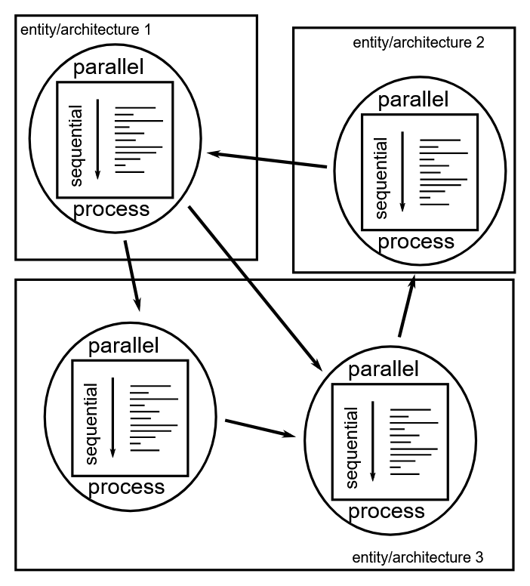
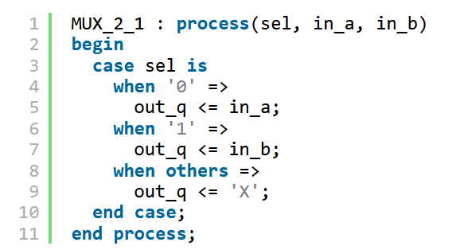
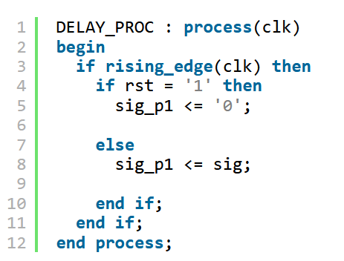
VHDL ‘process’ structure
“In VHDL, the process statement contains sequential statements.
Processes are only permitted inside an architecture. The statements within processes execute sequentially, not concurrently.”
Combinational logic
Sequential logic

Slide 49
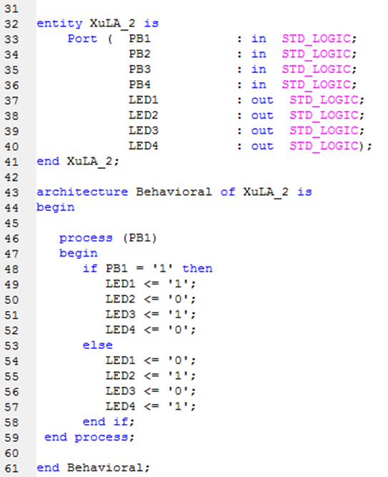
If/elsif/else statement
Used for conditional decisions with priority.
Conditions are evaluated top-to-bottom, and the first true condition is executed.
Commonly used in clocked logic and control paths.

Slide 50
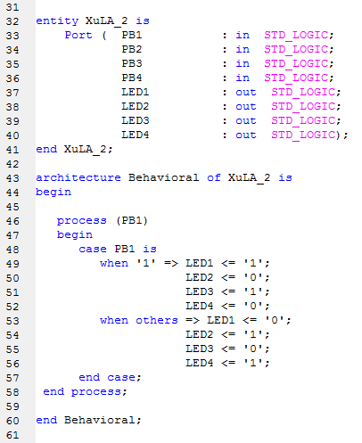
Case/when statement
Used for selecting one of many mutually exclusive options.
All choices are evaluated in parallel, no priority between branches.
Ideal for state machines and multiplexers..

Slide 51
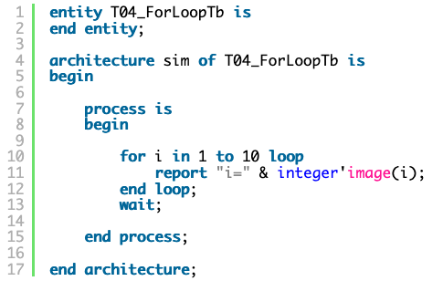
For loop statement
Repeats a set of sequential statements for a fixed range.
Used for iterating over arrays or buses.
Loops are unrolled in hardware, not executed over time.

