Slide 1
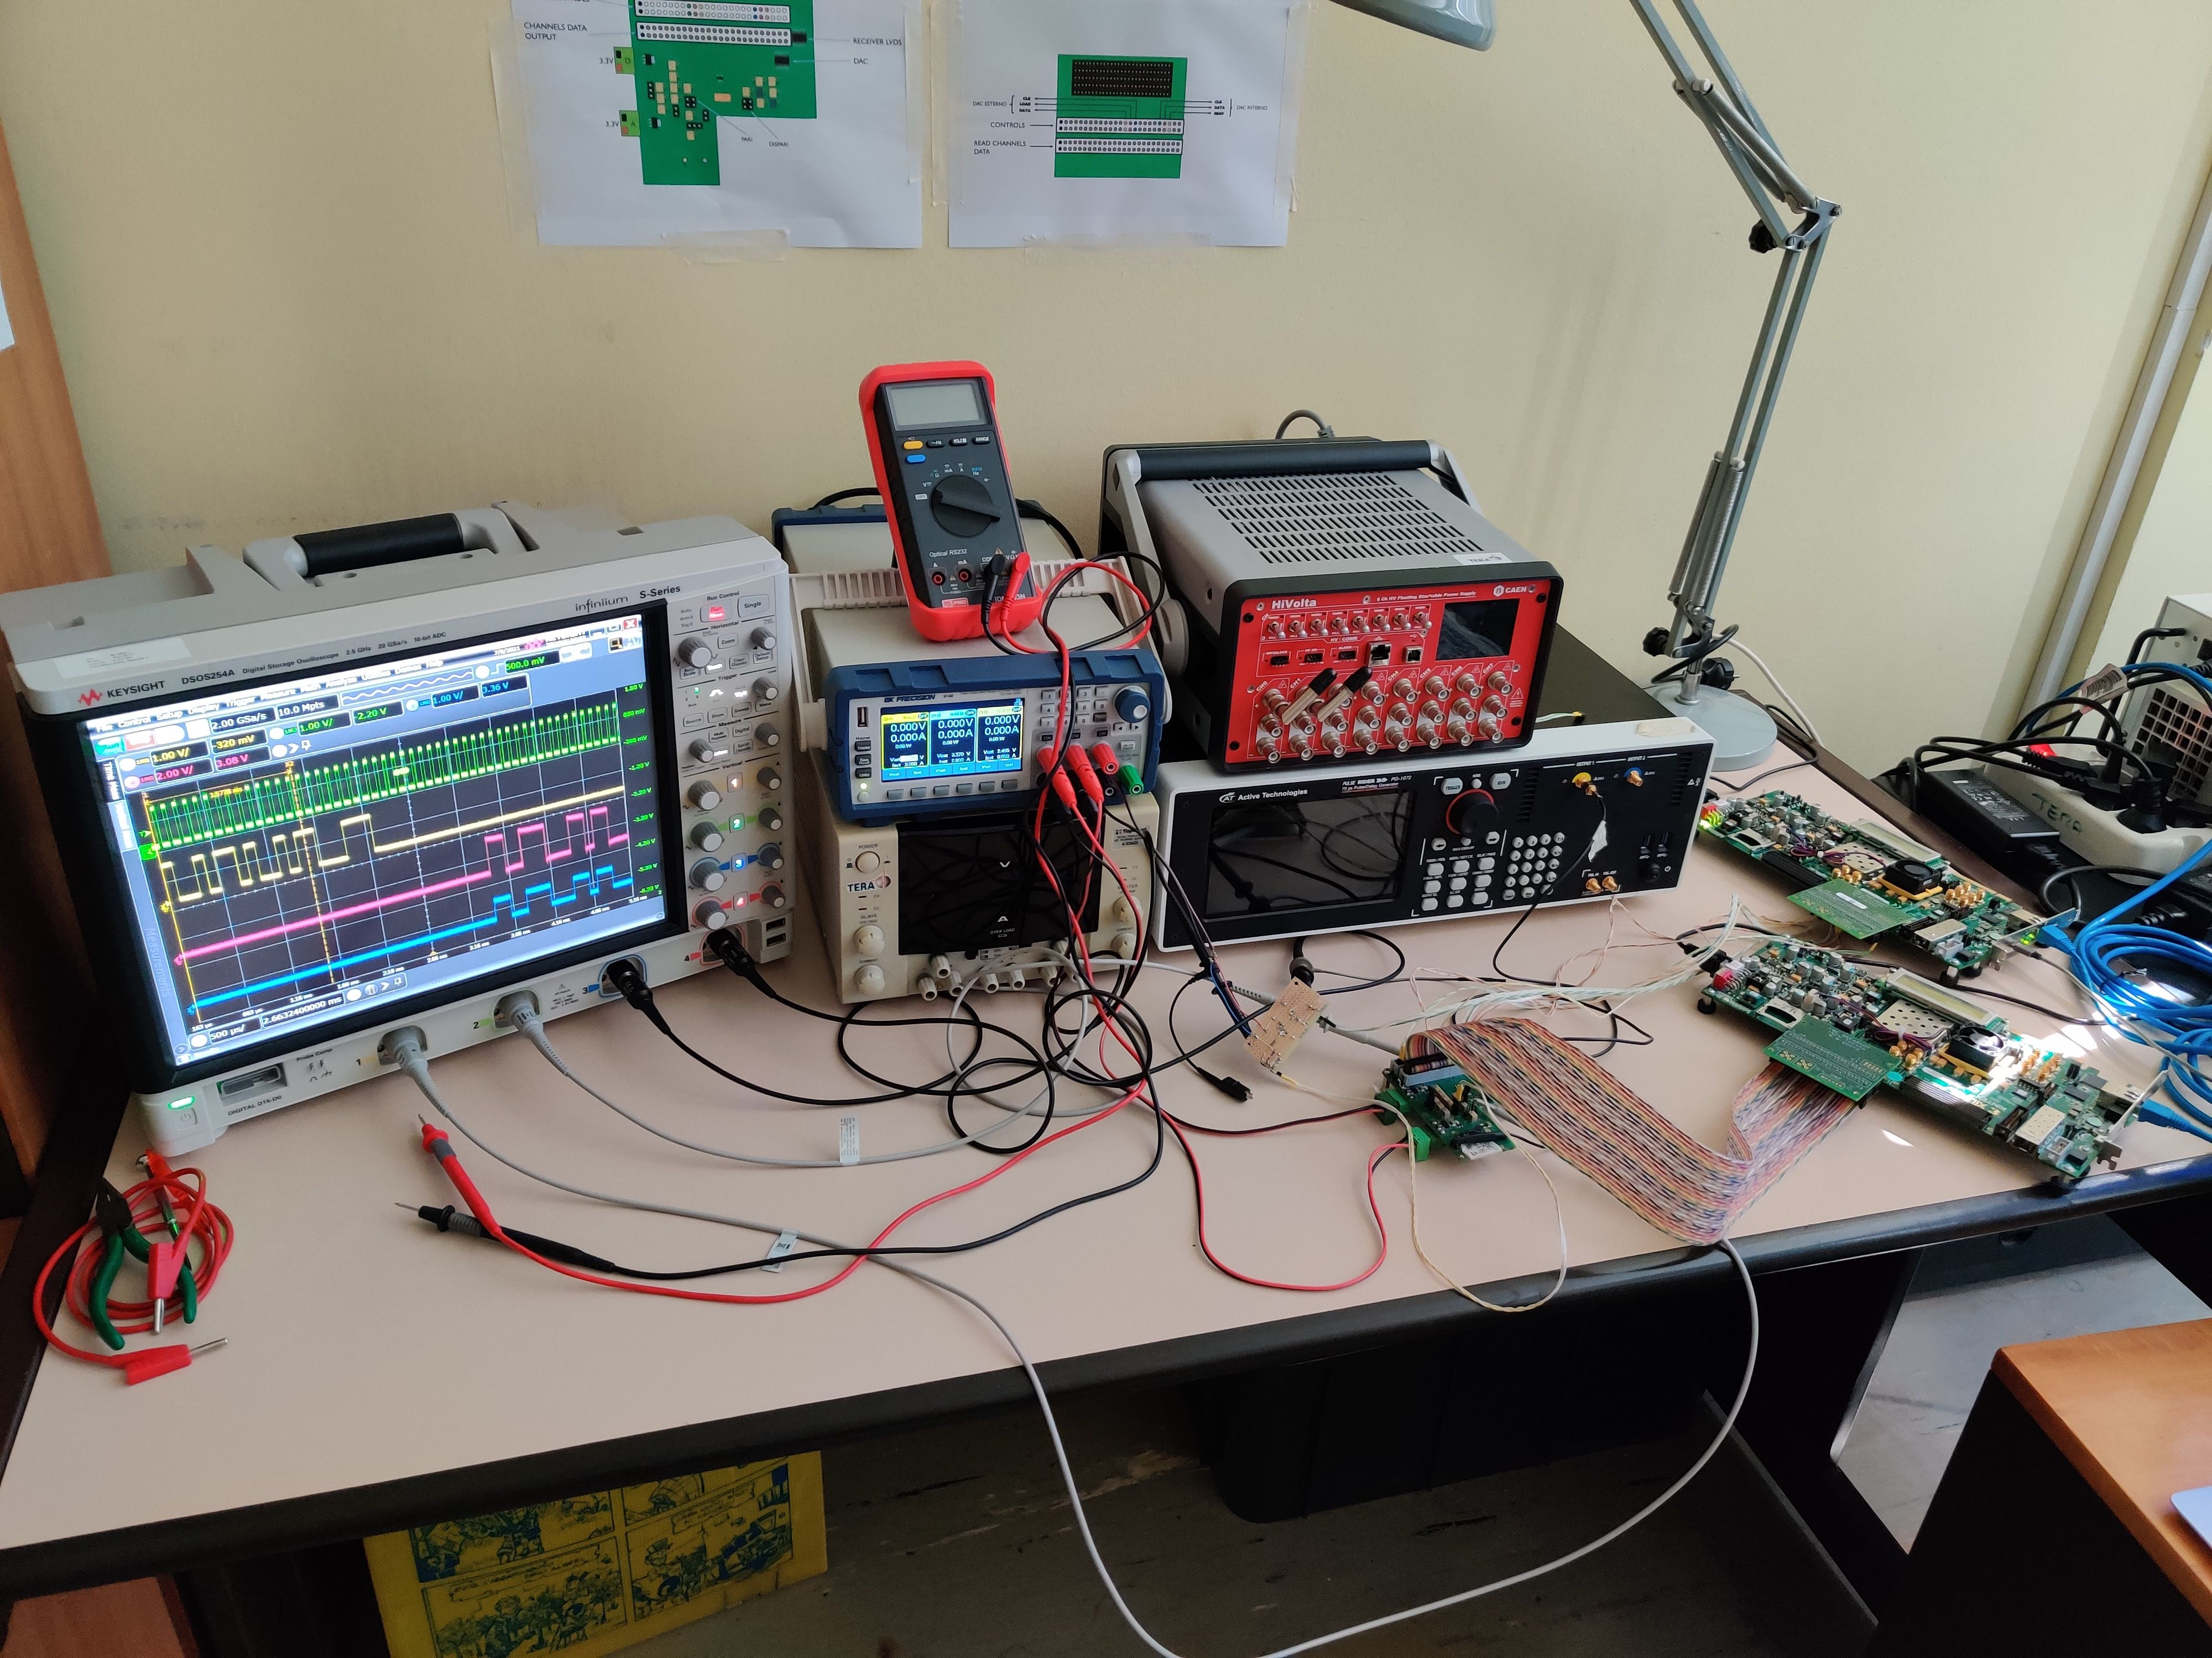
ci
Oscilloscope
Power Supply
Fast Pulse Generator
PC with LabView
Level translator
Test board
FPGA board

