Slide 1


MeshUp: Stateless Cache Side-channel Attack on CPU Mesh
Junpeng Wan, Yanxiang Bi, Zhe Zhou† Zhou Li
Fudan University University of California, Irvine
{18210240176, 19210240003, zhouzhe}@fudan.edu.cn zhou.li@uci.edu
† Zhe Zhou is the corresponding author

Slide 2
Background

Slide 3
Cause of Cache Timing Attack
Hardware Resource Sharing
Such as:
L1/L2/LLC
MMU/TLB
I/O buses
CPU execution ports
Cache directory
CPU interconnect: MeshUp, LoR

Slide 4
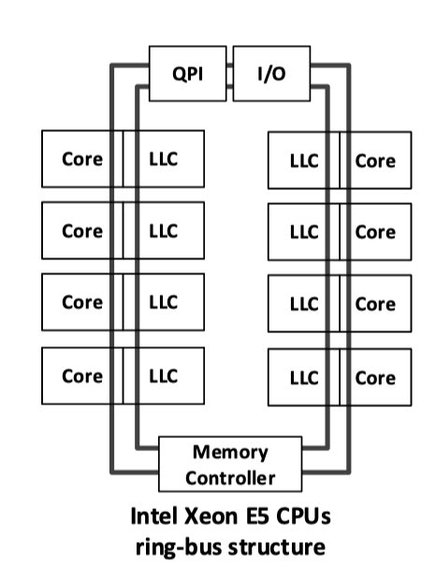
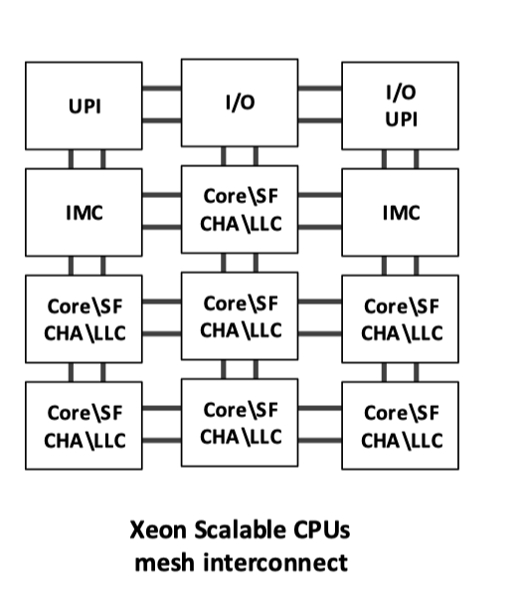
MeshUp Target - CPU Interconnect
Intra-CPU
Ring Bus (Lord of Ring[2])
Mesh (MeshUp)

Slide 5
MeshUp Target - CPU Interconnect
Inter-CPU
CPU A
UPI
UPI
UPI
UPI
CPU B
UPI: Intel Ultra Path Interconnect (MeshUp)

Slide 6
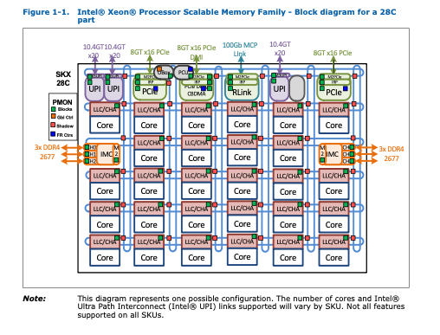
Mesh Interconnect(1)
UPI
CHA/LLC
UPI
CHA/LLC
Core
Core
IMC
CHA/LLC
CHA/LLC
IMC
Core
Core
CHA/LLC
CHA/LLC
CHA/LLC
CHA/LLC
Core
Core
Core
Core
CHA/LLC
CHA/LLC
CHA/LLC
CHA/LLC
Core
Core
Core
Core
Intel® Xeon® Processor Scalable Memory Family Uncore Performance Monitoring [3]

Slide 7

Mesh Interconnect(2)
UPI
CHA/LLC
UPI
CHA/LLC
Core
Core
Y-X route
Data and control flow go vertically firstly and then horizontally
Tiles
Core: ALU/Registers/Control Unit/L1/L2/…
Uncore: CHA/LLC/Cache Directory/…
IMC
CHA/LLC
CHA/LLC
IMC
Core
Core
CHA/LLC
CHA/LLC
CHA/LLC
CHA/LLC
Core
Core
Core
Core
CHA/LLC
CHA/LLC
CHA/LLC
CHA/LLC
Core
Core
Core
Core

Slide 8
Cache Structure
L1 cache
Core
L1 cache
Core
Mesh Interconnect
L2 cache
L2 cache
L1/L2
private
Inclusive
LLC
shared by all cores
Non-inclusive
LLC
Uncore
LLC
Uncore
CHA
CHA
Tile A
Tile B

Slide 9
Cache Structure
L1 cache
Core
L1 cache
Core
Mesh Interconnect
L2 cache
L2 cache
L1/L2
private
Inclusive
LLC
shared by all cores
Non-inclusive
CHA
Maintains states and positions of cachelines
A hash algorithm maps physical address to CHA
LLC
Uncore
LLC
Uncore
CHA
CHA
Tile A
Tile B

Slide 10
MeshUp Overview

Slide 11
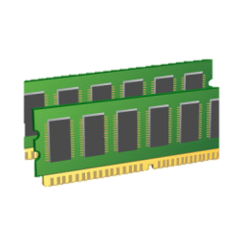


Threat Model
UPI
CHA/LLC
UPI
CHA/LLC
Core
Core
IMC
CHA/LLC
CHA/LLC
IMC
Core
Core
CHA/LLC
CHA/LLC
CHA/LLC
CHA/LLC
Cross-core Attack
Attacker and victim reside on the same CPU but on different cores
Cross-CPU Attack
Attacker controls at least one core on each CPU connected by UPI
Core
Core
Core
Core
CHA/LLC
CHA/LLC
CHA/LLC
CHA/LLC
Core
Core
Core
Core
UPI
CHA/LLC
UPI
CHA/LLC
Core
Core
IMC
CHA/LLC
CHA/LLC
IMC
Core
Core
CHA/LLC
CHA/LLC
CHA/LLC
CHA/LLC
Core
Core
Core
Core
CHA/LLC
CHA/LLC
CHA/LLC
CHA/LLC
Core
Core
Core
Core

Slide 12
Threat Model
UPI
CHA/LLC
UPI
CHA/LLC
Core
Core
IMC
CHA/LLC
CHA/LLC
IMC
Core
Core
CHA/LLC
CHA/LLC
CHA/LLC
CHA/LLC
Cross-core Attack
Cross-CPU Attack
Common in Cloud Setting
VMs and Containers
Core
Core
Core
Core
CHA/LLC
CHA/LLC
CHA/LLC
CHA/LLC
Core
Core
Core
Core
UPI
CHA/LLC
UPI
CHA/LLC
Core
Core
IMC
CHA/LLC
CHA/LLC
IMC
Core
Core
CHA/LLC
CHA/LLC
CHA/LLC
CHA/LLC
Core
Core
Core
Core
CHA/LLC
CHA/LLC
CHA/LLC
CHA/LLC
Core
Core
Core
Core

Slide 13

Threat Model
UPI
CHA/LLC
UPI
CHA/LLC
Core
Core
IMC
CHA/LLC
CHA/LLC
IMC
Core
Core
CHA/LLC
CHA/LLC
CHA/LLC
CHA/LLC
Core
Core
Core
Core
Cross-core Attack
Cross-CPU Attack
Common in Cloud Setting
Attack Strategy
Monitor the data flow on the interconnects
Infer victim’s memory access patterns
By timing difference resulted from interconnect congestion
CHA/LLC
CHA/LLC
CHA/LLC
CHA/LLC
Core
Core
Core
Core
UPI
CHA/LLC
UPI
CHA/LLC
Core
Core
IMC
CHA/LLC
CHA/LLC
IMC
Core
Core
CHA/LLC
CHA/LLC
CHA/LLC
CHA/LLC
Core
Core
Core
Core
CHA/LLC
CHA/LLC
CHA/LLC
CHA/LLC
Core
Core
Core
Core

Slide 14
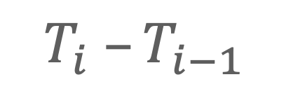
Attack Procedure
Probe Pseudocode
while True:
AccessData( )
T = GetTime( )
Probe
Access data to make congestion
Record latency(timestamp gap) between two operations
Infer
A higher latency indicates that data from other source is transmitting
$$T_{i} –T_{i−1}$$
Data Movement
Data Movement

Slide 15
Cross-core Attack

Slide 16
Mesh Interconnect
UPI
CHA/LLC
UPI
CHA/LLC
Core
Core
Settings
Attacker controls the core on Tile A
Victim controls the core Tile C
Victim has noticeable memory access
Key of Probe
High bandwidth to content with victim
High frequency to achieve high resolution
IMC
CHA/LLC
CHA/LLC
IMC
Core
Core
Tile A
CHA/LLC
CHA/LLC
CHA/LLC
CHA/LLC
Core
Core
Core
Core
Tile C
CHA/LLC
CHA/LLC
CHA/LLC
CHA/LLC
Core
Core
Core
Core
Tile B

Slide 17
Probe: Cacheline Eviction
Access Eviction set (EV)
EV is a set of cachelines
Force Mesh flow between two tiles
Record TSC
TSC (Time Stamp Counter) counts the number of CPU cycles since its reset
Probe Pseudocode
while True:
read(EVs)
T = RDTSCP( )

Slide 18
Probe: Cacheline Eviction
EV contains cachelines that
Locate in one Tile A L2 set
Also locate in Tile B’s LLC slice
LLC
Mesh Interconnect
LLC
L2 cache
L2 cache
Tile A
Tile B
Pyhsical Memory Address
63:17 | 16 | 15:6 | 5:0
L2 Tag |  | L2 set index | Offset
LLC Tag | LLC set index
Hash to LLC slice ID

Slide 19

Probe: Cacheline Eviction
EV size
$W_{L2}=ways of L2 set$
$W_{LLC}=ways of LLC set$
$W_{L2} <EV size≤W_{L2}+2∗W_{LLC}$
LLC
Mesh Interconnect
LLC
L2 cache
L2 cache
Tile A
Tile B
Pyhsical Memory Address
63:17 | 16 | 15:6 | 5:0
L2 Tag |  | L2 set index | Offset
LLC Tag | LLC set index
Hash to LLC slice ID

Slide 20
Probe: Cacheline Eviction
How to Construct an EV
One Tile A L2 set
Cachelines with same 15:6 bits physical address
Tile B’s LLC slice
Performance Monitors [4]
Attack Directory [5]
LLC
Mesh Interconnect
LLC
L2 cache
L2 cache
Tile A
Tile B
Pyhsical Memory Address
63:17 | 16 | 15:6 | 5:0
L2 Tag |  | L2 set index | Offset
LLC Tag | LLC set index
Hash to LLC slice ID

Slide 21

Probe: Cacheline Eviction
UPI
CHA/LLC
UPI
CHA/LLC
Core
Core
Eviction Effect
Tile A’s L2 will load cachelines from Tile B’s LLC
Tile A’s L2 will evict cachelines to Tile B’s LLC
IMC
CHA/LLC
CHA/LLC
IMC
Core
Core
Tile A
CHA/LLC
CHA/LLC
CHA/LLC
CHA/LLC
Core
Core
Core
Core
CHA/LLC
CHA/LLC
CHA/LLC
CHA/LLC
Core
Core
Core
Core
Tile B

Slide 22
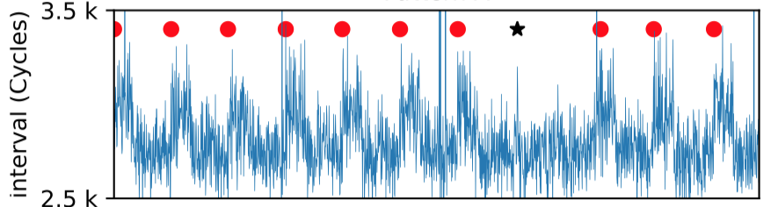
Evaluation
Latency
Target
2048-bit RSA private key
Java (JDK: Slide Window algorithm)
Results
Capture square or multiply operations
Recover ~30% keys by SRID algorithm[6]
TSC ID

Slide 23
Cross-CPU Attack

Slide 24
UPI interconnect
UPI
CHA/LLC
UPI
CHA/LLC
Core
Core
IMC
CHA/LLC
CHA/LLC
IMC
Core
Core
Settings
Attacker controls one core on each CPU
Victim accesses remote memory
UPI feature
Contains complex traffic
Hard to evict cachelines to LLC on remote CPU
CHA/LLC
CHA/LLC
CHA/LLC
CHA/LLC
Core
Core
Core
Core
Core A
CHA/LLC
CHA/LLC
CHA/LLC
CHA/LLC
Core
Core
Core
Core
UPI
CHA/LLC
UPI
CHA/LLC
Core
Core
IMC
CHA/LLC
CHA/LLC
IMC
Core
Core
Core B
CHA/LLC
CHA/LLC
CHA/LLC
CHA/LLC
Core
Core
Core
Core
CHA/LLC
CHA/LLC
CHA/LLC
CHA/LLC
Core
Core
Core
Core

Slide 25
Probe: False Sharing
Core A and Core B are on different CPU socket
Write same cachelines(set S)
According to cache coherence protocol, core A and core B will compete for cachelines’ inclusive state to modify them
Cachelines are transferred between two CPU by UPI
Core A Pseudocode
Core B Pseudocode
while True:
write(S)
Core A
Core B
while True:
write(S)
T = RDTSCP( )
 |  |  |  | ……….
A Cacheline(64 bytes)

Slide 26
Evaluation
Target
Applications Fingerprinting
40 APPS
Classification accuracy: 82.27%
Website Fingerprinting
100 websites
Classification accuracy: 82.25%

Slide 27
MeshUp Analysis

Slide 28
MeshUp Advantages & Limitations
Advantages
Stateless: not depend on microarchitectural state change & not require to know victim’s memory address
Bypass current defenses: Intel CAT & Page Coloring
Limitations
Low accuracy: only infer information from CPU interconnects’ data flow

Slide 29
Potential Mitigation
UPI
CHA/LLC
UPI
CHA/LLC
Core
Core
IMC
CHA/LLC
CHA/LLC
IMC
Core
Core
CHA/LLC
CHA/LLC
CHA/LLC
CHA/LLC
Core
Core
Core
Core
Spatial Isolation
Deploy different VMs in different areas
Not share LLC between areas
Improve route policy
Avoid cross-area data flows
Cache Randomization
Dynamic hash algorithm
increase the difficulty to implement attack
CHA/LLC
CHA/LLC
CHA/LLC
CHA/LLC
Core
Core
Core
Core
UPI
CHA/LLC
UPI
CHA/LLC
Core
Core
IMC
CHA/LLC
CHA/LLC
IMC
Core
Core
CHA/LLC
CHA/LLC
CHA/LLC
CHA/LLC
Core
Core
Core
Core
CHA/LLC
CHA/LLC
CHA/LLC
CHA/LLC
Core
Core
Core
Core

Slide 30
Summary
Identify new security implication of CPU interconnects
Develop MeshUp to conduct cross-core and cross-CPU attacks through CPU interconnects
Systematically analyze MeshUp and evaluate it against RSA key recovery and application&website ﬁngerprinting

Slide 31
Q&A
Email: jpwan19@fudan.edu.cn

Slide 32
References
[1] https://en.wikipedia.org/wiki/Side-channel_attack
[2] Lord of the Ring(s): Side Channel Attacks on the CPU On-Chip Ring Interconnect Are Practical
[3] Intel® Xeon® Processor Scalable Memory Family Uncore Performance Monitoring
[4] SKX_SF_Conflicts
[5] Attack Directories, Not Caches: Side-Channel Attacks in a Non-Inclusive World
[6] Sliding right into disaster: Left-to-right sliding windows leak

Slide 33
Mesh Interconnect(3)
UPI
CHA/LLC
UPI
CHA/LLC
Core
Core
ID Mappings by Reverse Engineering
CAPID6 register to find disabled tiles
Core ID to CHA ID Map
Uncore performance counters related to power management
Monitor same event on each CHA and keep a core active
Map the active core to CHA with highest event counts
IMC
CHA/LLC
CHA/LLC
IMC
Core
Core
CHA/LLC
CHA/LLC
CHA/LLC
CHA/LLC
Core
Core
Core
Core
CHA/LLC
CHA/LLC
CHA/LLC
CHA/LLC
Core
Core
Core
Core

Slide 34
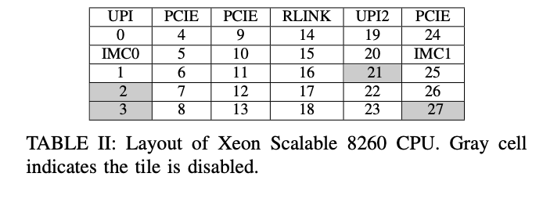
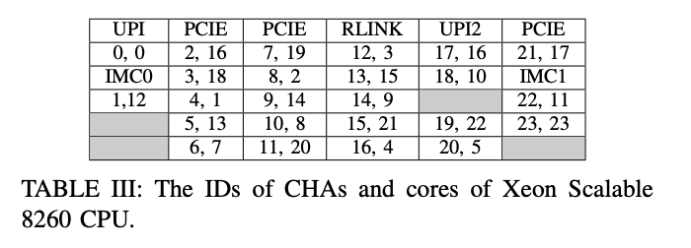
Mesh Interconnect(4)
UPI
CHA/LLC
UPI
CHA/LLC
Core
Core
IMC
CHA/LLC
CHA/LLC
IMC
Core
Core
CHA/LLC
CHA/LLC
CHA/LLC
CHA/LLC
Core
Core
Core
Core
CHA/LLC
CHA/LLC
CHA/LLC
CHA/LLC
Core
Core
Core
Core

Slide 35
Cache Structure(2)
L1 cache
Core
L1 cache
CHA
A hash algorithm maps physical address to CHA
Every cache line are managed by one CHA
maintains states and positions of a cacheline
L2 -> L2
LLC -> L2
L2 -> LLC
Memory -> L2
LLC -> Memory
…..
L2 cache
L2 cache
LLC
Uncore
LLC
Uncore
CHA
CHA
Tile A
Tile B

