Slide 1

CSCI 4830 Semester Project
Analyzing and Comparing Locking Mechanisms
in Varying Systems
          By: Stefan Knott

Slide 2
Overview
When and why to use different locking mechanisms across varying levels of contention, CPU set size, and thread pool size
Motivation: interests in runtime efficiency and concurrency on small scale systems.

Slide 3
Implementation
C/BASH
Pthread libraries (mux, sem, spin)
TTASB code implementation with max backoff of 250 miliseconds

Slide 4
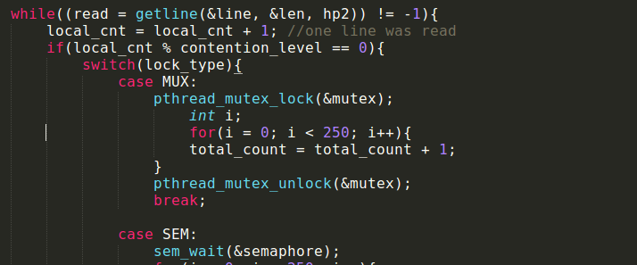
Implementation Cont'd
Contention control
Enter the CS
  250 increments
  O(1) runtime complexity
Lock delay short

Slide 5
Presumptions entering Testing
Mutex and semaphore seem to be common choices among programmers (lots of well documented libraries, CSCI 3753).
Spin locks are efficient when lock wait time is short and when we have many processors (pg. 141 Herlihy & Shavit)

Slide 6
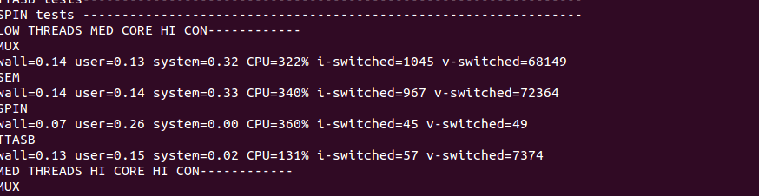
Testing
Core set sizes: 2, 4, 8
Thread pool sizes: 8, 15, 30
High contention level causes ~40x more contention than low level
Measuring: Runtime, CPU usage, context switches

Slide 7
Results
Low contention runtime << high contention runtime
Results separated into “Stressed” and “Relaxed” Systems
Stressed – CPU set size level <= thread pool size level. Typically low # CPUs needed
Relaxed – CPU set size level > thread pool size level. Typically high # CPUs needed

Slide 8
Low Contention Results
Use mutex as it's runtime is always less than or equal to the runtime offered by other mechanisms.
  When system was highly relaxed (high core, low thread pool size) runtime of MUX and SPIN/TTASB equal
Runtime range for all locks: 0.00-0.02s
  If this runtime wait difference of 0.02 is negligible – look to CPU usage.
TTASB consistently uses less CPU power
  4x less than MUX in high core low thread case

Slide 9
Very Stressed (low core, high con)

Slide 10
Stressed (med core, high con)

Slide 11
Relaxed (high core, high con)

Slide 12
Conculsions
If system is stressed (lots of work to do on few cores, commonly thread pool size >= core set size) – use MUX or SEM
If the system is relaxed (some work to do on lots of cores, commonly core set size > thread pool size) – use SPIN
Side note: if voluntary context switching is expensive use SPIN as it causes nearly 500x less voluntary switches than MUX/SEM. 2X Less involuntary switches as well

Slide 13

Remaining thoughts
Could be beneficial to implement a dynamic system which would change from using spin locks to mutexs or semaphores based on changing stress levels.
Thanks for listening

