Slide 1
Library Management
Chris Meyer | Stefan Knott

Slide 2

Development Goals
Provide location of books
Support Searches
Ability to Add/Remove/Edit
Easily Accessible Web Application

Slide 3
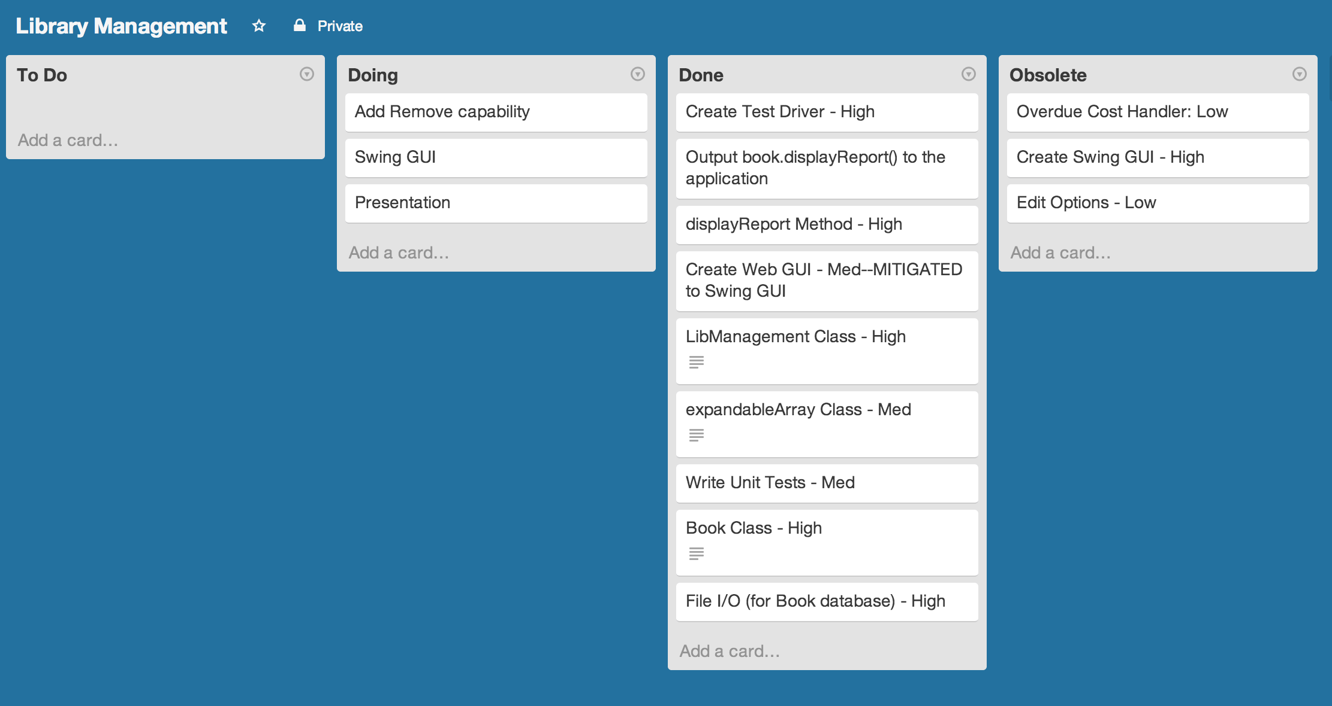

Progress Tracking
Less overhead: more development

Slide 4

Initial Risks Identified
Team Members
Web Application
Coding Language Barrier

Slide 5
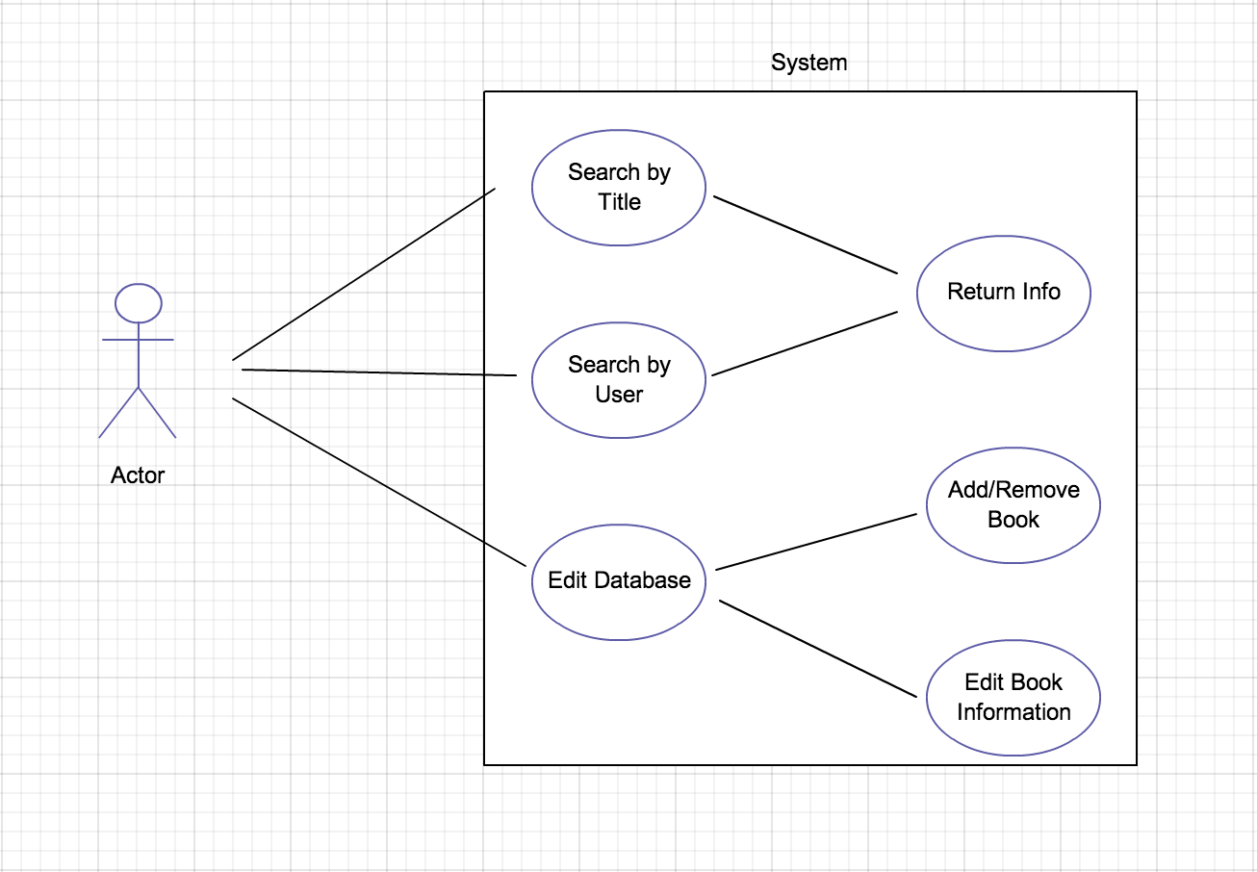
Program Structure: Development
GUI
LibManager.class
ExpandableArray.class
Date.class
Book.class

Slide 6
Program Development

Slide 7
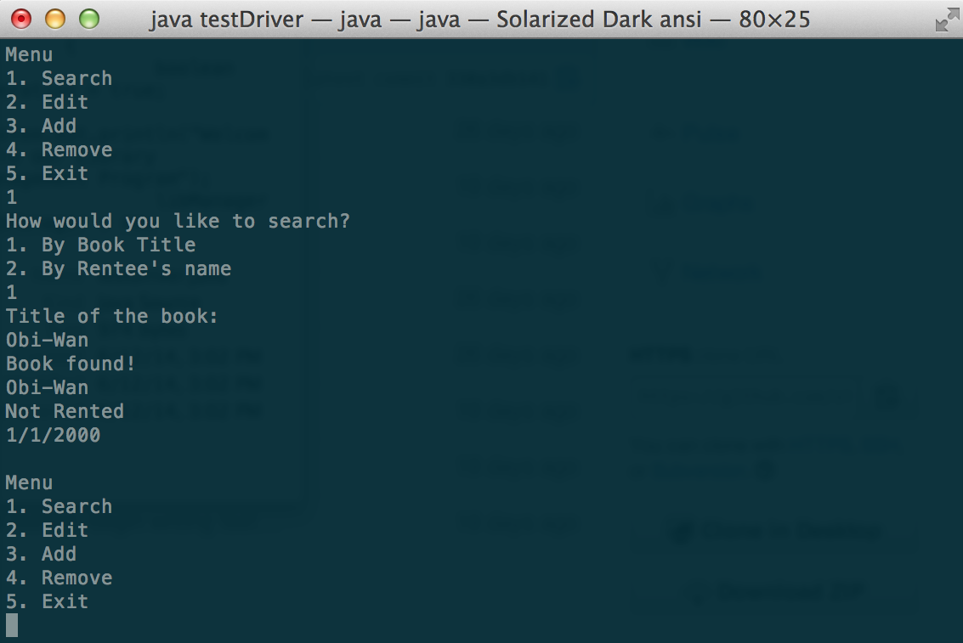
Basic Development: Command Line
Generates a library that meets most of our development criteria:
Add/Remove/Edit
Search
No Memory

Slide 8

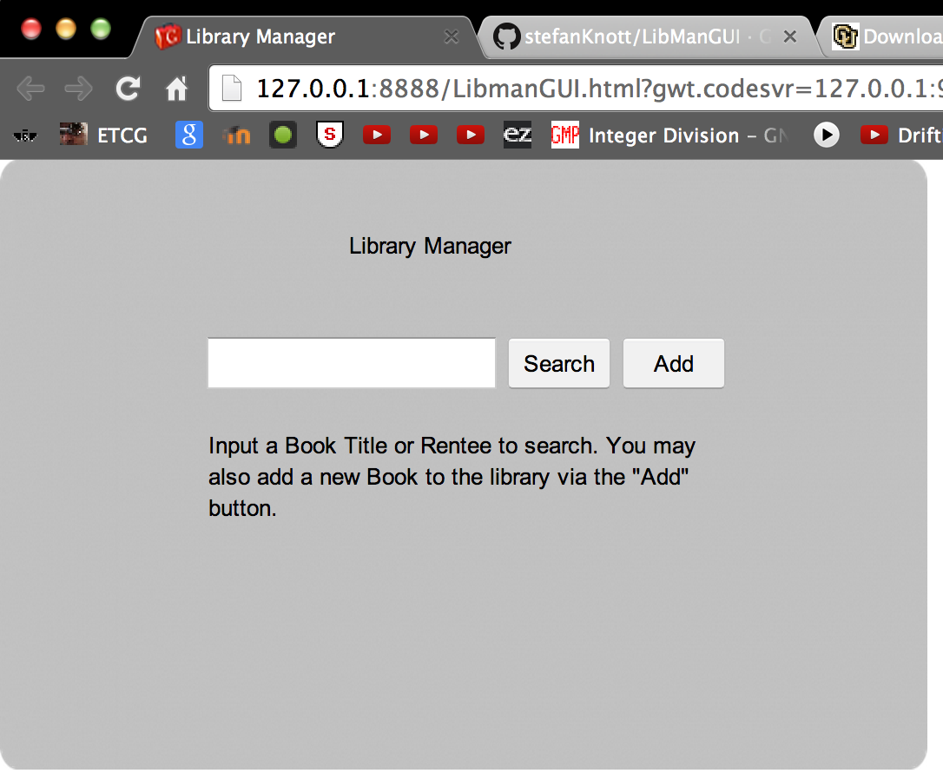

Further: Web GUI

Slide 9

Final GUI

Slide 10
Testing: DDT

Slide 11
Widescreen Test Pattern (16:9)
Aspect Ratio Test
(Should appear circular)
4x3
16x9

