Slide 1
A Simplified MIPS Processor in Verilog

Slide 2
Data Memory
module DM(MemRead, MemWrite, ABUS, DIN, DATABUS);
MemWrite: Nothing happens if 0. If 1, the memory at location ABUS will be written with DIN.
ABUS: At any moment, the data at location ABUS will appear at DATABUS.
MemRead: Not used.

Slide 3
Data Memory
Address bus: 8 bits.
Data bus: 32 bits. Each memory location holds 32 bits.

Slide 4
Data Memory
Init the contents in data memory with any value you like:
initial
begin
for (i=0; i <= DM_ADDR_MAX_m1; i = i + 1)
ram[i] = i*10 + 1;
end

Slide 5
Instruction Memory
module IM(CSB,WRB,ABUS,DATABUS);
CSB: chip select. If 0, selected. If 1, not selected.
WRB: Not used.
ABUS: Address bus. At any moment, if chip is selected, the data at location ABUS will appear at DATABUS.

Slide 6
Instruction Memory
Address bus: 8 bits.
Data bus: 32 bits. Each memory location holds 32 bits.

Slide 7
Instruction Memory
The most straightforward way of loading a program:
ram[0] = 32'b00100000000000000000000000000000; // addi $0, $0, 0
ram[1] = 32'b00100000001000010000000000000001; // addi $1, $1, 1
ram[2] = 32'b00100000010000100000000000000010; // addi $2, $2, 2
ram[3] = 32'b00100000011000110000000000000011; // addi $3, $3, 3
ram[4] = 32'b00000000000000000000000000000000; // nop
ram[5] = 32'b00000000000000000000000000000000; // nop
ram[6] = 32'b00000000000000000000000000000000; // nop
ram[7] = 32'b00000000000000000000000000000000; // nop
ram[8] = 32'b00000000000000000000000000000000; // nop
ram[9] = 32'b00000000000000000000000000000000; // nop

Slide 8
Get The Next PC
module getNextPC (PCSrc, currPC, offset, out);
parameter MIPS_PC_WIDTH_m1 = 7;
input PCSrc;
input [MIPS_PC_WIDTH_m1:0] offset;
input [MIPS_PC_WIDTH_m1:0] currPC;
output reg [MIPS_PC_WIDTH_m1:0] out;
always @(PCSrc, currPC, offset)
if (PCSrc == 0)
out <= currPC + 1;
else
out <= currPC + 1 + offset;
endmodule

Slide 9
PC
module MIPSPC(clk, newPC, PC);
Just an 8-bit D-flip-flop.

Slide 10
Register File
module MIPSREG(clk, RegWrite, ReadAddr1, ReadAddr2, WriteAddr, ReadData1, ReadData2, WriteData);
Just as what specified in the book.
RegWrite: If 0, disable write. If 1, register WriteAddr register WriteAddr will be overwritten with WriteData.
At any time, ReadData1 is the content of reg ReadAddr1, and ReadData2 is the content of reg ReadAddr2.

Slide 11
ALU
module MIPSALU (ALUctl, A, B, ALUOut, Zero);
input [3:0] ALUctl;
input [31:0] A,B;
output reg [31:0] ALUOut;
output Zero;
assign Zero = (ALUOut==0); //Zero is true if ALUOut is 0; goes anywhere
always @(ALUctl, A, B) //reevaluate if these change
case (ALUctl)
0: ALUOut <= A & B;
1: ALUOut <= A | B;
2: ALUOut <= A + B;
6: ALUOut <= A - B;
7: ALUOut <= A < B ? 1:0;
12: ALUOut <= ~(A | B); // result is nor
default: ALUOut <= 0; //default to 0, should not happen;
endcase
endmodule

Slide 12
Sign Extension
module SignExtend (in, out);
input [15:0] in;
output [31:0] out;
assign out[15:0] = in[15:0];
assign out[31:16] = in[15];
endmodule

Slide 13
Two-to-one Selector
module STwoToOne32 (sel, in0, in1, out);
input sel;
input [31:0] in0, in1;
output reg [31:0] out;
always @(sel, in0, in1)
if (sel == 0)
out <= in0;
else
out <= in1;
endmodule

Slide 14
Control
module MIPSCtrl (instr, RegDst, ALUSrc, MemToReg, RegWrite, MemWrite, MemRead, branch, ALUCtrl);
Take the 32-bit instruction, generate the control signals.

Slide 15
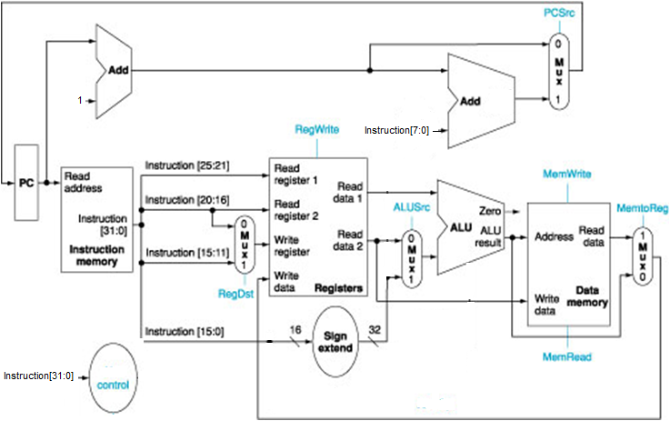
Data Path Setup According to

Slide 16
Supported instructions
add, sub, addi, lw, sw, beq.

Slide 17
Stepping through the program
The clock is set to be 200 time units. Run 200 every time.
Check the values of the wires in the waveform
Check the content of the registers and data memories in the memory windows.

Slide 18
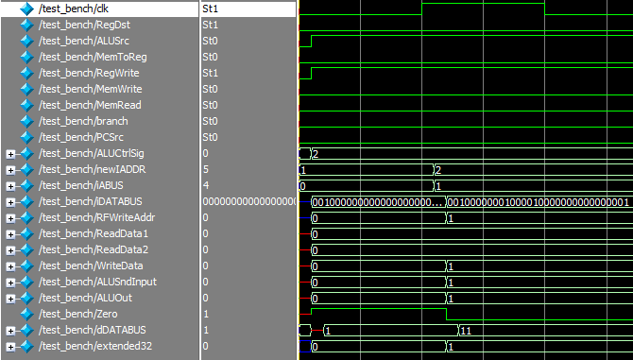
The waveform after two instructions
00100000000000000000000000000000; // addi $0, $0, 0
00100000001000010000000000000001; // addi $1, $1, 1

