Slide 1
Mini Lecture 10(b) Milk!!!!
Randal Burns
Parallel Computing for Data Science
10 October 2022

Slide 2
Synchronization
A look inside the critical section
Two common goals for synchronization
Contention:
How to resolve the conflicts that result from multiple processes trying to access shared resources?
Cooperation:
An action by one process may enable another action by another process
In such cases, processes should coordinate their actions

Slide 3
Why is synchronization hard?
Design an algorithm for purchasing milk between two roommates
We have a smart fridge with camera
Steps:
Arrive home
Look in fridge for milk
Leave for grocery
Buy milk
Arrive home with purchased milk

Slide 4
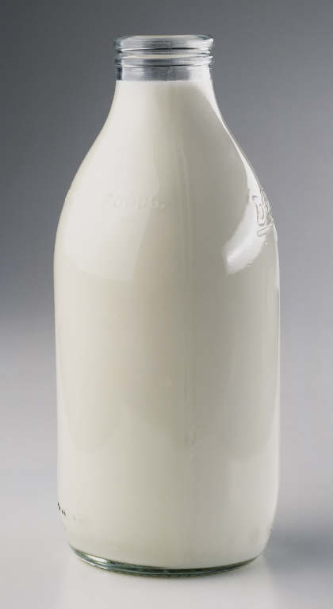
Alice
Arrive home
Look in fridge for milk
Leave for grocery
Buy milk
Arrive home with purchased milk
Bob
Arrive home
Look in fridge for milk
Leave for grocery
Buy milk
Arrive home with purchased milk

Slide 5
Why is synchronization hard?
Design an algorithm for purchasing milk between two roommates
Steps:
Look in fridge for milk
Leave for grocery
Buy milk
Arrive home with purchased milk
Too much milk!
Problem is impossible without communication between parties

Slide 6
Let’s Try Using Notes
Algorithm #1: If you find that there is no milk in fridge, leave a note on the door, go to store and purchase milk, on return home remove note
if (no note) then
if (no milk) then
leave note
buy milk
remove note
fi
fi

Slide 7
They can’t see each other!!
Alice
if (no note) then
if (no milk) then
leave note
buy milk
remove note
fi
fi
Bob
if (no note) then
if (no milk) then
leave note
buy milk
remove note
fi
fi

Slide 8
Let’s Try Using Notes
Algorithm #2: Based on leaving a note (with one’s name) before checking fridge
leave note A
if (no note B) then
if (no milk) then
buy milk
fi
fi
remove note

Slide 9

Alice
leave note A
if (no note B) then
if (no milk) then
buy milk
fi
fi
remove note
Bob
leave note B
if (no note A) then
if (no milk) then
buy milk
fi
fi
remove note

Slide 10
A Correct Algorithm
leave note A1
if (B2)
then leave note A2
else remove note A2 fi
while B1 and
((A2 and B2) or
(no A2 and no B2))
do skip do
if (no milk)
then buy milk fi
remove note A1
leave note B1
if (no A2)
then leave note B2
else remove note B2 fi
while A1 and
((A2 and no B2) or
(no A2 and B2))
do skip do
if (no milk)
then buy milk fi
remove note B1

Slide 11
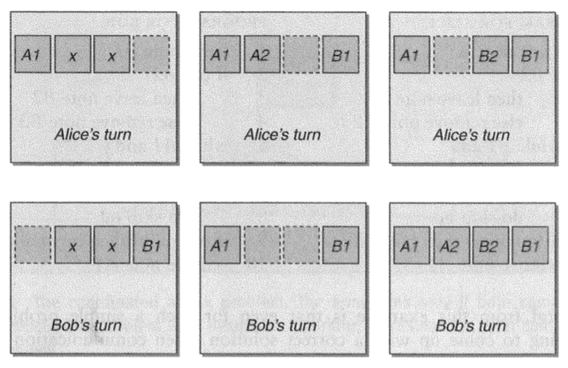
Configurations

Slide 12
Two Notes
First one to identify contention
Are two parties vying for this resource
Second one to break ties during contention
Essentially even and odd configurations
These notes are the analogies of atomic shared registers in computing
Essentially a volatile variable of basic type

Slide 13
Some Properties
Correct
Asynchronous: doesn’t depend on timing
Symmetric: equal chance of A/B buying milk
Notably steps aren’t symmetric
Two parties
Even simple synchronization is hard and subtle

