Slide 1
Equations, Pictures, and Plots

Slide 2
Useful Tips
- Text passed to a slide is in `String` format - It is not Markdown

Slide 3
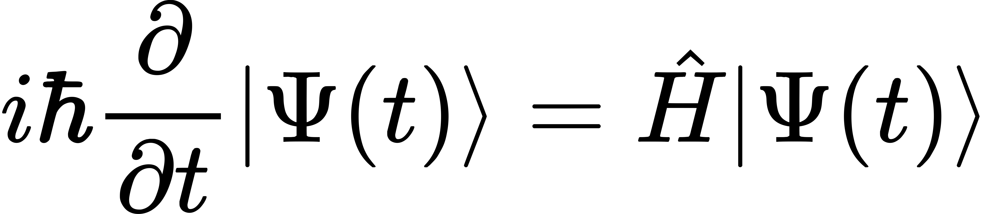
Equations

Slide 4
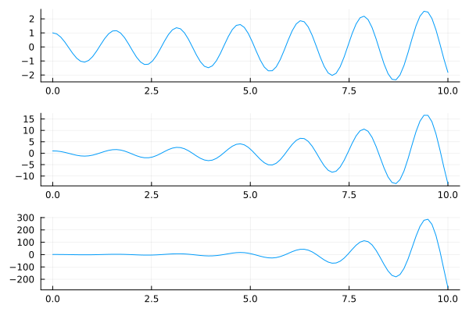
Plots

