Slide 2
Outlook for today: easy
Work on stuff you need help on
Low attendance, so we should be able to do individual meetings
Fresh data online, loaded into Access
Make your queries on this fresh data set
This will be the final data set

Slide 3
What to do next
Take my example, emulate, adding more substance and individual input
Your observations, comments
Your own personal integration of sources into your discussion will make for a complete paper
My one sentence discussion of results won’t be enough for you guys/gals
You’ll need to go beyond what I’ve done
Put in more of your own commentary

Slide 4
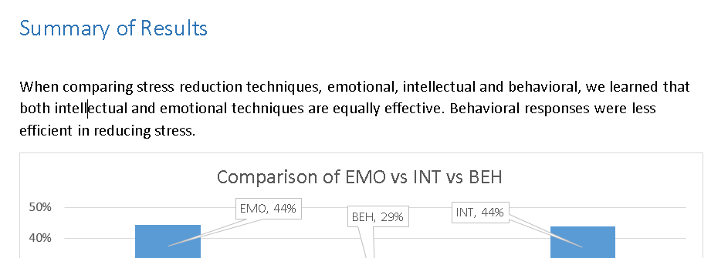
It’s time to be original
You’ve done well being very reverent and conservative up to this point
Now you’ve earned the right to originality, having established basis in fact for your conclusion
You have the right to reuse this statement in multiple locations
Abstract, intro, conclusion all restate your results

Slide 5
values
Be truthful
Be fair (unbiased)
Allow for surprises to take place
Be rational
Be scientific
Be scholarly
Be reverent / respectful
Be thoughtful of the experience of others
Dominate – be authoritative (RCC value)
Cross-cultural values
RCC values

Slide 6
Next step: piggyback
Analyze my statements
Model your own so they follow the spirit of it (not the letter)
Elaborate, using your own observations
So long as they follow the values on the prior slide
Never use colloquial speech
Never imitate the words of speaker, always be a writer, using a literary tone
Always use formal language
Always read your paper out loud, to yourself, to eliminate awkward statements
Simple statements are ok, always

