Slide 1
QuickHull algorithm analysis

Slide 2
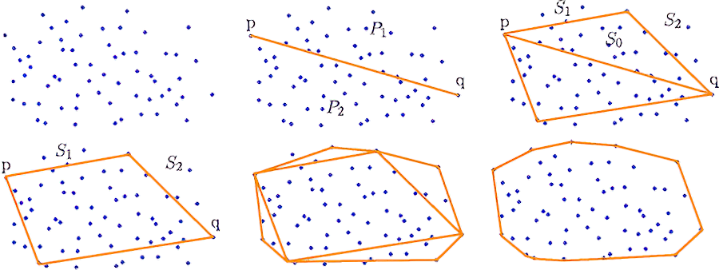
Introduction to QuickHull
A recursive algorithm that uses the divide and conquer approach
Introduced by C. Bradford Barber, David P. Dobkin, and Hannu Huhdanpaa in 1996
Creates a convex hull that encloses all points

Slide 3
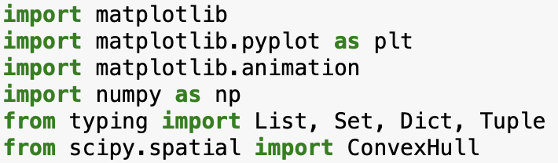
Preliminaries for the algorithm

Slide 4
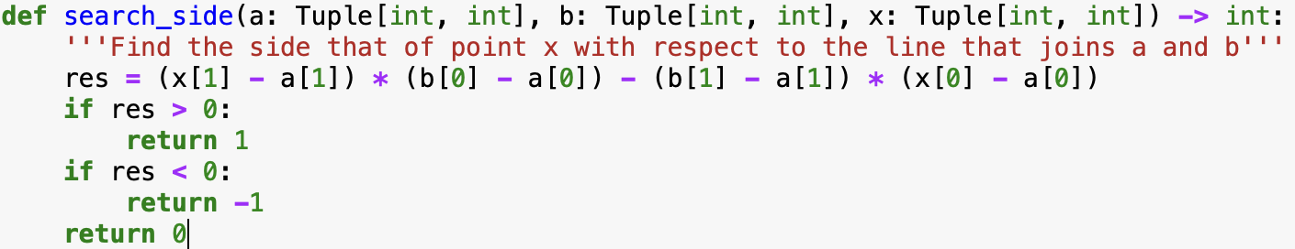
Functions used in the algorithm

Slide 5
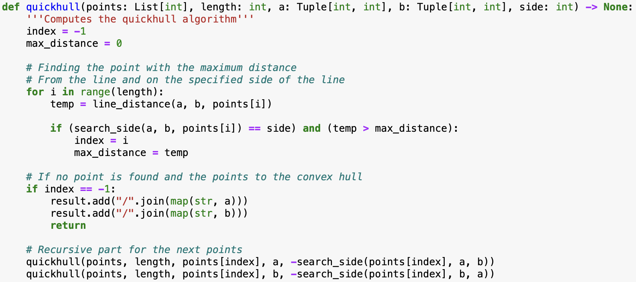
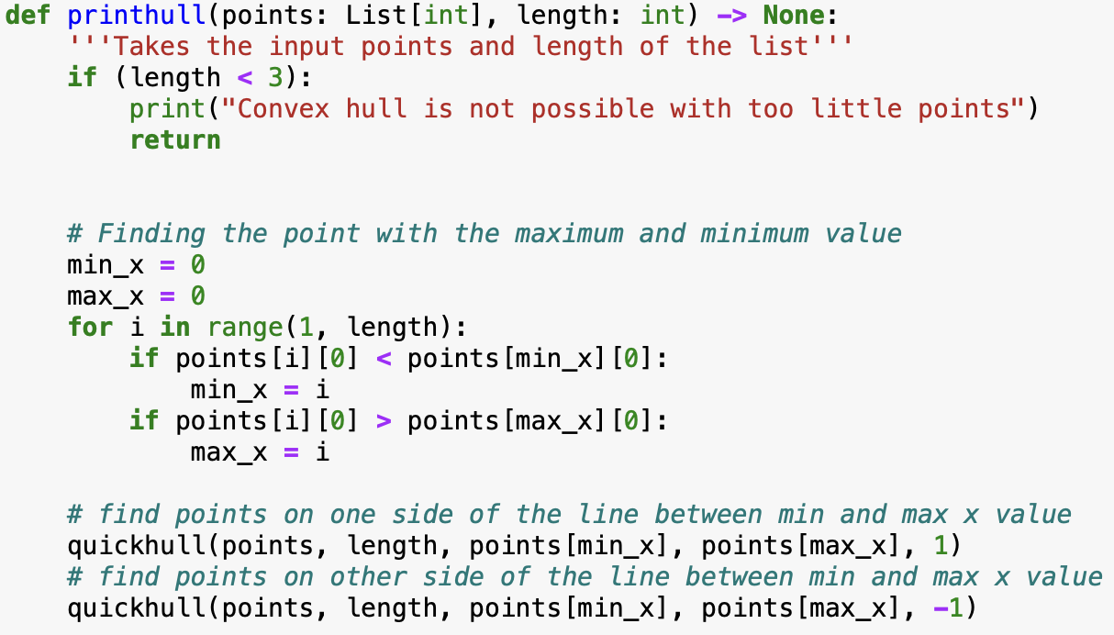
Main algorithm functions

Slide 6
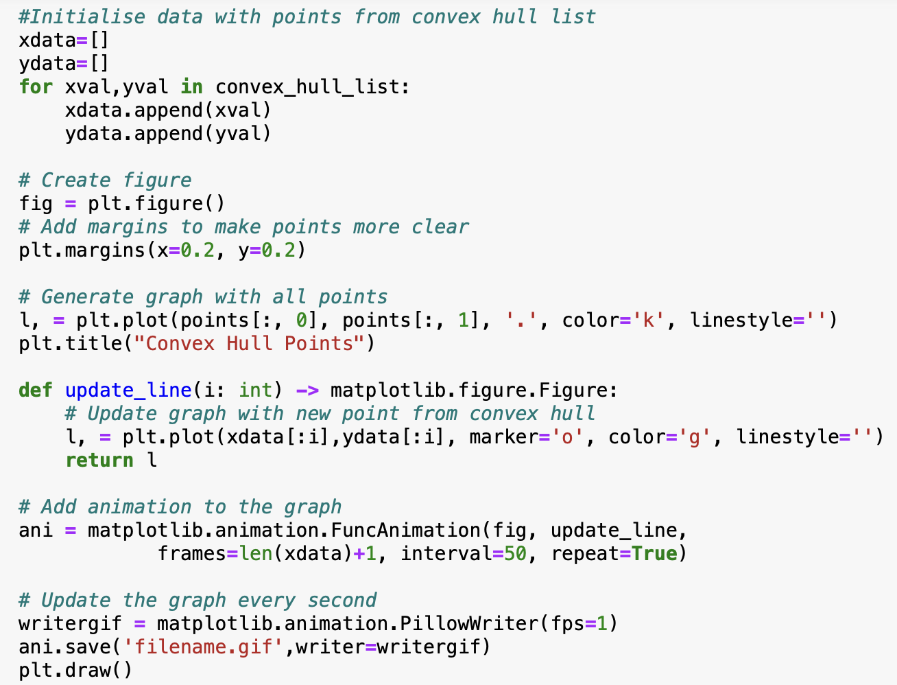
Visualisation of QuickHull

Slide 7
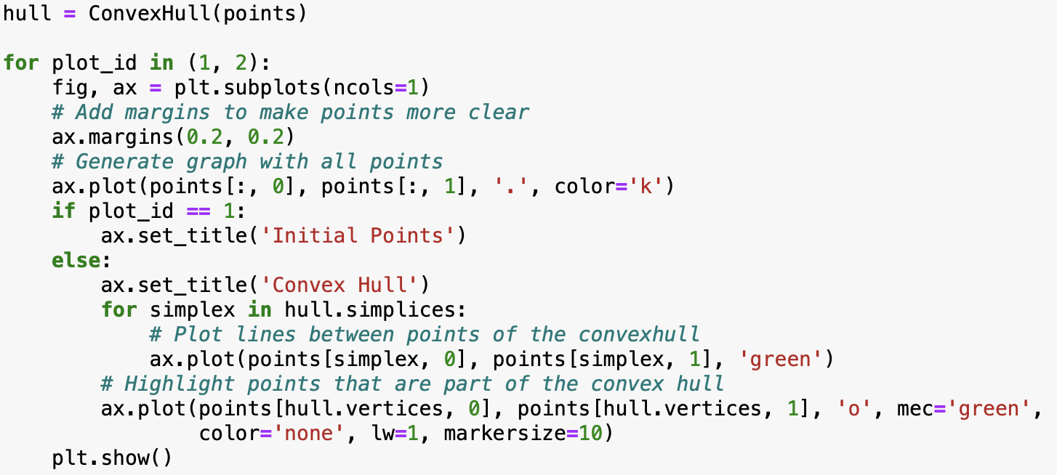
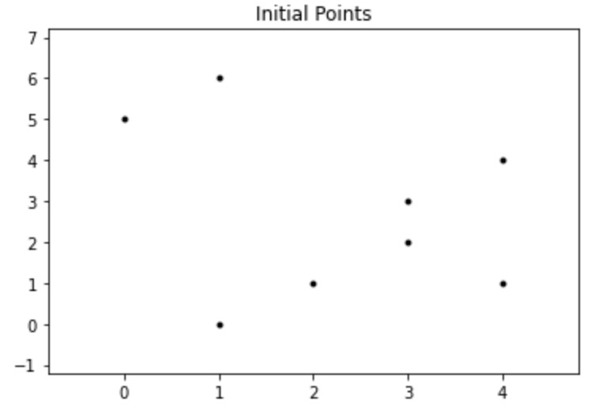
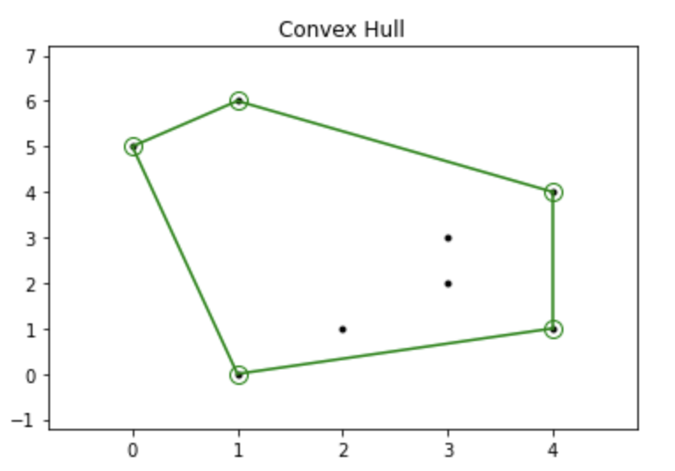
Visualisation of QuickHull cont.

