Slide 1
QuickHull algorithm analysis

Slide 2
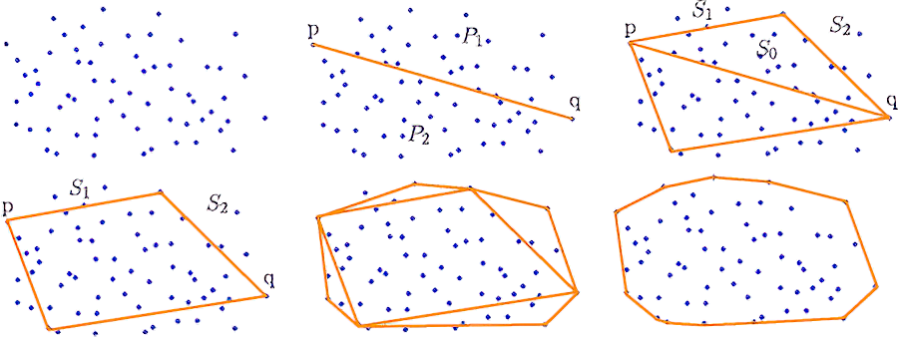
Introduction to QuickHull
A recursive algorithm that uses the divide and conquer approach
Introduced by C. Bradford Barber, David P. Dobkin, and Hannu Huhdanpaa in 1996
Creates a convex hull that encloses all points

Slide 3
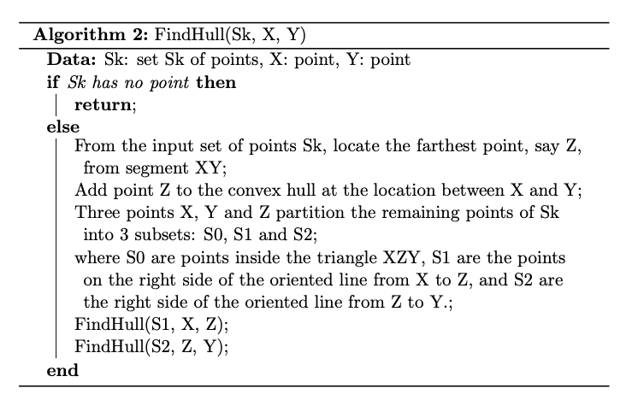
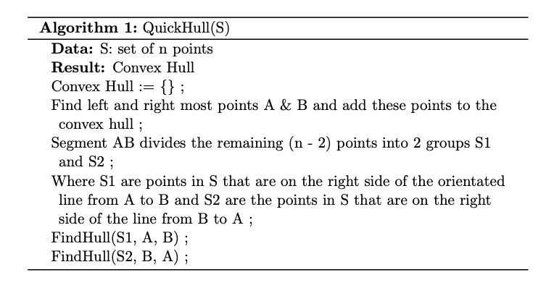
Pseudo-code and workings of the algorithm

Slide 4
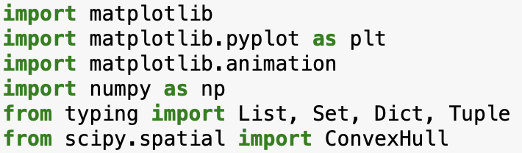
Preliminaries for the algorithm

Slide 5
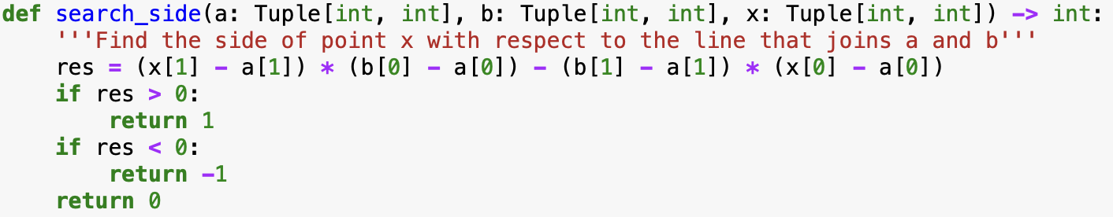
Functions used in the algorithm

Slide 6
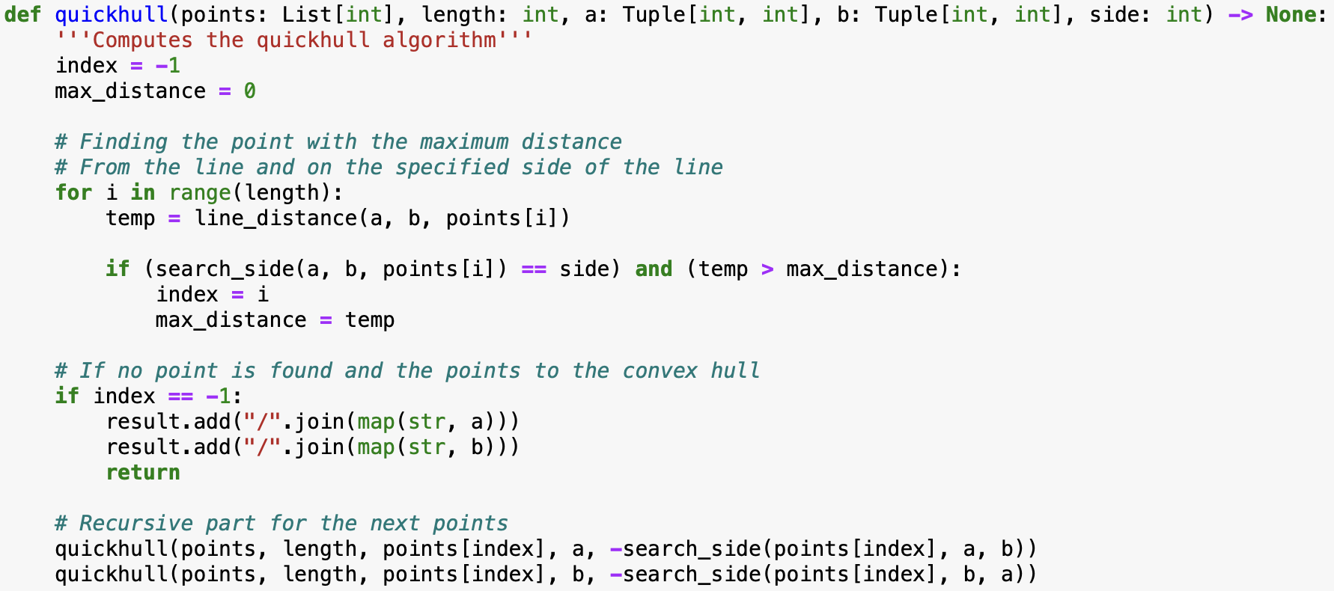
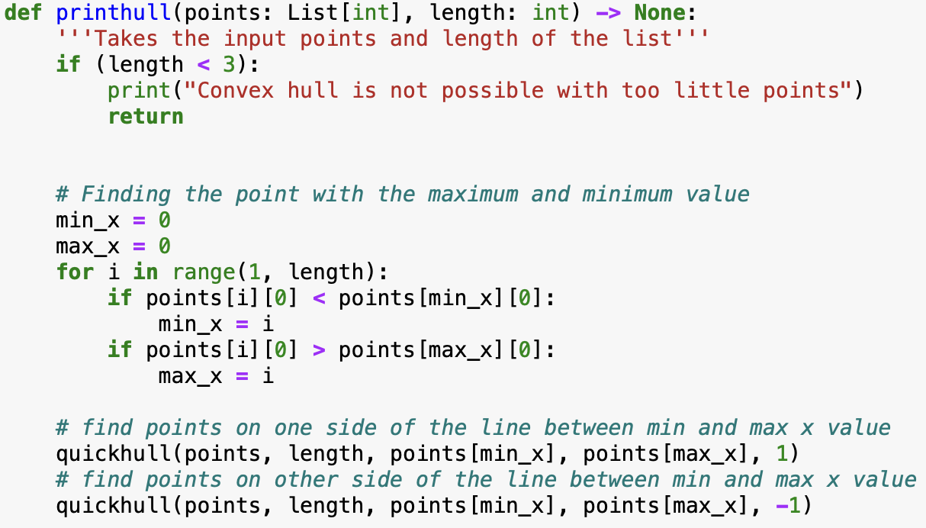
Main algorithm functions

Slide 7
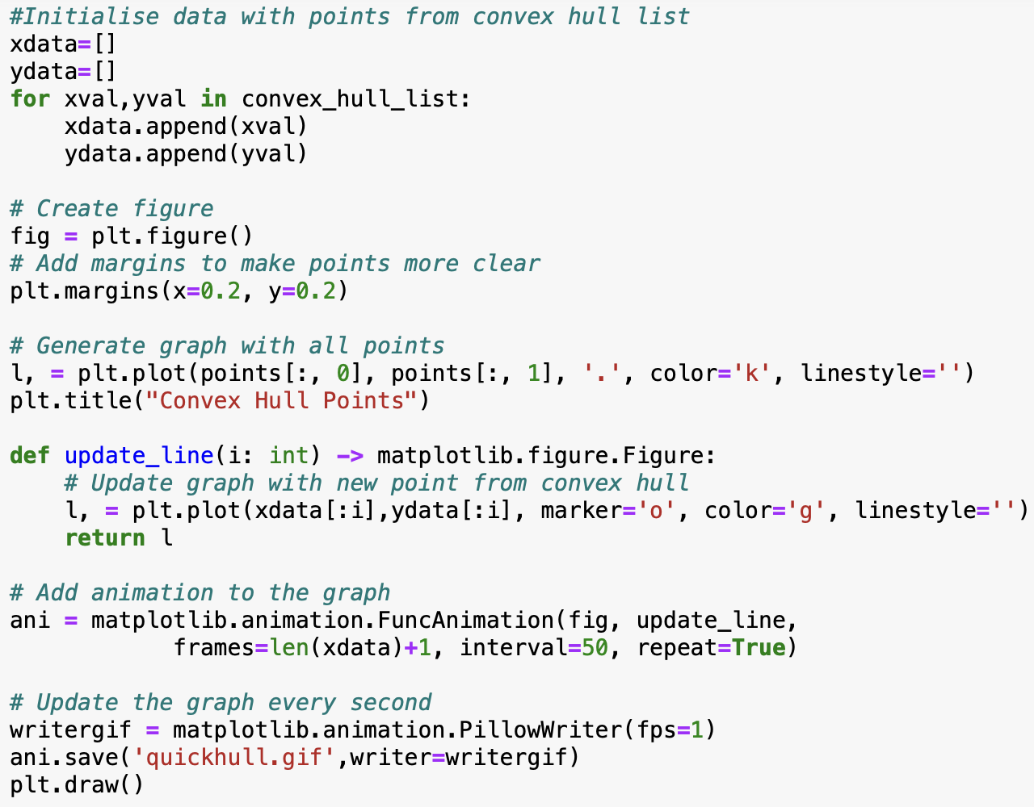
Visualisation of QuickHull

Slide 8
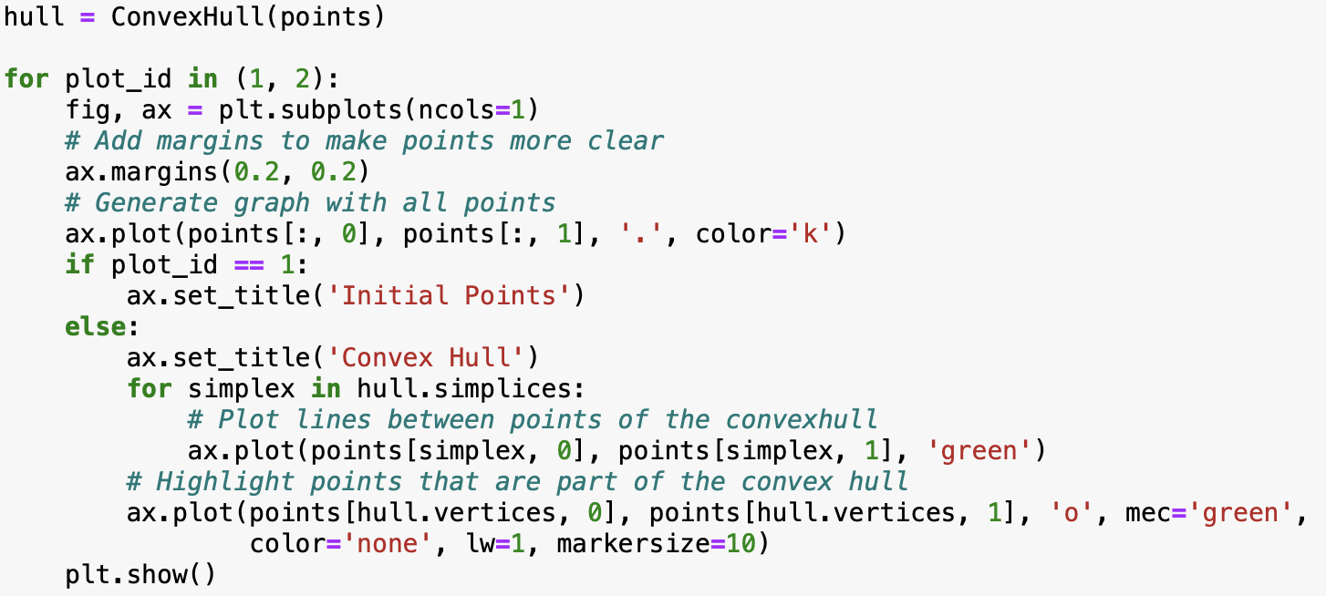
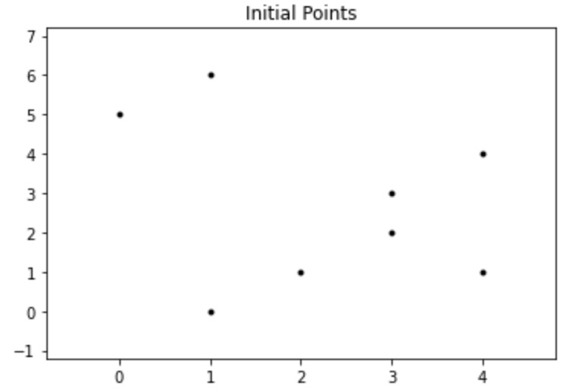
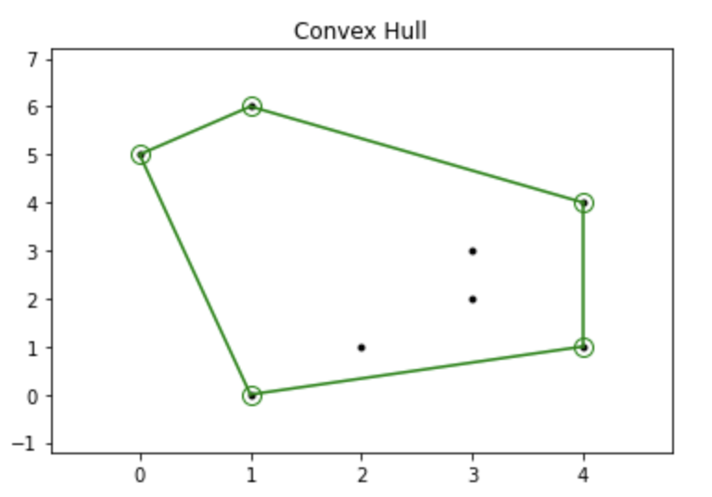
Visualisation of QuickHull cont.

Slide 9

Summary

