Slide 1
Case study: How does a bike-share company navigate speedy success?
Stefan Crasmareanu Data Analysis Case Study 18-26 February 2026

Slide 2
Agenda
Introduction and context
Business Task & Data available
Steps in cleaning, processing
Analysis
Conclusions
Proposals
Another approach using Machine Learning
Tools used
18-26 February 2026

Slide 3

Introduction
This case study is a project proposal integrated in the Google Data Analytics course as a way to exercise and develop know-how in the context of a capstone project.
Tackling this task involves:
Formulating business questions
Going through the standard stages of data processing (ask, prepare, process, analyze, share and act)
Using data to establish trends and patterns
Proposing business strategies to achieve the scope of the analysis
18-26 February 2026

Slide 4

Context
The study simulates a real project, centered around the activity of a fictional bike-sharing company.
The stakeholders for this project are:
- the analytics team
- the marketing manager
- executive director of the company
They showcase various levels of data analytics and business knowledge, but all require certain take-aways from the investigation.
Note: the data that is provided comes from a real bike-sharing company in Chicago. The data has been made available by Motivate International Inc. under this license.
18-26 February 2026

Slide 5
Business Task
Company specifications:
Founded in 2016, Cyclistic launched a successful bike-share offering in Chicago
Currently the program involves a fleet of 5,824 bicycles and network of 692 stations across the city
Until now, Cyclistic’s marketing strategy relied on building general awareness and appealing to
broad consumer segments
18-26 February 2026

Slide 6
How does the ride-sharing go?
the company offers the possibility to choose a one-time rent (either single-ride or a day-pass) or to become an annual member with permanent benefits
riders who choose a one-time rent are called casuals, and the others members
the bikes can be unlocked at any public station in the company’s infrastructure, as well as at public racks owned by the city council or simply from their sidewalk location
the bikes can be returned in any of the previously mentioned stations for free, but also on private sidewalks (provided that the public parking laws and regulations are respected) for an extra fee
the company offers a choice of classic or electric bikes
Note: no other specifications have been provided in the documentation
18-26 February 2026

Slide 7
What is the purpose of the study?
Cyclistic’s finance analysts have concluded that annual members are much more profitablethan casual riders -> Rather than creating a marketing campaign that targets all-new customers, the marketing strategy aims at converting casual riders into annual members
Therefore, the following study will focus on using data to understand:
How do casual and member riders behave differently?
What would convince a casual rider to become a member?
How can the company efficiently promote memberships?
18-26 February 2026

Slide 8
Where does the data come from?
The data provided corresponds to real-world rides. All information with private data or that could lead to identifying real persons has been removed.
The data available shows metrics regarding all rentals in the last 12 months, with no financial measurements.
No attempt to link this data to further communications provided by the real-world corresponding ride-sharing company was made.
The data available is:
Current (spans on the period February 2025 – January 2026)
Relevant to the business task
Reliable & Original (first-party data)
Comprehensive (includes all rentals in the specified period – over 5 mil. rentals)
Unbiased
Data Analysis Case Study
18-26 February 2026

Slide 9

Data dimensions
The raw data is provided in the form of .csv file for each of the 12 months.
Each ride represents an observation. The following data fields are listed:
ride ID (string): represents the primary key
rideable type (string): type of bike rented (classic/electric)
start and end time of the ride (date_time)
start location name (string): name of the starting station/rack/location
start location ID (string): ID of the starting station/rack/location
end location name (string): name of the end station/rack/location
end location ID(string): ID of the end station/rack/location
start and end location latitude/longitude (double)
rider status (string): member or casual
Data Analysis Case Study
18-26 February 2026

Slide 10
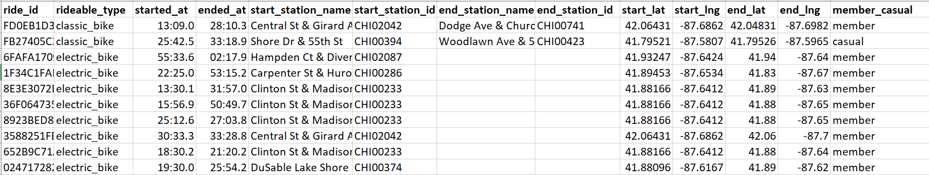
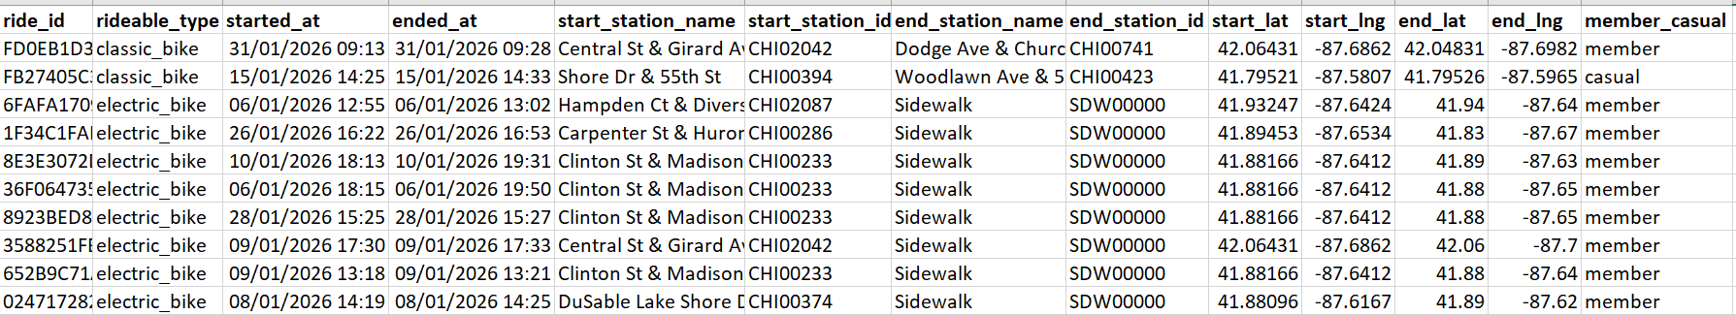
Data cleaning
The following steps were performed using Excel for each month’s csv:
Ensure that there are no blanks/duplicate ride IDs
Ensure that the rideable types are correct (classic/electric)
Ensure all dates and time are formatted correctly
Check that the data corresponds to the correct monthReplaced blanks in the start and end locations names with ‘Sidewalk’
Replaced blanks in the start and end locations IDs with ‘SDW00000’
Checked that latitude and longitude fall in the range specific for the city of Chicago
Checked that rider status values are correct (casual/member)
Data Analysis Case Study
18-26 February 2026

Slide 11

Data processing
Data size:
over 5.5 mil. different rides (corresponding to lines across the 12 .csv files)
storage size of 917MB
Approach was to use SQL databases to process and analyse the data
Data Analysis Case Study
18-26 February 2026

Slide 12
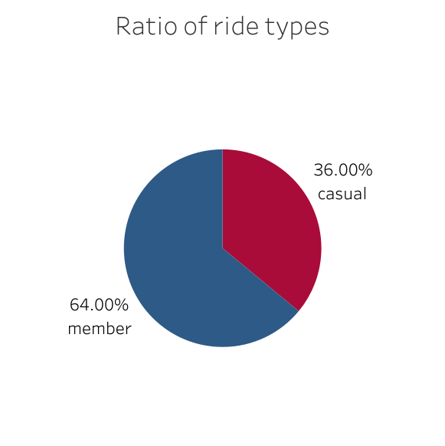
Steps to create a working database
cleaned data was uploaded to a BigQuery SQL database
checks regarding data integrity were performed (correct data format, unique primary keys etc.)
Monthly information was merged into two full-year tables:
Rides table: primary key is ride ID, with referring stations only by station ID (instead of both ID and name as originally)
Stations table: obtained by collecting all unique station IDs from the monthly tables to serve as primary key and attributing them a single name
A temporary table to compute the number of rides by casual/member riders was created ->frequently used through in the analysis phase
Context: 36% of rides in the last 12 months were done by casual renters
Data Analysis Case Study
18-26 February 2026

Slide 13
What makes the casuals special?
The first part of the analysis will focus on revealing different behaviour trends that characterize the casual riders. These particularities can then be targeted in order to convince casuals to become members.
The main findings are:
casuals are more likely to rent bikes for leisure, rather than day-to-day transport
casuals usually rent bikes for a longer duration compared to members
On the other hand, we established that certain trends are common for both casuals and members. These can also become part of the strategy further:
by far the most rides have a public sidewalk as start and/or end location
electric bikes have double the popularity of classic bikes
Data Analysis Case Study
18-26 February 2026

Slide 14
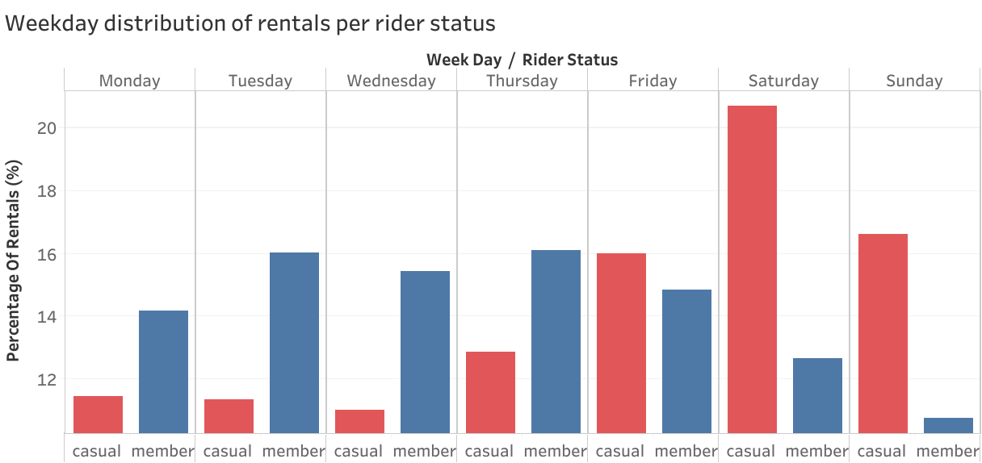
Leisure versus Business?
The graphs shows that by far the most casual riders rent bikes on weekend – opposite trend compared to members.
This suggests that casual riders prefer to rent bikes for fun activities on free days, rather than to commute to work/school.
Data Analysis Case Study
18-26 February 2026

Slide 15
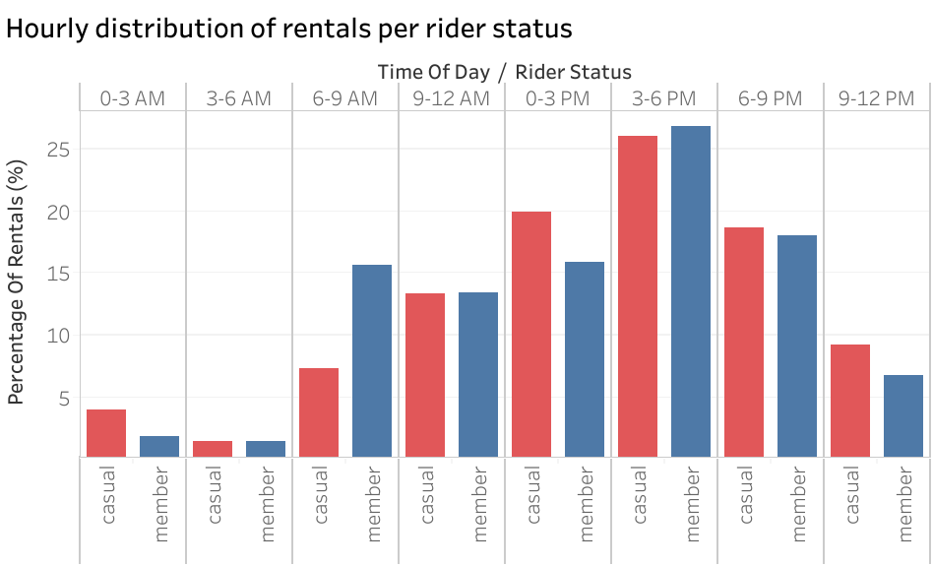
Leisure versus Business?
The same trend is confirmed when looking into the most popular times for the start of the ride, split into rides by casuals/members:
Casuals are most likely to rent bikes starting at noon to late afternoon, with members more active during rush hours (especially mornings).
Data Analysis Case Study
18-26 February 2026

Slide 16
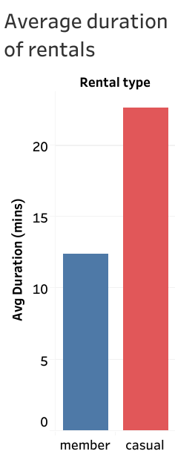
What about ride duration?
Computing the average ride duration for both casuals and members shows a clear trend:
Casuals take nearly twice as long rentals compared to members
Data Analysis Case Study
18-26 February 2026

Slide 17
Trends in behaviour
A strong tendency for both casuals is to pick-up/ park their bikes on public sidewalks. The following shows that these options are by far more popular than any of the company’s established stations:
Start location | Percentage of rides (%)
Sidewalk | 21.64639
Navy Pier | 2.14735
DuSable Lake Shore Dr & Monroe St | 1.237142
Michigan Ave & Oak St | 0.938106
DuSable Lake Shore Dr & North Blvd | 0.823562
End location | Percentage of rides (%)
Sidewalk | 24.36252
Navy Pier | 2.194048
DuSable Lake Shore Dr & Monroe St | 1.152396
Michigan Ave & Oak St | 0.940256
DuSable Lake Shore Dr & North Blvd | 0.915457
Top 5 most popular start/end locations amongst casual riders and the percentage of rides that they correspond to.
Note: a very similar trend can be observed amongst member riders as well
Data Analysis Case Study
18-26 February 2026

Slide 18
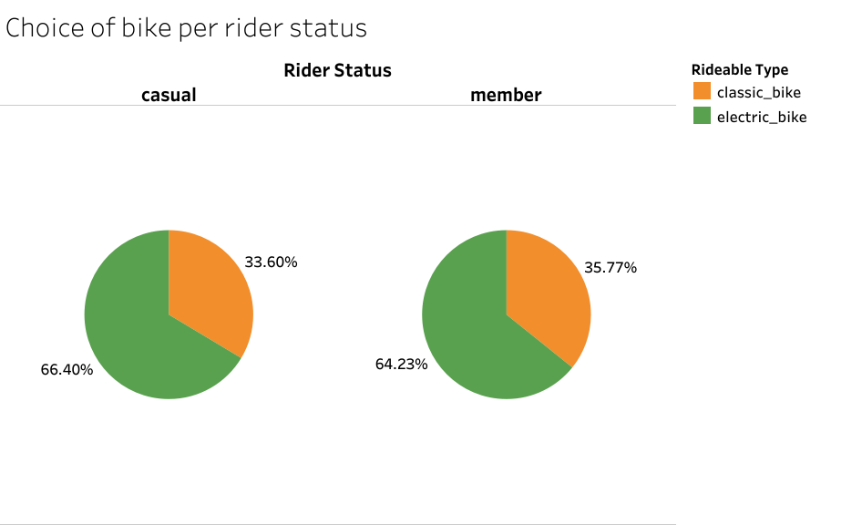
Choice of bike type
The following graphs shows that the rider status can not be correlated to a certain choice of bike type:
Electric bikes are almost twice as popular for both categories of customers
Data Analysis Case Study
18-26 February 2026

Slide 19
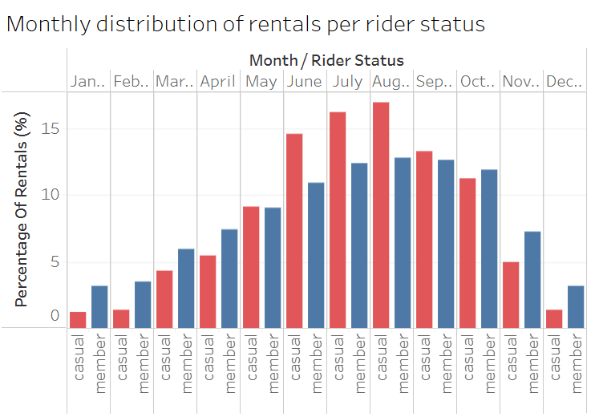
Issues during winter months
With leisure rides amongst casual customers more frequent, the data shows a low number of rides during colder months of the year:
This suggests a lack of opportunities for casual riders during winter months
Note: information from previous years should be used to fully confirm this trend

Slide 20

What would convince a casual rider to become a member?
The trends we established show up to a good extent what casual riders appreciate in the company’s services. A good strategy to convert them into members would be to include certain benefits for the membership status, that the current casuals can benefit from:
Improved financial packages for members during weekends and/or during the 12AM – 6PM hourly interval – financial incentive to become a member;
Possibility for members to reserve bikes for multiple people in advance – could help current casuals that want to ride bikes for leisure together with friends or family;
Offer indoors cycling possibilities for leisure during the winter time.
Free/reduced pay for members to park their bikes in public sidewalk spots at the end of ride;
Organize fun activities/competitions on weekends, with certain benefits for members, such as food & drinks
Data Analysis Case Study
18-26 February 2026

Slide 21
How can the company promote memberships?
Regardless of the measures that are adopted, the data can be useful to decide how the new strategy can be promoted amongst customers (especially those that are currently casuals).
Our proposal includes:
Designing the media interface (such as renting apps, sign postings, logos etc. ) of the company in a way that encourages cycling for leisure in order to resonate with the currently casual rider’ preferences;
Promote the offers at public leisure events, especially on weekends;
Put up promoting signs along the most popular riding areas for casuals.
Data Analysis Case Study
18-26 February 2026

Slide 22
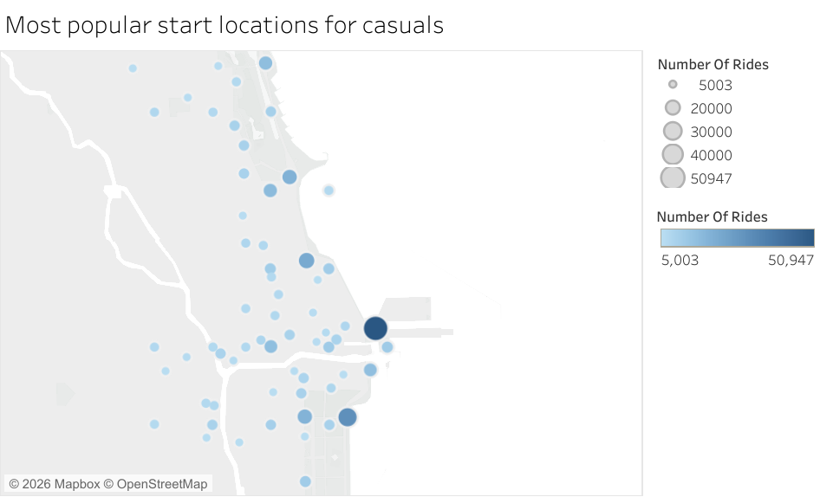
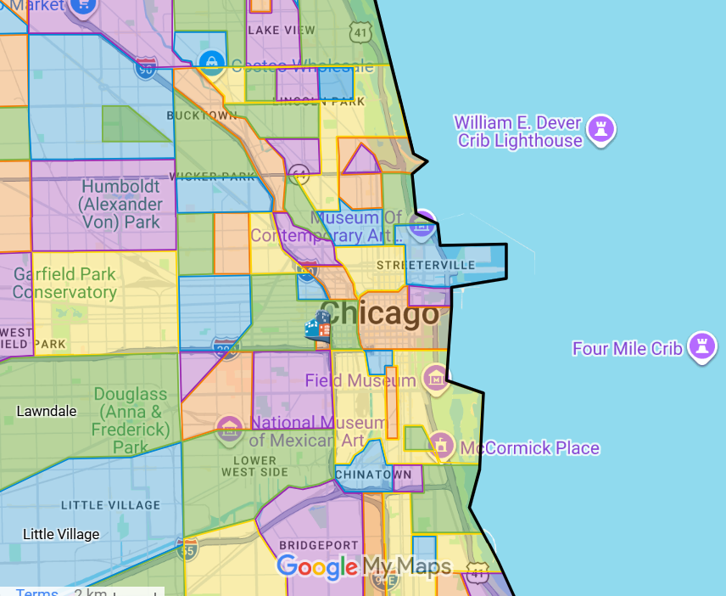
Most popular riding areas for casuals
Using latitude and longitude data, we show all the locations from which at least 5000 casual rides started :
The map shows that the most popular neighbourhoods are Streeterville, Downtown, New East Side and Gold Coast
Click for source of the above image

Slide 23
Conclusions
The data shows a strong tendency for the currently casual rides to rent bikes on weekends for leisure activities and for longer durations.
Measures can be taken to encourage activities during time off and to provide alternatives during winter period to increase year-round memberships.
A specific area in which most casual rides take place has been identifies .
Measures proposed:
- Improved financial packages for members during weekends and/or during the 12AM – 6PM hourly interval
Possibility for members to reserve bikes for multiple people in advance
Offer indoors cycling possibilities for leisure during the winter time.
Free/reduced pay for members to park their bikes in public sidewalk spots;
Organize fun activities/competitions on weekends, with certain benefits for members
Data Analysis Case Study
18-26 February 2026

Slide 24
Data limitations and future possibilities
The data that was used for this study has certain shortcomings:
No quantitative pricing information was made available (expected to be a strong factor influencing customer behaviour)
There is no possibility to track personal profiles – the data shows whether a rental was done by a member or a casual rider, but this fails to show personal trends
Information only covers the last 12 month – not fully reliable when it comes to establishing year-long trends
Possible steps for the future:
Add pricing information to check whether the financial dimension affects our conclusions
Add information about riders’ profile (such as anonymous rider IDs) -> new metrics can be derived, such as how often does a casual rider rent bikes (on average)
Use historical data from previous years to confirm year-long trends
Data Analysis Case Study
18-26 February 2026

Slide 25
Another approach using Machine Learning
The authors of the case study task propose to analyse data in order to discover what makes the casuals different from the members, and propose strategies accordingly. Another approach to the issue could be to discover which of the currently casual riders already behave like members – thus are more likely to be persuaded in acquiring memberships.
Thus, I developed the following scheme, with the aim to build a membership recommendation calculator:
BigQuery dataset
SQL feature query
Python dataframe
Machine Learning model
Membership recommendation calculator
18-26 February 2026

Slide 26

Model considerations
While the dataset can be viewed as a time series, this is not the most viable approach for the current task -> frequency, periodicity have little meaning when we don’t take into account the status of the clients;
Main idea is to define patterns for members/casuals and classify behaviours by measurable similarities;
Logistic regression is viable for the goal because it is designed to model binary outcomes and estimate the probability that an observation belongs to one of two categories;
The data metrics that will be used are rides duration, time of the day when it
occurs, day of the week (with special distinction for weekends), duration of the ride,
as well as the type of bike that is chosen;
The logistic regression function built-in the Python library scikit-learn will be used.
Data Analysis Case Study
18-26 February 2026

Slide 27
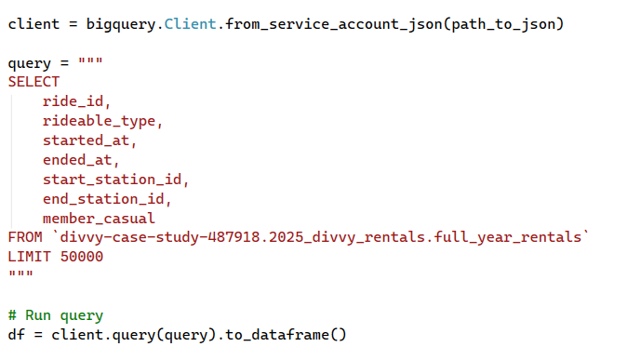
Bring data from SQL into Python
For demo purposes, only 50000 will be used to train the model; for real use cases, the data volume needs to be increased considerably
Data is converted into Python dataframe format
Data Analysis Case Study
18-26 February 2026

Slide 28
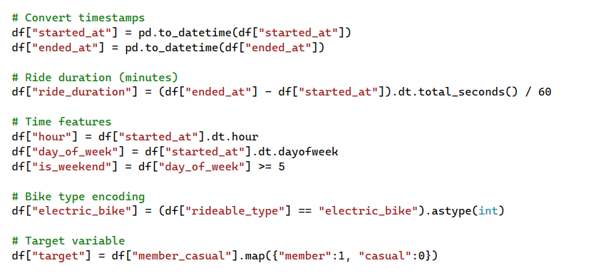
Prepare data for the model
The target variable is the rider status
Data Analysis Case Study
18-26 February 2026

Slide 29
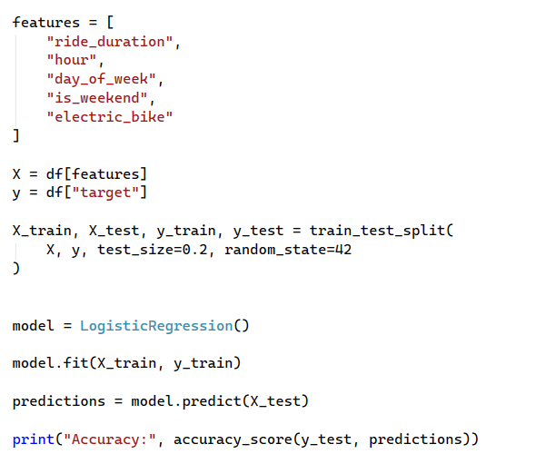
Train the model
We always compute the accuracy of the model
Data Analysis Case Study
18-26 February 2026

Slide 30
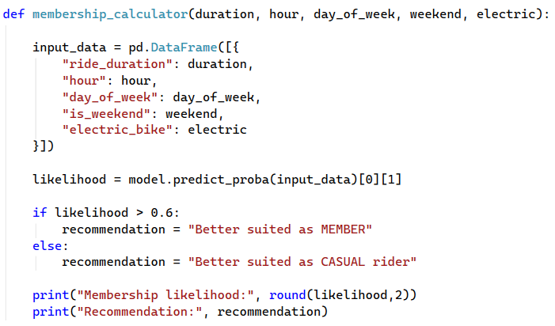
Build the membership recommendation calculator
Data Analysis Case Study
18-26 February 2026

Slide 31

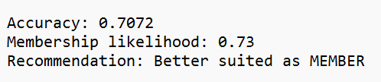
Calculator demo
Input:
We test the calculator for a casual rider that:
Rents bikes for an average of 12.75 minutes;
Usually rides around 8AM, and on Tuesdays;
Always chooses electric bikes.
Output:
The calculator estimates that rider’s behaviour has a similarity of 73% to the behaviour of current members.
Note: the relatively low accuracy of the model (approx. 70%) is due to the limited volume of data that is fed into the model, as well as possibly high discrepancies in the data

Slide 32
Tools
Spreadsheets editor: Microsoft Excel 2019
Relational Data Base Management System: BigQuery (with SQL syntax)
Visualizations: Tableau Public
Python 3.10 (with scikit-learn, pandas, google-cloud libraries)
All code/resources can be accessed on GitHub profile: https://github.com/stefancrasmareanu-a11y/Case_study_bike_sharing_company/
Data Analysis Case Study
18-26 February 2026

Slide 33

Thank you!
For any question regarding this study, feel free to contact me. Any feedback is appreciated!
Stefan Crasmareanu
stefancrasmareanu@gmail.com
Data Analysis Case Study
18-26 February 2026

