Slide 1
Demystifying the APEX JavaScript API-s
@stefan__dobre
#techfest19

Slide 2
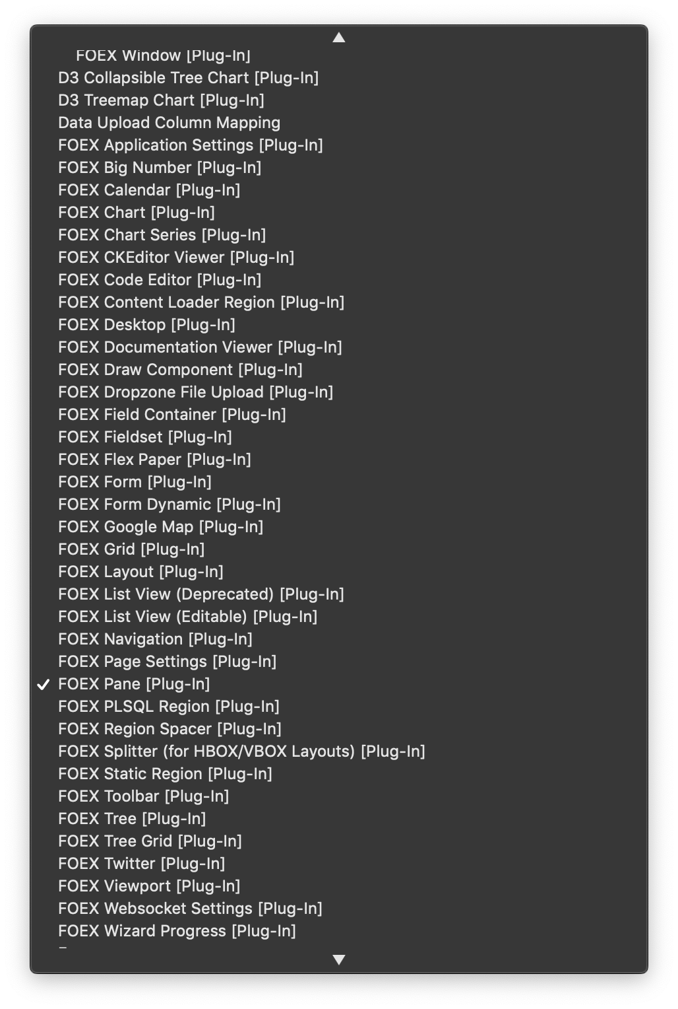
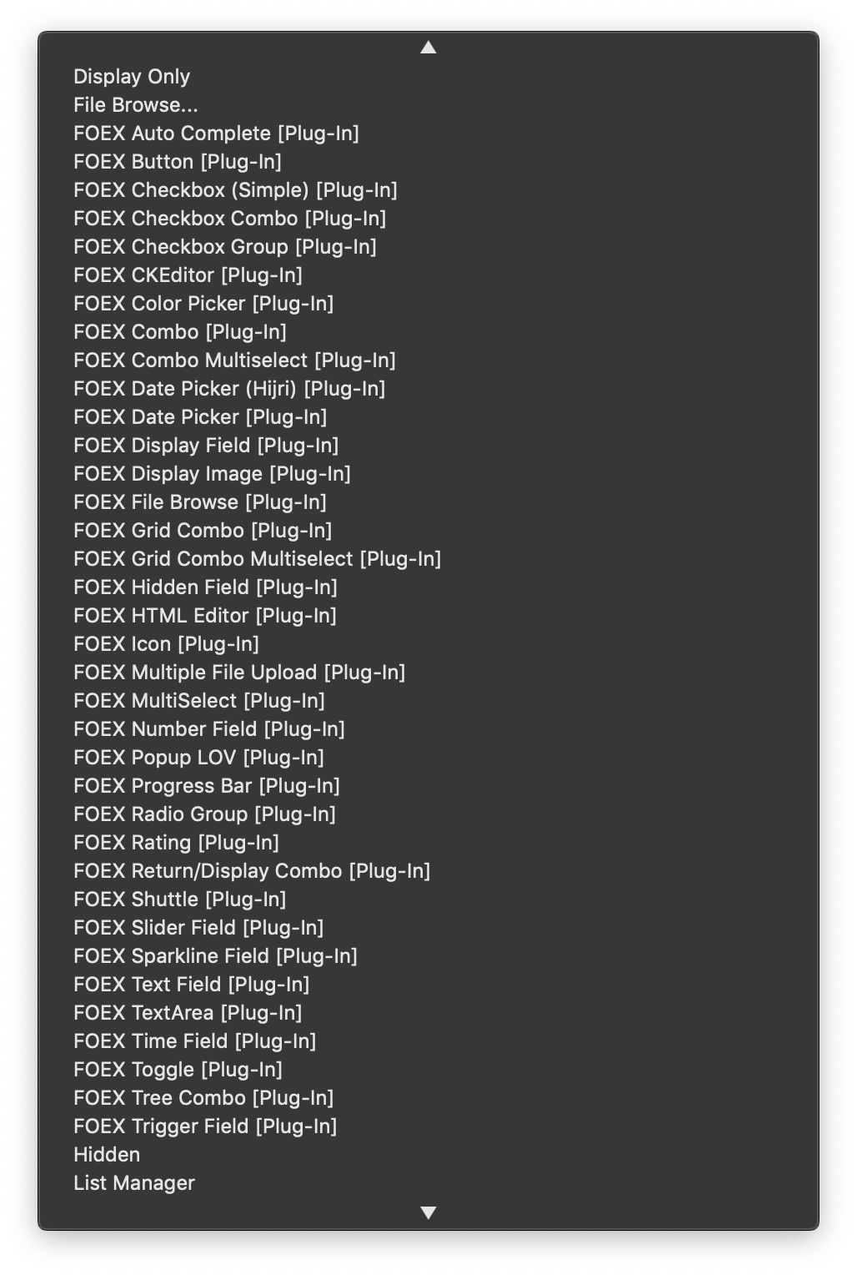
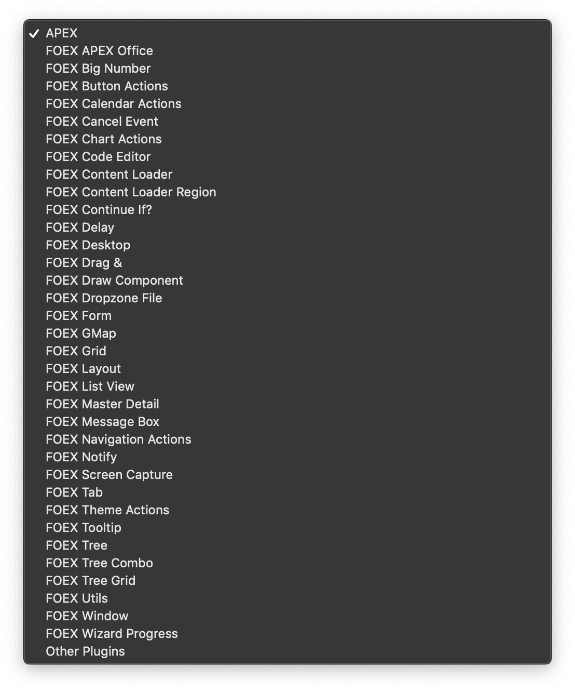
FOEX Plug-in Framework
160+ Plug-ins
Single Page Applications
Drag & Drop
Web Sockets

Slide 3
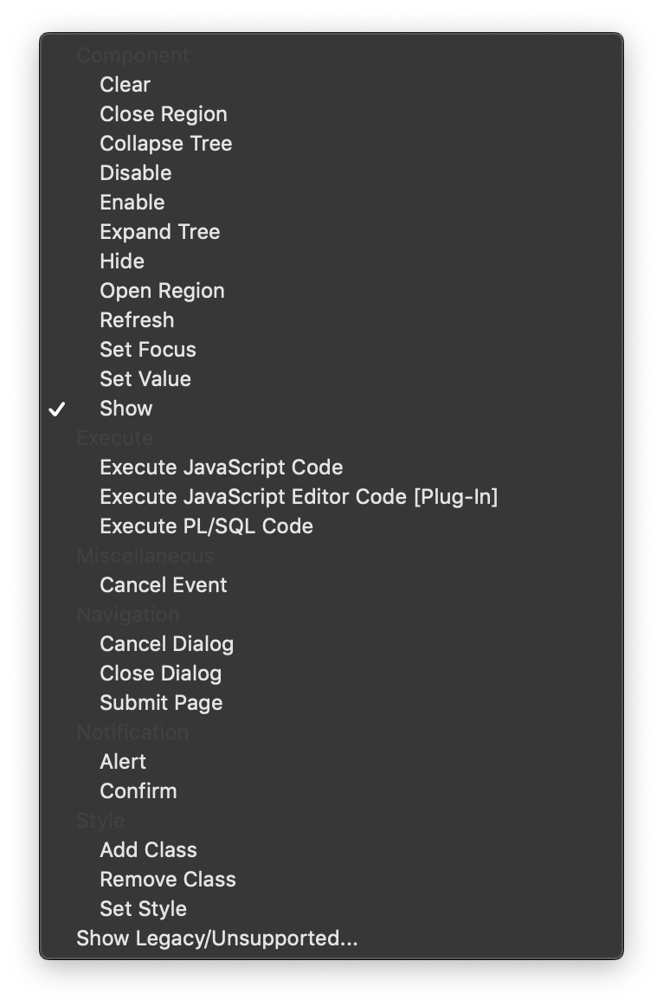
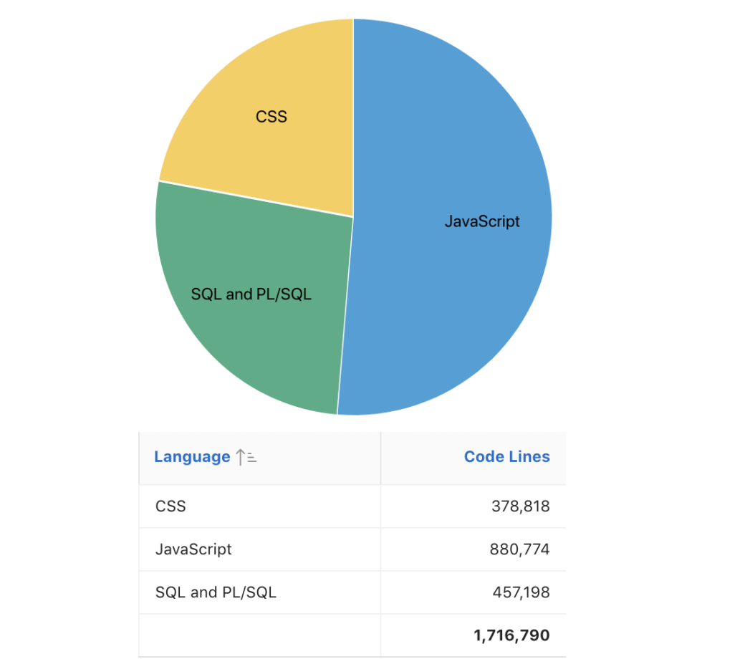
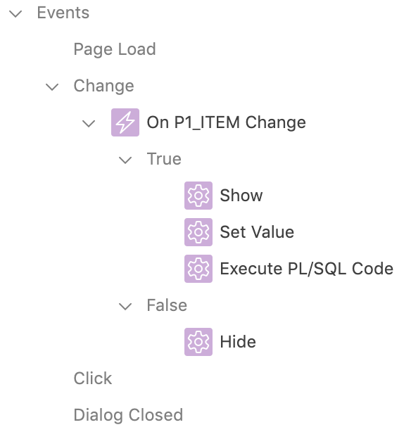
A case for JavaScript in APEX
Build more dynamic apps
Improve user experience
For when Dynamic Actions are not enough
Leverage already existing functionality
JavaScript will only keep growing
Notes:
1) Build more dynamic apps – Use AJAX Callbacks as opposed to traditional page submits
2) Improve user experience – Live validation
3) For when dynamic actions are not enough
- 1. Only 1 level condition
- 2. No error handling
4) Leverage already existing functionality
- How many dynamic actions do we have? 20, 30? But we know these API-s can do more
5) JavaScript will only grow
- Show chart
- More JET charts components, MLE coming to the database

Slide 4

Word of caution
Writing custom code =
Longer development
Longer maintenance
Statistically, more bugs

Slide 5
What JavaScript API-s does APEX offer us?
JavaScript API Reference (apex.oracle.com/jsapi)
Universal Theme JavaScript (apex.oracle.com/ut)
Integration with the API-s of 3rd party components
E.g. Charts, Calendar, Rich Text Editor

Slide 6
APEX JavaScript API Reference
apex.oracle.com/jsapi
1.
Widgets
2.
Namespaces
4.
Non-Namespace API-s
3.
Interfaces

Slide 7
APEX JavaScript API Reference
apex.oracle.com/jsapi
1.
Widgets
2.
Namespaces
3.
Interfaces

Slide 8
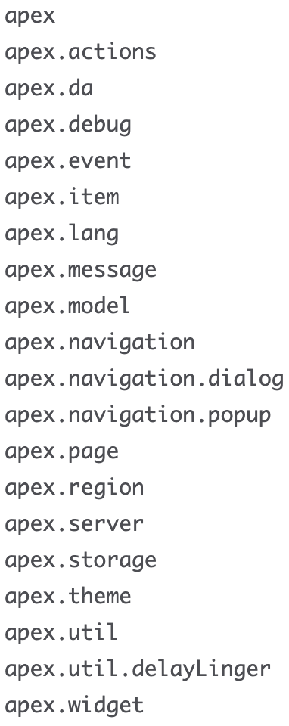
2. Namespaces
Could be compared to PL/SQL packages
Utility functions grouped together by purpose and scope
Note: apex.item & apex.region are functions themselves!

Slide 9
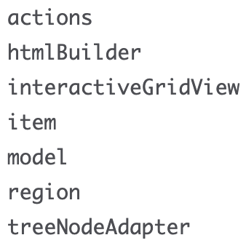
3. Interfaces
We cannot call interface methods directly
Components implement interfaces
Access the methods though their respective component
e.g an item interface's methods can be invoked through apex.item('P1_ITEM')

Slide 10
3. Interfaces
apex.region('emp').call('getActions')
apex.util.htmlBuilder()
apex.region('emp').call('getCurrentView')
apex.item('P1_ITEM')
apex.region('emp').call('getCurrentView').model
apex.region('emp')
apex.region('emp').call('getNodeAdapter')

Slide 11
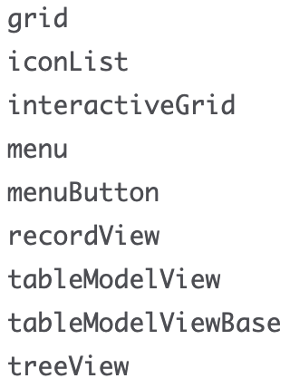
1. Widgets
Help us control 3 APEX components:
Tree
Menu
Interactive Grid
Tree & IG
Implement the region interface
apex.region('emp')
The interface controls a jQuery UI widget
apex.region('emp').call('functionName')
apex.region('emp').call('option', 'optionName')
apex.region('emp').call('option', 'optionName', 'optionValue')
Menu
Regular jQuery UI widget
$('#menuId').menu('functionName’)
$('#menuId').menu('option', 'optionName')
$('#menuId').menu('option', 'optionName', 'optionValue')

Slide 12
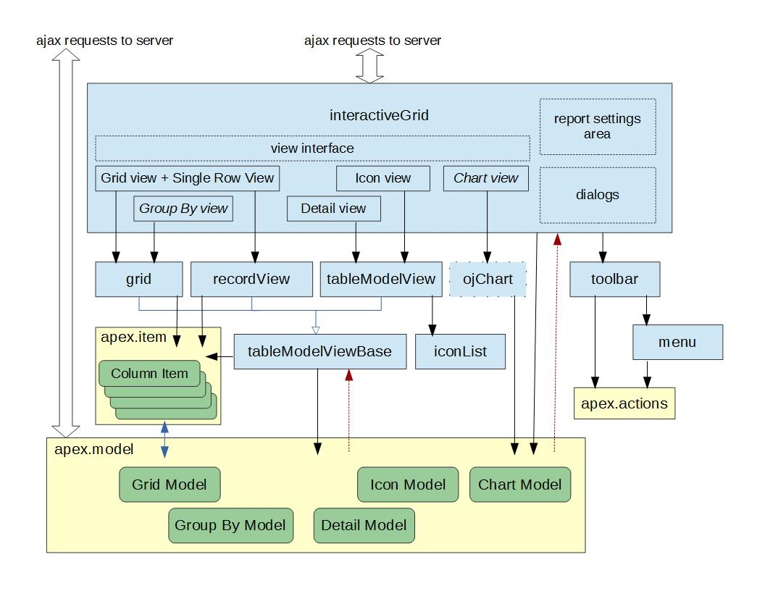
grid Widget
var region = apex.region('emp');
var gridView = region.call('getViews', 'grid');
var gridWidget = gridView.view$;
gridWidget.grid('selectAll');
https://hardlikesoftware.com/weblog/2016/06/08/interactive-grid-under-the-hood/

Slide 13
Some thoughts
Very useful, but there is a learning curve
Use with caution
Explore for yourself

