Slide 1
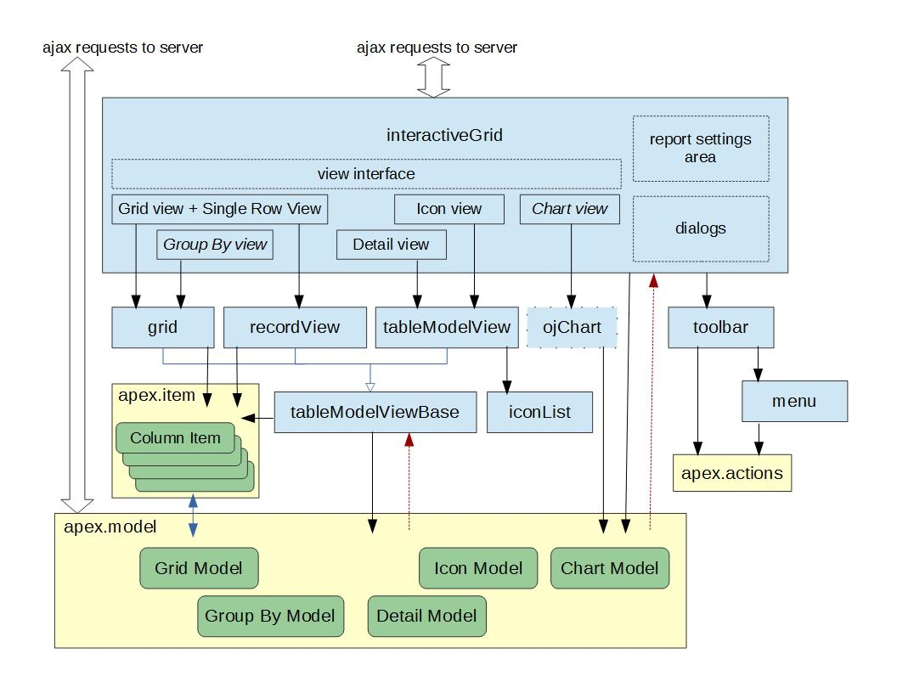
http://hardlikesoftware.com/weblog/2016/06/08/interactive-grid-under-the-hood/

Slide 2
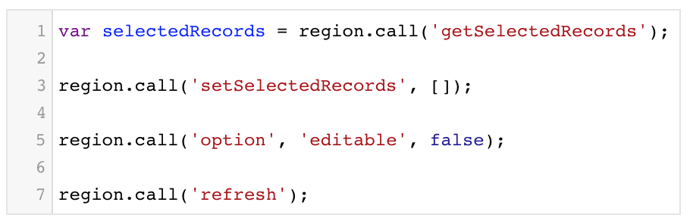
API Name:
interactiveGrid
How to get it:
What to do with it:

Slide 3
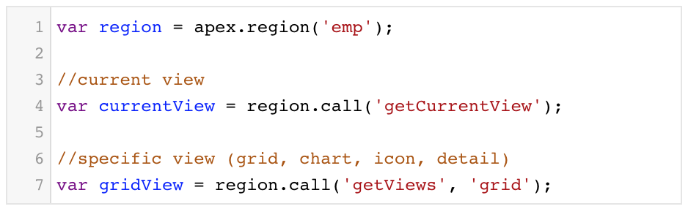
API Name:
interactiveGridView
How to get it:

Slide 4
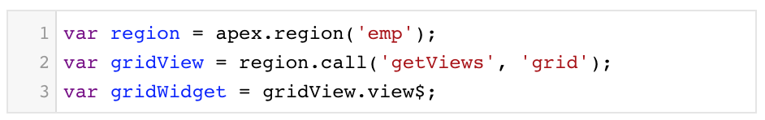
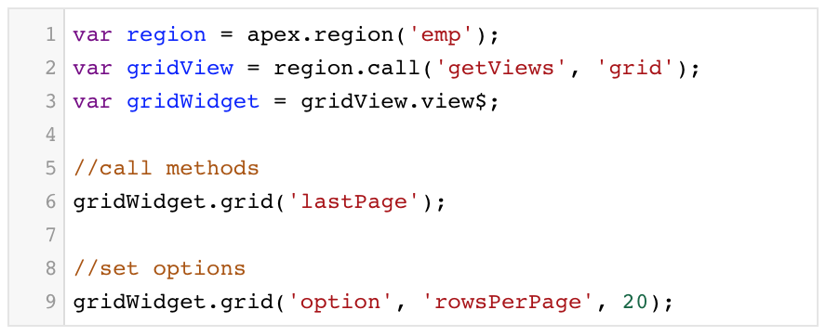
API Name:
grid
How to get it:
What to do with it:

