Slide 1
Subtask ID | Subtask description | Professional‘s description | #of subtasks per task
push | Push box on table | Lunge, feet hip wide, chest out, shoulders back, straight back, lean forward, bend front knee, extend your arms, pressure on front leg, push box by activating back muscles | 4
pull | Pull box on table | Lunge, feet hip wide, chest out, shoulders back, straight back, lean forward, bend front knee, extend your arms, pressure on front leg, pull box by activating back muscles | 4
turn | Turn box by 90° on table | Feet hip wide, lean slightly forward with straight back, turn box with arm muscles, weight of the box remains on the table | 4
fold | Put the box from one side to another on the table | Feet hip wide, straight back, slightly bended arms, depending on the distance to the box: lean over table, no bent knees, weight of the box remains on the table | 4
carry | Translation in space with the box in hand | Chest out, straight back, bend elbows to 90°, box near to body, shoulder in neural-zero | 4
walk | Translation in space without the box | “normal walking on their own judgment“, straight back | 4
lift | Lift up the box from the floor | Approach box as near as possible, weight shifted slightly to the front, bend knees, open legs while going down, stop at the raised heels, lean forward with straight back, lift box with quadriceps (tights), chest out, elbows aim at ca. 90° | 3
lower | Lower box to floor | Head above pelvis, bend knees and open legs, chest out, straight back and head, extend arms | 3
place | Put box on table | Parallel hip wide feet, bend knees slightly, lean forward with straight back, lower arms | 2
pick | Pick up box from table | Parallel hip wide feet, bend knees slightly, lean forward with straight back, lift with arms, abdominal and back muscles | 2
 |  |  | Total: 34 subtasks per task

Slide 2
Task 1 |  |  | Task 2 |  |  | Task 3
Sub- task# | Description | ST ID | Sub- task# | Description | ST ID | Sub- task# | Description | ST ID
 | start in front of mirror, box on floor |  |  | start in front of mirror, box on floor |  |  | start in front of mirror, box on floor
ST1 | lift up box | lift | ST1 | lift up box | lift | ST1 | lift up box | lift
ST2 | carry box to table | carry | ST2 | carry box to scale | carry | ST2 | carry box to table | carry
ST3 | place box on table | place | ST3 | lower box to scale | lower | ST3 | place box on table | place
ST4 | push box away | push | ST4 | lift up box | lift | ST4 | fold box away | fold
ST5 | fold box away | fold | ST5 | carry box to table | carry | ST5 | walk to table center | walk
ST6 | walk to left side of the table | walk | ST6 | place box on table | place | ST6 | turn box left | turn
ST7 | fold box to bottom | fold | ST7 | push box away | push | ST7 | fold box to bottom | fold
ST8 | pull box | pull | ST8 | walk to right side of table | walk | ST8 | push box away | push
ST9 | pick up box | pick | ST9 | pull box | pull | ST9 | walk to right side of table | walk
ST10 | carry box to scale | carry | ST10 | push box away | push | ST10 | pull box | pull
ST11 | lower box to scale | lower | ST11 | walk to table center | walk | ST11 | fold box away | fold
ST12 | lift up box from scale | lift | ST12 | fold box left | fold | ST12 | turn box right | turn
ST13 | carry box to table | carry | ST13 | turn box right | turn | ST13 | push box away | push
ST14 | place box on table | place | ST14 | fold box to bottom | fold | ST14 | walk to table center | walk
ST15 | turn box left | turn | ST15 | turn box left | turn | ST15 | fold box to bottom | fold
ST16 | push box away | push | ST16 | push box away | push | ST16 | turn box left | turn
ST17 | pull box | pull | ST17 | turn box left | turn | ST17 | pick up box | pick
ST18 | turn box right | turn | ST18 | pull box | pull | ST18 | carry box to scale | carry
ST19 | fold box away | fold | ST19 | fold box away | fold | ST19 | lower box to scale | lower
ST20 | pull box | pull | ST20 | turn box right | turn | ST20 | lift up box from scale | lift
ST21 | walk to left side of table | walk | ST21 | walk left side | walk | ST21 | lower box to scale | lower
ST22 | pull box | pull | ST22 | pull box | pull | ST22 | lift up box from scale | lift
ST23 | turn box right | turn | ST23 | fold box to bottom | fold | ST23 | carry box to table | carry
ST24 | push box away | push | ST24 | push box away | push | ST24 | place box on table | place
ST25 | fold box to buttom | fold | ST25 | walk to table center | walk | ST25 | push box away | push
ST26 | push box away | push | ST26 | pull box | pull | ST26 | pull box | pull
ST27 | walk to scale | walk | ST27 | pick up box | pick | ST27 | turn box right | turn
ST28 | walk to box on table | walk | ST28 | place box on table | place | ST28 | walk to right side of table | walk
ST29 | turn box left | turn | ST29 | pick up box | pick | ST29 | pull box | pull
ST30 | pick up box | pick | ST30 | carry box to scale | carry | ST30 | push box away | push
ST31 | carry box to (invisible) mirror | carry | ST31 | lower box to scale | lower | ST31 | pull box | pull
ST32 | put box on floor | lower | ST32 | lift up box | lift | ST32 | pick up box | pick
ST33 | lift box up | lift | ST33 | carry box to (invisible) mirror | carry | ST33 | carry box to (invisible) mirror | carry
ST34 | put box to ground | lower | ST34 | lower box to ground | lower | ST34 | lower box to ground | lower

Slide 3
Logging ID | Description | Unit | Research question
Elapsed time | Time since the beginning of the task | Milliseconds | RQ1.1.1-3
Current animation frame | Current frame of the GV animation | Frames | RQ1.1.1-3
Subtask ID | The current sub task performed by L | STID | RQ1.1.3
Hip distance | ED between hip of the GV and the hip L | Meters | RQ1.1.1
Left hand distance | ED between left hand GV and left hand L | Meters | RQ1.1.1
Right hand distance | ED between right hand GV and right hand L | Meters | RQ1.1.1
Left foot distance | ED between left foot GV and left foot L | Meters | RQ1.1.1
Right foot distance | ED between right foot GV and right foot L | Meters | RQ1.1.1
Head distance | ED between head GV and head L | Meters | RQ1.1.1*
Box distance | ED between box GV and box L | Meters | RQ1.1.2
Hip angle | ED between hip of the GV and the hip L | Degrees | RQ1.1.1
Left hand angle | ED between left hand GV and left hand L | Degrees | RQ1.1.1
Right hand angle | ED between right hand GV and right hand L | Degrees | RQ1.1.1
Left foot angle | ED between left foot GV and left foot L | Degrees | RQ1.1.1
Right foot angle | ED between right foot GV and right foot L | Degrees | RQ1.1.1
Head angle | ED between head GV and head L | Degrees | RQ1.1.1*, RQ1.3
Box angle | ED between box GV and box L | Degrees | RQ1.1.2
L spine bend | RM upright stance of L | Degrees | RQ1.2
L foot distance | RM support base of L | Meters | RQ1.2
L squat distance | RM squat of L | Meters | RQ1.2
L hip-box distance | RM box-near-body L | Meters | RQ1.2
GV spine bend | RM upright stance of GV | Degrees | RQ1.2
GV foot distance | RM support base of GV | Meters | RQ1.2
GV squat distance | RM squat of GV | Meters | RQ1.2
GV hip-box distance | RM box-near-body GV | Meters | RQ1.2
L looking at ID | The object L is looking at | LAID | RQ1.3
Pos x | X position for all 12 trackers | Meters | **
Pos y | Y position for all 12 trackers | Meters | **
Pos z | Z position for all 12 trackers | Meters | **
Rot x | X rotation for all 12 trackers | Meters | **
Rot y | Y rotation for all 12 trackers | Meters | **
Rot z | Z rotation for all 12 trackers | Meters | **
Total 146 columns

Slide 4
Perspective | Speed Mechanic | Multiple Representations
Ego-centric | Yes | No
Exo-centric | No | Yes
Ego- & Exo-centric | Yes | Yes
Augmented Exo-centric | Yes | Yes
Ego- & Augmented Exo-centric | Yes | Yes

Slide 5
 | Run 1 |  | Run 2 |  | Run 3
PT | Perspective | Task | Perspective | Task | Perspective | Task
PT1 | EGO | T1 | EXO | T2 | EGO & EXO | T3
PT2 | EGO | T3 | EXO | T1 | EGO & EXO | T2
PT3 | EGO | T2 | EXO | T3 | EGO & EXO | T1
PT4 | EGO & EXO | T3 | EGO | T1 | EXO | T2
PT5 | EGO & EXO | T2 | EGO | T3 | EXO | T1
PT6 | EGO & EXO | T1 | EGO | T2 | EXO | T3
PT7 | EXO | T2 | EGO & EXO | T3 | EGO | T1
PT8 | EXO | T1 | EGO & EXO | T2 | EGO | T3
PT9 | EXO | T3 | EGO & EXO | T1 | EGO | T2

Slide 6

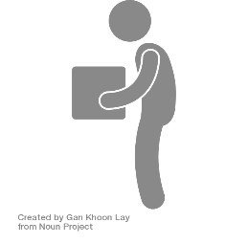

Avatar Representations
Conditions of VIRTUAL support
EGO-centric guidance
EXO-centric guidance
guidance
guidance
student
REAL
student
student
EGO-centric
EXO-centric
EGO-centric
EXO-centric
student
VIRTUAL (COPY)
EGO & EXO-centric guidance
Augmented EXO-centric guidance
guidance
guidance
guidance
student
student
VIRTUAL
EGO-centric
EXO-centric
EGO-centric
EXO-centric
EGO & Augmented EXO-centric guidance
guidance
student
EGO-centric
EXO-centric

Slide 7
Ego-centric visual perspectives
(g-class)
Exo-centric visual perspectives
(x-class)
Ego & exo-centric visual perspectives
(gx-class)
ego-centric VP
Purely exo-centric VP
Purely ego & exo-centric VP
guidance
guidance
guidance
student
student
student
EGO-centric
EXO-centric
EGO-centric
EXO-centric
EGO-centric
EXO-centric
Augmented exo-centric VP
Ego & augmented exo-centric VP
guidance
guidance
student
student
EGO-centric
EXO-centric
EGO-centric
EXO-centric
Avatar Representations
student
student
guidance
REAL
VIRTUAL (COPY)
VIRTUAL

Slide 8
400
Tracking volume
Scale
Box
Mirror
45
300
45
140
240
400
Table
120
70
Lighthouse
Vive Tracker

Slide 9
Tracking volume
Scale
Box
Mirror
Scale
Mirror
Posi-tions
Table center
Table
Table tight
Table left

Slide 10
Learner/GV 4
Back shift: 300 cm
Right shift: 200 cm
TABLE CENTER
Left shift: 200 cm
Learner/GV 2
Learner/GV 0
Learner/GV 3
Front shift: 150 cm
Learner/GV 1
Notes:
Exo heatmap

Slide 11
EXO
EGO & EXO
<1%
<1%
Learner/GV 4
21%
11%
14%
39%
45%
19%
Learner/GV 2
Learner/GV 0
Learner/GV 3
20%
31%
Learner/GV 1
Notes:
egoEgo

Slide 27
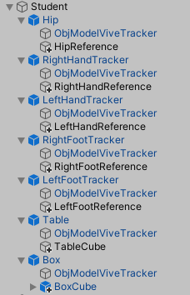
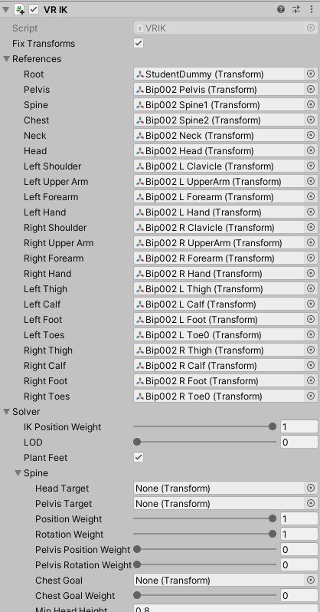
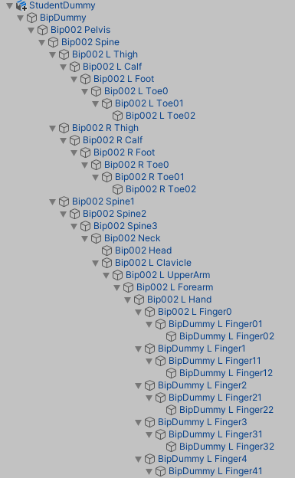
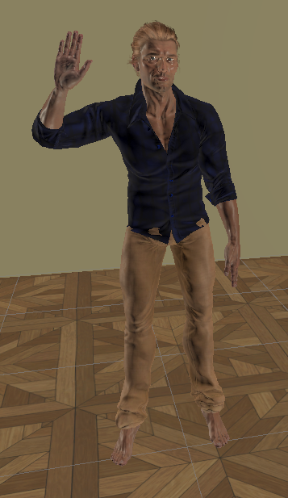
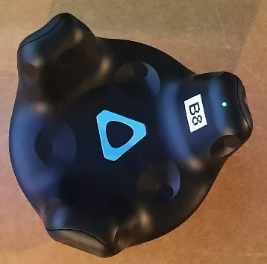
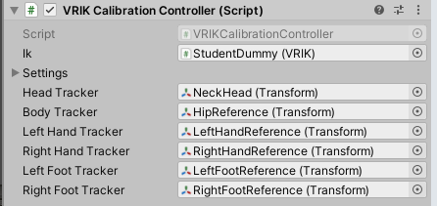
Vive Tracker
References
Calibration Controller
VRIK
Character
Output

Slide 28
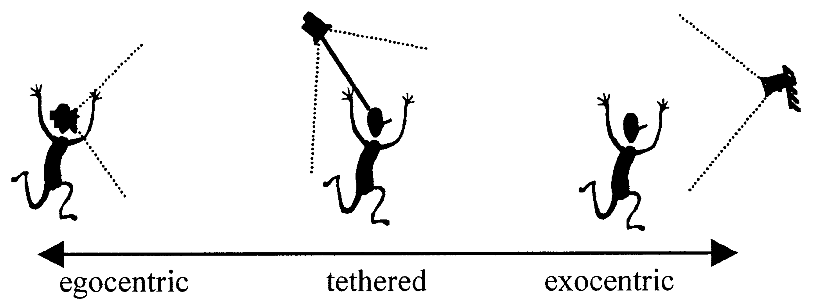

Slide 29
Overall accuracy error

Slide 31
Acc per subtask

