Slide 1
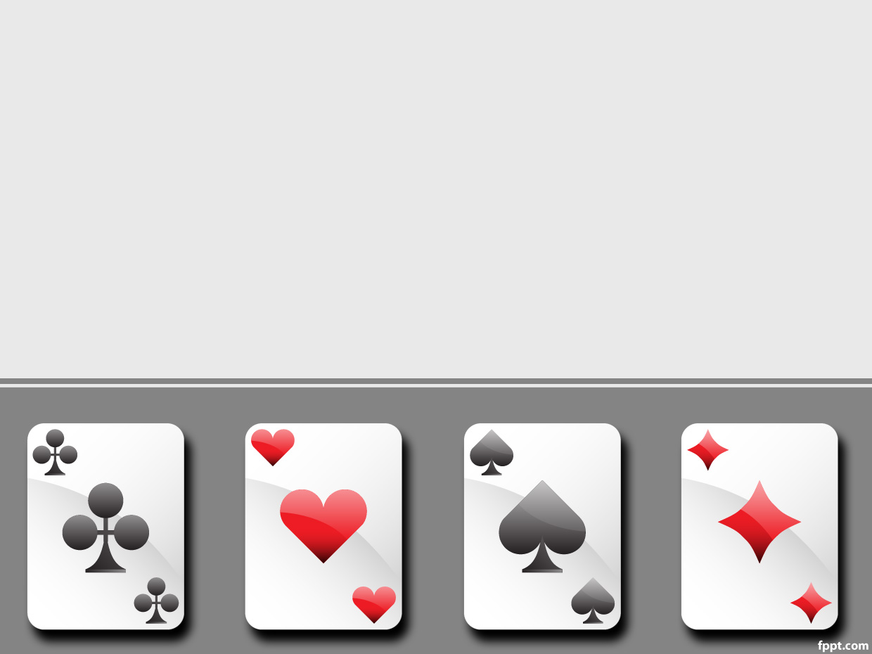
Unibus
Deep Reinforcement Learning in POSGs

Slide 2
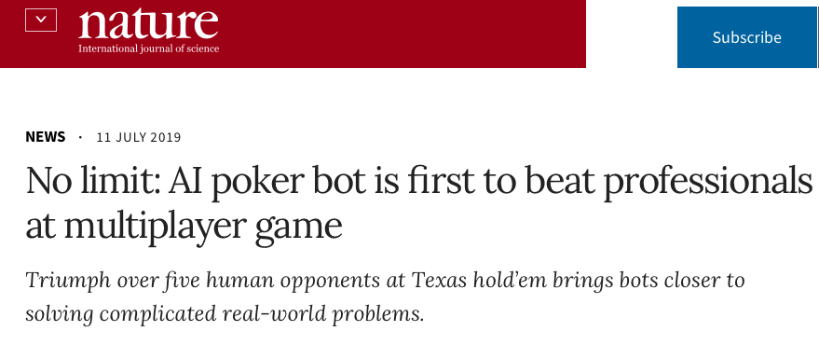
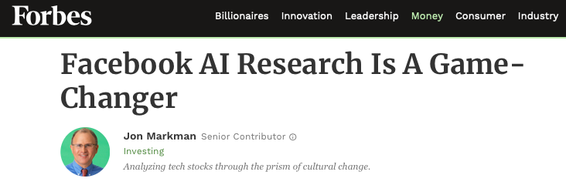
Inspiration

Slide 3
Key Components
Rules
  6 Player Fixed Limit Texas Hold‘em
Process
Agent
Learning Algorithm

Slide 4
2) Partially Observable Stochastic Game
  Finite set of agents (6)
  Finite set of states (a lot)
  Probability distribution over states
  Finite set of actions (fold, bet, raise)
  Finite set of observations
  Transition and observation probabilities
  A Reward function
  Beliefs about the current state

Slide 5
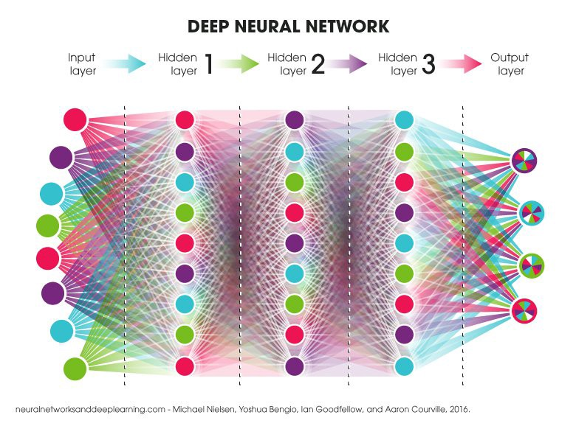
3) Agent
Fully connected Artificial Neural Network

Slide 6
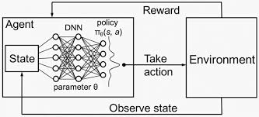
Learning Algorithm

Slide 7
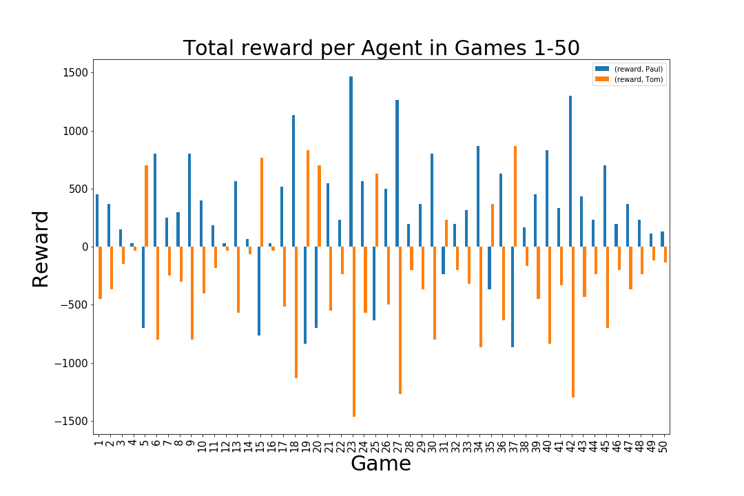
„Real World“
Tom (v1) vs. Paul (v2)

Slide 8
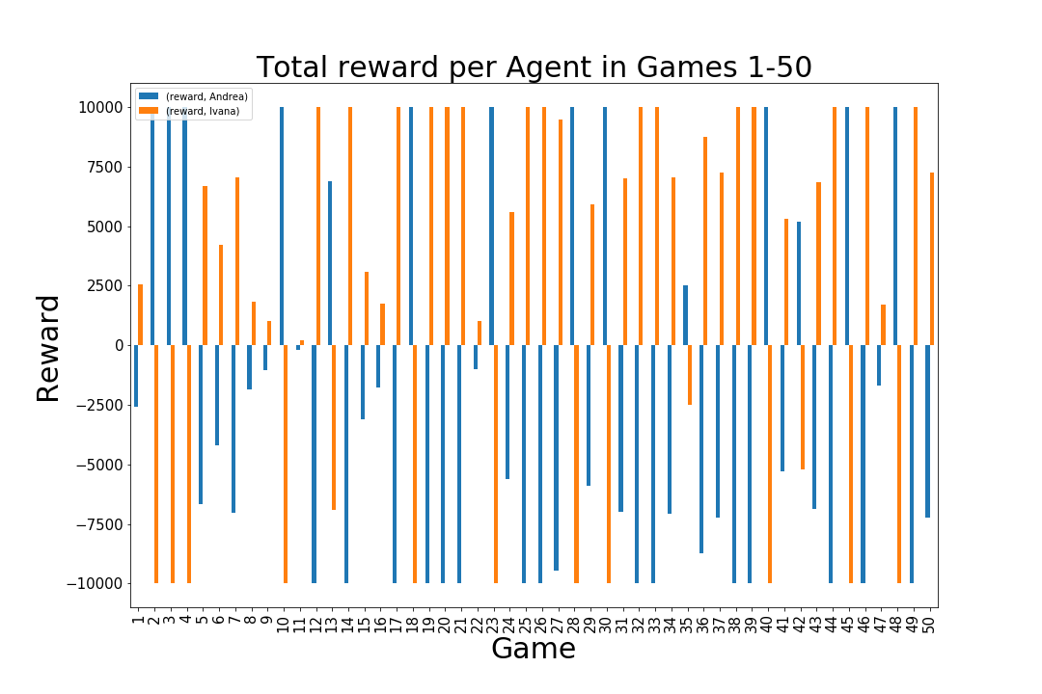
„Real World“
Andrea (v3) vs. Ivana (v4)

Slide 9
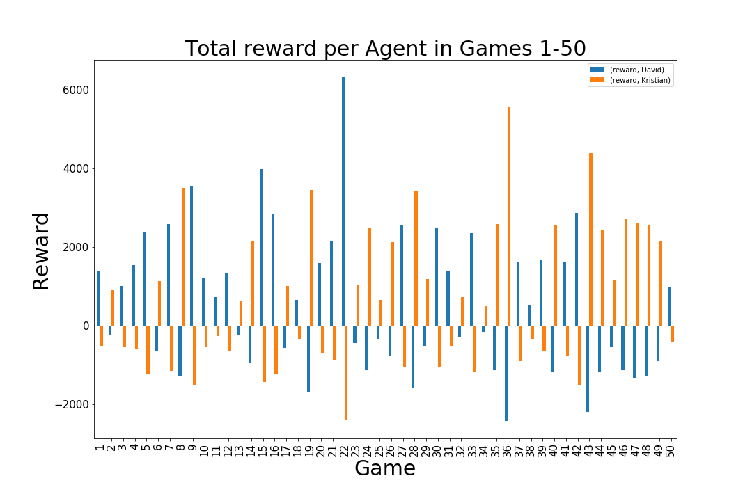
„Real World“
David (v5) vs. Kristian (v6)

Slide 10
