Slide 1
Is recovery proceeding according to expected successional patterns following grazing disturbance?
1. Above-ground vegetation at older disturbance sites will be more similar to reference vegetation than recently disturbed (regardless of seed inputs) in terms of:
Native vs. exotic richness
Native vs. exotic cover
Graminoid cover (*only species whose mature height > 10 cm)
2. Above-ground vegetation in recently disturbed sites will look MORE similar to seed inputs than older disturbance vegetation similarity to seed, or reference vegetation similarity to seed.
3. Seed inputs in recently disturbed sites will be highly similar throughout season
What is the diversity & rel.abund of seeds colonizing the site?

Slide 2
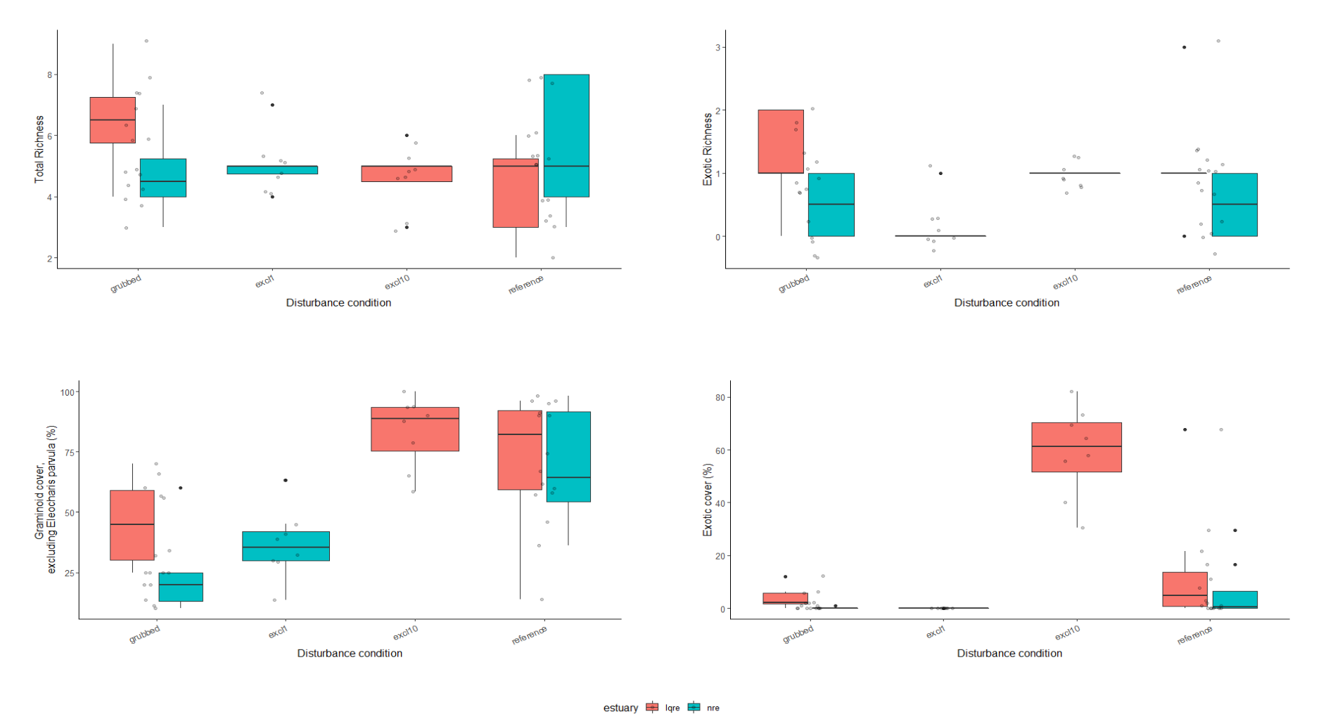
Notes:
Main messages : (1) disturbed sites have species richness similar to recovered & reference sites, (2) exotic sp richness is relatively low across all sites, (3) graminoids (*sp > 10 cm) recover over time, but (4) exotic species dominate graminoid cover after 10 years grazing exclusion

Slide 3
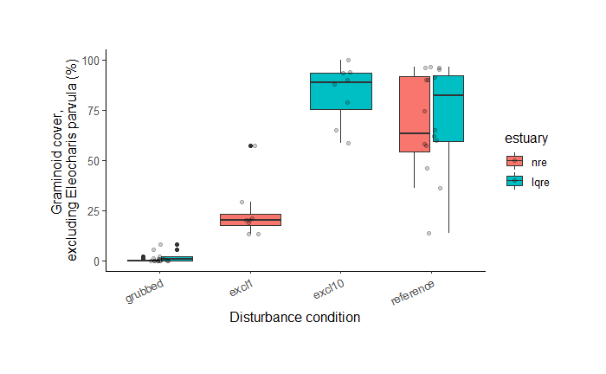
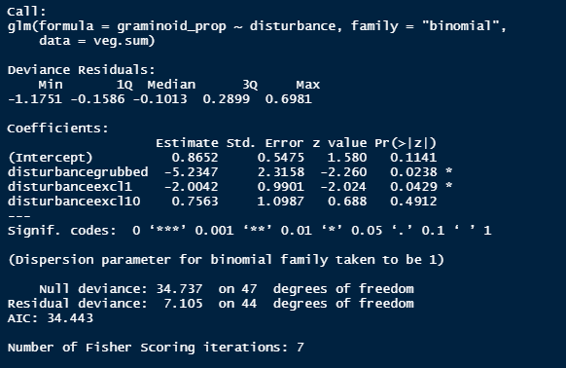
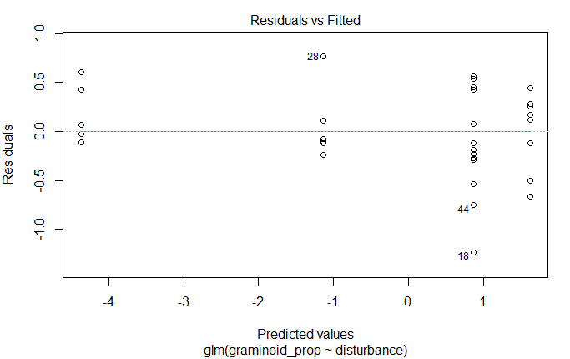
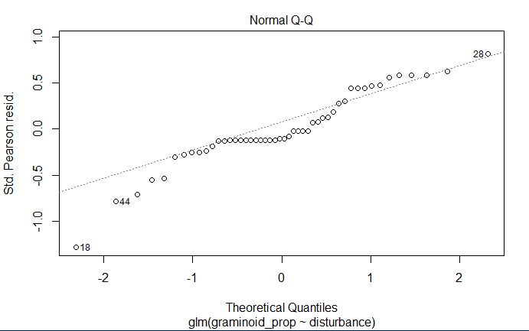
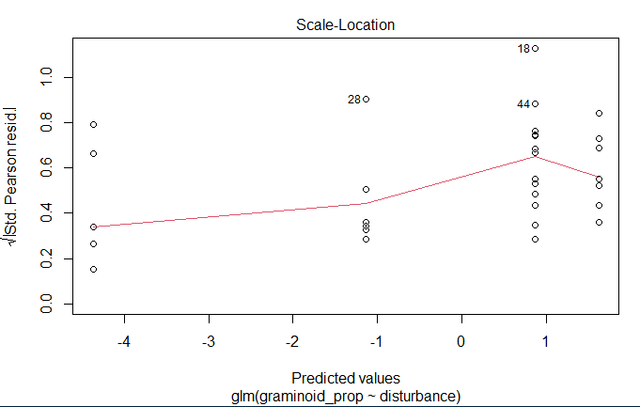
Graminoid cover
Notes:
Main message: graminiod cover severely impacted 1 year after grazing exclusion, but recovers to reference condition after 10 years grazing exclusion. Note: does not count ground-cover species < 10 cm tall (Eleocharis parvula).

Slide 4
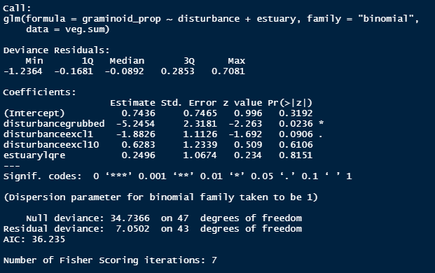
No significant effect of estuary on graminoid cover glm

Slide 5
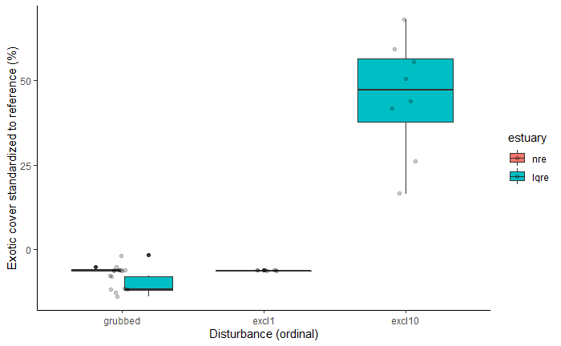
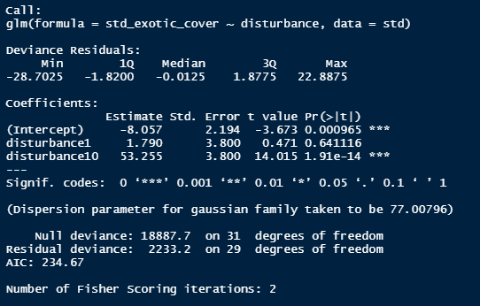
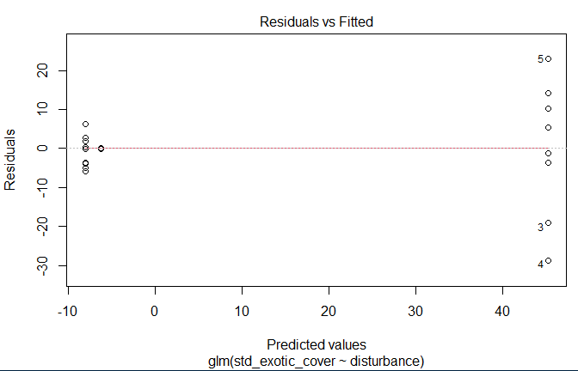
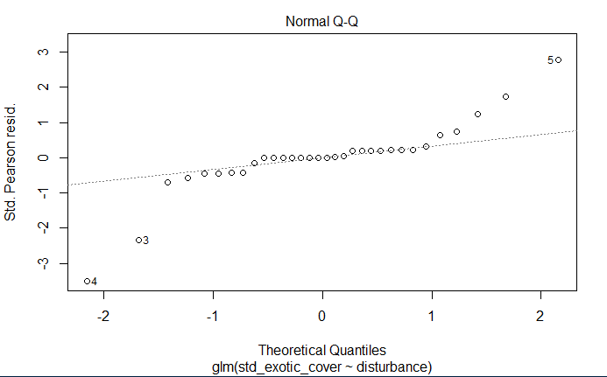
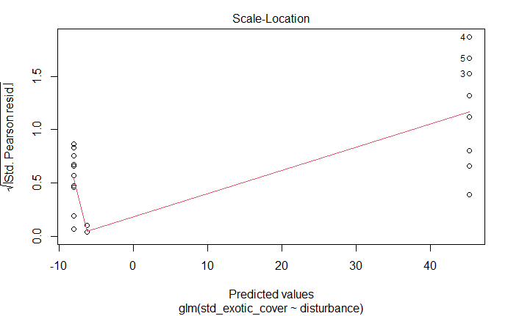
Exotic cover, standardized to reference
Notes:
Main message: 50% greater exotic cover in excl10 than reference. **Using comparison to reference to allow gaussian distribution; data do not fit models otherwise.

Slide 6
What does this mean?
Functional groups (graminoids) recover without intervention
However, increased abundance of exotic species alters ecosystem composition
Unknown effects on ecological processes
Applications:
Passive restoration (clonal recovery from remnant patches) presents high risk of exotic species encroachment.
Active restoration of transplanting required to restore native composition
Opportunity for native biodiverse restoration

Slide 7
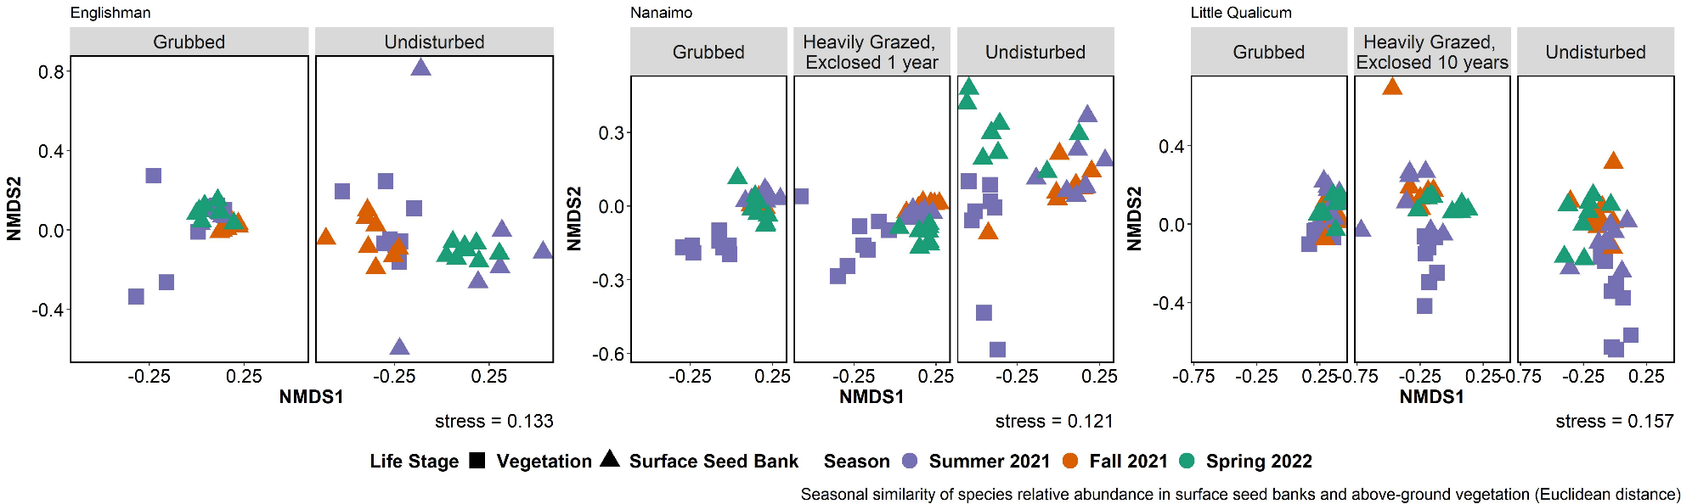

Slide 8
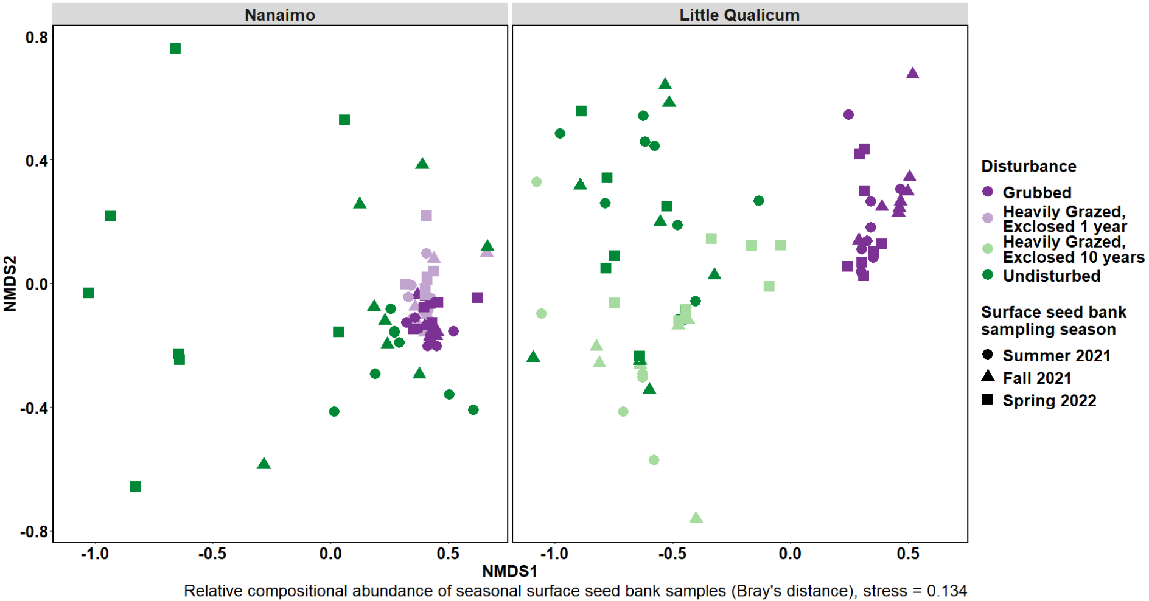

Slide 9
What does this mean?
Recently disturbed sites have high similarity between vegetation and seed bank
Seed bank diversity is more seasonally variable in undisturbed (reference) and sites exclosed 10 years.
Application: recruitment of ‘reference’ species from seed is not likely after disturbance (seeds are not present in seed bank)

Slide 10
Graduation timeline options
Spring 2023 Graduation
Apr. 30, 2023 program end date
(still spring graduation?)
Begin circulating dissertation to committee:
Early Oct., 2022
External Examiner form submitted:
Nov. 25, 2022
Dissertation submitted to G+PS:
Jan. 27, 2023
Last day for oral exam:
Mar. 24, 2023
Approved dissertation accepted by G+PS:
Apr. 21, 2023
Begin circulating dissertation to committee:
Early Nov., 2022
External Examiner form submitted:
Dec. 9, 2022
Dissertation submitted to G+PS
Feb. 3, 2023
Last day for oral exam:
Apr. 6, 2023
Approved dissertation accepted by G+PS:
Apr. 28, 2023

