Slide 1
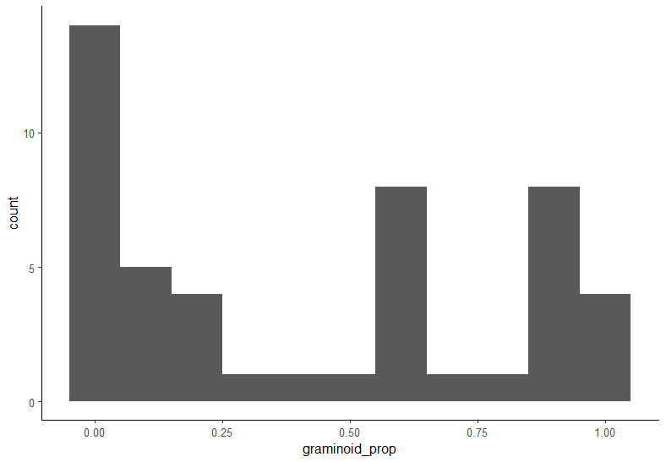
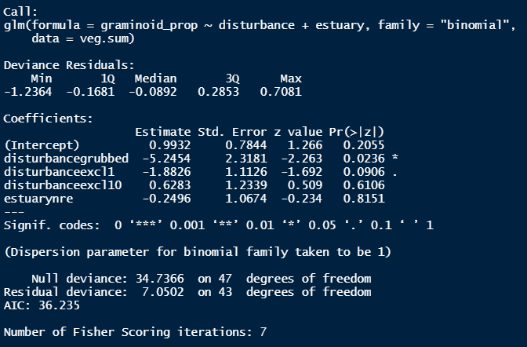


Above ground vegetation: tall, perennial graminoids

Slide 2
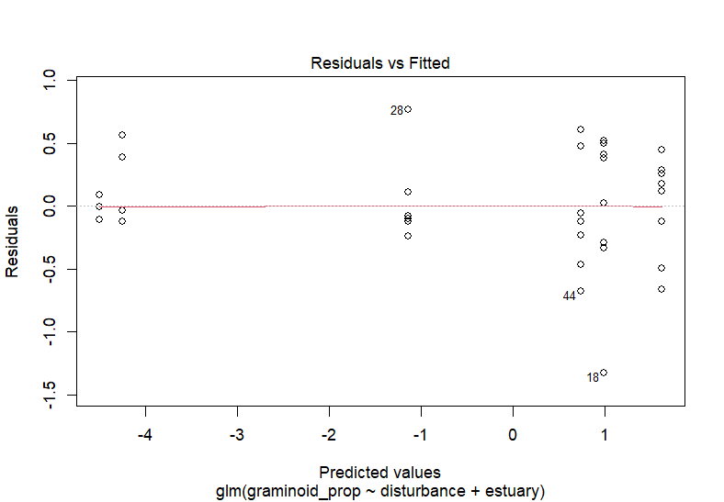
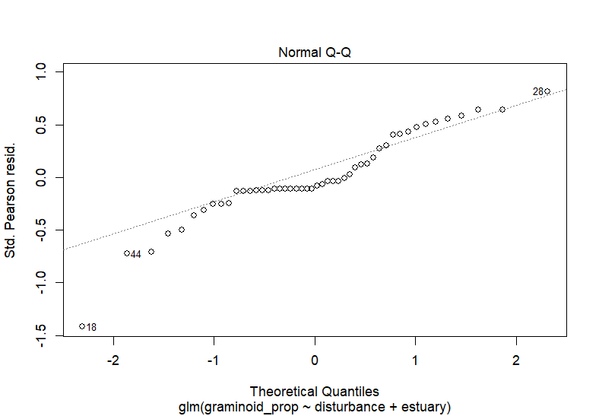
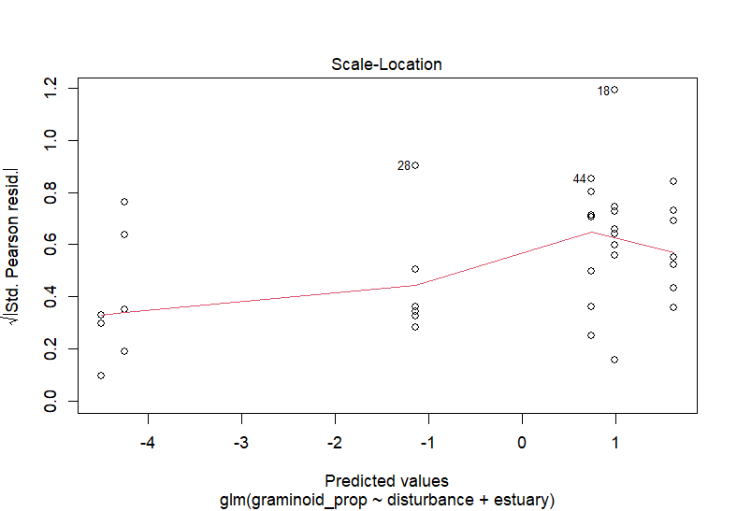
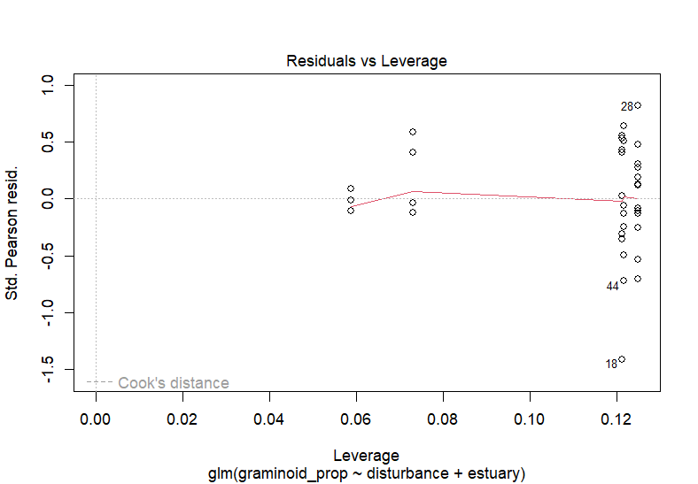
Above ground vegetation: tall, perennial graminoids

Slide 3
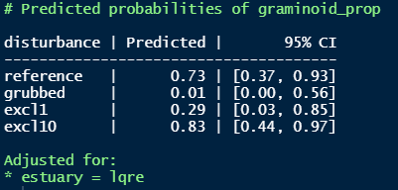

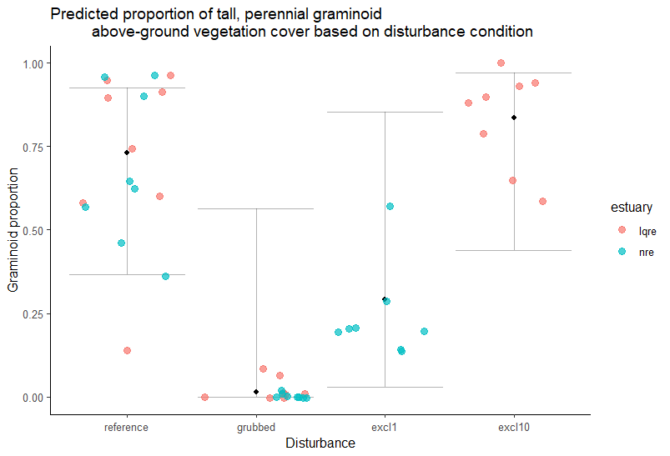

Slide 4
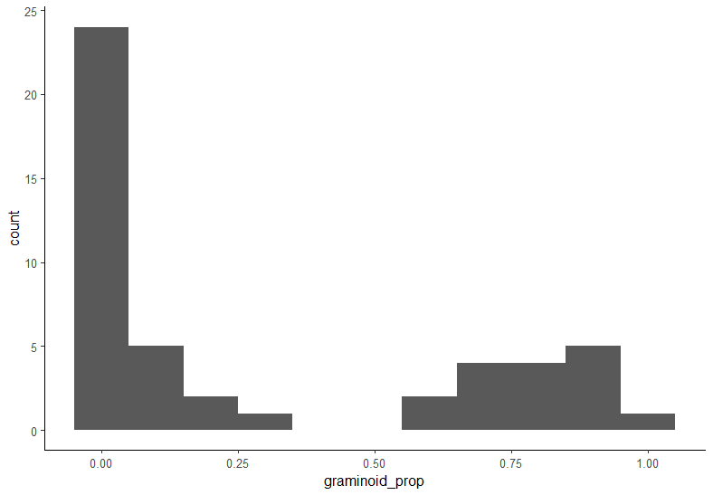
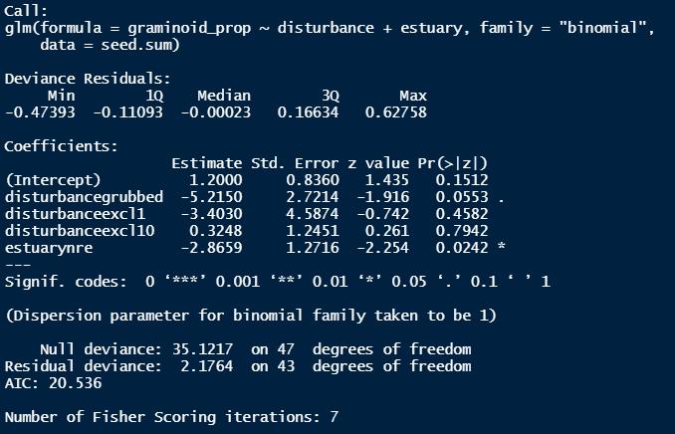


Surface seed bank: tall, perennial graminoids

Slide 5
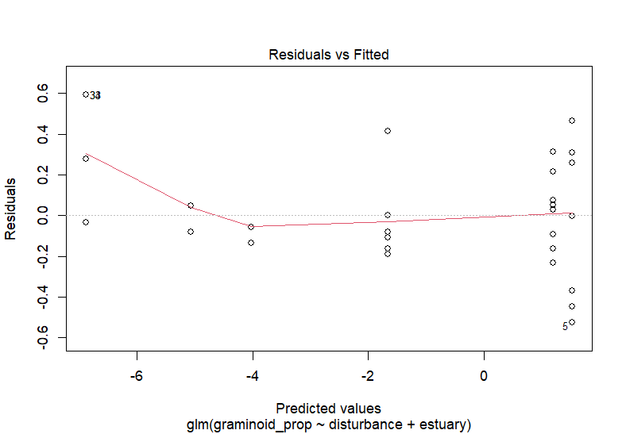
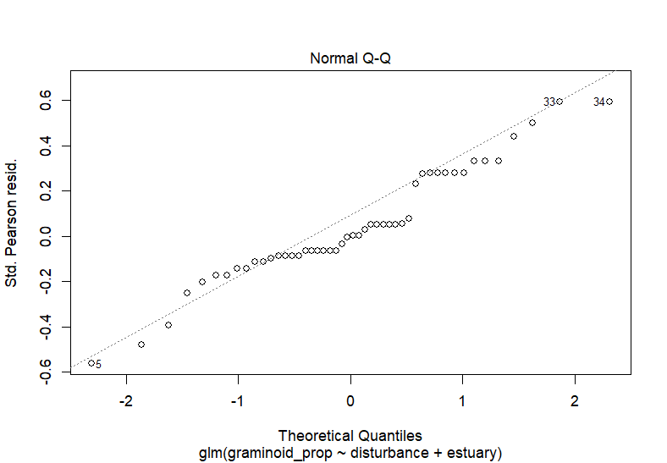
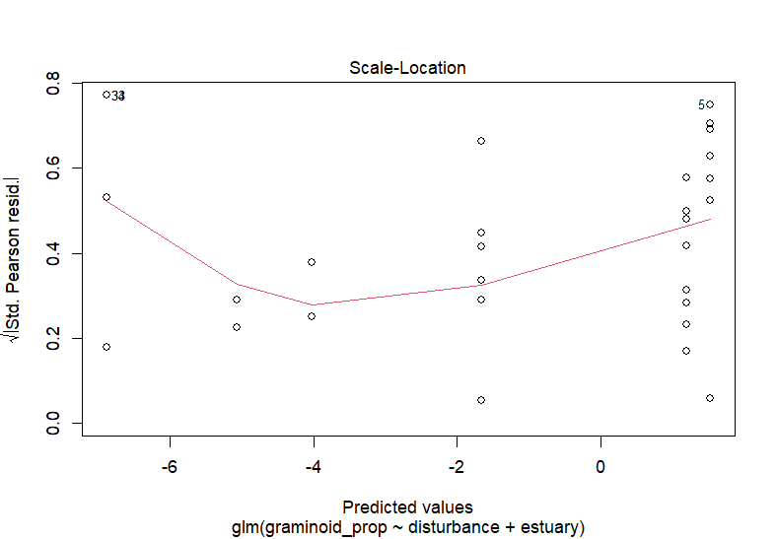
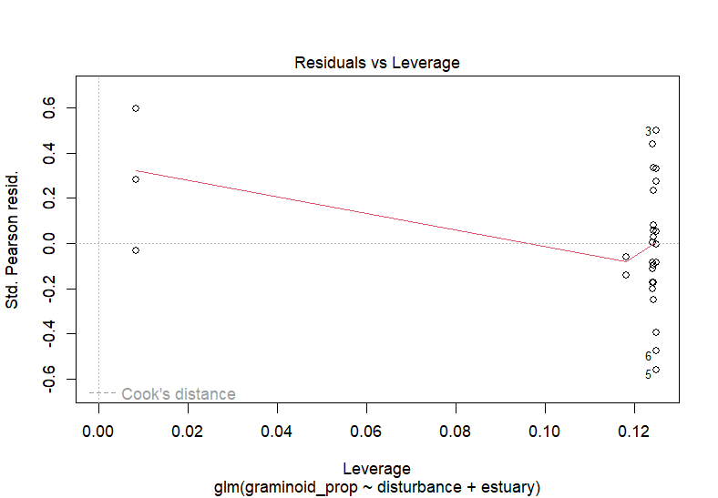
Surface seed bank: tall, perennial graminoids

Slide 6
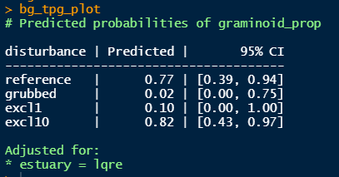

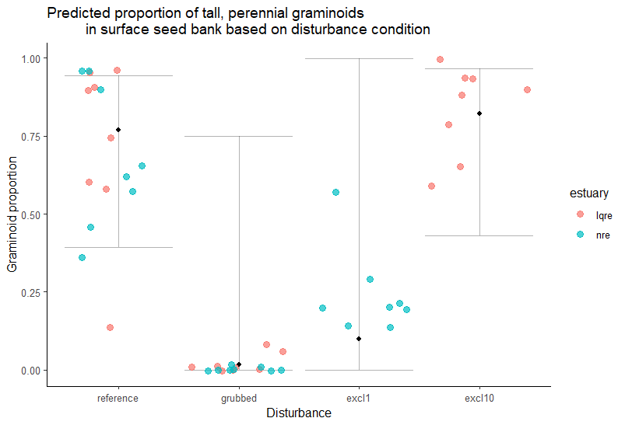

Slide 7
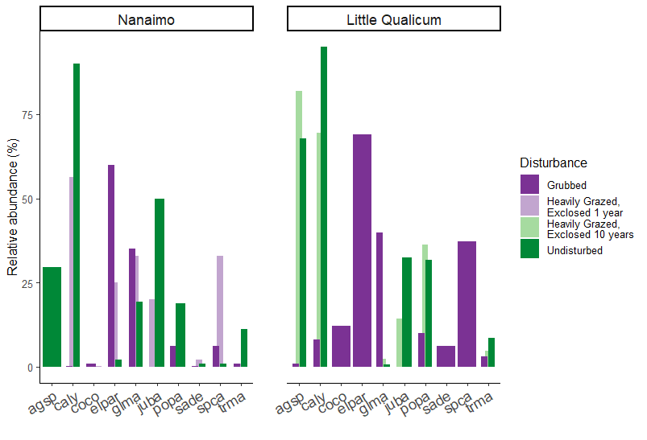
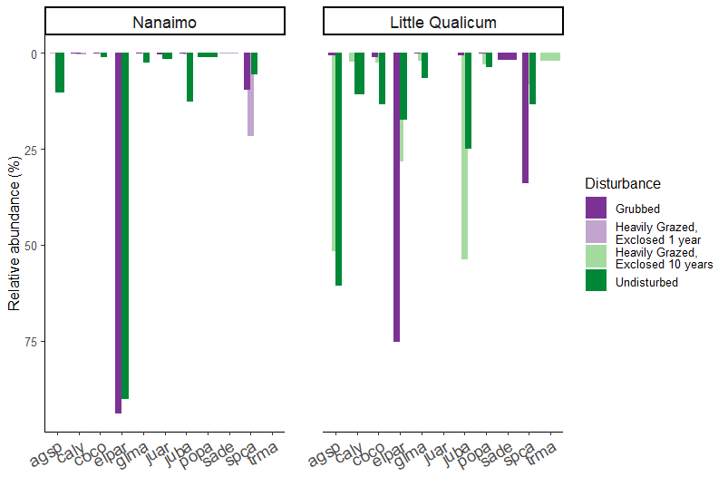
Above ground vegetation
Surface
seed bank
* If this plot is ideal, how can I force bar widths to be the same?! If I use position = position_dodge2(preserve = “single”), then chart plots every observation (not plotting mean).

Slide 8
If preceding slide is too “busy,” what do you think about faceting by disturbance/estuary?
See next 2 slides; personally I like the grouped bar chart to more quickly assess differences in species abundance between disturbance categories.

Slide 9
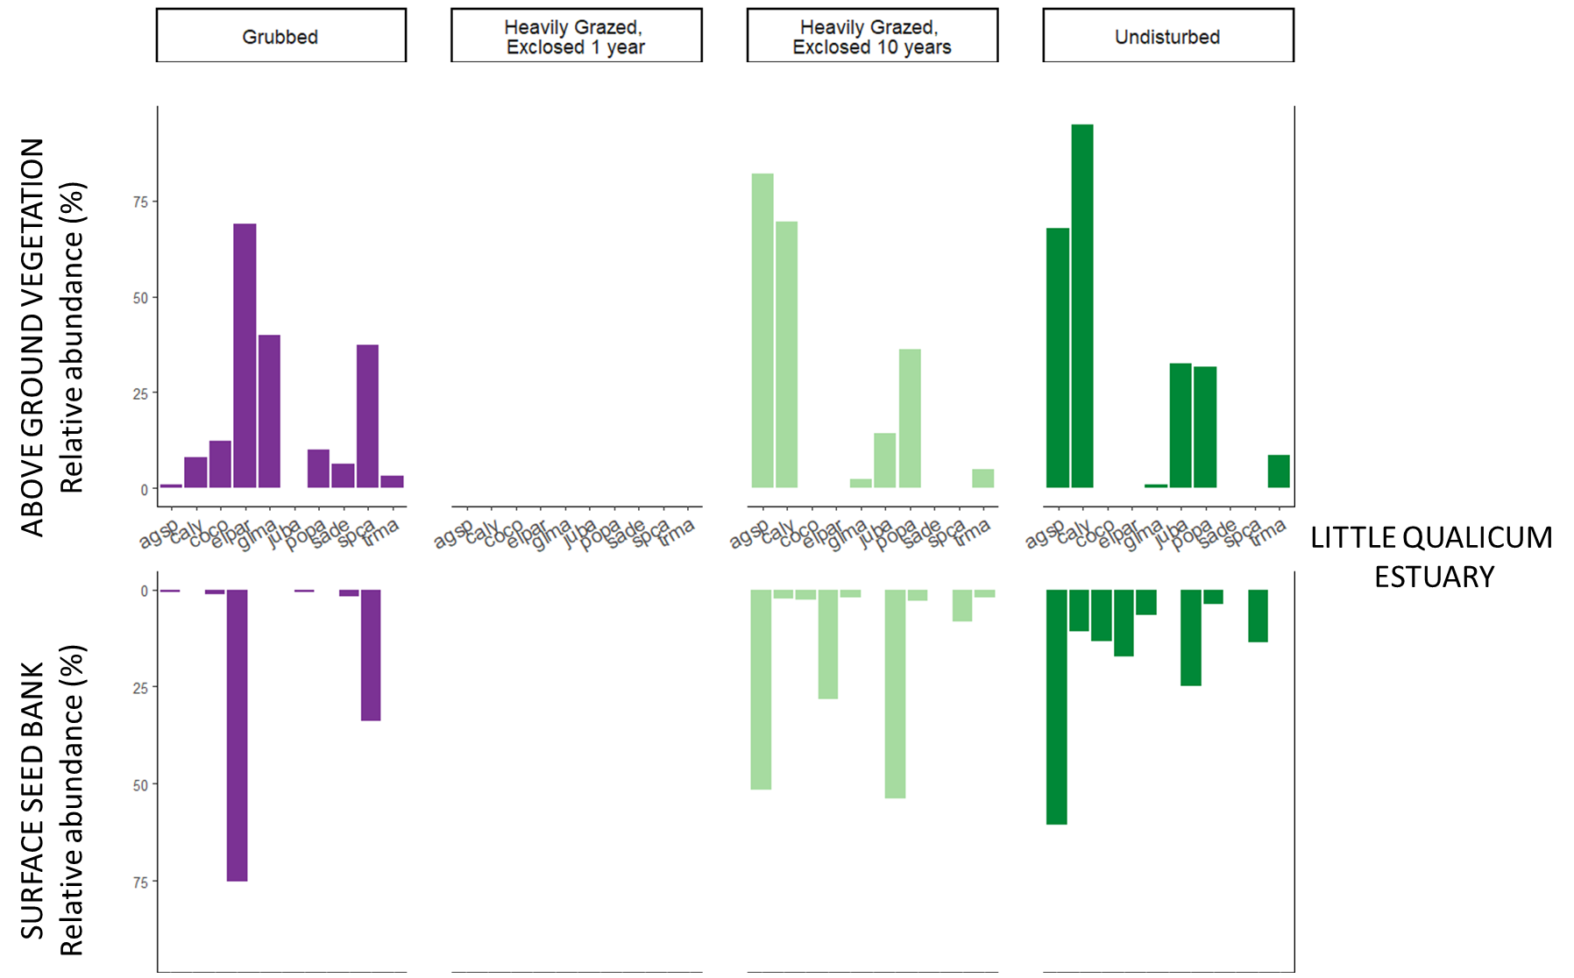

Slide 10
