Slide 1
Module 3: Linear Regression
Daesoo Lee,
Department of Mathematical Sciences, NTNU
23/01/2023

Slide 2
What will you learn?
Simple linear regression
Multiple linear regression

Slide 3
Linear Regression again!?
Also, we’ll learn about cool ML models from Module 7/8!

Slide 4
Warm-up

Slide 5

Warm-up
Do-it-yourself “by hand”
Go to the following webpage: https://gallery.shinyapps.io/simple_regression/
We have: $Y=β_{0}+β_{1}X_{1}+ε$ Try to estimate ${\hat{β}}_{0}$ (intercept) and ${\hat{β}}_{1}$ (slope).

Slide 6

Warm-up
Do-it-yourself “by hand”
Sum of Squares of Residuals (RSS) $RSS=\sum_{i=1}^{n}{{\left(y_{i}−\hat{f}\left(x_{i}\right)\right)}^{2} }=\sum_{i=1}^{n}{{\left(y_{i}−{\hat{y}}_{i}\right)}^{2} }$ The best estimates can be found at the minimal RSS!
The distribution of the residuals form the normal distribution!

Slide 7
Linear Regression

Slide 8

Linear Regression
Very simple approach for supervised learning.
Parametric
Is linear regression too simple? $→$ Could be, but very useful. $→$ Many learning methods can be seen as generalization of the linear model.

Slide 9
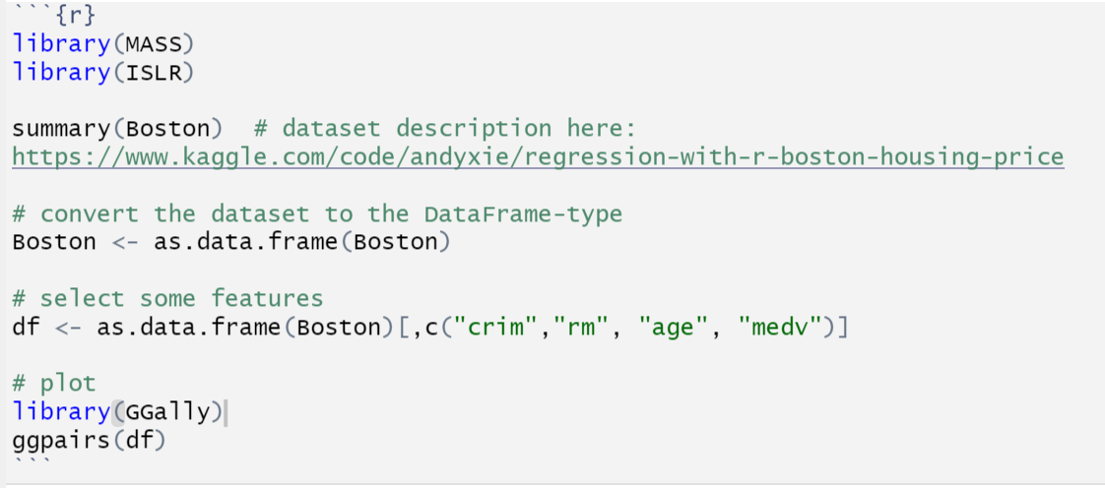
Linear Regression
Example: Boston Housing Price Dataset
{crime rate in the region, a number of rooms, home owner’s age, housing price}
crim: crime rate
rm: number of rooms
age: home owner’s age
medv: housing price
https://www.kaggle.com/code/andyxie/regression-with-r-boston-housing-price

Slide 10
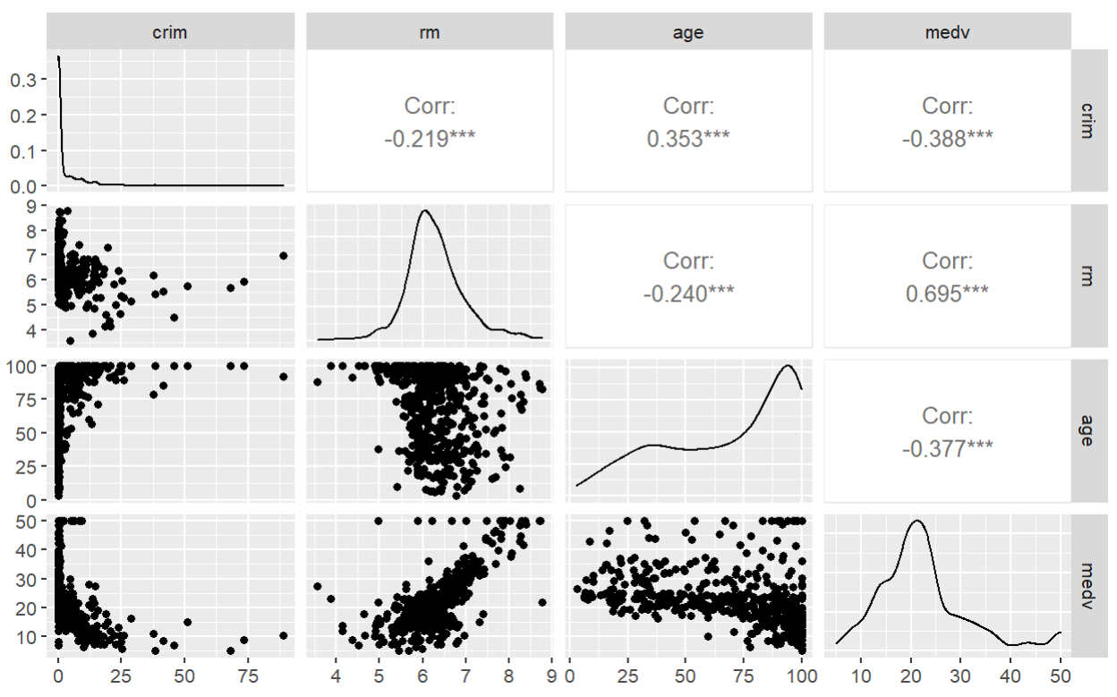
Linear Regression
Example: Boston Housing Price Dataset
crime rate
number of rooms
owner’s age
housing price
crime rate
number of
rooms
owner’s
age
housing
price
https://www.kaggle.com/code/andyxie/regression-with-r-boston-housing-price

Slide 11
Linear Regression
Interesting Questions
How good is “a number of room” as an input feature for predicting the housing price?
How strong is the relationship?
Is the relationship linear?
How well can we predict the housing price?

Slide 12
Simple Linear Regression

Slide 13
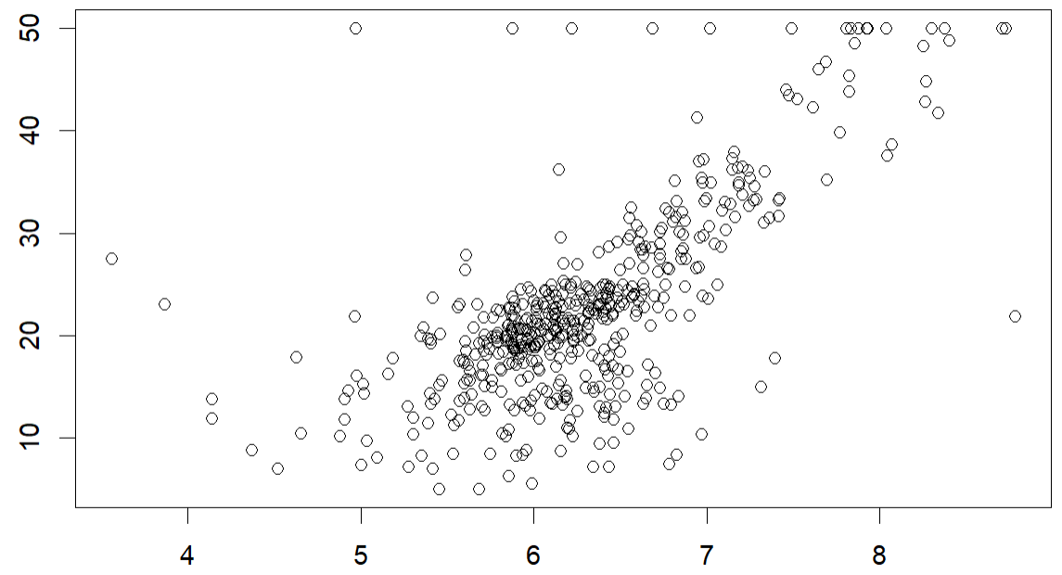


Linear Regression
Let’s think about the simplest form
$Y=β_{0}+β_{1}X_{1}+ε$
$housing.price=β_{0}+β_{1}×number.of.rooms$
$$\hat{Y}=\hat{f}(X)$$
Housing price
Number of rooms

Slide 14







Linear Regression
Modeling Assumptions
$$Y=β_{0}+β_{1}X_{1}+ε$$
$ε\sim N\left(0,σ^{2}\right)$
In this formulation, $Y$ is a random variable, $Y\sim N\left(β_{0}+β_{1}X_{1},σ^{2}\right)$
$$E\left(Y\right)$$
$$Y$$
: $ε,$ normal distribution
$$X$$

Slide 15













Linear Regression
$$Y$$
Modeling Assumptions
Variance of is the same for all
$E\left[ε\right]=0$
$Var\left[ε\right]=σ^{2}$
All $ε_{i}$ are normal distributed; $ε_{i}∈ε$
$ε$ is independent of any variable. i.e., $ε$ is independent of $X_{1}$ and $Y$.
$ε_{1},ε_{2},…,ε_{n}$ are independent of each other.
$$X$$
normal distribution $ε \sim N\left(0,σ^{2}\right)$
The straight line
$$Y=β_{0}+β_{1}X_{1}+ε$$
$$y_{1}$$
$$y_{2}$$
$$⋮$$
$$y_{n}$$
$$x_{11}$$
$$x_{21}$$
$$⋮$$
$$x_{n1}$$
$$ε_{1}$$
$$ε_{2}$$
$$⋮$$
$$ε_{n}$$
$$=$$
$$β_{0}+β_{1}$$
$$+$$

Slide 16
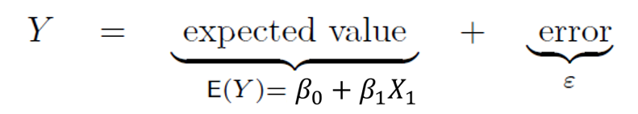





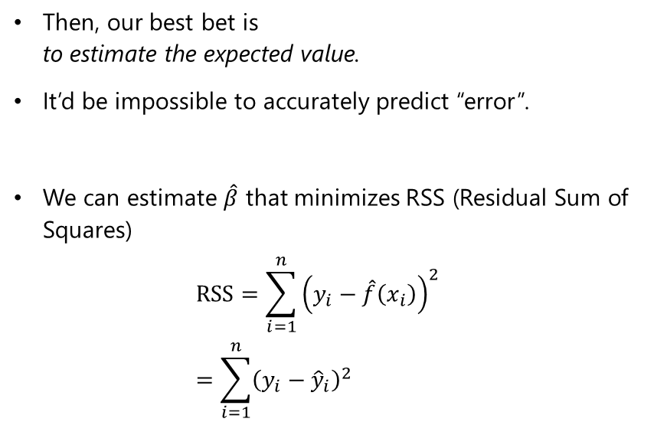


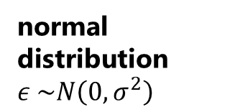
Linear Regression
normal distribution $ε \sim N\left(0,σ^{2}\right)$
Parameter estimation (“model fitting”)
The straight line
$$Y=β_{0}+β_{1}X_{1}+ε$$
Then, our best bet is to estimate the expected value.
It’d be impossible to accurately predict “error”.
We can estimate $\hat{β}$ that minimizes RSS (Residual Sum of Squares) $RSS=\sum_{i=1}^{n}{{\left(y_{i}−\hat{f}\left(x_{i}\right)\right)}^{2} }$ $=\sum_{i=1}^{n}{{\left(y_{i}−{\hat{y}}_{i}\right)}^{2} }$
$$y_{1}$$
$$y_{2}$$
$$⋮$$
$$y_{n}$$
$$x_{11}$$
$$x_{21}$$
$$⋮$$
$$x_{n1}$$
$$ε_{1}$$
$$ε_{2}$$
$$⋮$$
$$ε_{n}$$
$$=$$
$$β_{0}+β_{1}$$
$$+$$

Slide 17
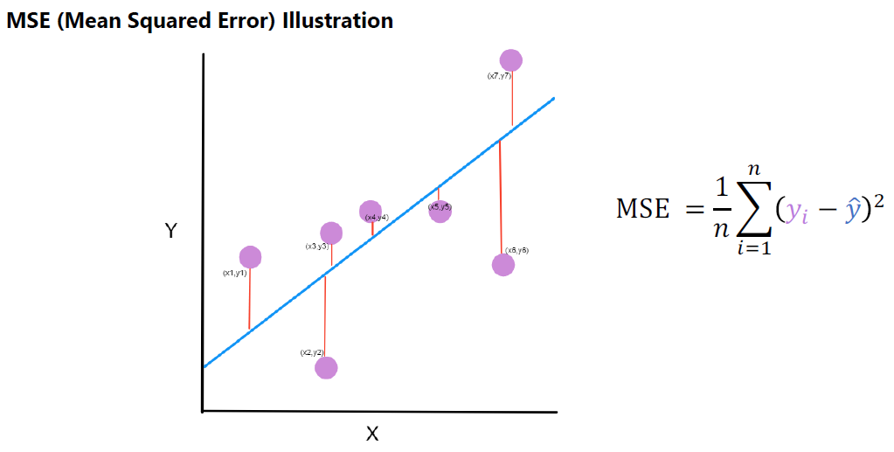
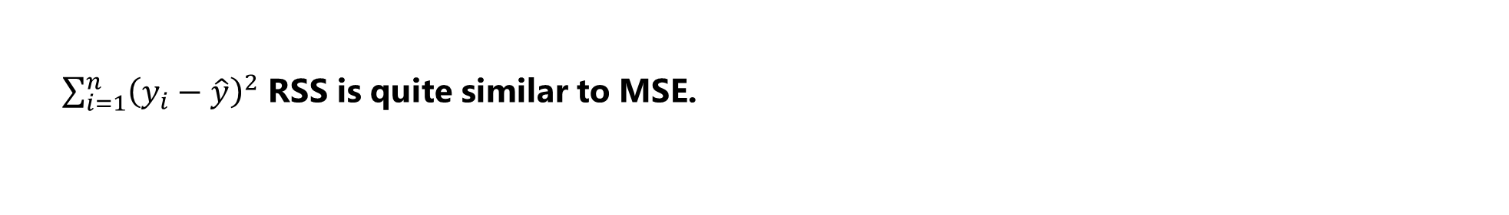
Linear Regression
$\sum_{i=1}^{n}{{\left(y_{i}−\hat{y}\right)}^{2}}$ RSS is quite similar to MSE.

Slide 18

Linear Regression
Residual Sum of Squares (RSS)
$$RSS=\sum_{i=1}^{n}{{\left(y_{i}−\hat{f}\left(x_{i}\right)\right)}^{2} }=\sum_{i=1}^{n}{{\left(y_{i}−{\hat{y}}_{i}\right)}^{2} }$$
We estimate $\hat{f}$ that minimizes RSS.
Then, we get “best” estimates of the learnable parameters ${\hat{β}}_{0},{\hat{β}}_{1}$. (NB! $\hat{Y}={\hat{β}}_{0}+{\hat{β}}_{1}X$)
Residual is defined as $y_{i}−\hat{y}$

Slide 19
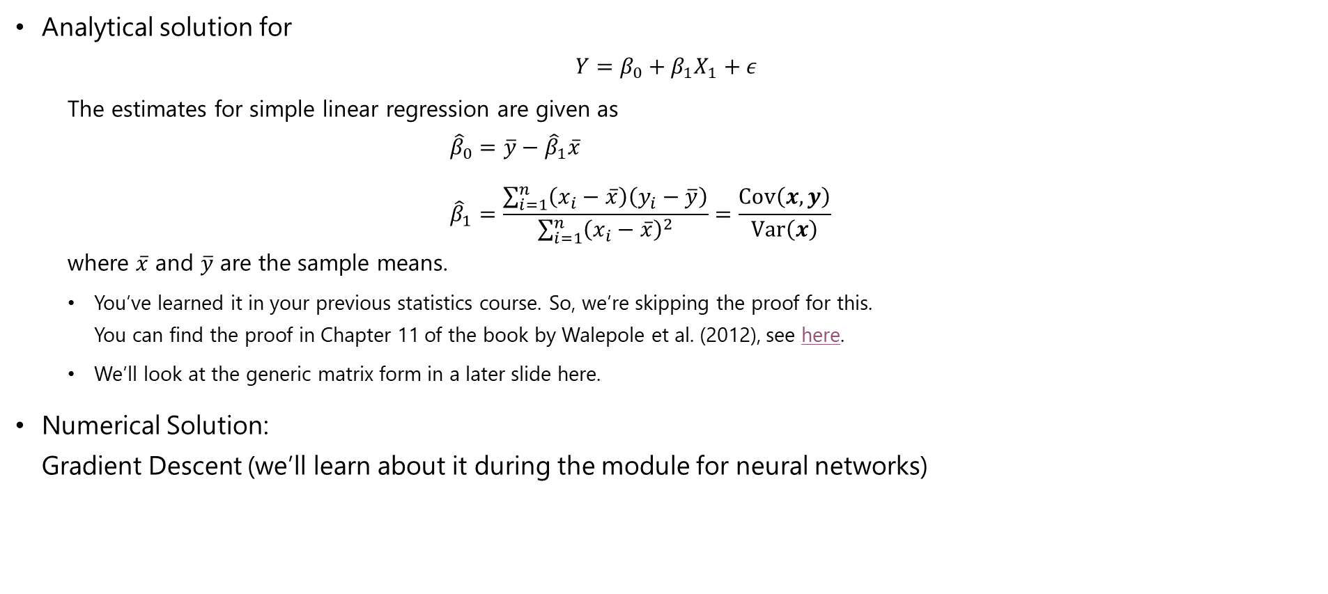
Linear Regression
Least Squares Estimators:
Analytical solution for $Y=β_{0}+β_{1}X_{1}+ε$
The estimates for simple linear regression are given as $${\hat{β}}_{0}=\overline{y}−{\hat{β}}_{1}\overline{x} \\ {\hat{β}}_{1}=\frac{\sum_{i=1}^{n}{\left(x_{i}−\overline{x}\right)\left(y_{i}−\overline{y}\right)}}{\sum_{i=1}^{n}{{\left(x_{i}−\overline{x}\right)}^{2}}}=\frac{Cov\left(x,y\right)}{Var\left(x\right)}$$ where $\overline{x}$ and $\overline{y}$ are the sample means.
You’ve learned it in your previous statistics course. So, we’re skipping the proof for this. You can find the proof in Chapter 11 of the book by Walepole et al. (2012), see here.
We’ll look at the generic matrix form in a later slide here.
Numerical Solution: Gradient Descent (we’ll learn about it during the module for neural networks)

Slide 20
Linear Regression
Do-it-yourself “by hand”
Go to the following webpage: https://gallery.shinyapps.io/simple_regression/
Try to “estimate” the correct parameters.

Slide 21

Linear Regression
Example (continued): Boston Housing Price Dataset
Let’s look at the simplest form $housing.price=β_{0}+β_{1}×number.of.rooms$
and let’s estimate $\hat{f}$ in R!
Housing price
Number of rooms

Slide 22

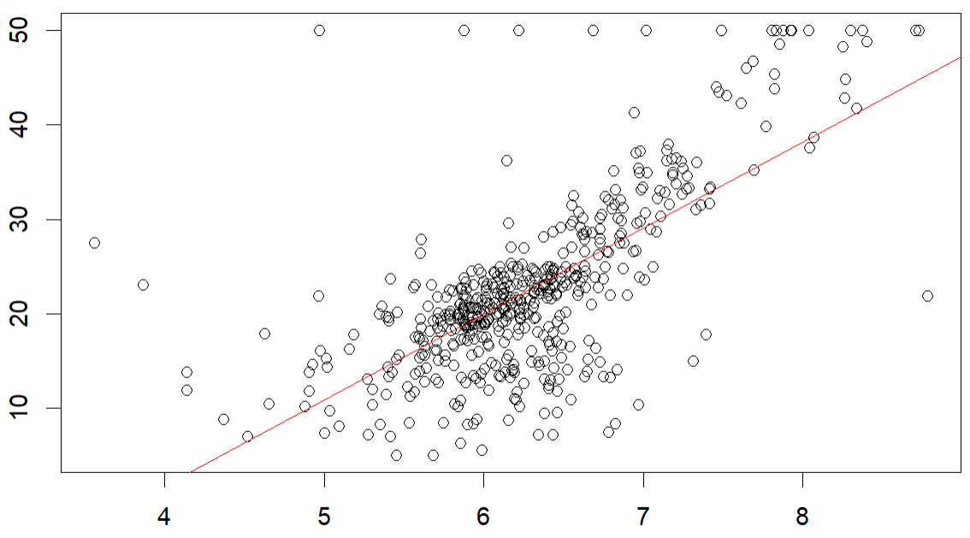
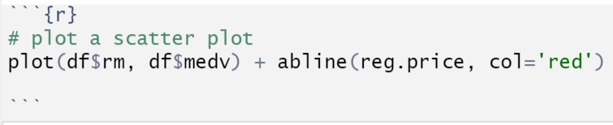


Linear Regression
Example (continued): Boston Housing Price Dataset
Let’s look at the simplest form $\hat{housing.price}={\hat{β}}_{0}+{\hat{β}}_{1}×\hat{number.of.rooms}$
$$\hat{f}$$
Housing price
Number of rooms

Slide 23
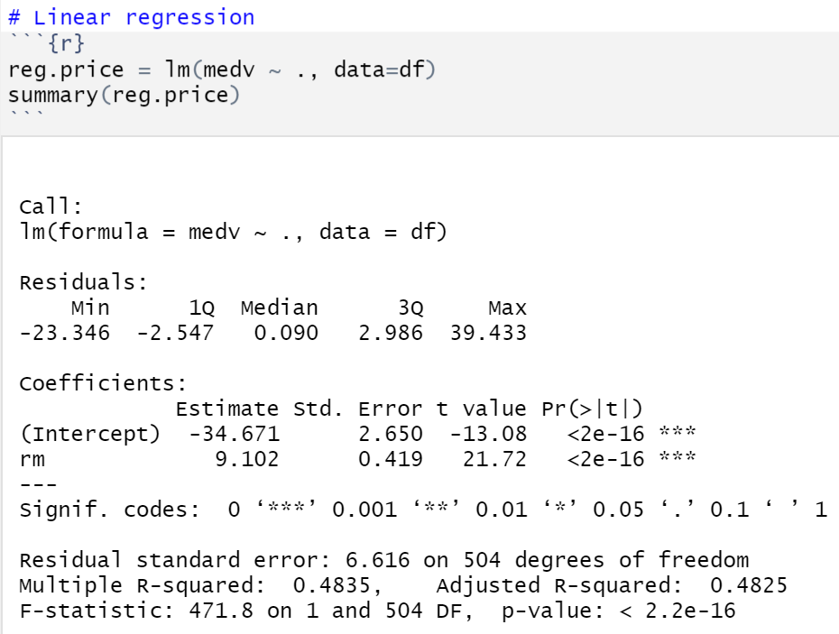



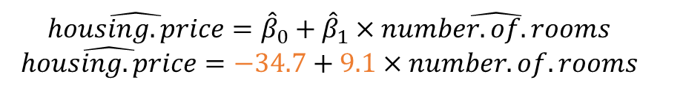


Linear Regression
Example (continued): Boston Housing Price Dataset
$$\hat{housing.price}={\hat{β}}_{0}+{\hat{β}}_{1}×\hat{number.of.rooms}$$
$$\hat{housing.price}=−34.7+9.1×number.of.rooms$$
$$\hat{f}$$
Housing price [$K]
Number of rooms

Slide 24


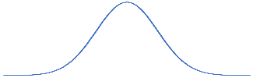






Linear Regression
Uncertainty in the estimates ${\hat{β}}_{0}$ and ${\hat{β}}_{1}$
Because we “estimate” ${\hat{β}}_{ }$, it contains some uncertainty.
e.g., ${\hat{BMI}}_{ }={\hat{β}}_{0}+{\hat{β}}_{1}×Weight$
$${\hat{BMI}}_{ }={\hat{β}}_{0}+{\hat{β}}_{1}×Weight$$
$${\hat{BMI}}_{ }={\hat{β}}_{0}+{\hat{β}}_{1}×Weight$$
Should be similar but probably not the same!
Therefore, $\hat{β}$ carries some uncertainty!
$${\hat{β}}_{rm}$$
$$9.1$$

Slide 25
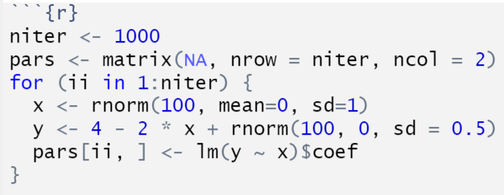
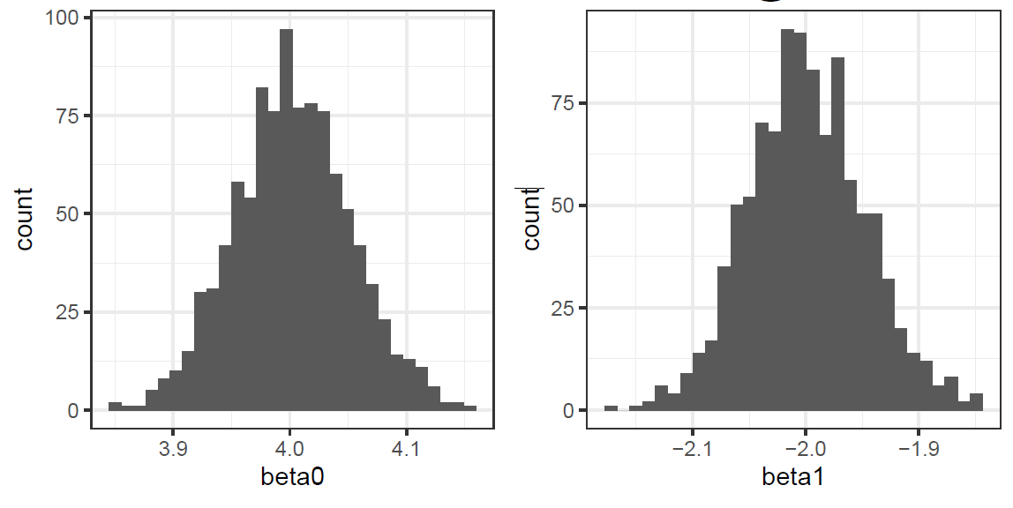





Linear Regression
Uncertainty in the estimates ${\hat{β}}_{0}$ and ${\hat{β}}_{1}$
Let’s look at some simulated example.
$y_{i}=4−2x_{i}+ε_{i};$ $ε_{i}\sim N\left({0, 0.5}^{2}\right)$
$$y_{i}=β_{0}−β_{1}x_{i}+ε_{i}$$
Run 100 times
$$\left(X,Y\right)$$
Fit $\hat{f}$ and get ${\hat{β}}_{0},{\hat{β}}_{1}$
$${\hat{y}}_{i}={\hat{β}}_{0}−{\hat{β}}_{1}x_{i}$$
Run this loop 1,000 times $→$ 1,000 pairs of ${\hat{β}}_{0},{\hat{β}}_{1}$
$${\hat{β}}_{0}\sim N\left(β_{0},σ_{β_{0}}^{2}\right)$$
$${\hat{β}}_{1}\sim N\left(β_{1},σ_{β_{1}}^{2}\right)$$

Slide 26
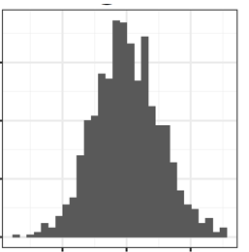
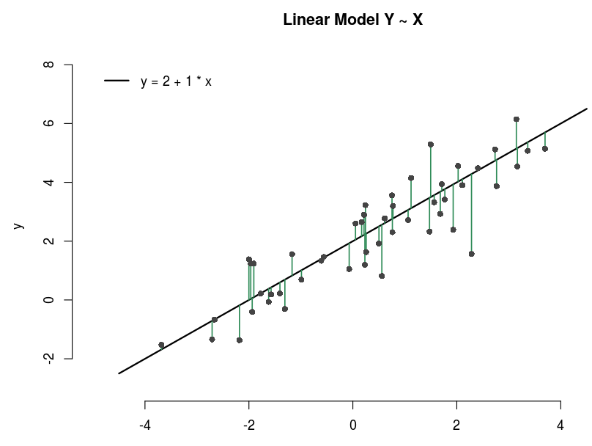
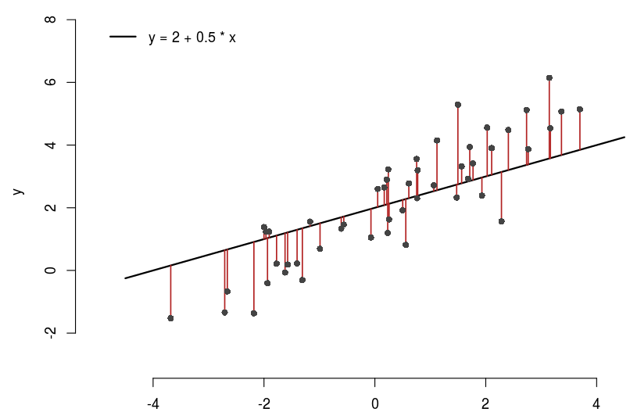



Linear Regression
Uncertainty in the estimates ${\hat{β}}_{0}$ and ${\hat{β}}_{1}$
The standard errors of ${\hat{β}}_{0}$ and ${\hat{β}}_{1}$ are given as follows: $SE{\left({\hat{β}}_{0}\right)}^{2}=\hat{σ}\left[\frac{1}{n}+\frac{\overline{x}}{\sum_{i=1}^{n}{{\left(x_{i}−\overline{x}\right)}^{2}}}\right]$ $SE{\left({\hat{β}}_{1}\right)}^{2}=\frac{{\hat{σ}}^{2}}{\sum_{i=1}^{n}{{\left(x_{i}−\overline{x}\right)}^{2}}}$ $\hat{σ}=RSE=\sqrt{\frac{1}{n−2}RSS}=\sqrt{\frac{1}{n−2}\sum_{i=1}^{n}{{\left(y_{i}−{\hat{y}}_{i}\right)}^{2}}}$
$Cov\left({\hat{β}}_{0},{\hat{β}}_{1}\right)$ is, in general, different from zero.
$$SE\left(\hat{β}\right)$$
$$\hat{β}$$
RSS: Residual Sum of Squares
RSE: Residual Standard of Error

Slide 27
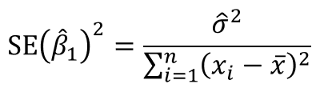



Linear Regression
Design issue with “Data Collection”
We typically want to minimize uncertainty
We can reduce it through “appropriate data collection”. We should increase $\sum{{\left(x−\overline{x}\right)}^{2}}$
That means, we should sample diversly.
$$SE\left(\hat{β}\right)$$
$$\hat{β}$$

Slide 28










Linear Regression
Appropriate data collection to reduce the standard error
$$y_{i}=4−2x_{i}+ε_{i}$$
$$\left\{\begin{aligned}x_{i}\sim N\left(0, 1\right) \\ ε_{i}\sim N\left({0, 0.5}^{2}\right) \end{aligned}\right.$$
$$y_{i}=4−2x_{i}+ε_{i}$$
$$\left\{\begin{aligned}x_{i}\sim N\left(0, 0.5\right) \\ ε_{i}\sim N\left({0, 0.5}^{2}\right) \end{aligned}\right.$$
Run 100 times
Run 100 times
$$\left(X,Y\right)$$
$$\left(X,Y\right)$$
Fit $\hat{f}$ and get ${\hat{β}}_{0},{\hat{β}}_{1}$
Fit $\hat{f}$ and get ${\hat{β}}_{0},{\hat{β}}_{1}$
Run this loop 1,000 times $→$ 1,000 pairs of ${\hat{β}}_{0},{\hat{β}}_{1}$
Run this loop 1,000 times $→$ 1,000 pairs of ${\hat{β}}_{0},{\hat{β}}_{1}$
$$SE\left({\hat{β}}_{1}\right)=0.05$$
$$SE\left({\hat{β}}_{1}\right)=0.1$$

Slide 29



Linear Regression
Residual Standard Error (RSE)
$$\hat{σ}=RSE=\sqrt{\frac{1}{n−2}RSS}=\sqrt{\frac{1}{n−2}\sum_{i=1}^{n}{{\left(y_{i}−{\hat{y}}_{i}\right)}^{2}}}$$
$SE{\left({\hat{β}}_{0}\right)}^{2}=\hat{σ}\left[\frac{1}{n}+\frac{\overline{x}}{\sum_{i=1}^{n}{{\left(x_{i}−\overline{x}\right)}^{2}}}\right]$
$SE{\left({\hat{β}}_{1}\right)}^{2}=\frac{{\hat{σ}}^{2}}{\sum_{i=1}^{n}{{\left(x_{i}−\overline{x}\right)}^{2}}}$
$${\hat{β}}_{rm}$$
$$9.1$$

Slide 30
Testing and Confidence Intervals

Slide 31
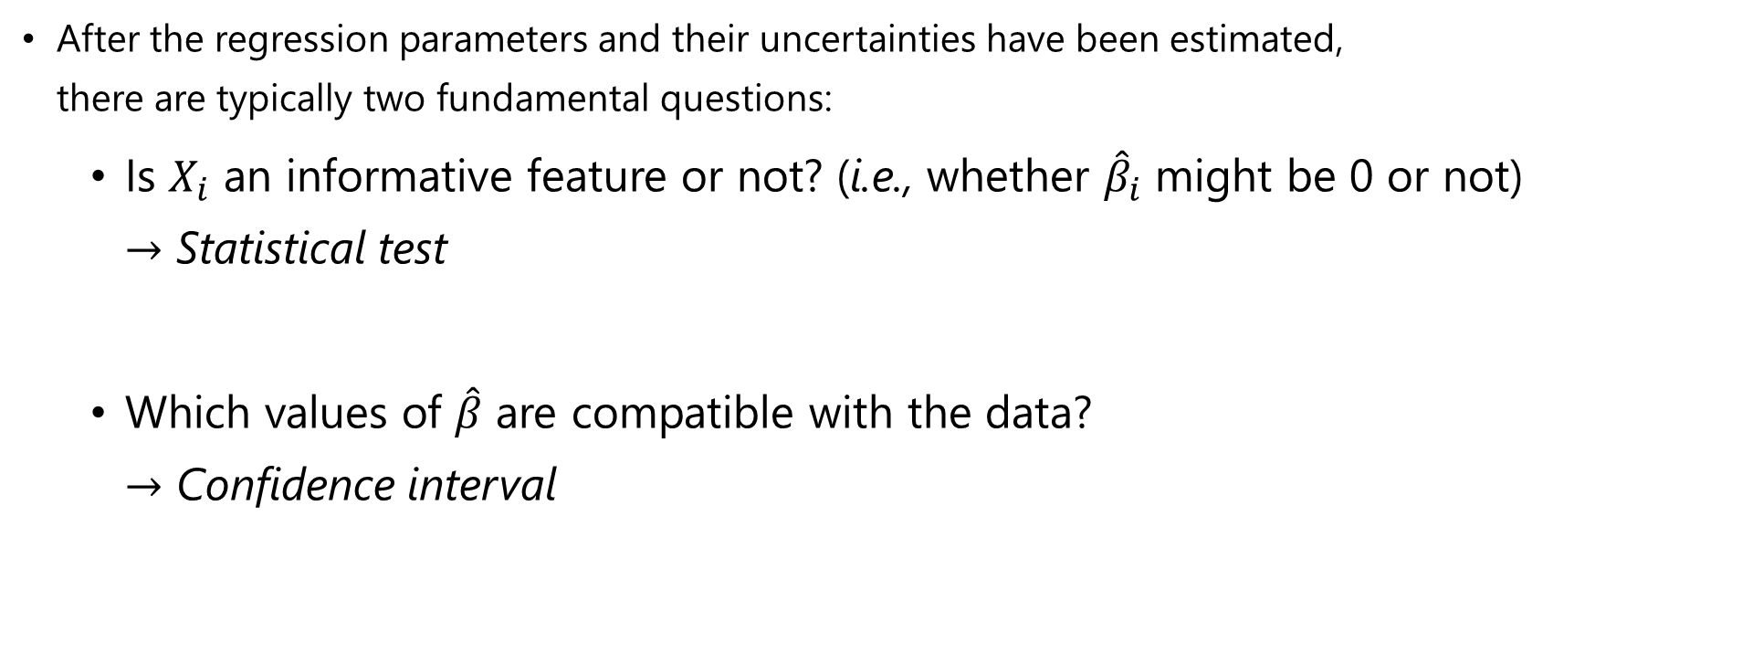
Testing and Confidence Intervals
After the regression parameters and their uncertainties have been estimated, there are typically two fundamental questions:
Is $X_{i}$ an informative feature or not? (i.e., whether ${\hat{β}}_{i}$ might be 0 or not) $→$ Statistical test
Which values of $\hat{β}$ are compatible with the data? $→$ Confidence interval

Slide 32
Testing and Confidence Intervals
Let’s talk about the statistical test, first

Slide 33

Testing and Confidence Intervals
Testing the effect of a covariate
Null hypothesis $H_{0}: β_{1}=0$ In our case, $H_{0}=$ “There is no relationship between $X_{i}$ and $Y$”
Alternative hypothesis $H_{A}: β_{1}≠0$ In our case, $H_{1}=$ “There is some relationship between $X_{i}$ and $Y$”
Learned in TMA4240 (Statistics)

Slide 34
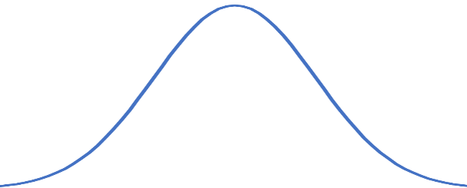


Testing and Confidence Intervals
To carry out a statistical test, we need a test statistic. This is some type of summary statistic that follows a known distribution under $H_{0}$. For our purpose, we use the T-statistic. $T=\frac{{\hat{β}}_{1}}{SE\left({\hat{β}}_{1}\right)}$
Note: If you want to test against another value $c$ than $β_{1}=0$, the formula is $T=\frac{{\hat{β}}_{1}−c}{SE\left({\hat{β}}_{1}\right)}$
T distribution under $H_{0}$
Learned in TMA4240 (Statistics)

Slide 35
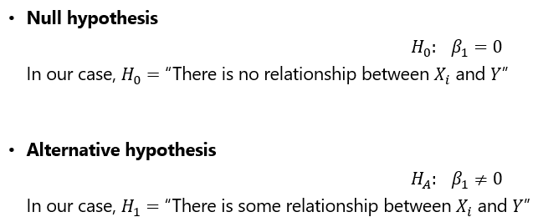

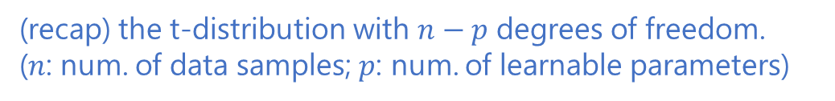
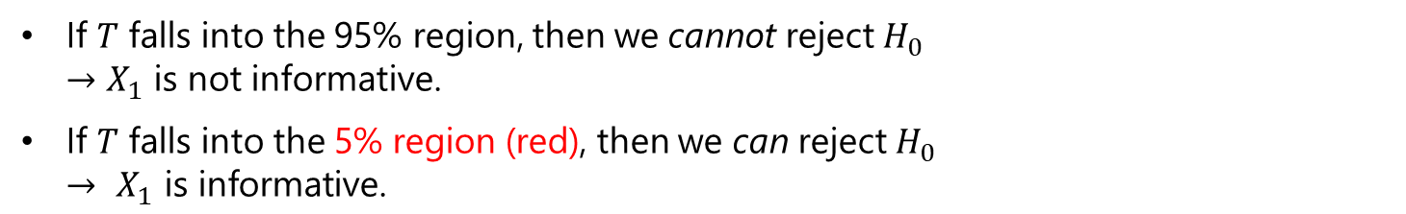


Testing and Confidence Intervals
Our question is
“Is $X_{i}$ an informative feature or not? (i.e., whether ${\hat{β}}_{i}$ might be 0 or not)?”
T distribution under $H_{0}$
(recap) the t-distribution with $n−p$ degrees of freedom. ($n$: num. of data samples; $p$: num. of learnable parameters)
If $T$ falls into the 95% region, then we cannot reject $H_{0}$ $→$ $X_{1}$ is not informative.
If $T$ falls into the 5% region (red), then we can reject $H_{0}$ $→ X_{1} \text{is} \text{informative}\text{.}$
Learned in TMA4240 (Statistics)

Slide 36
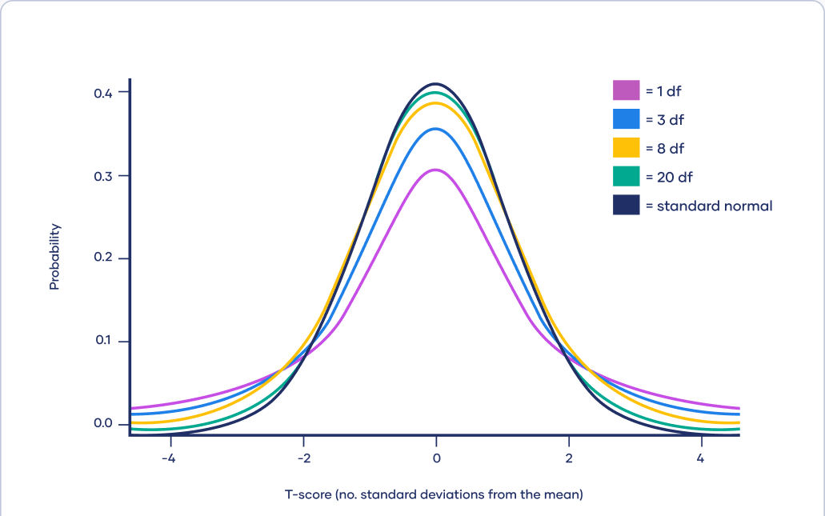
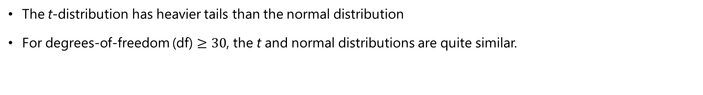
Testing and Confidence Intervals
Recap: The t-distribution
The t-distribution has heavier tails than the normal distribution
For degrees-of-freedom (df) $≥30$, the t and normal distributions are quite similar.

Slide 37



Testing and Confidence Intervals
Hypothesis tests for the example
a
$$T$$
p-value
$$T=\frac{{\hat{β}}_{rm}}{SE\left({\hat{β}}_{rm}\right)}$$

Slide 38
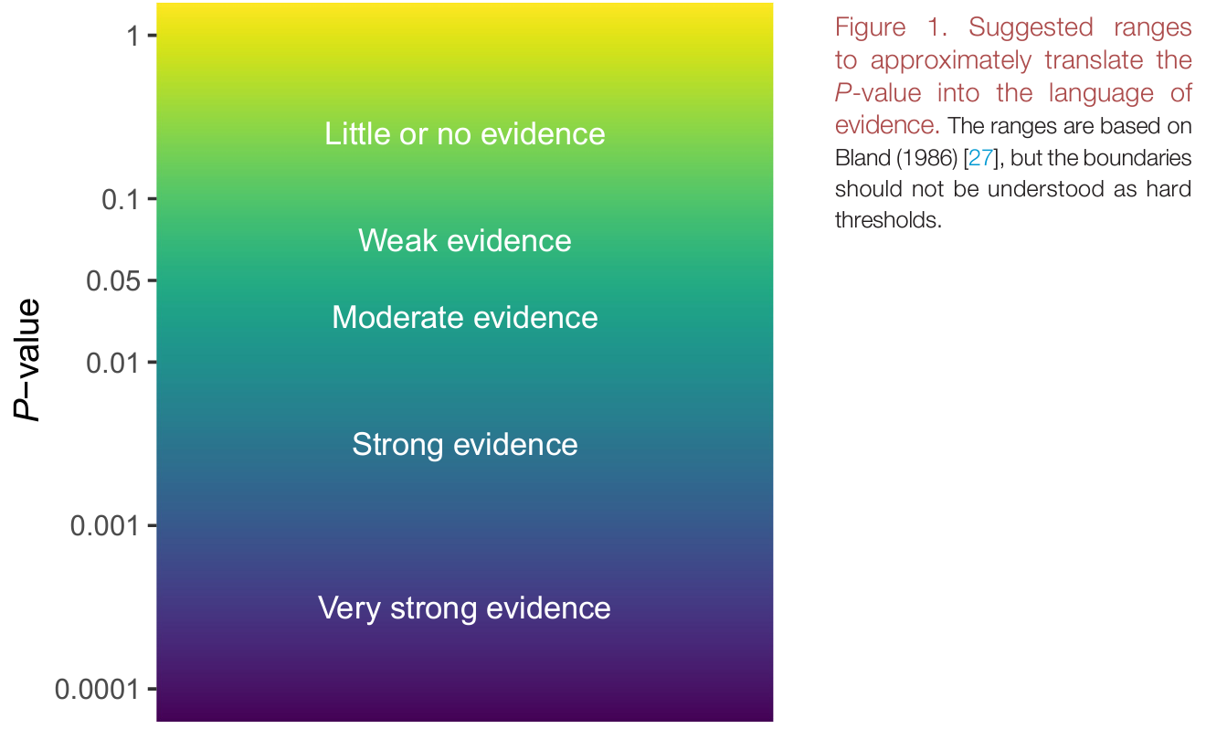
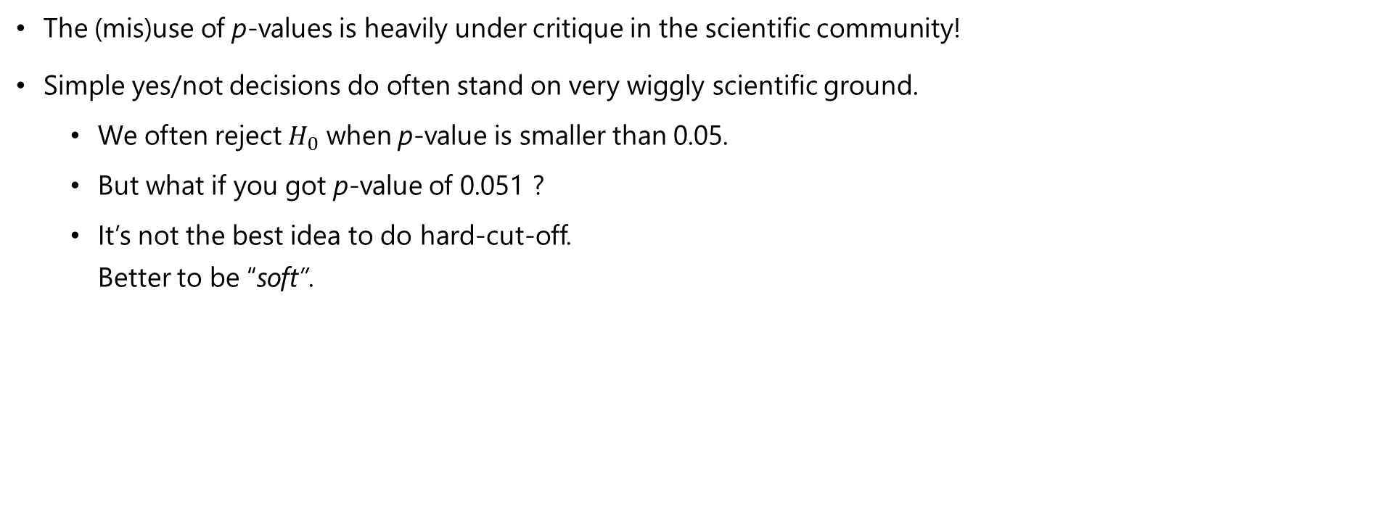
Testing and Confidence Intervals
Cautionary notes regarding p-values
The (mis)use of p-values is heavily under critique in the scientific community!
Simple yes/not decisions do often stand on very wiggly scientific ground.
We often reject $H_{0}$ when p-value is smaller than 0.05.
But what if you got p-value of 0.051 ?
It’s not the best idea to do hard-cut-off. Better to be “soft”.
Muff, Stefanie, et al. "Rewriting results sections in the language of evidence." Trends in ecology & evolution (2021).

Slide 39


Testing and Confidence Intervals
Confidence Intervals
Confidence intervals (CIs) are the range of $\hat{β}$ that are compatible with the data.
The t-distribution can be used to create confidence intervals for $\hat{β}$. $\hat{β}±t_{\left(1−α/2\right), n−p}∙SE\left(\hat{β}\right)$ $α$ can be 0.95 (i.e., 95% confidence interval) $n−p$: degree-of-freedom
$$t_{\left(1−α/2\right)}$$

Slide 40


Testing and Confidence Intervals
Confidence Interval in R
8.3
9.1
9.9
$${\hat{β}}_{rm}$$

Slide 41
Model Accuracy

Slide 42






Model Accuracy
Measured by
Residual Standard Error (RSE) It provides an absolute measure of lack of fit.
$R^{2}$ $R^{2}=1−\frac{\sum_{i=1}^{n}{{\left(y_{i}−{\hat{y}}_{i}\right)}^{2}}}{\sum_{i=1}^{n}{{\left(y_{i}−{\overline{y}}_{i}\right)}^{2}}}$ $R^{2}$ typically ranges between 0 and 1.
$$R^{2}=0.95$$
$$R^{2}=0.75$$
$$R^{2}=0.24$$

Slide 43
Multiple Linear Regression

Slide 44








Multiple Linear Regression
Model
$$Y=β_{0}+β_{1}X_{1}+β_{2}X_{2}+…+β_{p}X_{p}+ε$$
where $X_{j}$ is the j-th predictor and $β_{j}$ is the respective regression coefficient.
$$Y=Xβ+ε$$
$$y_{1}$$
$$y_{2}$$
$$⋮$$
$$y_{n}$$
$$1$$ | $$x_{11}$$ | $$x_{12}$$ | $$⋯$$ | $$x_{1p}$$
$$1$$ | $$x_{21}$$ | $$x_{22}$$ | $$⋯$$ | $$x_{2p}$$
$$⋮$$ | $$⋮$$ | $$⋮$$ | $$⋮$$ | $$⋮$$
$$1$$ | $$x_{n1}$$ | $$x_{n2}$$ | $$⋯$$ | $$x_{np}$$
$$β_{0}$$
$$β_{1}$$
$$⋮$$
$$β_{p}$$
$$ε_{1}$$
$$ε_{2}$$
$$⋮$$
$$ε_{n}$$
$$=$$
$$∙$$
$$+$$

Slide 45


Multiple Linear Regression
Notation
$Y:$ $(n×1)$ output
$X:$ $(n×(p+1))$ input
$β:$ $\left( \left(p+1\right)×1\right)$ regression parameters
$ε:$ $( n×1)$ random errors

Slide 46

Multiple Linear Regression
Classical linear model
$$Y=Xβ+ε$$
Assumptions:
$E\left[ε\right]=0$
$Cov\left(ε\right)=E\left[εε^{T}\right]=σ^{2}I$ (i.e., all $ε_{i}$ are independent of each other and $ε$is homogenous)
$X$ has full rank, $rank\left(X\right)=p+1$ (we assume $n≫\left(p+1\right)$) (i.e., all $X_{j}$ are independent of each other)
The classical normal linear regression model is obtained if additionally $ε\sim N_{n}\left(0,σ^{2}I\right)$ holds. $N_{n}$ denotes the n-dimensional multivariate normal distribution.

Slide 47



Multiple Linear Regression
The Boston-housing example for two predictors (input features)
We’re looking at the regression model $Y=β_{0}+β_{1}X_{1}+β_{2}X_{2}+ε$

Slide 48


Multiple Linear Regression
The Boston-housing example for two predictors (input features)

Slide 49


Multiple Linear Regression
Distribution of the response vector
For $Y=Xβ+ε$ where $ε\sim N_{n}\left(0,σ^{2}I\right)$
$Y\sim N_{n}\left(Xβ,σ^{2}I\right)$

Slide 50


Multiple Linear Regression
Parameter estimation for $β$
In multiple linear regression, $β$ is estimated with maximum likelihood and least squares.
Aim: we want to estimate $β$ by minimizing $RSS=\sum_{i=1}^{n}{{\left(y_{i}−{\hat{y}}_{i}\right)}^{2}}$ then, $β$ can be found by solving $\frac{∂RSS}{∂β}=0$

Slide 51








Multiple Linear Regression
Parameter estimation for $β$
$RSS=\sum_{i=1}^{n}{{\left(y_{i}−{\hat{y}}_{i}\right)}^{2}}=\sum_{i=1}^{n}{{\left(y_{i}−x_{i}^{T}\hat{β}\right)}^{2}}={\left(Y−X\hat{β}\right)}^{T}\left(Y−X\hat{β}\right)$
$\frac{∂RSS}{∂β}={\left(Y−X\hat{β}\right)}^{T}\left(Y−X\hat{β}\right)=0$
${RSS=\left(Y−X\hat{β}\right)}^{T}\left(Y−X\hat{β}\right)$ $=\left(Y^{T}−{\hat{β}}^{T}X^{T}\right)\left(Y−X\hat{β}\right)$ $=Y^{T}Y−Y^{T}X\hat{β}−{\hat{β}}^{T}X^{T}Y+{\hat{β}}^{T}X^{T}X\hat{β}$ $=Y^{T}Y−Y^{T}X\hat{β}−{\left({\hat{β}}^{T}X^{T}Y\right)}^{T}+{\hat{β}}^{T}X^{T}X\hat{β}$ $=Y^{T}Y−Y^{T}X\hat{β}−Y^{T}X\hat{β}+{\hat{β}}^{T}X^{T}X\hat{β}$ $=Y^{T}Y−{2Y}^{T}X\hat{β}+{\hat{β}}^{T}X^{T}X\hat{β}$
$\frac{∂RSS}{∂\hat{β}}={−2\left(Y^{T}X\right)}^{T}+\left(X^{T}X+{\left(X^{T}X\right)}^{T}\right)\hat{β}=0$ $={−2\left(Y^{T}X\right)}^{T}+\left(X^{T}X+X^{T}X\right)\hat{β}=0$ $={−2\left(Y^{T}X\right)}^{T}+2\left(X^{T}X\right)\hat{β}=0$ ${\left(Y^{T}X\right)}^{T}=\left(X^{T}X\right)\hat{β}$ ${\left(X^{T}X\right)}^{−1}{\left(Y^{T}X\right)}^{T}=\hat{β}$
$${\hat{β}}^{T}X^{T}Y→scalar \\ \left(1×p\right)∙\left(p×n\right)∙\left(n×1\right)→(1×1)$$
Therefore, ${\hat{β}}^{T}X^{T}Y={\left({\hat{β}}^{T}X^{T}Y\right)}^{T}$
$\frac{∂A^{T}\hat{β}}{∂\hat{β}}=A$
$\frac{∂{\hat{β}}^{T}A\hat{β}}{∂\hat{β}}=\left(A+A^{T}\right)\hat{β}$
$$X^{T}X$$
$${\left(X^{T}X\right)}^{T}=X^{T}X$$
$${\left(X^{T}X\right)}^{T}$$

Slide 52



Multiple Linear Regression
Example continued
Housing price prediction using all the input features
Simple to implement, yet important to really know what you’re using!
$$\hat{β}$$

Slide 53

The End!

Slide 54




Linear Regression
One quantitative response $Y$
One covariate $X_{1}$
Linear relationship between $X_{1}$ and $Y$
Then,
$$Y$$
$$Y=β_{0}+β_{1}X_{1}$$
$$X_{1}$$

Slide 55

Linear Regression
Least Squares Estimators:
Analytical solution:
$Y=β_{0}+Xβ+ε$
$X∈ℝ^{n×p}$
$β∈ℝ^{p×1}$
$Y∈ℝ^{n×1}$
You want to find $\hat{Y}={\hat{β}}_{0}+\hat{X}\hat{β}$
$\hat{β}={\left(X^{T}X\right)}^{−1}X^{T}Y$
${\hat{β}}_{0}=\overline{Y}−\hat{β}\overline{X}$
You’ve learned it in your previous statistics course. So, we’re skipping the proof. You can find the proof here: https://statproofbook.github.io/P/mlr-ols
Numerical Solution: Gradient Descent (we’ll learn about it during the module for neural networks)

