Slide 1
Predicting Classroom Project Funding
Stefanie Smith
Foundations of Data Science

Slide 2

DonorsChoose.org
Across the country, many public school teachers use their own money to buy supplies for their classrooms, including basic essentials like notebooks and pencils.
If schools and teachers cannot afford these supplies, students may miss out on learning opportunities.
DonorsChoose.org was established to help teachers get the resources they need for classroom projects.
Through the DonorsChoose.org website, teachers can request materials for their classrooms.
Donors can browse through requests, and select a project they would like to support financially.

Slide 3

Project Requests
A typical project request on DonorsChoose.org will include:
Title
Need statement
Essay
Teacher info
School info
Location
Grade level
Poverty level

Slide 4

Objective and Overview
In 2015, 72% of classroom projects posted on DonorsChoose.org were successfully funded.
By analyzing data available from DonorsChoose.org, the goal of this capstone project was to understand what types of projects receive full funding.
The analysis was limited to data from 2015, and included 190,000+ projects.
Exploratory data analysis was conducted, and a classification tree was developed to gain insight into the properties of projects that impact funding.
The results from this analysis can be used to help teachers improve their chances of success.

Slide 5
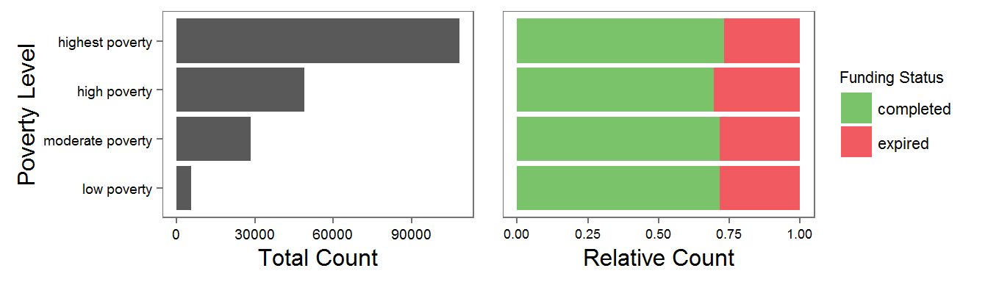
Impact of Poverty Level on Funding
Every project posted on DonorsChoose.org is categorized by poverty level, which refers to the percentage of students at a given school who qualify for free or reduced-price lunch, and is considered a measure of economic need.
Exploratory data analysis revealed that projects from “highest poverty” schools (where 65% or more of its students receive these lunches) have a slightly better success rate compared to the other poverty levels.

Slide 6
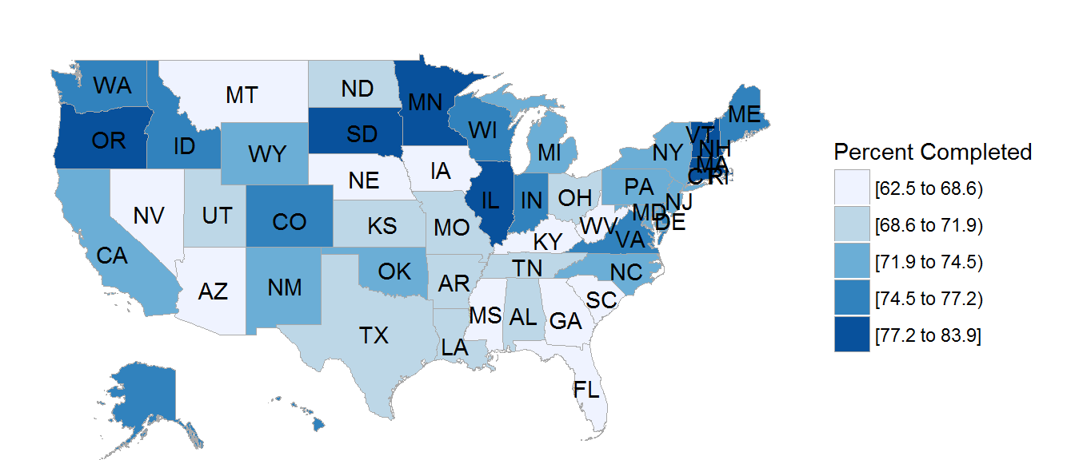
Impact of School Location on Funding
Project success rates were determined for every state across the country.
Success rates varied from 62.5% (South Carolina) to 83.9% (New Hampshire).

Slide 7
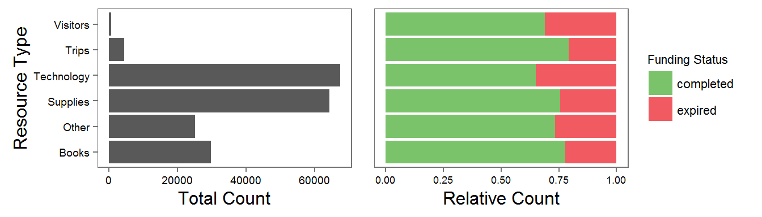
Impact of Resource Type on Funding
Every project on DonorsChoose.org is categorized by the type of resource requested.
Trip-based projects had the highest rate of success.

Slide 8
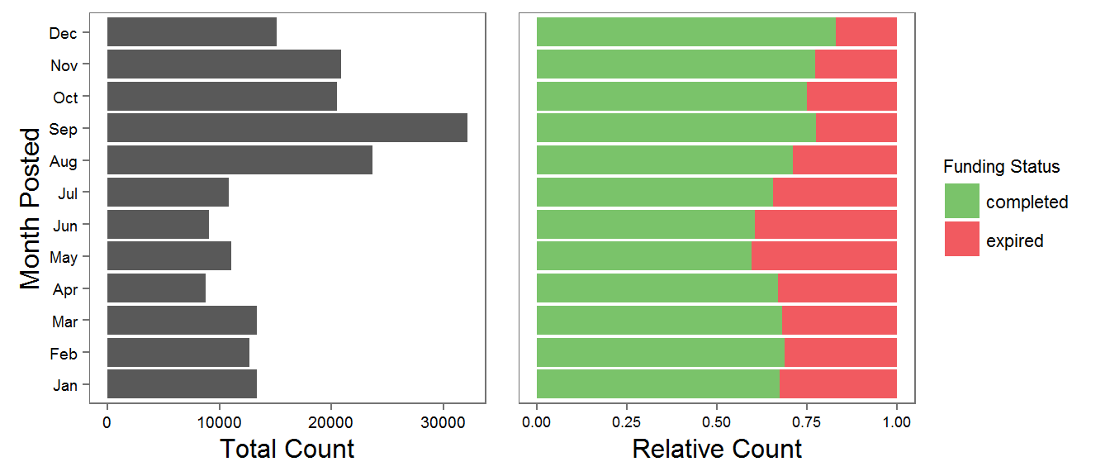
Impact of Date Posted on Funding
In 2015, a large number of projects were posted in September, which is typically the start of the school year.
Projects posted in December had the highest rate of success.

Slide 9
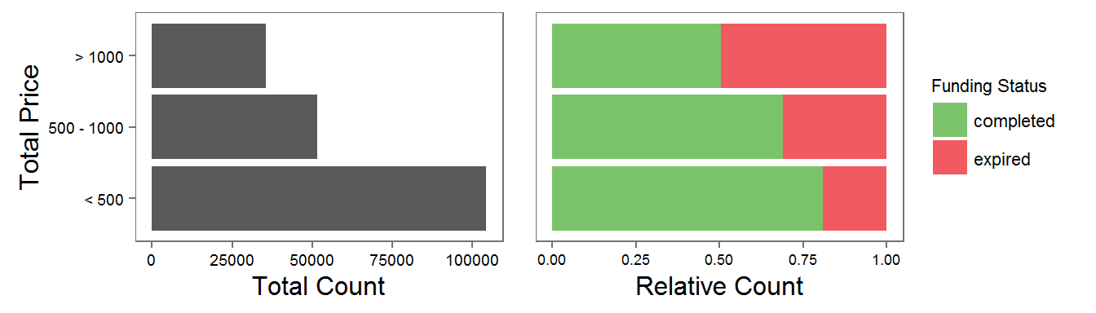
Impact of Project Cost on Funding
Exploratory data analysis revealed that lower cost projects have a better rate of success.

Slide 10
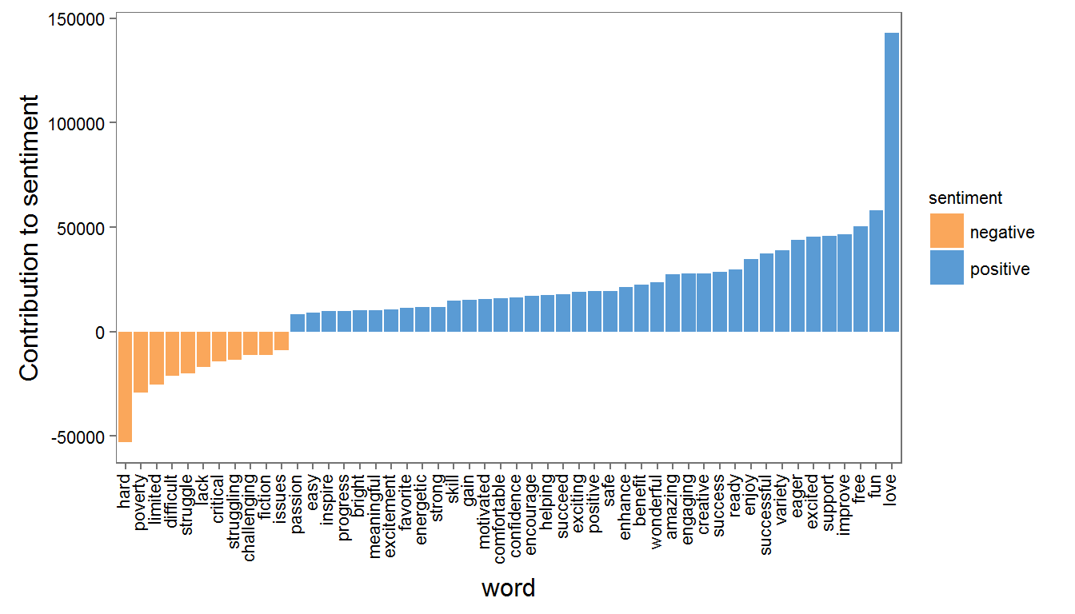
Sentiment Analysis of Project Essays
The text from every essay posted on DonorsChoose.org was analyzed, and the total number of positive and negative terms was calculated.
Sentiment analysis revealed that positive terms are used more frequently than negative ones.
Most common positive word: “love”
Most common negative word: “hard”

Slide 11
Building a Classification Tree
A classification tree was built using the CART method to predict a project’s funding status (completed or expired).
The independent variables consisted of factors that are within a teacher’s control, including:
Resource type
Total price
Focus area and subject
Essay length
Essay sentiment scores
Month posted
A training set was used to build the model (70% of the dataset), and a test set was used to evaluate the model.
The resulting tree was pruned using the 1-SE method.

Slide 12
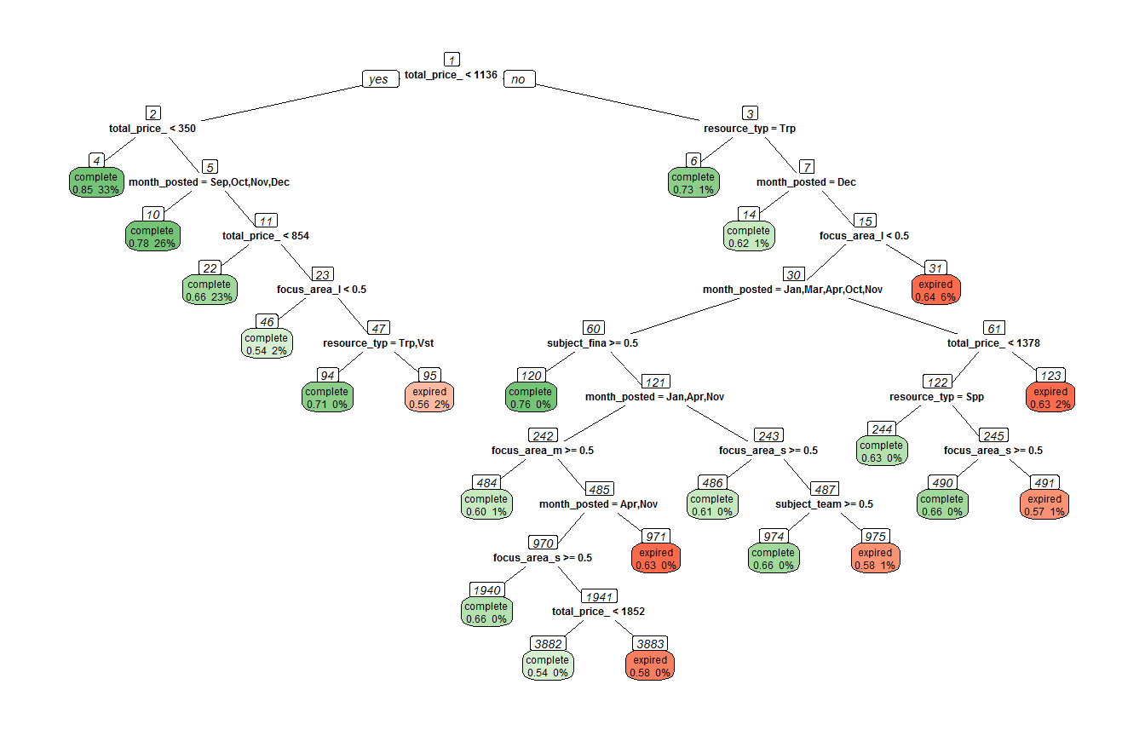
Classification Tree

Slide 13
Interpreting the Tree
In 2015, the overall project success rate was 72%.
Any leaf node with a success rate greater than 72% was considered for analysis.
Highlights from the analysis are summarized in the table below.
Teachers can improve their chances of success by developing a project that matches any of these leaf nodes.
Leaf Node | Project Attributes | Success Rate
4 | Total Price < $350 | 85%
6 | Total Price > $1136 Resource Type = Trips | 73%
10 | $350 <= Total Price < $1136 Month Posted = Sept – Dec | 78%

Slide 14

Recommendations to Teachers
The following recommendations are proposed based on the results from the classification tree:
For best chances of success, keep the project costs under $350.
If the project will cost more ($350 - $1136), then be sure to post the project early in the school year (September to December).
Avoid letting the costs get above $1136, unless considering a trip-based project.

Slide 15

Future Work
This capstone project focused on the project and essay datasets from DonorsChoose.org.
Additional insight may be gained from the other DonorsChoose.org datasets.
Donation data (including donor city, state, and donation amount):
Do donors typically donate to teachers in their local area?
Any differences between repeat donors and 1-time donors?
Resource data (breakdown of all materials/resources requested for a project and the corresponding prices):
Are “highest poverty” schools requesting different types of resources?
Do successful projects typically request many low cost items, or fewer high price items?

