Slide 1
VoiceWeb – Browser navigator using voice commands
Project by Stefan Ihnatiw

Slide 2
Purpose
Finding different approaches in interacting with the web browser
The ability to perform daily tasks in a more convenient manner
Writing messages using vocal input
Easier option to navigate for people with certain disabilities
Older people can prefer voice interaction rather than computer systems understanding
Identify different elements in the HTML document of a page

Slide 3
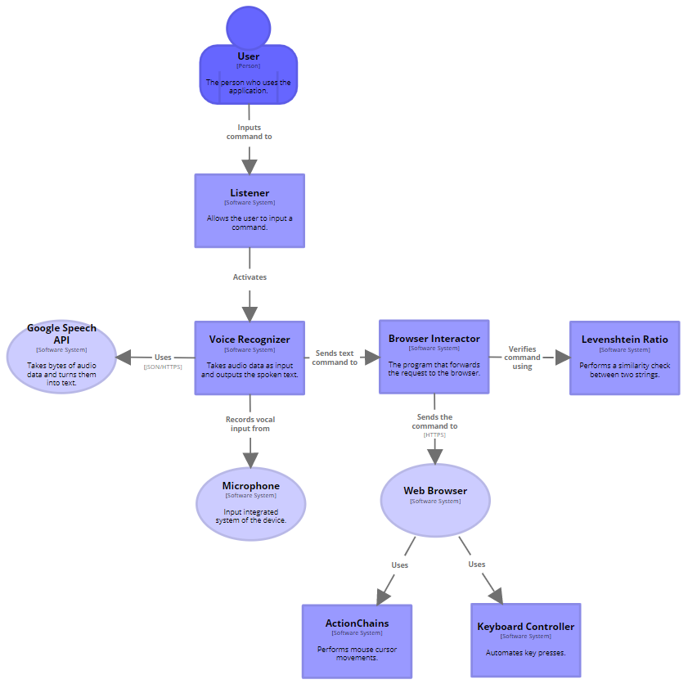
Architecture
The application consists of 2 main modules:
the voice recognizer
The browser interactor
The voice recognizer handles the conversion of audio input to a byte representation, which will be then transformed into a lossless type representation and sent to the Google Speech API to be recognized.
The browser interactor handles a text command by checking its similarity with the supported commands and implementing each functionality in a different method.

Slide 4
Browser interaction
Identify elements on a page
- using tags, ids, other attributes, xpath, css selector
Perform javascript commands written by the developer
Shortcut commands

Slide 5
Technologies used
SpeechRecognition module
- verifies the audio input devices present on the system and selects one to record from
- the audio data is recorded in chunks of frames
- while listening in background, it checks the energy threshold detected by the microphone to determine the presence of speech
- has the ability to interact with multiple APIs that can determine the text spoken in the audio representation

Slide 6
Technologies used
Selenium module
- mainly used for automation of the web browser, it can connect to an existing session and interact with it
- has the ability to identify HTML elements based on tag, class, value, id, xpath, css selector
- can execute javascript commands given by the developer

Slide 7
Technologies used
ActionChains
- provides the ability to move the mouse cursor to a certain HTML element
Pynput module
- performs key presses, combination of key presses and listens in the background for user keyboard actions
Levenshtein module
- measures the Levenshtein distance between two strings to determine the similarity ratio

Slide 8
Application flow
To input a command, the user has to hold down RCtrl and speak to the microphone
The listener prompts the voice recognizer to start recording the microphone
When the key is released, the recording stops, and the byte representation is sent to the recognizer API which returns the text result
The similarity between the command and the supported ones determines which action should the browser take
A request is sent to the browser to perform the action

Slide 9
Demo

