Slide 1
Auditing Gender Representation in Online Image Searches
Presenting: Stefan Wojcik
Computational Social Scientist
@stefanjwojcik

Slide 2
Other Members
Onyi Lam, Fmr Computational Social Scientist, now at FiscalNote
Brian Broderick, Data Science Engineer
Adam Hughes, Associate Director, Data Labs

Slide 3
About Pew Research Center Data Labs
Pew Research Center is a nonpartisan fact tank that informs the public about the issues, attitudes, and trends shaping the world. It does not take policy positions.
Data Labs is a team of computational social scientists exploring the intersection of digital trace data and survey data
We are hiring a computational social scientist! Ask me

Slide 4
Motivation
Algorithmic bias
Gender-bias in word embeddings
Disparities in accuracy of classifying gender across different skin types
Research Question
How often are women portrayed in different jobs in Google Image Search?
How does the result change with search language and country?

Slide 5
Challenges
How to analyze images at scale?
How do you accurately identify humans in images?
How to identify gender of individuals automatically and with high accuracy?
How to ensure classifier is not systematically biased?

Slide 6
Overview
Built a data pipeline for image collection, face detection and gender classification
Used off-the-shelf package for face detection
Used a pretrained neural network to fine tune a gender classifier
Documented significant variation in search result across languages

Slide 7
What is Transfer Learning?
Neural Network has many layers
Some neurons react to simple stimuli, others to complex stimuli
Lower layers of pre-trained models often have useful features
Reusing them saves a lot of computation time

Slide 8
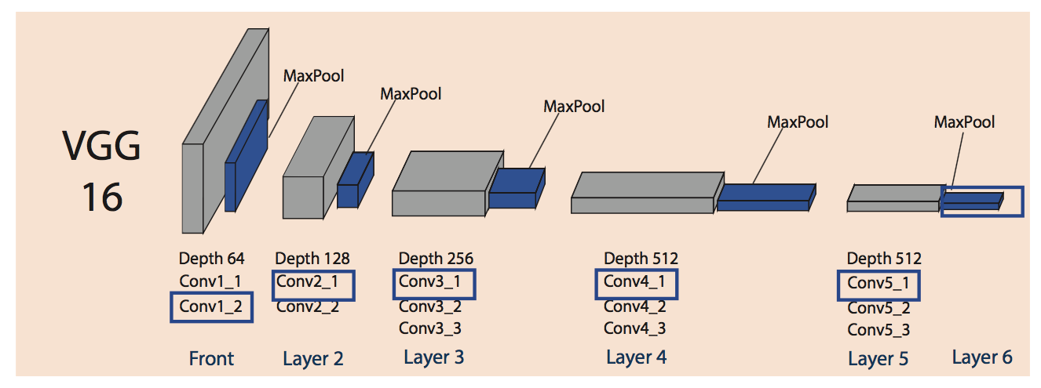
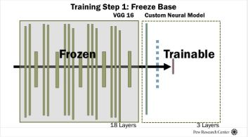
Fine Tuning a pretrained Neural Network Model
Pre-trained VGG16
freeze the VGG base, add custom layers, and unfreeze the top layers to retrain

Slide 9
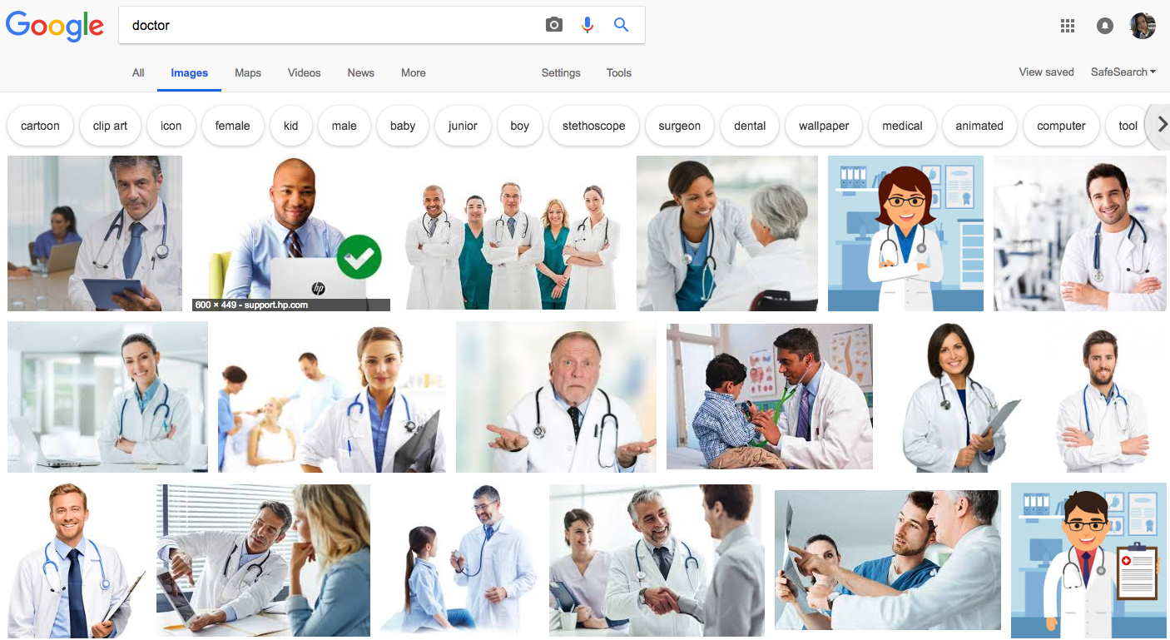
Methodology: Data Pipeline
Image Collection: saved and indexed top 100 images, and saved them in a database hosted on AWS
Face Detection
Gender Classification

Slide 10
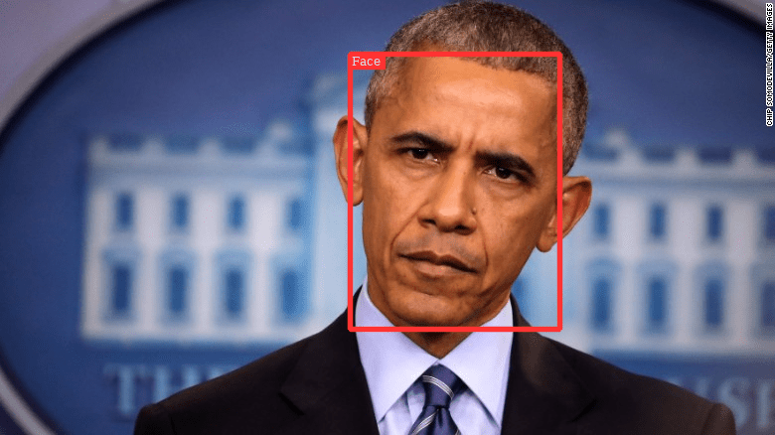
Methodology: Data Pipeline
Image Collection: saved and indexed top 100 images, and saved them in a database hosted on AWS
Face Detection: Open Source Python package dlib
Gender Classification

Slide 11
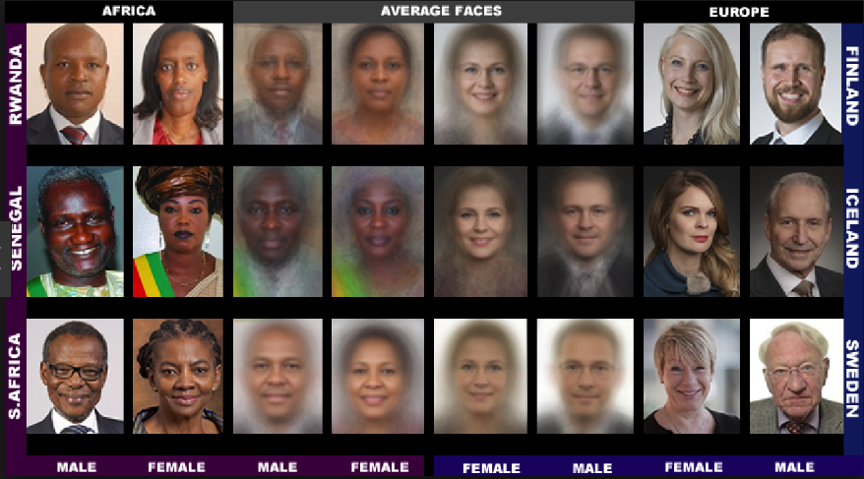
Methodology: Data Pipeline
Image Collection: saved and indexed top 100 images, and saved them in a database hosted on AWS
Face Detection: Open Source Python package dlib
Gender Classification: leveraged pre-trained neural network via Transfer Learning

Slide 12
Occupation List
Domestic
105 job titles that are identical to the BLS
Global
20 more general job titles

Slide 13
Model
Training Data Summary
27K faces, 14K males, 12K females
7 data sets from different sources
Emphasis on diversity: Brazilian municipal candidates, famous minorities, Labeled Faces in the Wild, google image searches by country
Model Performance
Reserved 20% of images for validation (7K faces) : 95% accuracy overall
Consistent performance across different minority groups

Slide 14
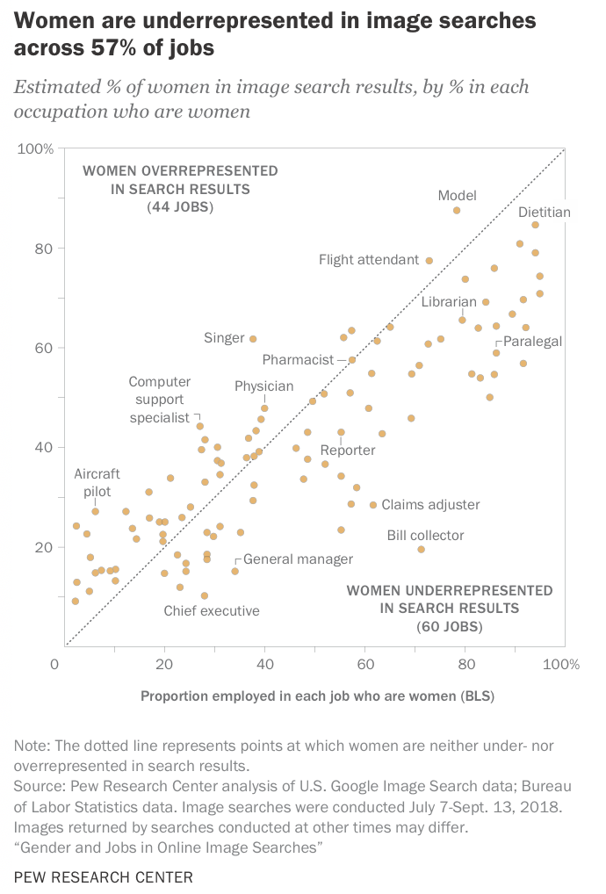
Comparing with BLS
Women underrepresented in 57% of jobs
More diversity in jobs predominantly held by one gender

Slide 15
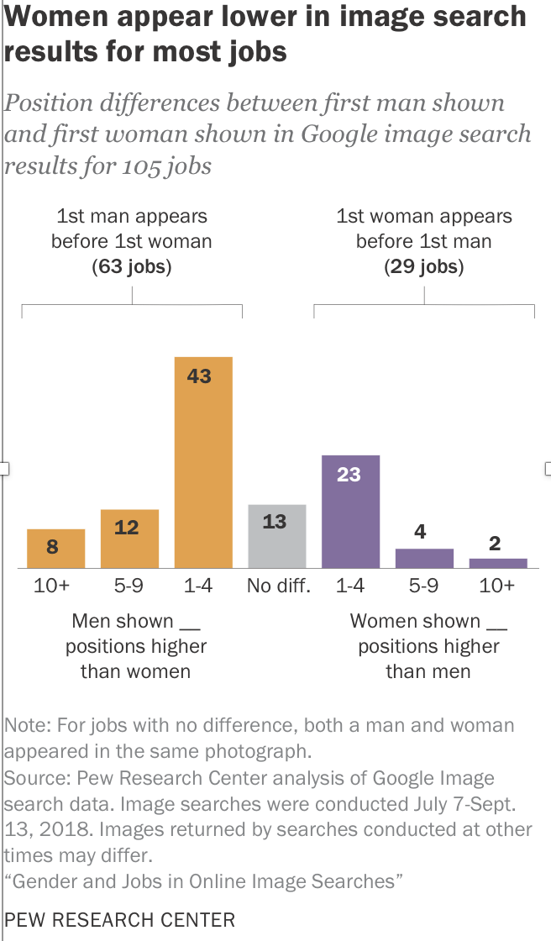
Image Position
Women appear lower in results

Slide 16
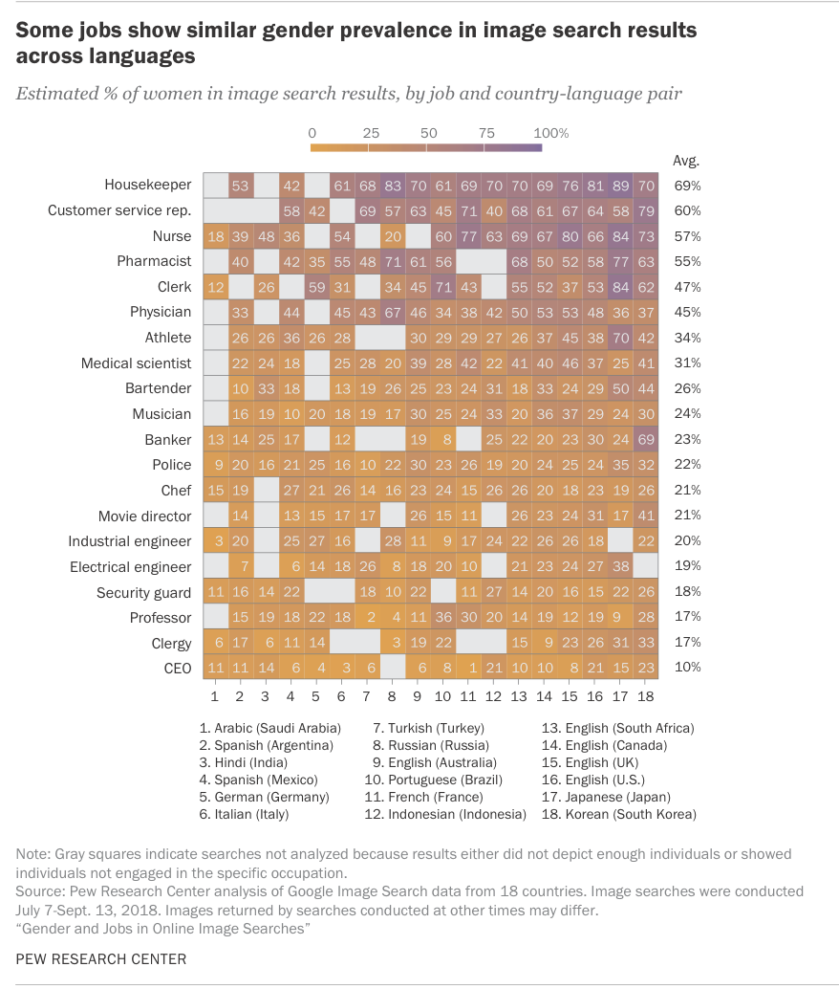
Cross-Language Comparison
Gender connotation for some jobs is global

Slide 17
Conclusions
Image searches for common jobs somewhat underrepresent women (57% of jobs)
Somewhat paradoxically, image searches also depict more diversity than exists
Women appear lower in image search results

Slide 18
Thank You!
Onyi Lam
Computational Social Scientist
olam@pewresearch.org

Slide 19
How Job Titles Were Selected
Start with the list of BLS job titles in 2017.
Exclude occupations that do not have information about the fraction of women employed. For example, “credit analysts” did not have information about the fraction of women in that occupation.
Filter out occupations that do not have at least 100,000 workers in the U.S.
Remove all occupations with ambiguous job functions (“all other,” “Misc.”).
Split all titles with composite job functions into individual job titles (For example, “models and demonstrators” to “models,” “demonstrators”).
Change plural words to singular (“models” to “model”) to standardize across occupations.⁷
Manually inspect the list to ensure that the occupations were comprehensible and likely to describe human workers. This involved removing terms that might not apply to humans (such as tester, sorter) based on the researchers’ review of Google results.
Use Google Trends to remove unpopular or highly technical job titles. Highly technical job titles like “eligibility interviewers, government programs” are searched for less frequently than less technical titles, such as “lawyer.” Accordingly, researchers decided to remove technical terms in a systematic fashion by comparing the relative search intensity of each potential job title against that of a reasonably common job title.

