Slide 1
Looks Can Be Confirming
The Effects of Gendered Candidate Appearance on Vote Choice
Stefan Wojcik
Shawnna Mullenax

Slide 2
Vote Choice
A truly vast literature: encompassing partisanship, institutions, behavior, and many other key factors.
Point of entry: vote choice and candidate appearance
Appearance provides cues about candidate traits, for example:
candidates who appear ‘competent’ receive higher vote shares
candidates who appear ‘trustworthy’ receive higher vote shares

Slide 3
Vote Choice and Candidate Appearance
Consistent findings surrounding competence and trust
Use of experimental designs and observational results lend considerable weight to findings
Regarding gender, survey evidence suggests negative biases affect vote choice
Yet, to date, little observational data find a harfmul effect for women at election time

Slide 4
Research Questions
Does candidate appearance have a latent gender dimension (i.e. masculine or feminine ‘look’)?
When candidate appearance largely reinforces cultural stereotypes regarding gender, do candidates do better? If men appear masculine, do they do better than men who appear less masculine? Does the same hold for women?
Does this relationship exist for different types of elections where different types of information may be available?

Slide 5
Challenges
What relevant data outside of experimental settings can test the relationship between candidate appearance and vote share?
Given appropriate images, how do you measure apparent masculinity/femininity apart from self-identified gender?
How do you measure the effects of such a measure in local elections?

Slide 6
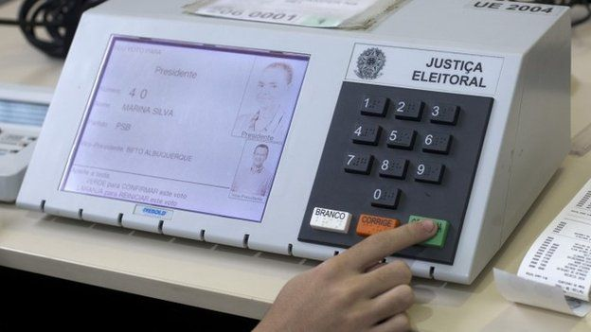
Research Design
We analyze over 193,000 candidate images and vote returns from the 2016 Brazilian municipal elections.
We create a latent variable model of gender, aided by deep learning techniques
We use cross-validation methods based on machine learning to establish the validity of our measure

Slide 7

Apparent Gender Score (AGS)
y$∗ =β_{0}+x^{′}β_{1}$
$β_{0}$ is a normalizing constant
$x$ is a set of features about a candidate image
$β_{1}$ is a set of weights on the features
y* is the apparent gender score of the candidate
if y* > .5, classify the candidate as male
if y* < .5, classify the candidate as female

Slide 8
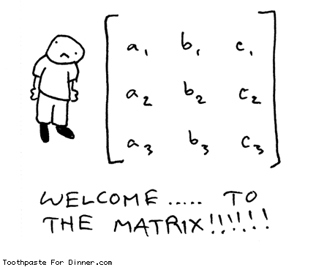

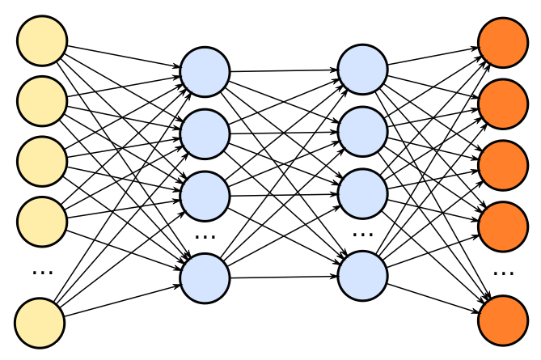


Creating the Apparent Gender Score (AGS)
x $=$
Candidate image
Deep Neural Network
Matrix of Image Features
AGS=
y$∗ =β_{0}+x^{′}β_{1}$
.90
Compress those features to a prediction using a
Support Vector Machine (SVM), scale to 0-1.
Certainty that the subject is a male*

Slide 9
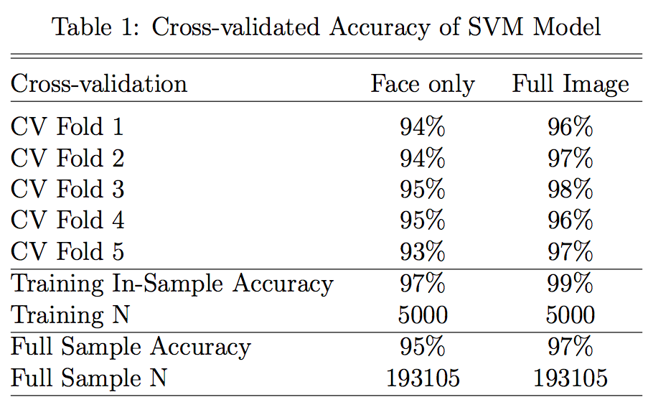
Cross-validation of AGS Score

Slide 10
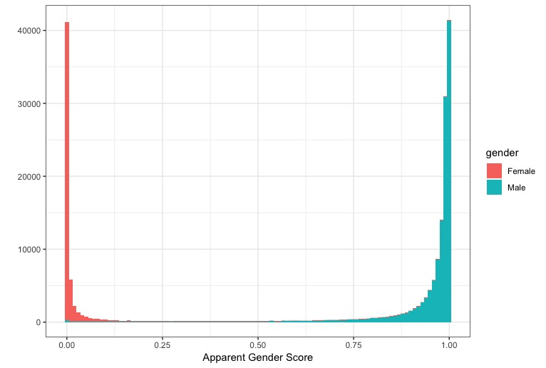

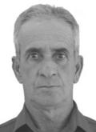
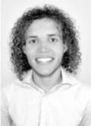

Histogram of Apparent Gender Scores
Low AGS
High AGS

Slide 11
Estimating the Effect of AGS on Vote Share
Log(vote %) ~ AGS * Gender + Age + Party + (1|City)
AGS measured from body and face
Two types of elections:
Low-information – city council elections
High-information – mayoral elections

Slide 12
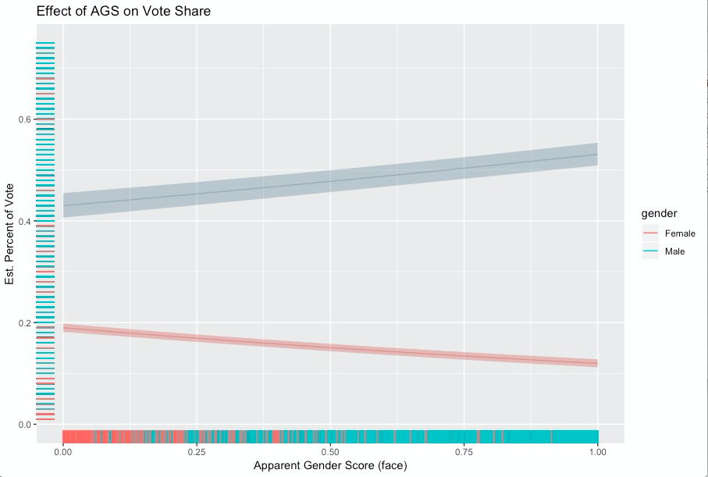
City Council Elections
For Men, 19% change in share relative to max
For Women, 37% change in share relative to max

Slide 13
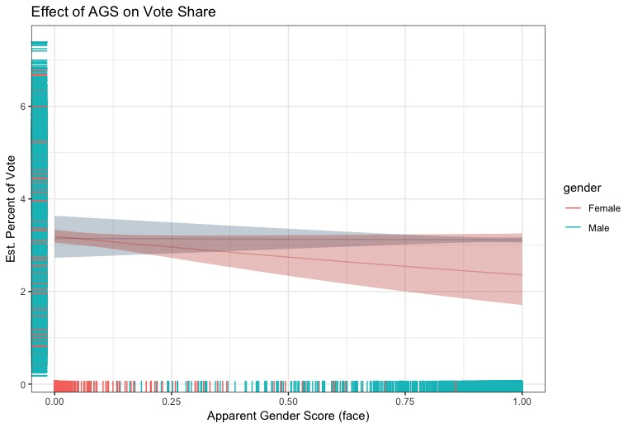
Mayoral Elections

Slide 14
Conclusion
Candidate images provide measurable gender dimensions
Deep learning can aid in uncovering complex image signals
Low information elections are associated with heightened effects of candidate gendered appearance
High information elections show minor effects of candidate gendered appearance
Thanks! stefan.wojcik@colorado.edu, shawnna.mullenax@gmail.com

