Slide 1
Progress update
Group –
Denny Diepgrond
Stefan Knegt
Tim Oosterhuis
Rogier de Weert

Slide 2
Articles
https://nestor.rug.nl/courses/1/INMCV-08.2016-2017.2A/content/_7876615_1/IEEE_SPM_2009_Salembier_Wilkinson.pdf

Slide 3
Written - literature

Slide 4
Written - Methods

Slide 5
Programming progress
Extracted 27025 labeled tokens from xml files
621 classes (32 Wrd_classes)

Slide 6
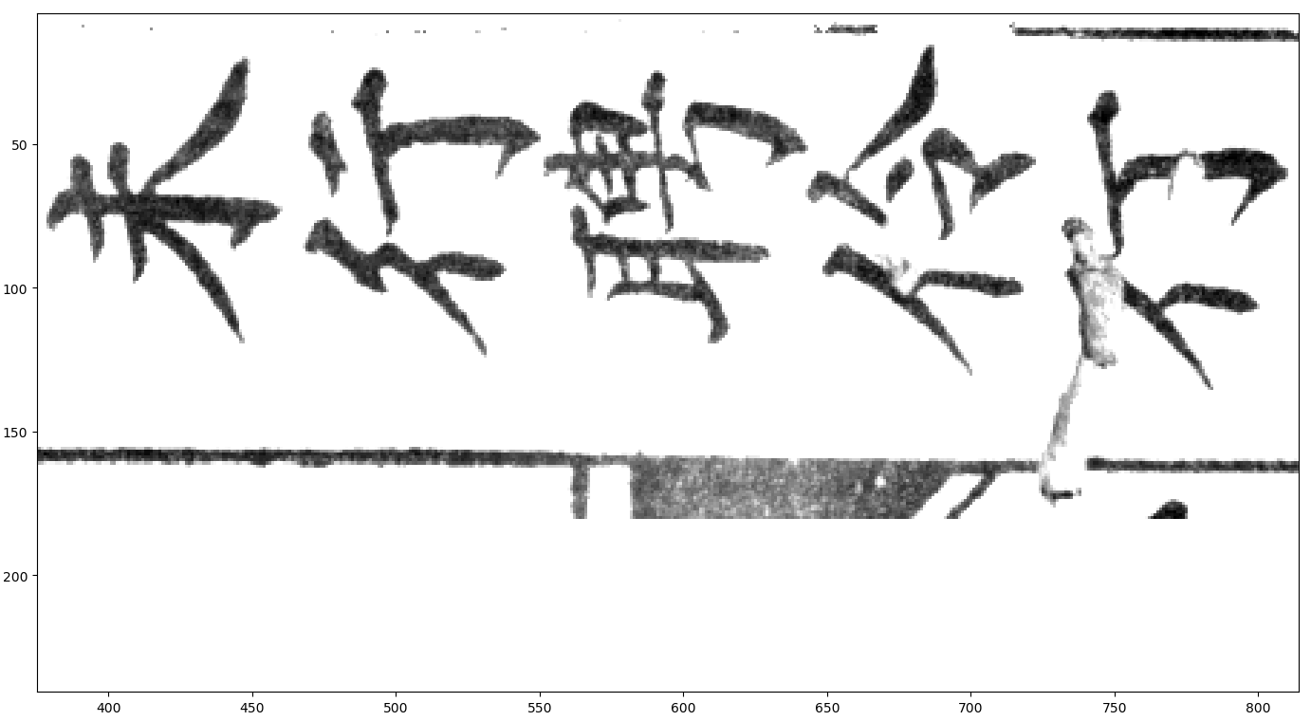
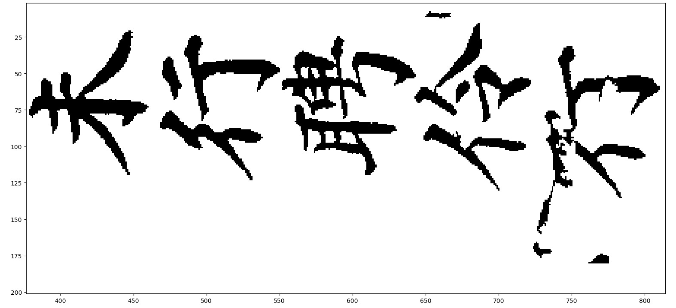
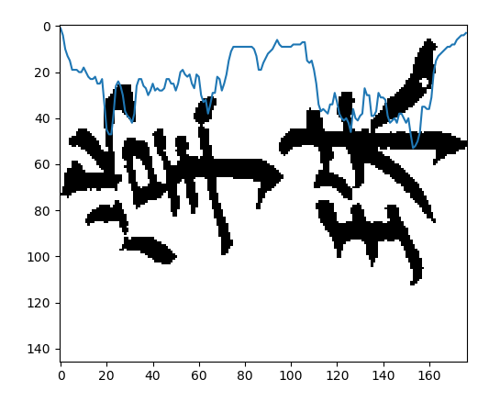
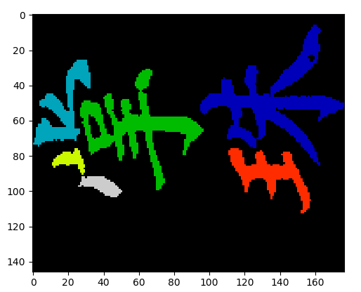
Programming progress
Preprocessing:
Convert images to binary
Remove small noise pixels
Remove table lines
Segmentation:
Pixel density - Baseline
Add. Info. from connected component overlap – Improvements?

Slide 7
Empirical evaluation progress

Slide 8
Overall progress schedule

