Slide 1
Progress update 2
Group DSTR
Denny Diepgrond
Stefan Knegt
Tim Oosterhuis
Rogier de Weert

Slide 2
Articles
Preprocessing
Connected Operators: A review of region-based morphological image processing techniques, Salembier, P. & Wilkinson, M. H. F. IEEE Signal Processing Magazine 26(6), 136-157, Nov-2009
Feature extraction
A Handwritten Character Recognition System Using Directional Element Feature and Asymmetric Mahalanobis Distance, Kate, N. et al. IEEE Transactions on Pattern Analysis and Machine Intelligence 21(3): 258-262, Mar-1999
Research on Feature Extraction Method for Handwritten Chinese Character Recognition Based on Kernel Independent Component Analysis, Zhiguo, H. & Xiaoli, Y. Research journal of Applied Sciences, Engineering and Technology 6(7): 1283-1287, 2013
Machine Learning
Zero-Shot Learning Though Cross-Modal transfer, Socher, R. et al., Computing Research Repository, abs/1301,3666, Feb-2013

Slide 3
Written – Literature / Intro

Slide 4
Written - Methods

Slide 5
Data exploration
Extracted 27025 labeled characters from xml files
621 classes (32 Wrd_classes)

Slide 6
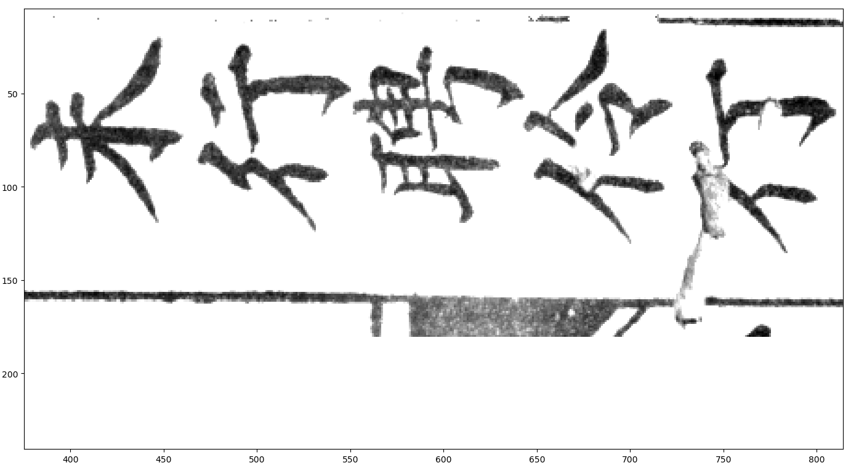
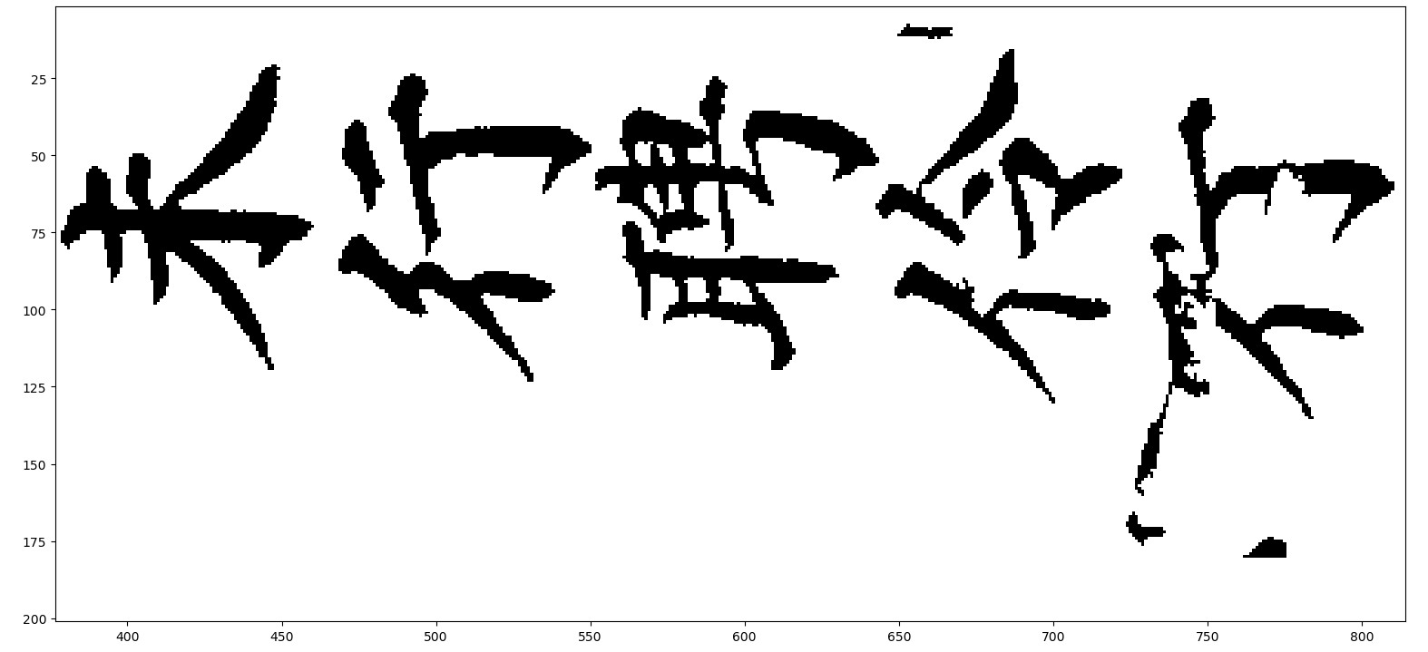
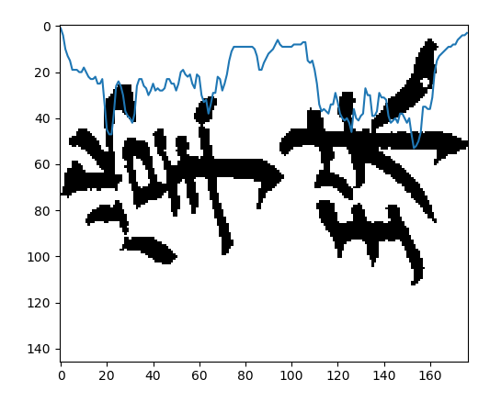
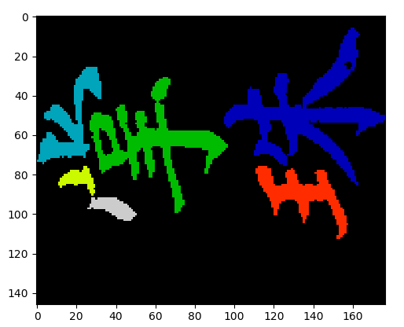
Programming progress
Preprocessing:
Rotation
To binary (otsu)
Remove small noise pixels
Remove table lines
Segmentation:
Pixel density - Baseline
Add. Info. from connected component overlap

Slide 7
Empirical evaluation progress
Ongoing process:
Run count for feature extraction
To do:
This week: classification
Possible: Segmentation optimalization
Method section report

Slide 8
Overall progress schedule
First preprocessing done
First segmentation method done
Start on feature extraction – Use labeled characters
Possible to start on classifier using labeled characters

