Slide 1
Progress update 1
Group DSTR
Denny Diepgrond
Stefan Knegt
Tim Oosterhuis
Rogier de Weert

Slide 2
Articles
Preprocessing
Connected Operators: A review of region-based morphological image processing techniques, Salembier, P. & Wilkinson, M. H. F. IEEE Signal Processing Magazine 26(6), 136-157, Nov-2009
Feature extraction
A Handwritten Character Recognition System Using Directional Element Feature and Asymmetric Mahalanobis Distance, Kate, N. et al. IEEE Transactions on Pattern Analysis and Machine Intelligence 21(3): 258-262, Mar-1999
Research on Feature Extraction Method for Handwritten Chinese Character Recognition Based on Kernel Independent Component Analysis, Zhiguo, H. & Xiaoli, Y. Research journal of Applied Sciences, Engineering and Technology 6(7): 1283-1287, 2013

Slide 3
Written – Literature / Intro

Slide 4
Written - Methods

Slide 5
Data exploration
Extracted 27025 labeled characters from xml files
621 classes (32 Wrd_classes)

Slide 6
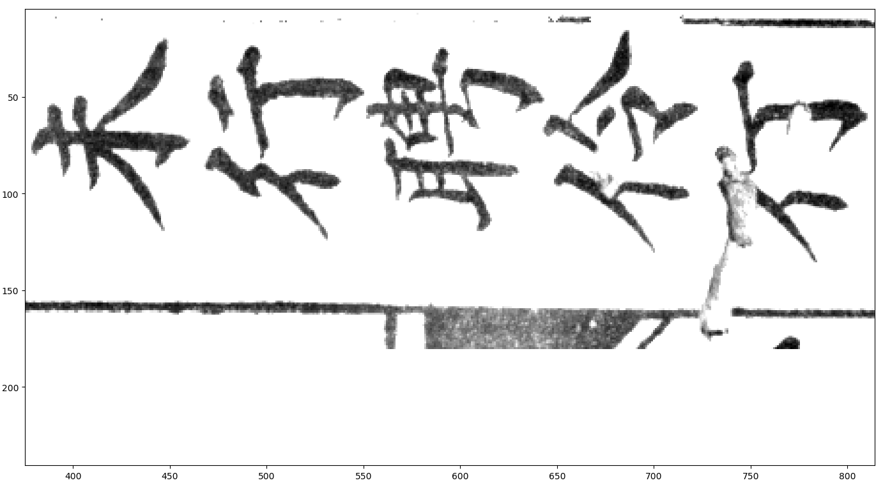
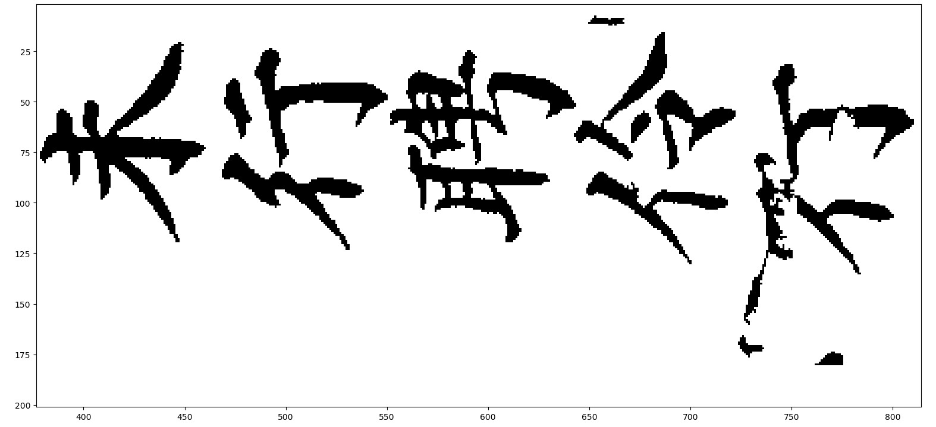
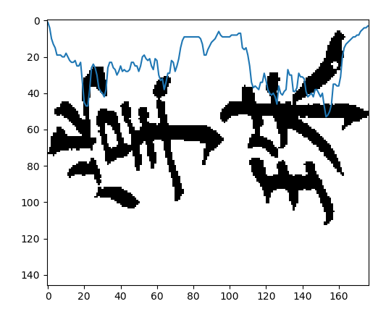
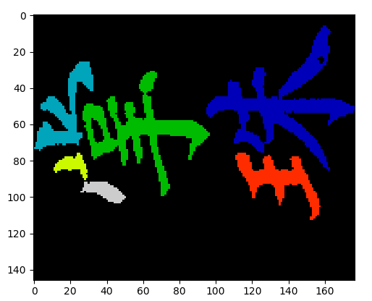
Programming progress
Preprocessing:
Convert images to binary
Remove small noise pixels
Remove table lines
Segmentation:
Pixel density - Baseline
Add. Info. from connected component overlap – Improvements?

Slide 7
Empirical evaluation progress
Ongoing process: Threshold optimization for binarization and noise removal

Slide 8
Overall progress schedule
First preprocessing done – needs empirical evaluation
Start on feature extraction – Use labeled characters
Possible to start on classifier using labeled characters

